Slide 1
Presentation to WFA on 802-11ai
Date: 2012-07-09
Authors:

Slide 2
Abstract
In the process of discussing future work in the Wi-Fi Alliance, a request was made for more information on both 802.11ah and 802.11ai
This presentation has the same information I used to make the presentation to the WFA.
It is NOT the same presentation, just the same information which was taken largely from the IEEE given in Okinawa.

Slide 3
IEEE 802.11ai Briefing
LRTG meeting, Toronto
Tom Siep,
CSR

Slide 4
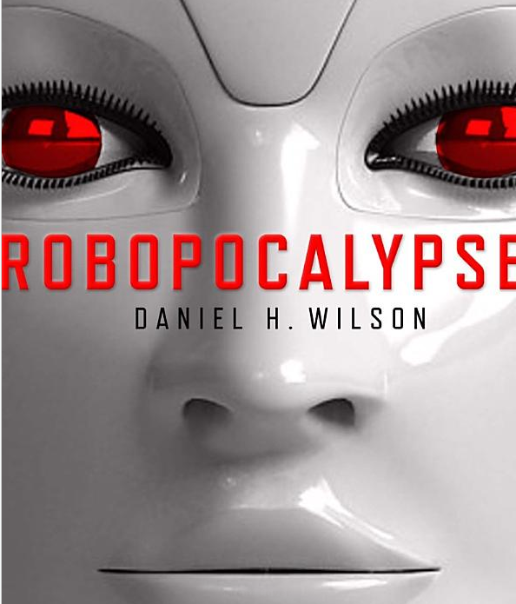
What is 802.11ai?
802.11ai — Will define the way artificially intelligent robots overtake the world using Wi-Fi.*
Actually, that’s a lie.
No public info is yet available for 802.11ai.
*https://www.cwnp.com/cwnp_wifi_blog/802-11-alphabet-soup

Slide 5
Fast Initial Link Setup (FILS)
Use Cases and Technical Approach
Prototypical use cases
  Establishes a small set reference use cases
  Sets criteria for 802.11ai submissions
  Full set of use case in 11-11-0238-19-00ai-Use-Case-Reference-List-for-TGai.docx
Technical Approach
  Make association faster by reducing serialization
  Do not damage security

Slide 6


Slide 7

Definitions (1 of 2)
FILS = Fast Initial Link Setup
Device set
  mobile STA
  network access point
  “point of interest”
Use Case Differences
  Link-Attempt Rate
  Media Load
  Coverage Interval
  Link Setup Time

Slide 8
Definitions (2 of 2)
Link-Attempt Rate
  Connection attempts per second
Media Load
  “Busyness” of the medium
Coverage Interval
  Time within the range
Link Setup Time
  Tolerable time to connect

Slide 9

Tokyo Central Station

Slide 10
Tokyo Central Station Use Case
Very large number of pedestrians attempt to connect at virtually the same time
General internet access with graphics and video
  Link-Attempt Rate: 100s/second
  Media Load: 50%
  Coverage Interval <10 sec
  Link Setup Time 100 ms
Driver for the adoption of FILS

Slide 11


Drive-by Information

Slide 12
Drive-by Use Case
Large number of vehicles
  uploading/downloading a large amount of information
  only in range for a short time.
Includes text, graphics, video
  Link-Attempt Rate <10
  Media Load 10 to 50%
  Coverage Interval <1 second
  Link Setup Time <100 ms
FILS is required to make the use case viable for 802.11

Slide 13

Other Use Cases
Pedestrian
  Electronic Payment
  Traveller Information
  Pedestrian Signal System
Vehicle
  Electronic Payment
  Internet Access
  Emergency Services
  Inspections
  Resource Management
Transit
  Station arrival
  Passenger In-transit access
  Station Lobby
  Connection Protection
  Dynamic Transit Operations
Notes:
Pedestrian
Electronic Payment
Traveller Information
Internet Access
Mobile Accessible Pedestrian Signal System
Vehicle
Electronic Payment
Traveller Information
Internet Access
Emergency Services
Inspections
Resource Management
Transit
Station arrival
Passenger In-transit access
Station Lobby
Connection Protection
Dynamic Transit Operations

Slide 14
802.11ai -- Fast Initial Link Setup (FILS)
Technical Approach
Make association faster by reducing serialization
Do not damage security

Slide 15
Technical Problem FILS solves
The purpose of Fast Initial Link Setup (FILS) is to enable efficient high volume initial access to network services.
Devices are increasingly becoming more mobile
  Large number of users are constantly entering and leaving the coverage area
  Current association mechanisms limit access to network resources due to overhead
Efficient mechanisms that scale well are needed
  Minimize the time the STAs spend in initial link setup
  Limit air-time needed to establish desired links
  Maintaining secure authentication.

Slide 16
Project Authorization for P802.11ai
This amendment defines mechanisms that provide IEEE 802.11 networks with fast initial link set-up methods which do not degrade the security offered by Robust Security Network Association (RSNA) already defined in IEEE 802.1.1.

Slide 17
Changes to the 802.11 standard
The current IEEE 802 .II specification does not meet these requirements in some usage scenarios. An optimization of the link set-up is desirable . Optimizations may include improvements to
  access point / network discovery,
  secure authentication,
  mechanisms to support concurrency in the exchange of higher layer protocol messages during the authentication phase (for example assignment of IP addresses).

Slide 18
State transition diagram for non-mesh STAs
(clause 10.3.2)

Slide 19
State transition diagram – simplified

Slide 20
Possible FILS State machine

Slide 21
Time line of TGai -- Fast Initial Link Setup
PAR Approved 2010-12-08
WG Letter Ballots Initial / Recirc Jan13 / Mar 13
Form Sponsor Ballot Pool / Reform Jul 13
MEC Done Jul 13
IEEE-SA Sponsor Ballots Initial / Recirc Nov13/ Jan14
Final 802.11 WG Approval Mar 14
final or Conditional 802 EC Approval Mar 14
RevCom & Standards Board Final or
Continuous Process Approval Mar14
ANSI Approved N/A
We are here

Slide 22
Questions?
Tom.Siep@csr.com

