Slide 1
Supplementary Plenary Information - July 2012
Date: 2012-July-12
Authors:
Name
Company
Address
Phone
email
Bruce Kraemer
Marvell
5488 Marvell Lane,
Santa Clara, CA, 95054
+1 (321)
751-3958
bkraemer@
marvell
.com
Abstract: Additional Information on topics for 802 interim meeting – July 2012
Notes:
November 2011

Slide 2
Monday
Notes:
November 2011

Slide 3
IEEE LOA Database
Monday Agenda Item 3.2.1
http://standards.ieee.org/about/sasb/patcom/pat802_11.html
8 entries with 2012 submission dates

Slide 4
Joint Meetings
Monday Agenda Item 4.1.3
External:
With 802.1 Thursday 8:00 am1 – Manchester A – 2nd level
Subject: Bridging
With 802.1 Thursday 10:30 am2 – Manchester A – 2nd level
Subject: 1905.1 report by Philippe Klein
Internal: None planned

Slide 5
New Project PARS ?
Monday Agenda Item 4.1.4
802.16q, amendment for multi-tier networks, PAR and 5C
802.16.3, new standards for mobile broadband network performance measurements, PAR and 5C
802.3bm, amendment for 40 Gb/s and 100 Gb/s Operation Over Fiber Optic Cables, PAR and 5C
802.3bn, amendment for Ethernet Passive Optical Networks Protocol over Coax Networks, PAR and 5C
802.11aj, amendment for Enhancements for Very High Throughput to support one or more of the Chinese 40-50 GHz and 59-64 GHz frequency bands, PAR and 5C
Please go to http://www.ieee802.org/PARs.shtml for a additional details

Slide 6
PAR Review
802.11 has 3 slots labeled “PAR” during the week to prepare comments and consider responses.
Monday pm2 Tuesday am2 Thursday am2
802.11 comments on each PAR must be provided to the respective WG by 5pm local time on Tuesday July 17.
If you have comments please supply them Monday, July 16.
Either attend the Monday session or send them to Bruce Kraemer and Jon Rosdahl.

Slide 7
Other PARS
Monday Agenda Item 4.1.4
Revision PAR - mc
PAR extension - ac

Slide 8
Manchester Hyatt meeting Levels
Monday Agenda Item 4.1.5
Social
Fourth Level
Mohsen
Bush
Ford
Windsor
Madeleine
Del Mar
Third Level
Ball rooms
Elizabeth
Manchester
Second Level
Betsy
Edward
Ground Floor
Notes:
November 2011

Slide 9
Group Room assignments
Monday Agenda Item 4.1.5
WG | Room | Level
16 | Ford AB, C | 3rd
18 | Edward D | 2nd
19 | Edward A | 2nd
21 | Edward C | 2nd
22 | Edward B | 2nd
Notes:
November 2011

Slide 10
WG Agendas
Monday Agenda Item 4.1.5
18: Agenda
Opening Report 18-12-0058 r0
19: Agenda 19-12-0119 r0
Opening Report 19-12-0120r0
21: Agenda 21-12-0073r1
Opening Report 21-12-0080r0
22: Agenda 22-12-0062r0
Opening Report 22-12-0064r1

Slide 11
September Meeting – Indian Wells, California
September 16 – 21, 2012
Monday Agenda Item 4.1.10
Hotel Registration OPEN
Meeting Registration OPEN
Early bird registration expires Fri Aug 3

Slide 12
Other Special Events
Monday Agenda Item 4.1.11
Breakfast – Elizabeth Foyer level 2
Breaks – Elizabeth Foyer level 2
Wednesday Social 6:30 pm start
Badge needed for admission – Guest also
Location: Pool side, 4th Floor

Slide 13
IETF & IEEE Leadership meeting
July 25 in San Jose
Agenda (preliminary)
9-9:30AM Introductions, Goals of the meeting
9:30-10AM short introduction to IETF Areas, how IETF works, how decisions are made, how liaisons are managed
10-10:30AM short introduction to IEEE 802 WGs, how IEEE 802 works, how decisions are made, how liaisons are managed
10:45-12PM discussion about how to collaborate and manage relationship, exchange information about new work when charters are discussed, share information about IETF Last Calls and IEEE 802 Ballots, access to work-in-progress documents
1-2:45PM discuss specific areas where collaboration is needed
3-4PM action items, follow-up methods, plans for next meeting

Slide 14
IETF & IEEE Leadership meeting
Areas of intersection identified.
- IETF work proposed and underway in that addresses the operation and control of MAC bridged networks and IEEE 802.1 Interworking including TRILL, CCAMP and SPB,
- IETF BFD and 802.1AX
- IETF NVO3 and IEEE 802.1 DCB
- IETF EMU and IEEE 802.1X, 802.11 and 802.16 security based on EAP
- IETF ADSL MIB and IEEE 802.3
- IETF 6LOWPAN and IEEE 802.15
- IETF PAWS WG and IEEE 802.1, 802.11, 802.15, 802.16, 802.22
- IETF HOKEY and IEEE 802.21
- IETF IPFIX Information Elements for Data Link monitoring
- IETF RADIUS attributes for IEEE 802 networks

Slide 15
IETF & IEEE Leadership meeting
41 people registered
Attendees representing 802.11
Mark Hamilton
Dorothy Stanley
Dave Halasz
Donald Eastlake
Gabor Bajko
Jon Rosdahl
EC meeting 8-9pm Tuesday
Additional 802.11 discussion/planning during Friday plenary

Slide 16
Dr. Konstantinos Karachalios
IEEE-SA new Managing Director
Monday Agenda Item 4.1.12
I am pleased to announce that Dr. Konstantinos Karachalios will join IEEE as our new Managing Director of the IEEE Standards Association (IEEE-SA) on 20 August.
Dr. Karachalios is internationally recognized and widely respected for his work within the standards development and intellectual property communities. He comes to us after completing 25 years of service with the European Patent Office (EPO). During his tenure at EPO, he held positions as Head of the International Academy, Manager of International Technical Cooperation for Africa and the Middle East and, most recently, in the field of External Relations with a focus on public policy issues in areas that include ICT standards and emerging technologies. He was responsible for EPO relationships with international and intergovernmental organizations, including serving as a liaison to standards setting bodies and in the capacity of envoy to a number of United Nations organizations.
Among the highlights of his EPO career is Dr. Karachalios's work as scenarios analyst and co-editor of the EPO’s book "Scenarios for the Future: How might IP regimes evolve by 2025? What global legitimacy might such regimes have?" He contributed to repositioning the many important issues surrounding intellectual property, reframing the way in which intellectual property issues are debated in the global arena and initiating and coordinating strategic responses to the challenges raised by those discussions.
Dr. Karachalios earned a Master’s degree in Mechanical Engineering and a Ph.D in Energy Engineering (nuclear reactor safety), both from the University of Stuttgart.
In his role as Managing Director of the IEEE-SA, Dr. Karachalios will report directly to me and will also serve as a member of the IEEE Management Council. He is now in the process of relocating his family to New Jersey from Europe.

Slide 17
802.11 Topics for July 2012 EC
Monday Agenda Item 4.1.13
Begin Sponsor Ballot
  Nothing anticipated
Requests to submit to RevCom?
  11ad Conditional
New project PAR to NesCom?
  CMMW
PAR Extension ?
  11ac
Revision PAR?
  11REVmc
Study Group start up?
  Depends upon results of WNG meeting
Study Group extension?
  Two planned, ISD & CMMW

Slide 18
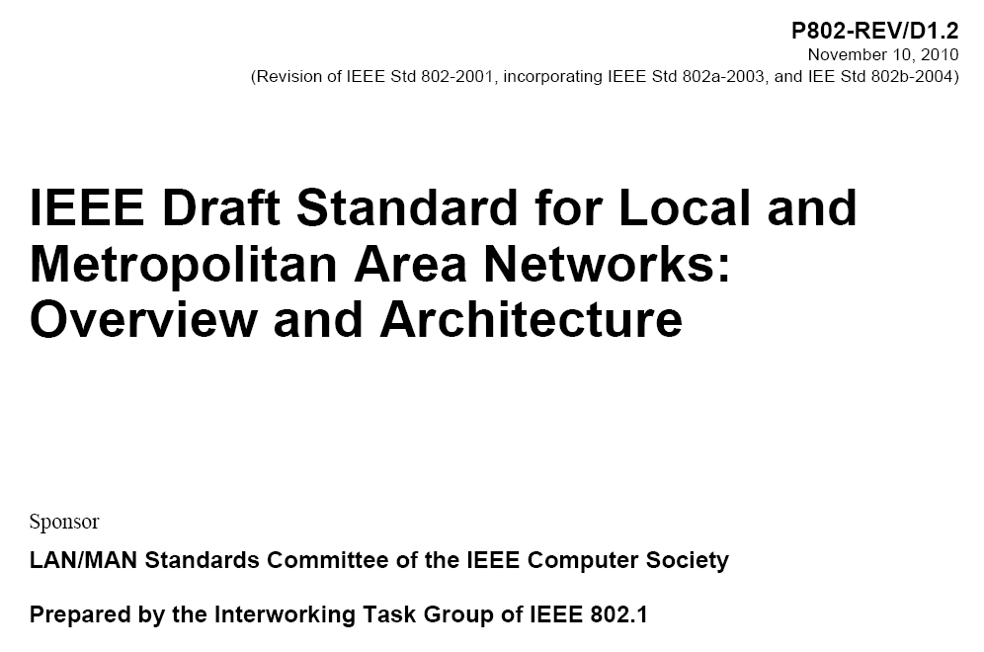
802.1 Architecture Document
Monday Agenda Item 4.1.14

Slide 19
Architecture
Monday Agenda Item 4.1.14
802.1 owns a project to Update the Overview and Architecture standard for 802
Ballot on D1.4 closed July 6
Approve: 27 Disapprove: 7 Abstain: 8
Returned: 42
Approve ratio: 79%
5 commenters, 41 comments
http://ieee802.org/1/files/public/docs2012/802-rev-d1-4-pdis-v00.ods
  13 Technical/General
  28 Editorial

Slide 20
Smart Grid Meetings
Monday Agenda Item 4.1.15
EC Study Group :
Monday pm2 Elizabeth D – 2nd level
Tuesday pm2 Elizabeth E – 2nd level
Wednesday pm2 Elizabeth D – 2nd level
Notes:
November 2011

Slide 21
Wednesday Plenary Topics
Monday Agenda Item 4.1.16
PAR changes review
Overview of new project PAR & 5C
  CMMW
802 University Outreach feedback
Overview of O M Change proposal
Central Desktop – new IEEE Service - overview
Awards

Slide 22
Tutorials
Monday Agenda Item 4.1.17
TUTORIAL #1 (6:00 -7:30 PM)
TITLE OF TUTORIAL: What’s next? Wireless Communication beyond 60 GHz
TUTORIAL SPONSOR (WG Chair): Bob Heile (Chair WG)
TUTORIAL #2 (7:30 - 9:00 PM)
TITLE OF TUTORIAL: IEEE Industry Connections Ethernet Bandwidth Assessment
TUTORIAL SPONSOR (WG Chair): David Law (Chair WG 3)
TUTORIAL #3 (9:00 - 10:30 PM)
TITLE OF TUTORIAL: Heterogeneous Networking among the IEEE 802 Family proposal for an Open Mobile Network Interface (OMNI) Standard
TUTORIAL SPONSOR (WG Chair): Roger Marks (Chair WG 16)
Tutorial Location Manchester GHI

Slide 23
Wednesday
Notes:
November 2011

Slide 24
Social
Wednesday Agenda Item 2.7
Wednesday Social 6:30 pm start
Badge needed for admission
Location: Pool Deck

Slide 25
Wednesday Agenda Item 5.2
Room Changes
??
Notes:
November 2011

Slide 26
Wednesday Agenda Item 5.2
Revised Agenda Graphic
If needed

Slide 27
Wednesday Agenda Item 5.3
Mid-week Officer Changes
If needed

Slide 28
University Outreach
Wednesday Agenda Item 6.2
The IEEE 802® LAN/MAN Standards Committee (LMSC) University Outreach Program is intended to engage university and college students and faculty in standards development.
The first University Outreach day will be at the San Diego IEEE 802 Plenary on July 17.
  orientation session, followed by opportunities to observe the groups actually developing standards.
  The program will conclude with a session soliciting questions and feedback from participants.
  Interested students and faculty can find additional information on and register for the July IEEE 802 University Outreach day via: https://802world.org/plenary/university-outreach/.
University Outreach day will have a registration fee of only $25.00.

Slide 29
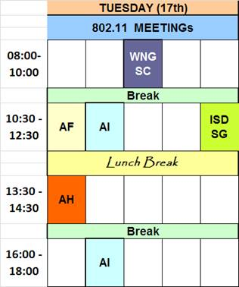
University Outreach
Wednesday Agenda Item 6.2
6 students registered for this session
802.11 Topics suggested
Jon is designated contact person

Slide 30
Wednesday Agenda Item 5.9
Awards

Slide 31
TGaa Awards
WG Task Force Chair | Graham Smith | Sponsor Ballot Chair and technical contribution - OBSS
WG Task Force Vice-Chair and Technical Editor | Alex Ashley | Vice- Chair, Technical Editor and technical contribution – GCR, SCS and HCCA TXOP negotiation
Original WG Task Force Chair | Ganesh Venkatesan | Chair through SG and Letter Ballots and technical contribution – 802.11avb interworking.

Slide 32
TGaa Awards
Brian Hart | technical contribution - initial specification(s) of the GCR feature
Dan Harkins | technical contribution – protected HCCA TXOP negotiation
David Hunter | technical contribution - completeness of the draft, comment resolution
Mark Hamilton | technical contribution - completeness of the draft, comment resolution and 11mb awareness
Qi Wang | technical contribution – details of GCR
Edward Reuss | technical contribution – video and interworking, comment resolution
Santosh Pandey | Technical contribution – GCR and OBSS

Slide 33
TGaa Awards –in absentia
Naveen Kakkani | technical contribution - initial specification(s) of GCR feature
Hang Liu | Technical contribution – first Technical Editor who contributed to the PAR/5C and started the draft version 0.01 of 11aa
Todor Cooklev | technical contribution – PAR/5C and initial work in creating 11aa, video content and interworking
John Simons | technical contribution – PAR/5C and initial work in creating 11aa
Satish Putta | technical contribution – 802.1avb integration
Jochen Miroll | technical contribution – SCS and GCR

Slide 34
TGae Awards
WG Task-Force Chair | Michael Montemurro
Technical Editor | Henry Ptasinski
Special Editor | Matthew Fischer

Slide 35
TGae Awards
Santosh Pandey Reason: Made significant contributions to the TGae amendment
Mark Hamilton Reason: Significant technical contribution and minutes
Stephen McCann Reason: Significant Technical Contribution and editing help
Dorothy Stanley Reason: Significant technical and editorial contribution
Paul Lambert Reason: Significant technical contribution
David Hunter Reason: Significant technical contribution and minutes
Harish Ramamurthy Reason: Significant technical contribution

Slide 36
TGREVmb Awards
WG Task Group Chair | Dorothy Stanley
WG Task Group Chair | Matthew Gast
WG Task Group Vice Chair | Michael Montemurro
Sub-Editor & editorial panel, reviewer and contributor | William Marshall

Slide 37
TGREVmb Awards
Mark Hamilton Reason: Major technical contributions – State Machine
Jouni Malinen Reason: State machine and security contributor
David Hunter Reason: Major reviewer
Peter Ecclesine Reason: Technical contributions, including 11y roll-in
Stephen McCann Reason: Technical contributions, including 11u roll-in
Kazuyuki Sakoda Reason: Technical contributions - 11s roll-in
Lee Armstrong Reason: Technical contributions - 11p roll-in
George Vlantis Reason: Technical review, editor panel
Joe Kwak Reason: Major Technical Contribution- MIB review and development
Matthew Fischer Reason: Major reviewer – MAC topics
Brian Hart Reason: Major reviewer – PHY topics
Dan Harkins Reason: Major reviewer – 11s roll-in, security
Vinko Erceg Reason: Major reviewer – PHY topics
Shi Yang Reason: Major Technical Contribution- MIB review and development
Eldad Perahia Reason: Major reviewer – PHY topics
Henry Ptasinski Reason: Contributor, security topics
Robert Stacy Reason: Major reviewer – PHY topics

Slide 38
TGREVmb Awards - in Absentia
Kaberi Banerjee Reason: Editor Panel
Yuichi Morioka Reason: Editor Panel
Ashish Shukla Reason: Review commenter
Michael Bahr Reason: Major reviewer – 11s roll-in
Menzo Wentink Reason: Technical contributions, including 11z roll-in
Mark Rison Reason: Major technical contributions – State Machine

Slide 39
Friday

Slide 40
Announcements
Friday Agenda Item 2.07
Coffee will be continuously available from 7:30am to 11:00am
When we reach 10:00 we will determine if we take a break

Slide 41
IEEE LOA Database
Friday Agenda Item 2.08
http://standards.ieee.org/db/patents/pat802_11.html
8 entries with 2012 submission dates

Slide 42
IEEE Store Contents - July 2012
Friday Agenda Item 2.09
Amendment | Draft in Shop July 18 | Draft in Members Area | Publication in Shop July 18 | Publication in Get 802 July 18
11.2 | 1.01
S |  |  | $5
802.11 -2012 |  |  | $5
AA | yes | published | $5
AE |  | published | $5
AC | - | 3.0 | D3.0 $5
AD | - | 9.0 | D9.0 $5
k, n, p, y, r, w, u, v, z
802.11-2007
http://www.techstreet.com/ieeegate.html
Notes:
November 2011

Slide 43
802.11 drafts to ISO/IEC JTC1/SC6
Friday Agenda Item 2.10
Task Group | After Okinawa | After Atlanta | After Jacksonville | After Waikoloa | After Atlanta
TGae | D5.0 | D7.0
TGaa | D6.0 | D7.0
TGREVmb | D10.0 | D12.0
TGad |  |  | D5.0 | D7.0 | D8.0
TGac | - |  | D2.0 |  | D3.0
The WG told SC6 it would liaise 802.11ac as soon as it passes a LB
802.11-2012 was submitted to SC6 when approved by the SASB – April 2012
Notes:
November 2011

Slide 44
Tutorials
Friday Agenda Item 2.11
None during September 2012
Call for November 2012 suggestions
802.1 tutorial being submitted

Slide 45
Future Venues - 2012
Friday Agenda Item 6.3
2012
# 131 January 15-20, 2012 ----Hyatt Regency, Jacksonville, FL
Including 802.16 and 802.21
# 132 March 11-16, 2012 –Hilton Waikoloa, Big Island, HI
# 133 May 13-18, 2012, Hyatt Regency Atlanta, Atlanta, Georgia, USA
# 134 July 15-20, 2012 Grand Hyatt Manchester, San Diego, CA, USA
# 135 September 16-21, 2012, Hyatt Grand Champion, Indian Wells, CA
# 136 Nov 11-16, 2012 Grand Hyatt San Antonio, San Antonio, TX, USA
Notes:
November 2011

Slide 46
Future Venues -2013
Friday Agenda Item 6.3
2013
# 137 January 13-18, 2013 - --Hyatt Regency Vancouver, BC, CA
# 138 March 17-22, 2013 –Caribe Royale, Orlando, FL, USA
# 139 May 12-17, 2013 ----Hilton Waikoloa, Big Island, HI
# 140 July 14-19, 2013 --- Geneva , CH ITU headquarters
# 141 September 15-20, 2013----Confirmed– Nanjing, China
# 142 Nov 10-15, 2013 Hyatt Regency Dallas, TX, USA
Notes:
November 2011

Slide 47
Future Venues - 2014
Friday Agenda Item 6.3
2014
# 143 January 19-24, 2014 - --Hyatt Century Plaza, Los Angeles, CA, US
# 144 March 16-21, 2014 –Hyatt Regency Atlanta, Atlanta, GA, US
# 145 May 11-16, 2014 ----Hilton Waikoloa, Big Island, HI
# 146 July 13-18, 2014 --- Manchester Grand Hyatt, San Diego, CA, US
# 147 September 14-19, 2014----1st priority– Kobe, Japan
# 148 November 2-7, 2014 Hyatt Regency San Antonio, TX, US
Notes:
November 2011

Slide 48
September Meeting – Indian Wells, California
September 16 – 21, 2012
Friday Agenda Item 7
Hotel Registration OPEN
Meeting Registration OPEN
Early bird registration expires Fri Aug 3

Slide 49
