Slide 1
Prioritized PS-Polls
Date: 2012-5-16
Authors:

Slide 2
Abstract
This contribution suggests allowing STAs to transmit PS-Polls at different priority levels. This is achieved by having a TIM encoding that conveys different STA groups and assigning channel-access priority to each group
The objective is to reduce PS-Poll collisions when a large number of PS STAs are associated with an AP

Slide 3
Background
In 11ah, there can be a large number of STAs associated with each AP; many of them operate in PS mode
Upon waking up from doze and seeing its bit in the TIM set, an STA will send a PS-Poll to AP
PS-Poll collisions happen when several STAs transmit PS-Polls shortly after a TIM
PS-Poll collisions increase latency and drop rate for buffered BUs at AP

Slide 4
Observation 1
Not all STAs with set TIM bits are ready to transmit PS-Polls:
  Different STAs have different Listen Intervals that determine how often they listen to the Beacon frames
  For each STA, the longer the TIM bit has been set without PS-Poll being received at AP, the more likely that the STA will attempt to transmit a PS-Poll following the next TIM
The likelihood of a non-TIM STA ([1],[2]) transmitting PS-Poll in a certain BI can also be deduced from its Listen Interval
=> AP may compare the likelihood of different STAs being awake to transmit PS-Polls and use that to coordinate the transmissions

Slide 5
Observation 2
Not all buffered BUs at AP need to be delivered to STAs with the same latency/drop-rate requirements:
  Different applications, e.g., real-time vs. best effort, have different QoS constraints
  Within one application, there are certain messages with more stringent requirements than others
=> Based on QoS requirements of the buffered BUs, AP can coordinate PS-Poll transmissions from the corresponding STAs

Slide 6
Main Idea – Prioritized PS-Polls
Define a mechanism that allows AP to prioritize PS-Poll transmissions by:
  Indicating different STA groups within each TIM
  Associating with each STA group within the TIM a channel-access priority
  An awake STA with buffered BUs transmits PS-Poll according to the given channel-access priority of its indicated group

Slide 7
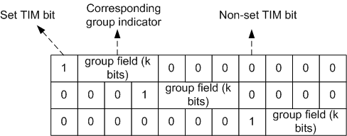
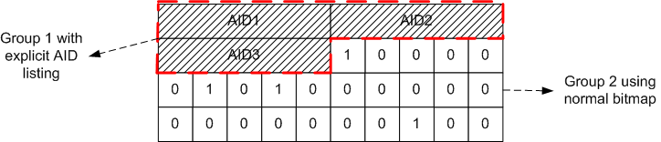
Indicating STA Groups within TIM
Approach 1: using a fixed k-bit field after each set TIM bit:
Approach 2: mixed use of explicit AID listing and TIM bitmap:

Slide 8
Assigning Priority to PS-Polls
Each STA-group within a TIM can be given an access priority to transmit PS-Polls; the priority can be a combination of:
  Interframe Space, e.g., AIFS
  Contention Windows, e.g., CW, CWmin, CWmax
  Time Allowance, e.g., different groups of STAs are allowed to transmit PS-Polls in different slots/periods
  Retry Limit, e.g., set the maximum number of PS-Poll retries within a beacon interval for each STA group
=> Can be further studied

Slide 9
Summary
In 11ah, with a large number of STAs operating in PS mode, PS-Poll collisions increase latency and drop-rate for buffered BUs
AP has knowledge of how likely/urgent each STA can/should transmit PS-Poll
=> We propose that AP indicates through TIM the different groups of STAs (that have buffered BUs) and gives different channel-access priorities to different groups
The implementation details are TBD

Slide 10
References
[1] 11-12-0610-00-00ah, Non-TIM Stations in 11ah
[2] 11-12-0618-00-00ah, Listen Interval for Sensor Devices

Slide 11
Straw Poll 1
Do you agree that, to reduce collisions, PS-Polls from different STAs can be transmitted using different channel-access priorities?
  Y:
  N:
  A:

Slide 12
Straw Poll 2
Do you agree that PS-Poll priority can be indicated in the TIM through STA grouping, as explained in Slide 6?
  Y:
  N:
  A:

