Slide 1
Block ACK Transmission
Date: 2012-05-15
Authors:

Slide 2
Abstract
This presentation addresses a Block ACK transmission issue in IEEE 802.11ah, where asymmetric transmissions will likely to prevail

Slide 3
Asymmetric Transmission
Ref: 802.11-12/0400r0 [ACK transmission]
AP to STN (Downlink) vs STN to AP (Uplink)
STN has more constraints as opposed to AP
Transmission power (power amplifier etc)
Capability
Transmission capability (1 MHz vs AP with 2 MHz and beyond)
Functionalities (AP may serve different types STN)
Use Cases
Use Case 3 : Extended range Wi-Fi
Use Case 1: Sensors and meters

Slide 4
Problems for Normal ACK
Ref: 802.11-12/0400r0 [ACK transmission]
STN can receive data but AP may not receive ACK
Simple Fix: allow STN to use lower MCS or narrower bandwidth for ACK
Ref: 802.11-12/0324r1 [Short ACK]
Short ACK helps with lowest MCS in SIG but not with narrower bandwidth
May result in downlink using narrower bandwidth unnecessarily

Slide 5
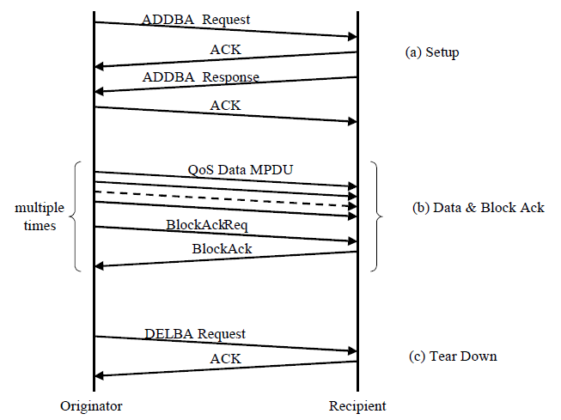
Problem for Block ACK
Block ACK
Improves channel efficiency by aggregating several ACKs
Problem in asymmetric cases: (b) Data & Block ACK phase
Multiple downlink data MPDUs use lower MCS or narrower bandwidth than necessary
Not efficient use of channel
BlockAck payload can be large
~ 214 bytes
Short ACK may not applicable
Use Cases
Use Case 3 : Extended range Wi-Fi
Use Case 1: Sensors and meters

Slide 6
Proposal
Basic idea
Determine uplink and downlink MCS and bandwidth in BlockACK setup phase (Management frame ADDBA)
May use Short ACK to help
Block ACK setup steps (ADDBA)
ADDBA Request
STN records successful Downlink MCS and BW from AP
ADDBA Response
STN informs AP the preferred MCS and BW for downlink

Slide 7
Comparison
(Short)
(mod)
Proposed
Current

Slide 8
Implementation Example
ADDBA Request: STN records successful Downlink MCS and BW
Try
ADDBA Request
X
Try lower MCS, same BW
( config “A”)
ADDBA Request
ShortACK
STN notes “config A”
X
X
ADDBA Response
STN may send ADDBA Response
Try lower MCS, narrower BW
(config “B”)
ADDBA Request
ShortACK
AP
STN

Slide 9
Implementation Example (cont’d)
ADDBA Response: STN informs AP the preferred MCS and BW for downlink (config “A”)
Could be part of Status Code or a new field
ADDBA Response
May skip using open-loop link adaptation
[ref: 802.11-12/0645r1]
X
Try same MCS & BW as config “B”
X
ADDBA Response
Try lower MCS, same BW
(config “C”)
AP notes “config A”
for downlink and
“config D” for uplink
ADDBA Response
Try lower MCS, narrower BW
(config “D”)
ShortACK
STN notes “config D” for uplink
AP
STN

Slide 10
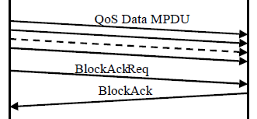
Block Transmissions and ACK
Data and Block ACK transmission
AP
STN
AP uses config “A”
NAV to include
config “A” + “D”
STN uses config “D”

Slide 11
Conclusions
In 11ah, Block ACK from STN may not reach AP
AP may transmit at higher power and better off in capability
STN can receive Data but its ShortACK or BlockACK may not reach AP
Downlink may have to use lower MCS or BW than necessary
Propose to allow Block ACK Response to include preferred MCS and BW information

Slide 12
Straw Poll 1
Do you agree to allow STN transmit Block ACK with lower (or more robust) modulation and coding rates than that of received frames from AP?

Slide 13
Straw Poll 2
Do you agree to allow STN transmitting Block ACK with narrower bandwidth PHY after received frames from AP?

Slide 14
Straw Poll 3
Do you agree to use the following procedure for Block ACK transmission
(Short)
(mod)

