Slide 1
Enhanced Uplink Channel Access for 802.11ah
Date: 2012-05-15
Authors:

Slide 2
Abstract
Simulation results in earlier contributions suggest PCF or DCF to be enhanced in 802.11ah for:
  Short, bursty traffic with large number of STAs (11-10/1511r0)
  FTP traffic with Wifi-offloading (11-11/1515r0)
We present further simulation results on scenario #5 of 11-11/0905r5 and show fairness issues in uplinks and downlinks.
We present a mechanism for coordinated access to the wireless medium.

Slide 3
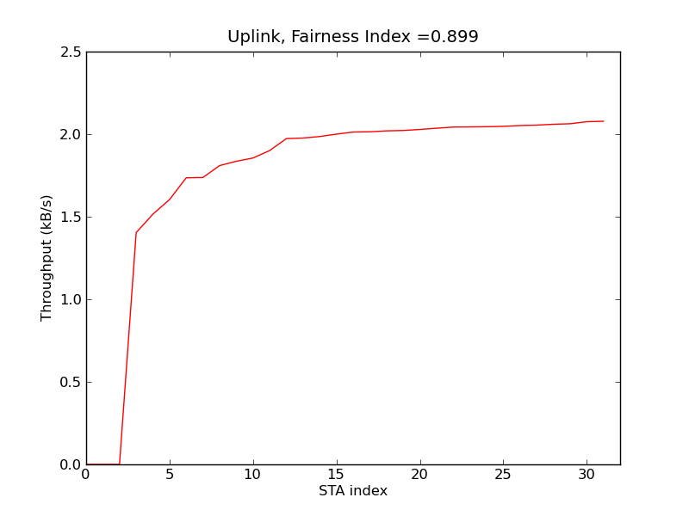
Use Case 3: Extended Range Wi-Fi
Parameters
  31 STAs + 1 AP
  2MHz channel, 600kbps
  UDP traffic, 512 B payload
  Uplink ~ 16kbps
  Downlink ~ 240 kbps
Observation
  Low downlink
  3 STAs have zero uplink
  Unfair
  ~ 70% utilization
  Uplink: 1.5 ~ 2.1kB/s per STA
  Downlink: 2.8 kB/s total

Slide 4
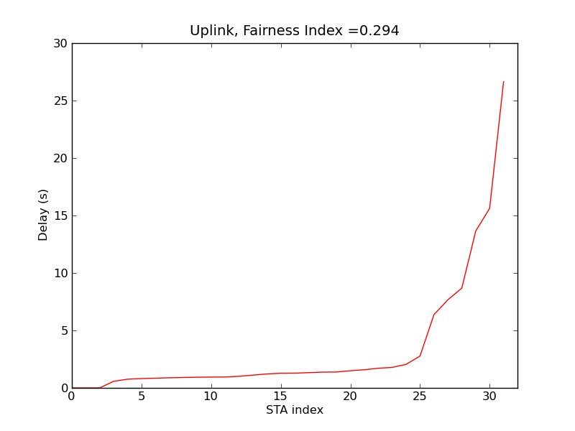
Use Case 3: Extended Range Wi-Fi (cont’d)
Uplink delay performance
  Sorted in increasing values
  Unfair
  Delay values are not ideal for VoIP
Downlink delay performance
  10 ~ 40s
  Larger than STAs
Zero throughput, no delay

Slide 5
Issues
Problem
  High delay
  Low utilization
  Unfairness between STAs and AP
AP can coordinate uplink access through
  Point Coordination Function (PCF)
  Power-Saving Multi-Pull (PSMP)
But these functions are not desirable in OBSS cases
  Frames are separated by SIFS
  No CCA can be performed
  Cause interference to neighbor BSS

Slide 6
Proposal
AP to facilitate grouping and coordinating uplink access
Smaller group sizes
  Manage fairness within a group
  Including downlink
Suggest to use backoff duration to coordinate traffic
  Basic EDCA mechanism is still the same: CCA is performed
  Address OBSS issues
  Improve delay performance

Slide 7
Example
aSlotTime
STA 1 -> 2
STA 2 -> 4
STA 3 -> 5
AP
DIFS
DIFS
STA 1
CCA
Uplink MPDU
STA 2
CCA
CCA
Uplink MPDU
DIFS
STA 3
CCA
No uplink
OBSS
STA x
CTS
Receive

Slide 8
Conclusion
Use Case 3: Extended Range Wifi Problems
  High contention for small number of STAs
  High delay, unsuitable for target applications
  Unfairness between STAs and AP
  Low channel utilization
There is a need for AP to facilitate grouping and coordinating uplink access
  Smaller group sizes
  Suggest use of backoff duration to coordinate uplink traffic

Slide 9
References
[1] 11-11/0905r5, TGah Functional Requirements and Evaluation Methodology Rev 5.
[2] 11-10/1511r0, Fairness of DCF.
[3] 11-11/1515r0, 802.11ah Wi-Fi Offloading Considerations.

