Slide 1
Supplementary Plenary Information - March 2012
Date: 2012-May-12
Authors:
Name
Company
Address
Phone
email
Bruce Kraemer
Marvell
5488 Marvell Lane,
Santa Clara, CA, 95054
+1 (321)
751-3958
bkraemer@
marvell
.com
Abstract: Additional Information on topics for 802 interim meeting – May2012
Notes:
November 2011

Slide 2
Monday
Notes:
November 2011

Slide 3
IEEE LOA Database
Monday Agenda Item 3.2.1
http://standards.ieee.org/about/sasb/patcom/pat802_11.html
7 entries with 2012 submission dates

Slide 4
Joint Meetings
Monday Agenda Item 4.1.3
External: None planned
Internal: None planned

Slide 5
New Project PARS ?
Monday Agenda Item 4.1.4
Please go to http://www.ieee802.org/PARs.shtml for a additional details

Slide 6
Other PARS
Monday Agenda Item 4.1.4

Slide 7
New Par Form and Process
A new user interface will be available May 8, 2012 for all PAR submittals.
With an improved user interface, the PAR submittal form includes some notable changes:
One page entry form, no longer need to click through multiple pages.
Detailed explanations/instructions are hidden, available on mouse-over.
Periodic auto-save as you navigate through the fields. Save as draft at any point, without completing a page.
Blank form with all instructions available via help links.

Slide 9
Hotel meeting Levels
Monday Agenda Item 4.1.5
Lobby
Ballroom
Exhibit
Atlanta Conference Center
(ACC)
Notes:
November 2011

Slide 10
Group Room assignments
Monday Agenda Item 4.1.5
WG | Room | Level
16 | Fairlie, Greenbriar | ACC
18 | University | ACC
19 | Vinings | ACC
21 | Techwood | ACC
22 | Marietta | ACC
Notes:
November 2011

Slide 11
WG Agendas
Monday Agenda Item 4.1.6
18: 18-12-00xx r0 Opening Report
19: 19-12-0054 r1 Agenda
19-12-0056r0 Opening Report
21: 21-12-0046r0 Agenda
22: 22-12-0045r1 Agenda

Slide 12
ITU-R Question 236/1 continued
Monday Agenda Item 4.1.6
What are the interference considerations to radiocommunications associated with the implementation of wireless and wired technologies and devices used in support of power grid management systems?
How will spectrum availability be affected by interference associated with widespread deployment of such technologies and devices?
The outcome of this question will be the identification of spectrum, technologies, bandwidths and data rates for wireless Smart Grid management.
It is recommended IEEE 802 make an initial input to the June, 2012 meeting of ITU-R WP1A

Slide 13
July Meeting – San Diego, California
July 15 – 20, 2012
Monday Agenda Item 4.1.10
Hotel Registration open
Meeting Registration open
Early bird registration expires June 1

Slide 14
TG Elections
Monday Agenda Item 4.1.11
Final Call for Nominations
Introduction of Candidates during TG
Outline of Election Process on Wednesday

Slide 15
Election Process
Monday Agenda Item 4.1.11
Task Group Officer elections take place May 2012
Nominations between March and May
Election Procedure in one of the TG or SC meetings prior to Wednesday am2 WG plenary

Slide 16
WG11 Task & Study Group Candidates – May 2012
Cat | Group | Chair | Vice Chair | Technical Editor | Secretary
TG | AC | Osama Aboul-Magd | Menzo Wentink, Joonsuk Kim | Robert Stacey | David Yang
TG | AD | Eldad Perahia | James Yee | Carlos Cordeiro | -OPEN-
TG | AF | Richard Kennedy | Peter Ecclesine, Zhou Lan | Peter Ecclesine | Zhou Lan
TG | AH | Dave Halasz | Yongho Seok | Minyoung Park | Joseph Teo Chee Ming
TG | AI | Hiroshi Mano | Marc Emmelmann Robert Stacey | Tom Siep | Hitoshi Morioka
SC | WNG | Clint Chaplin | Jim Lansford
SC | ARC | Mark Hamilton | David Bagby
SC | JTC1 | Andrew Myles
SC | REG | Richard Kennedy
NYRQ = Not yet required, nominations are not open OPEN = Candidate Nominations are open

Slide 17
Other Special Events
Monday Agenda Item 4.1.12
Breakfast – Ballroom and Conference room levels
Lunch Buffet – Regency VII 11:30 to 1:30
Badge needed for admission
Wednesday Social 6:30 pm start
Badge needed for admission
Location: Hard Rock Café (just south of hotel at 215 Peachtree)
Use Velvet Underground Entrance

Slide 18
802.11 Topics since March 2011 EC
Monday Agenda Item 4.1.13
802.11aa passed RevCom and Standards Board
802.11ae passed RevCom and Standards Board
Notes:
November 2011

Slide 19
802.11 Topics for July 2012 EC
Monday Agenda Item 4.1.13
Begin Sponsor Ballot
  Nothing anticipated
Requests to submit to RevCom?
  Nothing anticipated
New project PAR to NesCom?
  ISD, CMMW
PAR Extension ?
  11ac and 11ad
Revision PAR?
  11mc
Study Group start up?
  Depends upon results of WNG meeting
Study Group extension?
  Two planned, ISD & CMMW

Slide 20
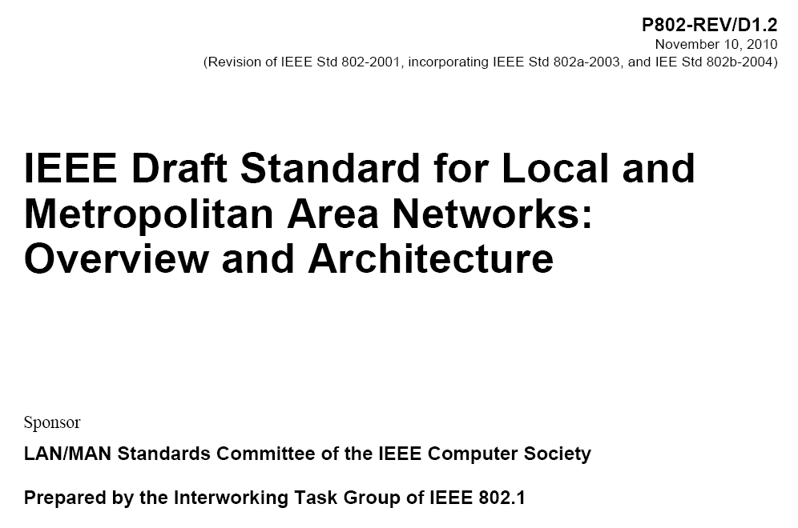
802.1 Architecture Document
Monday Agenda Item 4.1.14

Slide 21
Architecture
Monday Agenda Item 4.1.14
802.1 owns a project to Update the Overview and Architecture standard for 802
A ballot on D1.3 is complete – ballot failed – hoping to move to sponsor soon
Yes 18 = 72.00%, No. of Voters = 65, Voters responding = 32, # comments = 93 (29 technical, 63 editorial)
802.11 ARC (Wednesday AM1) will review resolution status and any 802.11 action items

Slide 22
Smart Grid Meetings
Monday Agenda Item 4.1.15
Two sessions
Tuesday pm2 – Regency V
Wednesday pm2 - Inman
Revision of NIST Smart Grid PAP#2 Guideline
Review NIST Framework document
EC Study Group formed:
Wednesday pm1 - Inman
  Thursday am2 - Inman
  Thursday pm1
Notes:
November 2011

Slide 23
Wednesday Plenary Topics
Monday Agenda Item 4.1.16
TG Elections
Venue Selection process
  Plenary
  Interim
PAR changes overview
Overview of new project PAR & 5C
  CMMW
  ISD
802 University Outreach plans

Slide 24
Tutorials
Monday Agenda Item 4.1.17
None during May 2012
Call for July 2012 suggestions
802.15 THz Interest Group
This tutorial gives an overview on recent achievements in the emerging field of communication systems operating beyond 60 GHz targeting to deliver wireless 100 Gbps over short distances. Within IEEE 802.15 the THz Interest Group is looking for systems for carrier frequencies in the THZ band which starts at 300 GHz. The tutorial will provide an overview on the state-of-the art in technology and demonstrators for these frequency bands. Applications, for which dedicated standards may be appropriate, will be presented focusing on usage models and technical expectations. Finally the regulatory situation after WRC 2012 is discussed.

Slide 25
Wednesday
Notes:
November 2011

Slide 26
TG/SG/SC Officer Election Process
Week of May 13-18, 2012
Wednesday Agenda Item 4.1
Nominations close on Monday May 14
Announcement of Candidate slate Monday May 14
Elections Monday,Tuesday, Wednesday before mid-week plenary
Process will be scheduled to occupy ~ 1 hour
Candidate speeches Wednesday
Confirmation on Wednesday
  Candidate speeches, introductions
  Officially instated to office

Slide 27
802.11 Operations Manual
IEEE 802.11™
Wireless Local Area Networks (WLANs)
Operations Manual
www.ieee802.org/11
Date:
September 21, 2011

Slide 28
WG Officer Election Process - Part 1
  3.4 Working Group Officer Election Process
The election of the IEEE 802.11 WG Officers (Chair and Vice-Chairs) is held in March of each even-numbered year. The nominations for the election shall be made at the WG Opening Plenary meeting. The WG Chair shall designate one of the WG Vice-Chairs as an Acting Chair Pro Tem if the WG Chair is running for re-election. If not running for re-election, the WG Chair shall conduct the election process. This election process shall be used for each WG officer election.
Each candidate shall be given a short time (nominally, two minutes) for an introductory statement of acceptance that should nominally contain the candidate’s:
  Summary of qualifications
  Commitment to participate and accept duties and responsibilities
  Vision for the WG.

Slide 29
WG Officer Election Process – Part 2
The floor shall be opened for discussion (nominally for five-ten minutes total).
  The Acting Chair should limit the duration of comments and promote open participation, both pros and cons. If only one candidate is nominated, the Acting Chair may choose to sharply limit the debate.
The discussion shall be repeated, with the WG Chair leading the process for the nomination(s) of the WG Vice-Chair(s).
At the Mid-Plenary meeting, the WG Officers shall conduct the election, count the votes, and notify the WG of the results.
  Voting tokens shall be used to cast valid votes during the session.
  In order to be elected, any candidate must receive a simple majority (over 50%) of the votes cast in the election for the respective position.
  Should no candidate receive a majority in the election, a runoff election shall be held at the WG Closing Plenary meeting. The process shall be similar to the initial election, except that:
    New nominations shall not be permitted.
    In the runoff election, the nominated candidate having received the fewest votes in the previous election round shall not be an eligible candidate (in case a tie prevents this possibility, all the nominated candidates shall remain eligible).

Slide 30
Wednesday Agenda Item 5.2
Room Changes
??
Notes:
November 2011

Slide 31
Wednesday Agenda Item 5.2
Revised Agenda Graphic
If needed

Slide 32
Wednesday Agenda Item 5.3
Mid-week Officer Changes
If needed

Slide 33
Friday

Slide 34
IEEE LOA Database
Friday Agenda Item 2.08
http://standards.ieee.org/db/patents/pat802_11.html
7 entries with 2012 submission dates

Slide 35
IEEE Store Contents - May 2012
Friday Agenda Item 2.09
Amendment | Draft in Shop May 12 | Draft in Members Area | Publication in Shop May 12 | Publication in Get 802 May 12
11.2 | 1.01
S |  |  | $5
802.11 -2012 |  |  | $5
AA | Published? | 9.0 | $5
AE |  | published | $5
AC | - | 2.0 | D2.0 $5
AD | - | 7.0 | D7.0 $5
k, n, p, y, r, w, u, v, z
802.11-2007
http://www.techstreet.com/ieeegate.html
Notes:
November 2011

Slide 36
802.11 drafts to ISO/IEC JTC1/SC6
Friday Agenda Item 2.10
Task Group | After Okinawa | After Atlanta | After Jacksonville | After Waikoloa
TGae | D5.0 | D7.0
TGaa | D6.0 | D7.0
TGREVmb | D10.0 | D12.0
TGad |  |  | D5.0 | D7.0
TGac | - |  | D2.0
The WG told SC6 it would liaise 802.11ac as soon as it passes a LB
802.11-2012 was submitted to SC6 when approved by the SASB – April 2012
Notes:
November 2011

Slide 37
Tutorials
Friday Agenda Item 2.11
None during May 2012
Call for July 2012 suggestions
802.15 THz Interest Group
This tutorial gives an overview on recent achievements in the emerging field of communication systems operating beyond 60 GHz targeting to deliver wireless 100 Gbps over short distances. Within IEEE 802.15 the THz Interest Group is looking for systems for carrier frequencies in the THZ band which starts at 300 GHz. The tutorial will provide an overview on the state-of-the art in technology and demonstrators for these frequency bands. Applications, for which dedicated standards may be appropriate, will be presented focusing on usage models and technical expectations. Finally the regulatory situation after WRC 2012 is discussed.

Slide 38
July Meeting – San Diego, California
July 15 – 20, 2012
Friday Agenda Item 7
Hotel Registration open
Meeting Registration open
Early bird registration expires June 1

Slide 39
Future Venues - 2012
Friday Agenda Item 6.3
2012
# 131 January 15-20, 2012 ----Hyatt Regency, Jacksonville, FL
Including 802.16 and 802.21
# 132 March 11-16, 2012 –Hilton Waikoloa, Big Island, HI
# 133 May 13-18, 2012, Hyatt Regency Atlanta, Atlanta, Georgia, USA
# 134 July 15-20, 2012 Grand Hyatt Manchester, San Diego, CA, USA
# 135 September 16-21, 2012, Hyatt Grand Champion, Indian Wells, CA
# 136 Nov 11-16, 2012 Grand Hyatt San Antonio, San Antonio, TX, USA
Notes:
November 2011

Slide 40
Future Venues -2013
Friday Agenda Item 6.3
2013
# 137 January 13-18, 2013 - --Hyatt Regency Vancouver, BC, CA
# 138 March 17-22, 2013 –Caribe Royale, Orlando, FL, USA
# 139 May 12-17, 2013 ----Hilton Waikoloa, Big Island, HI
# 140 July 14-19, 2013 --- Geneva , CH ITU headquarters
# 141 September 15-20, 2013----Confirmed– Nanjing, China
# 142 Nov 10-15, 2013 Hyatt Regency Dallas, TX, USA
Notes:
November 2011

Slide 41
Future Venues - 2014
Friday Agenda Item 6.3
2014
# 143 January 19-24, 2014 - --Hyatt Century Plaza, Los Angeles, CA, US
# 144 March 16-21, 2014 –Hyatt Regency Atlanta, Atlanta, GA, US
# 145 May 11-16, 2014 ----Hilton Waikoloa, Big Island, HI
# 146 July 13-18, 2014 --- Manchester Grand Hyatt, San Diego, CA, US
# 147 September 14-19, 2014----Under review – Kobe, Japan
Seoul, Korea
# 148 November 2-7, 2014 Hyatt Regency San Antonio, TX, US
Notes:
November 2011

Slide 42
