Slide 1
Grouping For .11ah Networks
Date: 2012-03-12
Authors:

Slide 2
Abstract
We consider the benefits in performance of grouping
compared to traditional DCF operation in 802.11ah

Slide 3
Motivation
Use case 1c: Extended range hotspot [1]
Typical scenarios may include:
Extended home coverage
Campus wide coverage
Shopping malls
Overloading of the system cannot always be prevented with planning e.g.
Users may all decide to check stocks at opening/closing of market
If activation trigger for sensors (or M2M devices) is not time-dependent it may require that they contact the network at the same time e.g.,
Different sensors in system monitoring of e.g., shopping mall will all report at the same time if you have smoke, fire, or water detectors and there is fire
May be natural that high number of sensors are reporting
It is desirable as fire department would know the extent of fire and smoke and if sprinklers are working

Slide 4
Motivation
Performance parameters of relevant importance
Overloading can cause unfairness
Certain users may never get the chance to transmit
Energy efficiency
Laptop/cell phone batteries have finite capacity
Investigate grouping performance in terms of the above
Considering the same grouping protocol as in [2]

Slide 5
Simulations
1000 STAs associated with an AP
STAs are uniformly distributed within a 1km radius
Traffic model
1000 packets/s
Packets consist of 256 bytes
2 MHz channel

Slide 6
Simulation Scenarios
1 group or 3 groups (randomly created)
Scenarios
Three groups (1.0/0.0/0.0) no sleep simultaneous start
Only STAs in a single group can contend
DCF is used for the STAs that pass the “contention test”
If they have traffic, contend simultaneously
STAs that fail the test go to sleep
Group schedules alternate with time (short beacons can be used)
Three groups (1.0/0.0/0.0) sleep randomized start
DCF with randomization
Uniform in Beacon interval
STAs listen Beacons, sleep, wake up to transmit and sleep
1 group (1.0) sleep (DCF with sleep option)

Slide 7
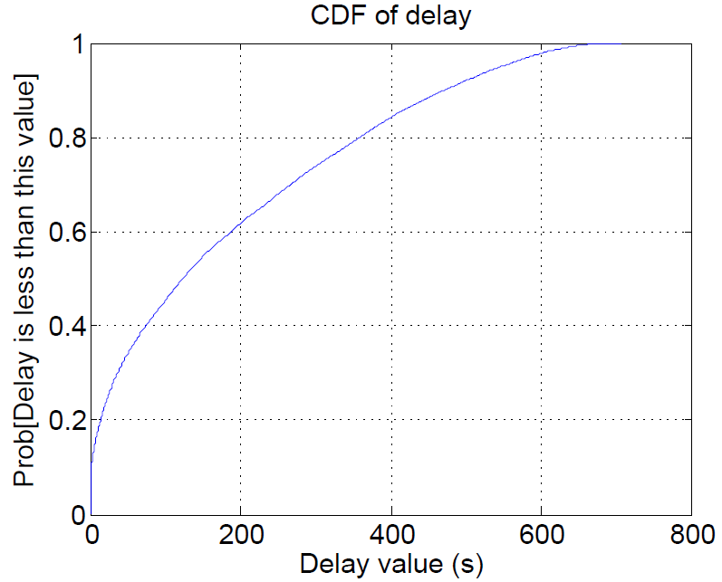
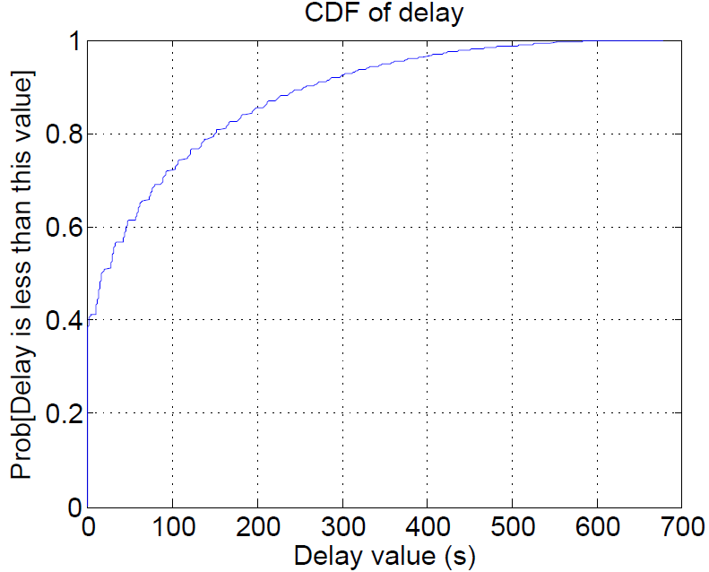
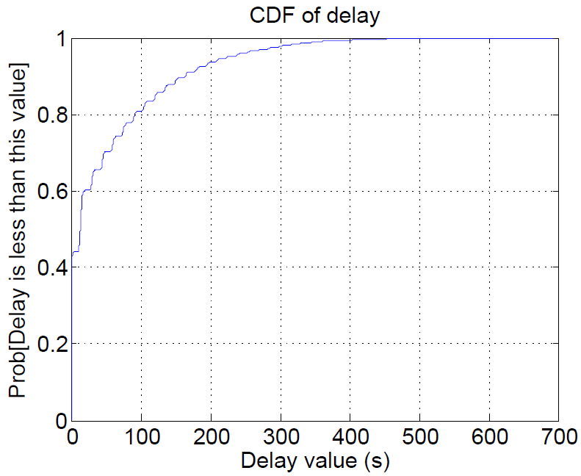
The 1000 STAs case: CDF of Delay
DCF (1 group)
3 groups not randomized
3 groups randomized
Average ~184s
Average ~81s
Average ~50s
Large delays
Normal since the system is overloaded
Grouping of 3 groups with randomization outperforms DCF in terms of delay

Slide 8
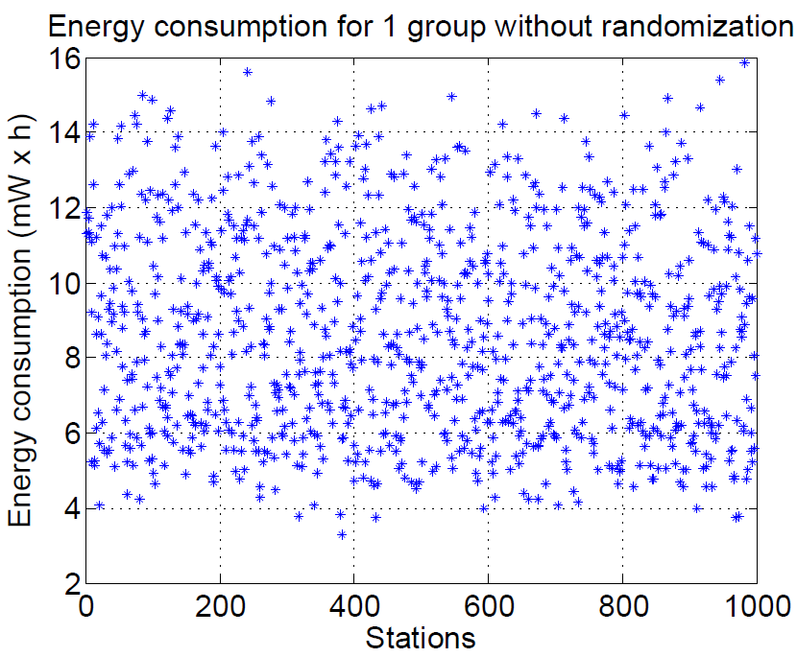
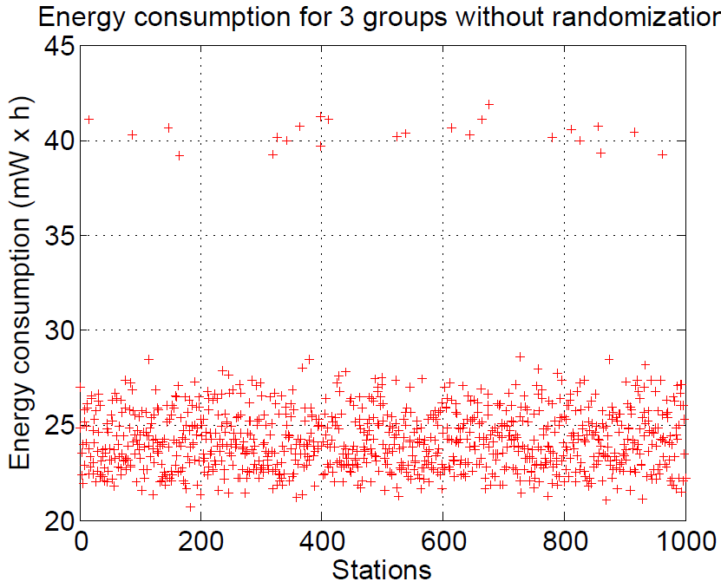
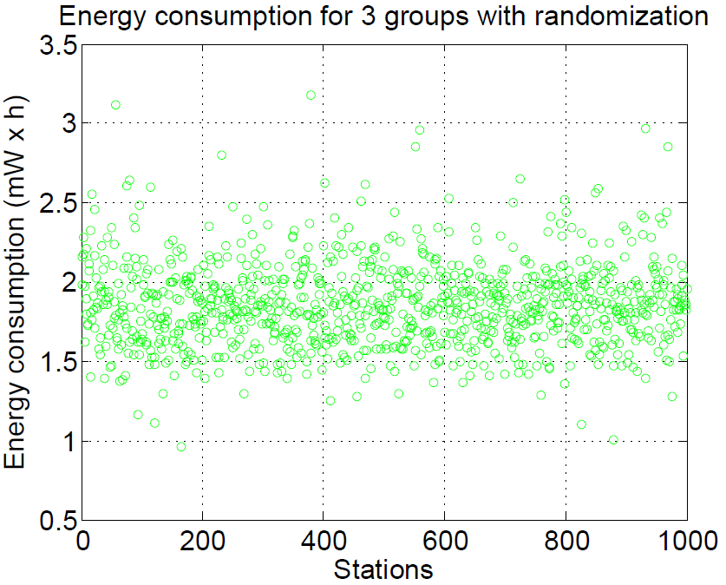
The 1000 STAs case: Energy per STA
DCF (1 group)
3 groups not randomized
3 groups randomized
Energy consumption per STA is best under 3 groups with randomization
Worst case energy consumption is better than best case consumption of DCF
Grouping of 3 groups with randomization outperforms DCF
Randomization is needed in addition to grouping
To avoid contention at the same time

Slide 9
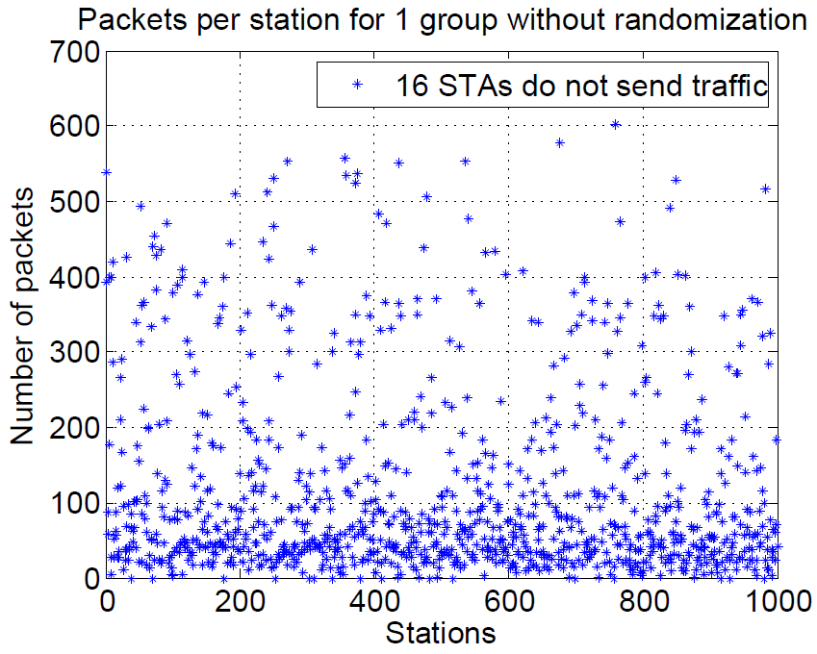
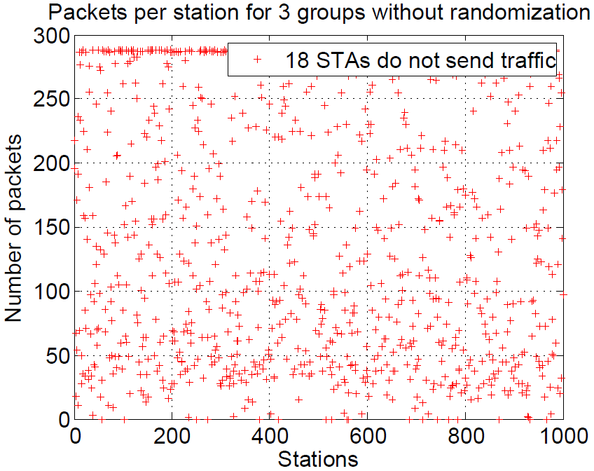
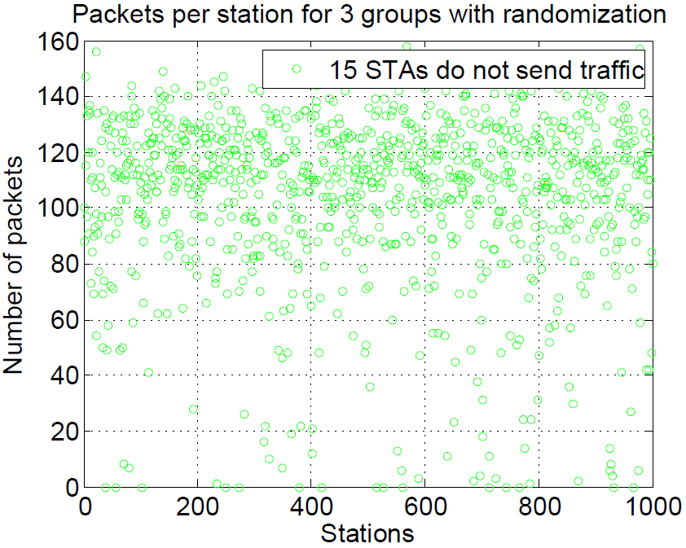
The 1000 STAs case: Packets per STA
DCF (1 group)
3 groups not randomized
3 groups randomized
Fairness improves with grouping and randomization
Jain Index of fairness with maximum at 1
DCF: 0.4575
3 groups no randomization: 0.7013
3 groups randomization: 0.9168

Slide 10
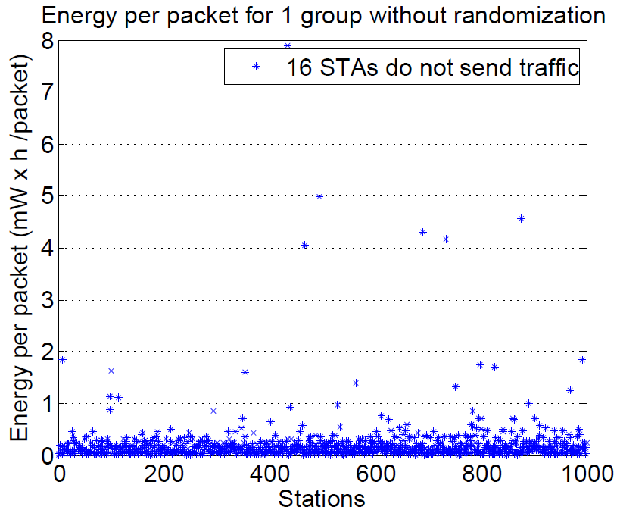
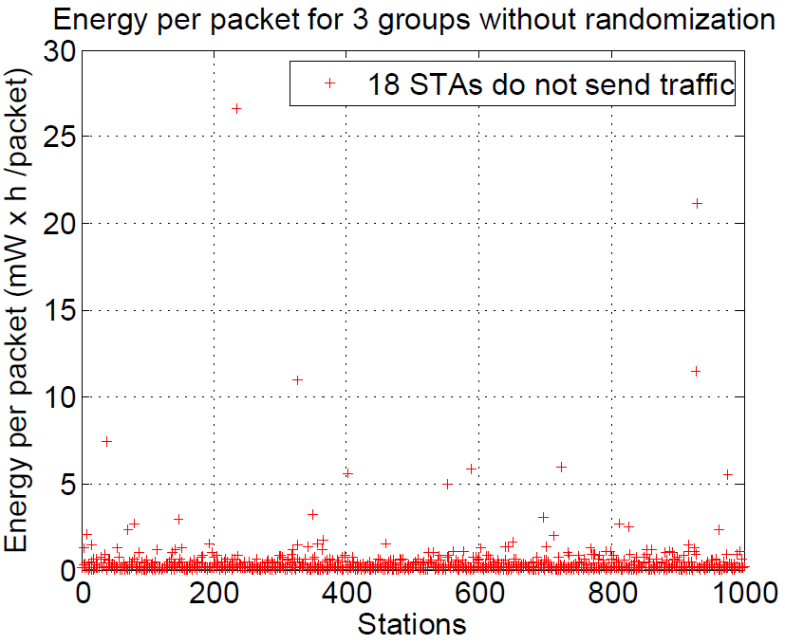
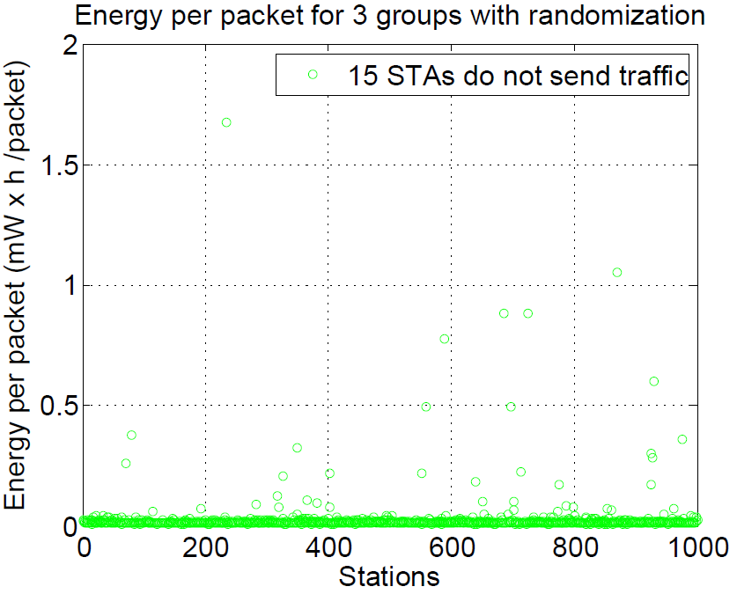
The 1000 STAs case: Energy per Packet
DCF (1 group)
3 groups not randomized
3 groups randomized
Worst case energy per packet is better under 3 groups with randomization

Slide 11
Conclusions
Grouping with randomization outperforms DCF under an overloaded 802.11ah network
Delay
Energy efficiency
Fairness
The exact parameters of grouping can be implementation specific

Slide 12
References
[1] 11-11-0457-00-00ah-potential-compromise-of-802-11ah-use-case-document
[2] 11-12-0028-01-00ah-power-saving-possibilities-for-networks-supporting-a-large-number-of-stas

Slide 13
Straw Poll
Do you support including STA grouping with randomized start of the content to improve channel access in the specification framework?
Y: N: A

