Slide 1
On the 802.11ah Performance
Date: 2012-03-07
Authors:

Slide 2
Abstract
In our earlier contributions 12/0090r1 & 11/1515r1 we presented offloading use case performance results seen above TCP/IP layer for 16Mhz channel in 11ah
In this contribution we provide further analysis how the downclocking affects to the 11ah performance
Check the 802.11 MAC/PHY layer overhead effect on the performance Theoretical analysis for 2MHz and 16MHz channels
Simulation results for 16MHz channel
Notes:
doc.: IEEE 802.11-yy/xxxxr0

Slide 3
Theoretical Analysis for 16MHz
40/256/1500 Byte packets
MCS2: QPSK ¾
Time calculated for one DATA-ACK transaction (including DIFS)
Contention overhead not included (CWIN==0)
SIFS 160us -> 64us throughput gain:
1500 B ~ 13 %
256 B ~ 21 %
40 B ~ 24 %
Even higher gains can be obtained with higher MCS

Slide 4
Theoretical Analysis for 2MHz
256 Byte packet
MCS2: QPSK ¾
Time calculated for one DATA-ACK transaction
Contention overhead not included (CWIN==0)
~10% theoretical data rate improvement achieved by reducing SIFS from 160us to 64us

Slide 5
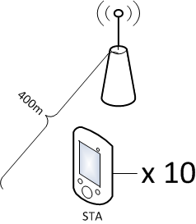
Simulation Parameters
16 MHz channel simulations to see the effect of reduced IFS
SIFS values selected to be multiple of 16.0 us as in theoretical analyses
10 STAs placed inside the 400m radius from AP
Range in with 900MHz enables high MCSs
Packet sizes 40/1500 bytes (TCP packet sizes)
Parameter | Value
Symbol Time | 40 us (32us + 8 us GI)
SIFS | 160/128/96/64 us
Slot time | 45 us
MCS | 0-7 (1/2 BPSK – 5/6 64 QAM)
Bandwidth and Frequency | 16 MHz at 900 MHz
Number of subcarriers TOT/PILOT/DATA | 484/16/468
Tx Power | 30 dBm

Slide 6
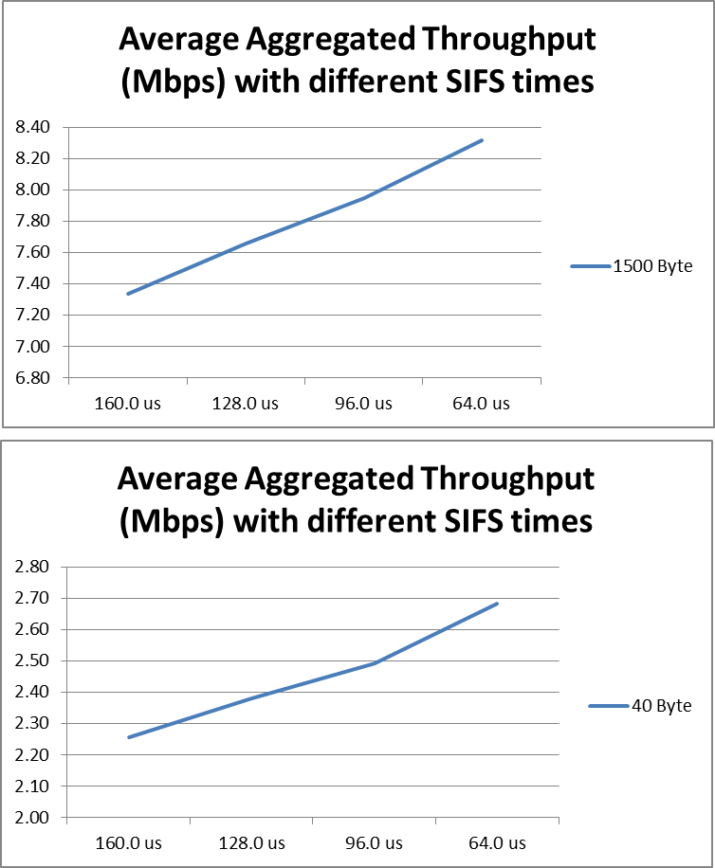
Simulation Results
Throughputs for 40 / 1500 Byte packets with different SIFS values
1500 Byte: 13% gain
40 Byte: 18% gain
Gains are measured on top of MAC layer

Slide 7
Conclusions
Performance gains by reducing the IFSs can be observed for the 16 MHz channel
Also for 2MHz channel
Higher gains are seen for the higher channels widths due to the shorter DATA transmission times while overhead remains to be fixed
Theoretical analyses and simulation results were shown to indicate the issue
The ill side-effects of downclocking could be reduced by specifying shorter the IFS values for the 11ah
Additionally having only one 16 MHz channel available would mean that there is high probability for an OBSS situation

Slide 8
Strawpoll 1
Do you support to specify shorter IFS (Inter Frame Space) values for the 11ah, than what is obtained by direct downclocking?
Y:
N:
A:

Slide 9
Strawpoll 2
Do you support to remove the 16 MHz channel option from the 11ah and set the highest channel bandwidth to be 8MHz
Y:
N:
A:

Slide 10
Strawpoll 3
Do you support the maximum transmission bandwidth of 11ah to be 16M by using 8M+8M channel aggregation to be optional
Y:
N:
A:

