Slide 1
WLAN and Cellular Interworking and Discovery Use Case
Date: 2012-05-14
Authors:

Slide 2
Abstract
Overview of WLAN and Cellular Use Case
Present ANDSF: the 3GPP Discovery Function for non-3GPP access
  Highlight some known issues with the current function
Potential SG Actions

Slide 3



WLAN and Cellular Use Case
Services
Service Provider NW
ANDSF Server
P-GW
Terminal Fetches Policy
WLAN /
Unlicensed Band
Allocate Specific App Flows to Specific Links
Terminal Selects & Connects to WLAN
UE/STA

Slide 4
ANDSF: Mobile Services Discovery Protocol
ANDSF (Access Network Discovery and Selection Function)
  Provides 3GPP Mobiles (UEs) information about available networks and policies for selecting and using such networks
  Primary function is selecting non-3GPP access networks, in particular 802.11-based (WLAN) networks
    Also includes CDMA2000 info, WiMaX info, etc.
  Location (and UE) specific
  Relatively static: (currently) not intended to be responsive to real-time network conditions
Is this a “service discovery” protocol? Absolutely:
  Services discovered: mobile IP access as provided by the UEs mobile operator
  Cellular devices are one of the largest markets for 802.11-based technology; thus, mobile services are an important class of services whose discovery 802.11 should support

Slide 5
ANDSF Architecture
Simple client-server architecture
  IP-based interface (S14)
  OMA DM (Device Management) used as
    Protocol
    Information Standard
Both Push and Pull communication models used
Source: 3GPP TS 23.402, v. 10.4.0
High-level overview of the protocol (Pull model)
  ANDSF Discovery by UE
  UE contacts ANDSF to request policy information
  UE interprets and acts on the policy
Push model variations
  Policy is pushed to UE (SMS is the most common method)
  Push may provide full information
  Alternatively, it may result in UE contacting ANDSF for more information (i.e. Push may be just a Pull trigger)

Slide 6
ANDSF Operational Overview
ANDSF Discovery Options
  H (home)-ANDSF and V(visiting)-ANDSF may be discovered via DNS (IETF RFC 1035)
  H-ANDSF may be provisioned
  H-ANDSF may be discovered via DHCP query (IETF RFC 6153)
ANDSF Security
  3GPP GBA-based security preferred
  OMA-DM specified security can be used as fall-back
ANDSF Access / Information request (Pull only)
  Typically utilizes OMA DM Generic Alert
ANDSF Discovery Information and Policy “encoding”
  A single OMA DM Management Object (MO) is used (define in 3GPP TS 24.312)
  The MO carries information related to discovery of networks as well as their usage
  We overview discovery only

Slide 7
ANDSF MO Overview
Top-Level View
Source: 3GPP TS 24.312, v. 10.3.0
Discovery Information Sub-Tree

Slide 8
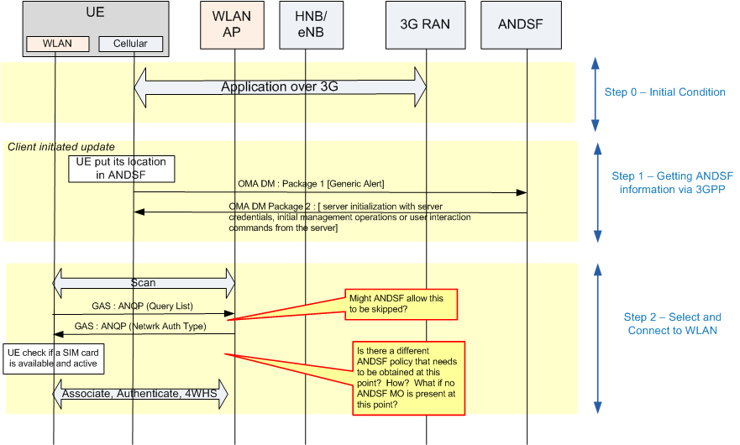
WLAN/ANDSF interoperability example

Slide 9
There are known issues with the current function
GSMA and WBA provided a detailed analysis which identifies a number of issues
  Incompatibility of ANQP MO and ANDSF MO
  Signaling inefficiencies
  Functionality which needs to be improved
LS to 3GPP and WiFi Alliance based on this paper
  http://www.3gpp.org/ftp/inbox/LSs_from_external_bodies/GSMA/LS to 3GPP and WFA on WiFi Roaming.zip
  Some excerpts:
    WFA is requested to define its Subscription Management Object (MO) to make policy objects optional. This will allow for a migration path towards the use of an ANDSF MO in future, where policy is provisioned via an ANDSF MO.
    WFA is requested to limit the scope of its Subscription MO to policies needed for a terminal’s Wi-Fi network selection function. This would thus make ISMP and ISRP out of scope within WFA (Note that ISMP and ISRP remain within scope of 3GPP – the change is to prevent remove potential overlap of definitions).
    Upon completion of the WFA work on Subscription MO, WFA and 3GPP are requested to work together to align their definitions to ensure consistency on this subject. GSMA and WBA would also like WFA to forward the Subscription MO to us to check it’s appropriateness to meet requirements from the Task Force, once the Subscription MO is finalised.
    Once the Subscription MO is finalised, WFA and 3GPP are requested to work together to update ANDSF to align with the relevant parts of the HotSpot 2.0 MO.

Slide 10
Summary Potential SG Actions
ANDSF is an important ISD protocol
  Enables discovery and usage of “mobility services,” which is arguably the main IP-network service offered by cellular networks
  Known gaps exist when ANDSF is used with existing 802.11-based systems (i.e. WiFi systems)
The SG should examine the issues highlighted in detail
  To understand whether these are in scope for 802.11
  If so, the scope of the proposed amendment produced by SG should include closing these gaps.

Slide 11
Suggested Use Case
  A user is roaming and does not want to get pricy data access over the cellular connection
  The user enters a location where the user’s home operator can offer a decently priced deal to get data over a WLAN roaming agreement
  The user’s device discovers the WLAN access that can provide the service and obtains a new operator’s policy where local WLANs are indicated as a preferred access for the data service
  The device selects and connects to the indicated WLAN, and data services are now accessed through this WLAN
  Note: The use case can also be applicable to WLAN-only devices

Slide 12
References
3GPP
TS 23.402, Architecture Enhancement for non-3GPP Access: http://www.3gpp.org/ftp/Specs/html-info/23402.htm
TS 24.302, Access to the 3GPP Evolved Packet Core (EPC) via non-3GPP access networks: http://www.3gpp.org/ftp/Specs/html-info/24302.htm
TS 24.312, Access Network Discovery and Selection Function (ANDSF) Management Object (MO): http://www.3gpp.org/ftp/Specs/html-info/24312.htm
IETF:
RFC 1035, Domain names: implementation and specification: http://www.rfc-editor.org/rfc/rfc1035.txt
RFC 6153, DHCPv4 and DHCPv6 Options for Access Network Discovery and Selection Function (ANDSF) Discovery: http://tools.ietf.org/html/rfc6153
OMA
OMA-DDS-DM_ConnMO-V1_0- 20081107-A: "Standardized Connectivity Management Objects."
OMA-DDS-DM_ConnMO_WLAN-V1_0-20081024-A: "Standardized Connectivity Management Objects WLAN Parameters.”
OMA-ERELD-DM-V1_2: "Enabler Release Definition for OMA Device Management.“
http://www.openmobilealliance.org/Technical/current_releases.aspx

