Slide 1
Group Synchronized DCF
Date: 2012-03-12
Authors:

Slide 2
Abstract
STAs with a group may be allowed to contend for the medium – idea of group synchronized DCF (GS-DCF)
Medium access window allowed to certain groups and prohibited to other groups
- AP decides on defining the medium access start and end times
Performance comparison of GS-DCF with DCF

Slide 3
Group Medium Access in Beacon Frame
AP informed of Supported Rates, QoS Capability, QoS Traffic Capability, and Power Capability in Association Request frame from STAs
AP clusters STAs into groups and informs the group IDs in Association Response frame
Beacon frame defines the medium access time for each group

Slide 4
Proposed Information Element
Time
Stamp
Beacon Interval
Supported Rates
FH
Parameter
Set
DS
Parameter
Set
CF
Parameter
Set
GrPS
Parameter
Set
Capability Information
SSID
TIM
Beacon Frame
Proposed IE
Propose to add an Information Element termed as Group Access Parameter Set (GAPS) element in the Beacon frame
GAPS element for group ‘n’ shall comprise of:
(i) GID: Group Identification
(ii) Group Access Start Time: Value of T_n
(iii) Group Interval End Time: End time of medium access

Slide 5
Medium Access of STA Groups
Group Access Start Time for Group 3
Group i’s medium access Start Time is decided by the AP
Start Time based on number of associated / active STAs per group and priority setting per group
Group Interval End Time for i-th group is identical to prohibition time for (i+1)-th group

Slide 6
Overlapping Medium Access Times among STA Groups
Overlapping medium access times for efficient medium contention, e.g., Groups 4 and 3 medium access
Overlapping medium access reduced idle medium time

Slide 7
GS-DCF Medium Access
Short Beacon
Beacon
GAPS
Beacon frame consists of information on all group synchronized medium access periods until next beacon
Time not assigned to groups is assigned for regular DCF

Slide 8
Simulation Parameters
GS-DCF Mechanism Parameters
Number of groups: 5
Group size: 20 STAs
Packet accumulation interval 0-800ms
Group active interval 800-1000ms
Data rate per STA: 5 - 35 kbps
No RTS/CTS
DCF Parameters
Number of STAs: 100 STAs
Active interval 0-1000ms
Data rate per STA: 5 - 35 kbps
No RTS/CTS

Slide 9
Simulation Parameters
Channel Bandwidth | 2MHz
TX Power | 30dBm
Antenna Gains | 3dB
Communication Range | 100 Meters
Packet Size | 250Bytes
Slot Time/SIFS/DIFS | 48µs/160µs/256µs
(CWmin, CWmax) | (15, 1023)
MCS | BPSK ½
Simulation time | 16s

Slide 10
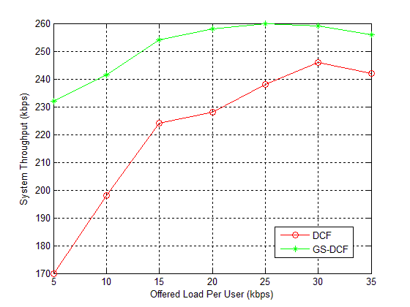
Throughput Comparison between DCF and GS-DCF

Slide 11
Summary
GAPS element proposed to be included in the Beacon frame
Only limited number of groups are allowed to contend during specified medium access window defined in the GAPS element
GS-DCF outperforms DCF with increasing number of STAs contending for the channel

Slide 12
References
“Power Saving Possibilities for Networks Supporting a Large number of STAs,” doc.: IEEE 802.11-12/0028r1, January 2012, Renesas Mobile Corporation
“DCF Enhancements for Large Number of STAs,” doc.: IEEE 802.11-11/1255r0, September 2011, CATR

Slide 13
Straw Poll
Do you agree to include the GAPS information element in the Beacon frame?

