Slide 1
PS-Poll Enhancements
Date: 2012-03-12
Authors:

Slide 2
Abstract
In overload situation lots of STA may send PS-Poll messages and corresponding immediate ACK consume significant bandwidth
→ Block ACK may be beneficial
STA may have different needs depending on their operational state, e.g.
receive only high priority data to preserve energy,
wait for critical data
Beneficial to signal some more information in PS-Poll message
Contribution proposes enhancements to PS-Poll message and block ACK for PS-Poll

Slide 3
Motivation
Energy constrained sensors using energy harvesting with very low energy level
Only wants to receive important traffic to save energy

Slide 4
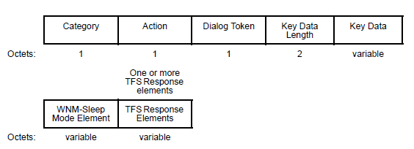
WNM Sleep Mode Request and Response Frames in IEEE 802.11v
WNM Sleep Mode Request frame from STA
WNM Sleep Mode Response frame from AP

Slide 5
Signaling using WNM-Sleep Mode and PS-Poll
AP
STA
WNM Sleep Request
WNM Sleep Response
PS-Poll
Immediate ACK
WNM Sleep Mode with traffic filters for initiation of STA sleep period
AP filters buffered data using traffic filter information upon receipt of PS-Poll

Slide 6
Current PS-Poll Message
Frame
Control
BSSID
(RA)
TA
AID
FCS
MAC Header
Blank header with no specific information delivered to AP
- Propose to add traffic filter indications for limited downlink data
- Parameters on bulk data and its content

Slide 7
PS-Poll Message Enhancement
Octets
1
2
2
6
6
4
BSSID
(RA)
Buffered
Data
Threshold
Critical
Data
Traffic
QoS
Frame
Control
AID
TA
FCS
MAC Header
Buffered Data Threshold (4 bits): This field indicates the threshold (as an exponent of 2, expressed in KB) of buffered data above which the STA prefers to be ACK-ed with BU =1 by the AP. This field is utilized by the AP in defining priorities among the STAs;
Critical Data (1-bit): This field indicates if a STA is waiting for time-critical or periodic information. This field is also utilized by the AP in defining priorities among the STAs.
Traffic QoS (3 bits): Each application may have traffic streams with different access categories and QoS classes. This field indicates the lowest QoS class for which teh STA prefers to be ACK-ed with BU=1 by the AP.

Slide 8
Decision on BU Bit in ACK Following PS-Poll
Beacon
ACK
BU=0/1
AP
STAA
PS-Poll
If STAs, [buffered data < Buffered Data Threshold], or Traffic QoS <= Value and Critical Data = 0,
Then, BU bit = 0, Else, BU bit = 1
AP can set BU bit = 1 for important notifications

Slide 9
Immediate and Block ACK
AP can decide to send immediate ACK or a Block ACK
Avoid sending of numerous ACK when large amount of PS-Poll messages are sent
Block ACK frame consists of each STA ID, BU bit, and duration to service period
Block ACK sent with beacon (STA know that they should receive a Block ACK latest with next beacon)
Notes:
IE for Block ACK

Slide 10
Summary
Additional information in PS-Poll gives flexibility to STAs to receive downlink data
Choice of immediate or Block ACK messages can reduce overload situations
Notes:
Repeat the abstract for summary

Slide 11
Reference
1. “Low Power Medium Access,” doc. : IEEE 802.11-12/0114r0, January 2012.

Slide 12
Straw Poll
Do you agree to introduce a block ACK message to PS-Polls in addition to the immediate ACK in overload situations due to multiple PS-Poll messages?

Slide 13
Straw Poll
Do you agree to add the Critical Data field in the PS-Poll message?

Slide 14
Straw Poll
Do you agree to add the Traffic QoS field in the PS-Poll message?

Slide 15
Straw Poll
Do you agree to add the Buffered Data Threshold field in the PS-Poll message?

