Slide 1
Supplementary Plenary Information - March 2012
Date: 2012-March-14
Authors:
Name
Company
Address
Phone
email
Bruce Kraemer
Marvell
5488 Marvell Lane,
Santa Clara, CA, 95054
+1 (321) 751-3958
bkraemer@
marvell
.com
Abstract: Additional Information on topics for 802 plenary meeting – March 2012
Notes:
November 2011

Slide 2
Monday
Notes:
November 2011

Slide 3
IEEE LOA Database
Monday Agenda Item 3.2.1
http://standards.ieee.org/about/sasb/patcom/pat802_11.html
18 entries with 2010 submission dates
30 entries with 2011 submission dates
6 entries with 2012 submission dates

Slide 4
Joint Meetings
Monday Agenda Item 4.1.3
External: Thursday am1 11aa and 802.1avb
Kona 2
Internal:

Slide 5
NEW PARS
Monday Agenda Item 4.1.4
802.1AX-rev, revision to 802.1AX link aggregation, PAR and 5C
802.1Qbu, amendment for frame preemption, PAR and 5C
802.1AEbw, amendment for extended packet numbering, PAR and 5C
802.1Xbx, amendment for MAC security key agreement protocol (MKA) extensions, PAR and 5C
802.1Qbv, amendment for enhancements for scheduled traffic, PAR and 5C
802.3bk, amendment for extended Ethernet Passive Optical Networks (ExEPON), PAR and 5C
802.21d amendment for multicast group management, PAR and 5C
802.15.4n amendment for China medical band, PAR and 5C
802.15.4p amendment for positive train control (PTC), PAR and 5C
802.15.8 new standard for peer aware communications (PAC), PAR and 5C
PAR Monday PM2 Waikoloa 1
PAR Tuesday AM2 Kona 2
PAR Thursday AM2 Kona 2
Please go to http://www.ieee802.org/PARs.shtml for a additional details

Slide 6
Other PARS
Monday Agenda Item 4.1.4

Slide 7
Group Room assignments
Monday Agenda Item 4.1.5
WG | Room | Location
16 | Kohala 2, Kona 1, ++ | Convention Area
18 | Bella Vista 1/2 | Underneath Kirin
19 | Bella Vista 3/4 | Underneath Kirin
21 | Palm Terrace B | Ocean Tower
22 | Palm Terrace A | Ocean Tower
Notes:
November 2011

Slide 8
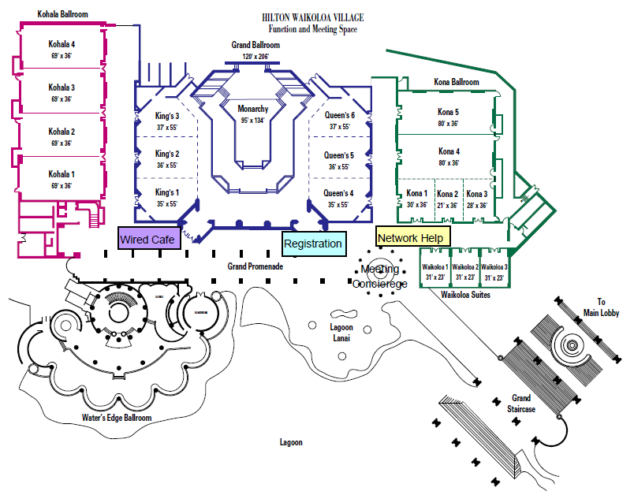

Slide 9
Room Schematic
Kohala
King’s
Monarchy
Queen’s
Kona
Waikoloa
Lagoon

Slide 10
WG Agendas
Monday Agenda Item 4.1.6
18: 18-12-0022 r0 Opening Report
19: 19-12-0034 r0 Agenda
19-12-0035r0 Opening Report
21: 21-12-0019r0 Agenda
21-12-0021 Opening Report
22: 22-12-0016r2 Agenda

Slide 11
FCC Proceedings List
Monday Agenda Item 4.1.6
THE FCC WTB AND THE OFFICE OFENGINEERING AND TECHNOLOGY SEEK COMMENT ON PROGENY’S M-LMS FIELD TESTING REPORT (Docket No. 11-49) (18-12/21r1) Comment Date: March 15, 2012, Comment Date: March 30, 2012 .
FCC SEEKS COMMENT ON CERTAIN WIRELESS SERVICE INTERRUPTIONS. (DA No. 12-311). (Dkt No 12-52 ) FCC seeks comment on concerns and issues related to intentional interruptions of wireless service by government authorities for the purpose of ensuring public safety. Comments Due: 04/30/2012. Reply Comments Due: 05/30/2012(18-11/101r0).

Slide 12
ITU-R Items Impact on radiocommunication systems from wireless and wired data transmission technologies used for the support of power management systems (18-12-0025) Question ITU-R 236/1
Monday Agenda Item 4.1.6
This question specifically asks:
What are the technical and operating features and the characteristics of wireless technologies and devices in support of power grid management systems?
What are the data rates, bandwidths, frequency bands and spectrum requirements needed in support of power grid management systems?

Slide 13
ITU-R Question 236/1 continued
Monday Agenda Item 4.1.6
What are the interference considerations to radiocommunications associated with the implementation of wireless and wired technologies and devices used in support of power grid management systems?
How will spectrum availability be affected by interference associated with widespread deployment of such technologies and devices?
The outcome of this question will be the identification of spectrum, technologies, bandwidths and data rates for wireless Smart Grid management.
It is recommended IEEE 802 make an initial input to the June, 2012 meeting of ITU-R WP1A

Slide 14
May Meeting – Atlanta Georgia May 13 - 18
Monday Agenda Item 4.1.10
Hotel Registration open
Meeting Registration open
Early bird registration expires April 13

Slide 15
Elections
Monday Agenda Item 4.1.11
Final Call for Nominations
Introduction of Candidates
Outline of Election Process on Wednesday

Slide 16
Election Process
Monday Agenda Item 4.1.11
Working Group Officer elections take place March 2012
Nomination procedure
Election Procedure
Task Group Officer elections take place May 2012
Nomination procedure
Election Procedure

Slide 17
Other Special Events
Monday Agenda Item 4.1.12
Breakfast – Lunch Buffet – Breaks
Badge needed for admission
Wednesday Social 6:30 pm start
Badge needed for admission
Moving to Luau area if weather permits
Final notification Wed plenary

Slide 18
Topics since November 2011 EC
Monday Agenda Item 4.1.13
802.11 REVISION Passed RevCom and SASB
802.11aa submitted to RevCom for March 28
Passed EC
802.11ae submitted to RevCom for March 28
Passed EC
Notes:
November 2011

Slide 19
802.11 Topics for March 2012 EC
Monday Agenda Item 4.1.13
Begin Sponsor Ballot
Nothing anticipated
Requests to submit to RevCom?
Nothing anticipated
New project PAR to NesCom?
Nothing anticipated
PAR Extension ?
Nothing anticipated for March but two for July
Study Group start up?
Depends upon results of WNG meeting
Study Group extension?
Two planned, ISD & CMMW

Slide 20
802.1 Architecture Document
Monday Agenda Item 4.1.14

Slide 21
Architecture
Monday Agenda Item 4.1.14
802.1 owns a project to Update the Overview and Architecture standard for 802
A ballot on D1.3 is complete – ballot failed – hoping to move to sponsor soon
Yes 18 = 72.00%, No. of Voters = 65, Voters responding = 32, # comments = 93 (29 technical, 63 editorial)
802 wide comment reviews scheduled for :
Monday 7pm-9pm Water’s Edge
Tuesday 4pm – 6pm Water’s Edge
Thursday 8am – 10am Water’s Edge
802.11 ARC (Wednesday AM1) will review resolution status and any 802.11 action items

Slide 22
Smart Grid Meetings
Monday Agenda Item 4.1.15
Two sessions
Tuesday pm2 – Kohala 3
Wednesday pm2 - Kohala 4
Revision of NIST Smart Grid PAP#2 Guideline
Review NIST Framework document
Discuss creation of EC TAG in Wednesday session
Notes:
November 2011

Slide 23
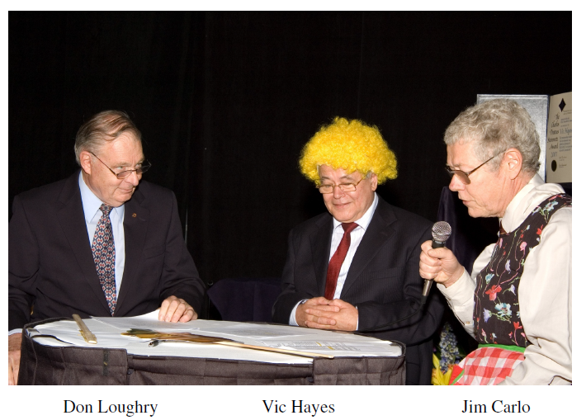
802 chair 1990-1996
802 chair 1996-2001

Slide 24
Memorial books for Don and Jim being circulated
Please add your thoughts

Slide 25
Wednesday Plenary Topics
Monday Agenda Item 4.1.17
WG Elections
Architecture Comment Resolution Status
ePOLL status
Comment Resolution Guidelines
Operations Manual Updates
Venues and Treasury updates & Discussion
Time is allocated on Wednesday for each of these. Extended discussions will continue on Friday as needed.

Slide 26
ePOLL
A new balloting and comment submission system for WG ballots has been on trial for the past few months
How is the experimentation with the new tool progressing?
What’s different?
Why introduce a new tool?
What do balloters need to know to effectively use the tool in the next major WG ballot?

Slide 27
Comment Resolution Guidelines
All 802.11 ballot commenters want to be ensured that their submitted comments are considerately dealt with by the comment resolution committee.
There have been concerns raised about practices used
Incomplete consideration
Inconsistent practices across TGs
Guidelines are being developed to highlight best practices to address both concerns
Please review 11-11-1625 r1
Similar guideline activity underway in RevCom for Sponsor ballots

Slide 28
Tutorials
Monday Agenda Item 4.1.18
None during March 2012
Call for July 2012 suggestions

Slide 29
Wednesday
Notes:
November 2011

Slide 30
Wednesday –Topic Summary
Monday Agenda Items 4 & 5
Liaison Reports
Election Process (Bruce) 11-11-1597
Elections
Wednesday Discussion topics
ePOLL (Adrian Stephens)
Comment Resolution Guidelines 11-11-1625r2 (Adrian Stephens)
TGaa MAC address update 11-12-0426r0 (Adrian Stephens)
Architecture Ballot Status (Michael Montemurro)
eTool status (Jon Rosdahl)
Pending rules changes (Jon Rosdahl)
https://mentor.ieee.org/802-ec/dcn/12/ec-12-0008-01-00EC-more-proposed-changes-to-p-p-and-om.pptx
https://mentor.ieee.org/802-ec/dcn/12/ec-12-0005-02-00EC-ieee-802-lmsc-rules-changes-for-march-2012.doc
https://mentor.ieee.org/802.11/dcn/09/11-09-0002-09-0000-802-11-operations-manual.doc
Friday
Update on 1905.1
Future Meeting Venues /Independent Treasury (Jon) 11-12-0083
Regulatory changes options

Slide 31
WG Officer Election Process Week of March 11-16, 2012
Wednesday Agenda Item 4.1
Nominations close on Monday March 12
Announcement of Candidate slate Monday March 12
Elections on Wednesday
Process will be scheduled to occupy ~ 1/2 hour
Candidate speeches Wednesday
Elections on Wednesday
Down selection votes if needed
Confirmation by EC on Friday March 16
Officially instated to office after close of EC business Friday

Slide 32
Current 802 Rules
Wednesday Agenda Item 4.1
IEEE PROJECT 802
LAN / MAN STANDARDS COMMITTEE (LMSC)
WORKING GROUP (WG)
POLICIES AND PROCEDURES (P&P)
As approved 7/22/2011
Last edited 9/25/2011

Slide 33
6.2 Election of Officers
Current 802 P&P
A WG may elect a new Chair or Vice Chair at any plenary session, subject to confirmation by the IEEE 802 LMSC Sponsor
All WG elections become effective at the end of the plenary session where the election occurs. A plenary session is as defined in the LMSC OM, 4.1[refs4]. Prior to the end of that plenary session, persons that have been elected during the session are considered „Acting‟. Persons who are succeeding someone that currently holds the position do not acquire any rights for that position until the close of the plenary session.

Slide 34
Chair Responsibilities – Part 1
6.5.1. Chair
The main responsibility of the WG Chair is to enable the WG to operate in an orderly fashion, produce a draft standard, recommended practice, or guide, or to revise an existing document.
The Chair or Chair’s designee shall have the following responsibilities.
a) To lead the activity according to all of the relevant policies and procedures
b) To be objective
c) To entertain motions, but not make motions
d) To not bias discussions
e) To delegate necessary functions as needed
f) To ensure that all parties have the opportunity to express their views
g) To set goals and deadlines and endeavor to adhere to them
h) To be knowledgeable in IEEE standards processes and parliamentary procedures and ensure that the processes and procedures are followed
i) To seek consensus as a means of resolving issues
j) To prioritize work to best serve the group and the goals
k) To ensure compliance with the IEEE-SA Intellectual Property Policies, including but not limited to the IEEE-SA Patent Policy and Copyright Policy.
l) To fulfill any financial reporting requirements of the IEEE, in the absence of a Treasurer.
m)To participate as needed in meetings of the Sponsor to represent the WG and, in the case of a “Directed Position”, vote the will of the WG in accordance with the Directed Position Procedure (See 6.2 of the LMSC OM [refs4])

Slide 35
Chair Responsibilities – Part 2
6.5.1. Chair
n) To call meetings and issue a notice for each meeting at least 30 calendar days prior to the meeting
o) To ensure agendas are published at least 14 calendar days before a meeting
p) To ensure important requested documents are issued to members of the WG, the Sponsor, and liaison groups.
q) To ensure a membership roster is created and maintained
r) To ensure participant attendance is recorded at each meeting
s) To be responsible for the management and distribution of working group documentation in compliance with IEEE-SA guidelines, including but not limited to guidelines with regard to posting and distribution of drafts and approved IEEE standards.
t) To ensure lists of unresolved issues, action items, and assignments are maintained
u) To maintain liaison with other organizations at the direction of the Sponsor or at the discretion of the WG Chair with the approval of the Sponsor
v) To ensure that any financial operations of the WG comply with the requirements of clause 14 of these P&P
w) To establish WG rules beyond the WG rules set down by the Sponsor. These rules must be written and all WG members must be aware of them
x) To assign / unassign subtasks and task leaders (e.g., secretary, subgroup chair, etc.)
y) To determine if the WG is dominated by an organization and, if so, treat that organizations‟ vote as one (with the approval of the Sponsor)
z) To manage balloting of projects
aa) To decide which matters are procedural and which matters are technical
bb) To decide procedural matters or defer them to a vote by the WG
cc) To place issues to a vote by WG members
dd) To preside over WG meetings and activities of the WG according to all of the relevant policies and procedures

Slide 36
802.11 Operations Manual
IEEE 802.11™ Wireless Local Area Networks (WLANs)
Operations Manual
www.ieee802.org/11
Date:
September 21, 2011

Slide 37
WG Officer Election Process - Part 1
3.4 Working Group Officer Election Process
The election of the IEEE 802.11 WG Officers (Chair and Vice-Chairs) is held in March of each even-numbered year. The nominations for the election shall be made at the WG Opening Plenary meeting. The WG Chair shall designate one of the WG Vice-Chairs as an Acting Chair Pro Tem if the WG Chair is running for re-election. If not running for re-election, the WG Chair shall conduct the election process. This election process shall be used for each WG officer election.
Each candidate shall be given a short time (nominally, two minutes) for an introductory statement of acceptance that should nominally contain the candidate’s:
Summary of qualifications
Commitment to participate and accept duties and responsibilities
Vision for the WG.

Slide 38
WG Officer Election Process – Part 2
The floor shall be opened for discussion (nominally for five-ten minutes total).
The Acting Chair should limit the duration of comments and promote open participation, both pros and cons. If only one candidate is nominated, the Acting Chair may choose to sharply limit the debate.
The discussion shall be repeated, with the WG Chair leading the process for the nomination(s) of the WG Vice-Chair(s).
At the Mid-Plenary meeting, the WG Officers shall conduct the election, count the votes, and notify the WG of the results.
Voting tokens shall be used to cast valid votes during the session.
In order to be elected, any candidate must receive a simple majority (over 50%) of the votes cast in the election for the respective position.
Should no candidate receive a majority in the election, a runoff election shall be held at the WG Closing Plenary meeting. The process shall be similar to the initial election, except that:
New nominations shall not be permitted.
In the runoff election, the nominated candidate having received the fewest votes in the previous election round shall not be an eligible candidate (in case a tie prevents this possibility, all the nominated candidates shall remain eligible).

Slide 39
TG/SG/SC Officer Election Process Week of May 13-18, 2012
Wednesday Agenda Item 5.5
Nominations close on Monday May 14
Announcement of Candidate slate Monday May 14
Elections Monday,Tuesday, Wednesday before mid-week plenary
Process will be scheduled to occupy ~ 1 hour
Candidate speeches Wednesday
Confirmation on Wednesday
Candidate speeches, introductions
Officially instated to office

Slide 40
Wednesday Agenda Item 5.2
Room Changes
AD complete for the week
AD Releases Wednesday pm2 & Thursday am1
AC requests use of Thursday am1 slot
AH requests addition of Thursday pm1 slot
AI requests Wed pm2 & Thurs pm2
Notes:
November 2011

Slide 41
Wednesday Agenda Item 5.2
Revised Agenda Graphic
If needed

Slide 42
Wednesday Agenda Item 5.3
Officer Changes
If needed

Slide 43
Friday

Slide 44
IEEE LOA Database
Friday Agenda Item 2.08
http://standards.ieee.org/db/patents/pat802_11.html
18 entries with 2010 submission dates
30 entries with 2011 submission dates
6 entries with 2012 submission dates

Slide 45
IEEE Store Contents - March 2012
Friday Agenda Item 2.09
Amendment | Draft in Shop Mar 16 | Draft in Members Area | Publication in Shop Mar 16 | Publication in Get 802 Mar 16
11.2 | 1.01
S | 12.0 |  | $5
802.11 Revision | 12.0 | 12.0 | $5
AA |  | 9.0
AE | 8.0 | 8.0
AC | - | 2.0
AD | - | 5.0
k, n, p, y, r, w, u, v, z |  |  |  | Yes
802.11-2007 |  |  |  | Yes
http://www.techstreet.com/ieeegate.html
Notes:
November 2011

Slide 46
802.11 drafts to ISO/IEC JTC1/SC6
Friday Agenda Item 2.10
Task Group | After Okinawa | After Atlanta | After Jacksonville
TGae | D5.0 | D7.0
TGaa | D6.0 | D7.0
TGREVmb | D10.0 | D12.0
TGad |  |  | D5.0
TGac | - |  | D2.0
The WG told SC6 it will liaise 802.11ac as soon as it passes a LB
802.11-2012 will be submitted to SC6 when approved by the SASB – early 2012
Notes:
November 2011

Slide 47
Tutorials
Friday Agenda Item 2.11
Call for July 2012 suggestions

Slide 48
802.11 Chair Elect Appointments
Friday Agenda Item 2.12
WG Secretary – Stephen McCann
Treasurer – Jon Rosdahl
Publicity – Stephen McCann
ANA Authority – Adrian Stephens
WG Technical Editors – Adrian Stephens, Peter Ecclesine

Slide 49
Energy Star – Small Network Equipment
Friday Agenda Item 6.2
The U.S. Environmental Production Agency (EPA) welcomes your input on the attached Draft 1 Version
1.0 ENERGY STAR® Small Network Equipment (SNE) specification. Comments on Draft 1 are due to EPA no later than March 30, 2012.
EPA views improving the efficiency of Small Network Equipment (SNE) as an important opportunity for reducing national household energy use due to the large installed base of products, always-on status, and potential opportunity to enable energy savings in connected end point devices like computers, televisions, and set-top boxes. This Draft 1 specifications includes requirements and proposed efficiency levels based on testing by stakeholders and related conversations.
http://www.energystar.gov/
http://www.energystar.gov/index.cfm?c=new_specs.small_network_equip

Slide 50
Energy Star – Small Network Equipment
Friday Agenda Item 6.2
EPA will be hosting a webinar to discuss specification development. The meeting will be held on March 23, 2012, from 12:00 pm - 2:00 pm EST. Please RSVP no later than March 22, 2012, by emailing networking@energystar.gov with the subject “RSVP - ES SNE March 23 Webinar.”
Cover Letter (38KB)
Draft 1 Version 1.0 SNE Specification (106KB)
Test Method (845KB)
Draft 1 Dataset
Notes on Dataset (95KB)

Slide 51
May Meeting – Atlanta Georgia May 13 - 18
Monday Agenda Item 4.1.10
Hotel Registration open
Meeting Registration open
Early bird registration expires April 13

Slide 52
Future Venues - 2012
Friday Agenda Item 6.3
2012
# 131 January 15-20, 2012 ----Hyatt Regency, Jacksonville, FL
Including 802.16 and 802.21
# 132 March 11-16, 2012 –Hilton Waikoloa, Big Island, HI
# 133 May 13-18, 2012, Hyatt Regency Atlanta, Atlanta, Georgia, USA
# 134 July 15-20, 2012 Grand Hyatt Manchester, San Diego, CA, USA
# 135 September 16-21, 2012, Hyatt Grand Champion, Indian Wells, CA
# 136 Nov 11-16, 2012 Grand Hyatt San Antonio, San Antonio, TX, USA
Notes:
November 2011

Slide 53
Future Venues -2013
Friday Agenda Item 6.3
2013
# 137 January 13-18, 2013 - --Hyatt Regency Vancouver, BC, CA
# 138 March 17-22, 2013 –Caribe Royale, Orlando, FL, USA
# 139 May 12-17, 2013 ----Hilton Waikoloa, Big Island, HI
# 140 July 14-19, 2013 --- Geneva , CH ITU headquarters
# 141 September 15-20, 2013----Confirmed– Nanjing, China
# 142 Nov 10-15, 2013 Hyatt Regency Dallas, TX, USA
Notes:
November 2011

Slide 54
Future Venues - 2014
Friday Agenda Item 6.3
2014
# 143 January 19-24, 2014 - --Hyatt Century Plaza, Los Angeles, CA, US
# 144 March 16-21, 2014 –Hyatt Regency Atlanta, Atlanta, GA, US
# 145 May 11-16, 2014 ----Hilton Waikoloa, Big Island, HI
# 146 July 13-18, 2014 --- Manchester Grand Hyatt, San Diego, CA, US
# 147 September 14-19, 2014----Under review – Kobe, Japan
Seoul, Korea
# 148 November 2-7, 2014 Hyatt Regency San Antonio, TX, US
Notes:
November 2011

Slide 55
Future Venues - 2015
Friday Agenda Item 6.3
2014
# 149 January 19-24, 2014 - --Hyatt Century Plaza, Los Angeles, CA, US
# 150 March 16-21, 2014 –Sand, Singapore
# 151 May 11-16, 2014 ----Hilton Waikoloa, Big Island, HI
# 152 July 13-18, 2014 --- Manchester Grand Hyatt, San Diego, CA, US
# 153 September 14-19, 2014----Under review – Kobe, Japan
Seoul, Korea
# 154 November 2-7, 2014 Hyatt Regency San Antonio, TX, US
Notes:
November 2011

