Slide 1
Uplink Throughput Performance of IEEE 80211ah Networks under OBSS Scenarios
Date: 2012-01-19
Authors:

Slide 2
The OBSS Problem
  Larger coverage range in IEEE 802.11ah network makes the OBSS problem more pronounced (limited channels but increased interference area)
AP
Notes:
May use same channel
doc.: IEEE 802.15-<doc#>
<month year>
>
Page 2

Slide 3
Abstract
Study the uplink throughput performance of IEEE 802.11ah network under OBSS Scenarios using two metrics:
(i) average throughput
(ii) coverage (10 percentile throughput)

Slide 4
Indoor Multi-Floor Scenario
80 rooms in a building of 4 floors
20 rooms in each floor separated by a corridor
Room Dimensions: 20m * 20m * 5m
Building Dimension: 200m * 42m * 20m
4th floor
20 m
20 m
3rd floor
20 m
20 m
2nd floor
20 m
20 m
1st floor
20 m
20 m

Slide 5
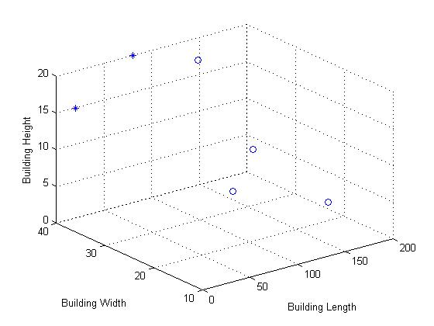
Topology with 2 APs and 4 STAs
Randomly place APs and STAs in any of the 80 rooms
Each room can only have one AP but multiple STAs
A STA associates with an AP based on minimum indoor path loss computations
AP1
Coverage issues
Hidden terminal problem
AP2
STA1
Example Scenario

Slide 6
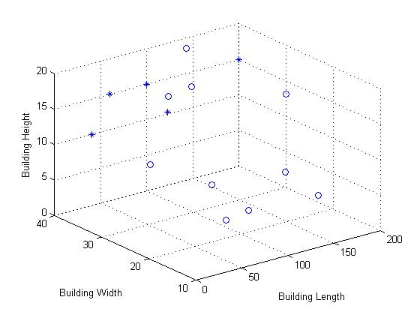
Topology with 5 APs and 10 STAs
Example Scenario
At least one STA connects to each AP
Example Scenario

Slide 7
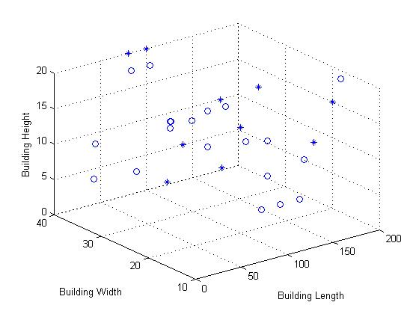
Topology with 10 APs and 20 STAs
Example Scenario
Example Scenario

Slide 8
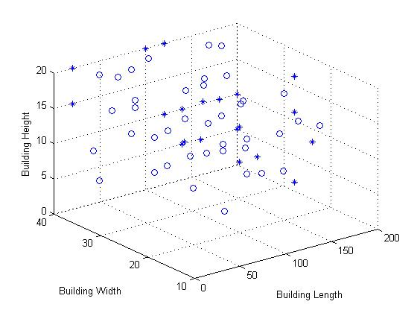
Topology with 20 APs and 40 STAs
Example Scenario

Slide 9
Simulation Parameters
Channel Bandwidth | 2MHz
Building Dimension (L*B*H) | 200*40*20 m³
Room Dimensions (L*B*H) | 20*20*5 m³
Floor Attenuation Factors | 0, 12.9, 18.7, 24.4
Data Rate | 2.3 Mbps
TX Power | 23dBm
Antenna Gains | 3dBi
Max Communication Range | -88dBm
Max Interference Range | -92dBm
Packet Size | 1500Bytes
DIFS | 256µs
SIFS | 160µs
Slot Time | 48µs
[CWmin, CWmax] | [15, 1023]
Simulation Time | 160s
Notes:
Mention that data rate basically means full buffer!! Add Snapshot time (results are quite unfair and this might change if the snapshot time is higher); I think packet size should be scaled as well to 150B.

Slide 10
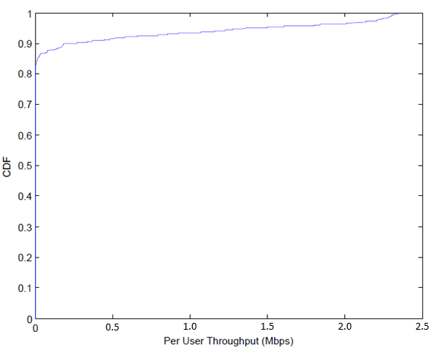
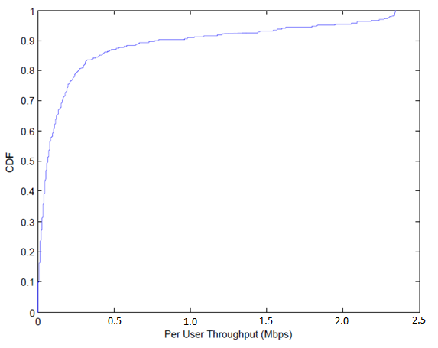
Uplink Throughput Performance (10 APs, 20 STAs)
No RTS-CTS
With RTS-CTS
Average Throughput = 81.5Kbps
Average Throughput = 140.37Kbps
Notes:
Unfairness between cells

Slide 11
Average UL Throughput with and without RTS-CTS
177% increased throughput
1 AP, 2 STAs
2 APs, 4 STAs
Throughput (kbps)
5 APs, 10 STAs
69% increased throughput
10 AP, 20 STA
20 APs, 40 STAs
With RTS-CTS
Without RTS-CTS

Slide 12
Coverage (10 Percentile Throughput) Performance with RTS-CTS
20 APs, 40 STAs
10 APs, 20 STAs
Throughput (kbps)
5 APs, 10 STAs
2 APs, 4 STAs
1 AP, 2 STAs
10% of the STAs have throughput below indicated value

Slide 13
Discussions
RTS and CTS significantly improves performance
Unfairness in user throughput distribution in the presence of relatively large number of networks

Slide 14
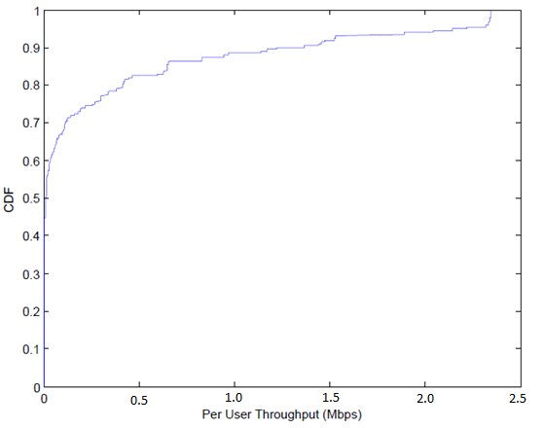
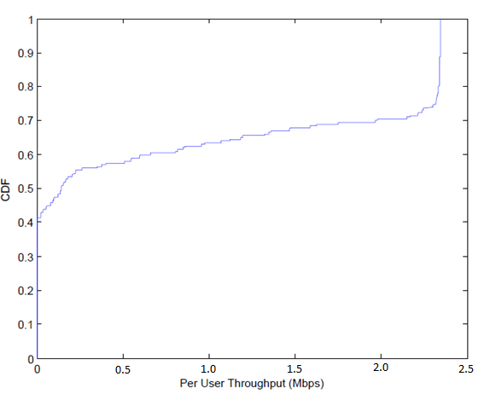
Appendix: Uplink Throughput Performance (1 AP, 2 STAs)
No RTS-CTS
With RTS-CTS
Average Throughput = 307.89Kbps
Average Throughput = 855.30Kbps
Notes:
Emphasize here that we start with a coverage limited scenario

Slide 15
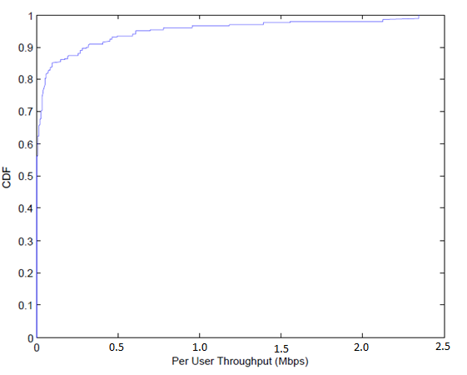
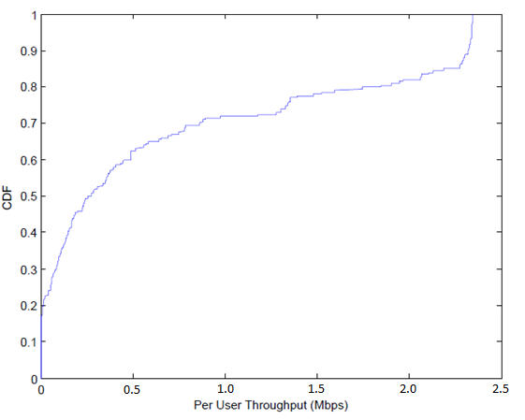
Appendix: Uplink Throughput Performance (2 APs, 4 STAs)
No RTS-CTS
With RTS-CTS
Average Throughput = 149.01Kbps
Average Throughput = 717.00Kbps
Chittabrata Ghosh, Nokia

Slide 16
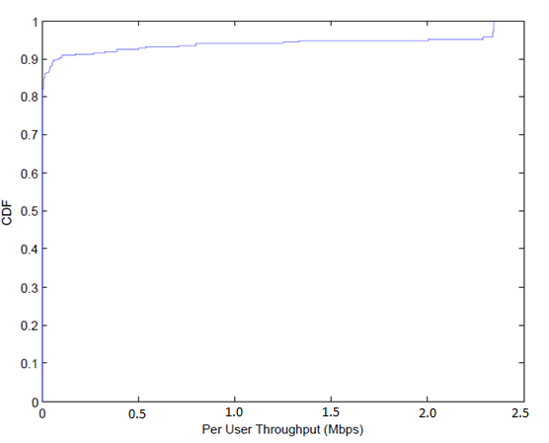
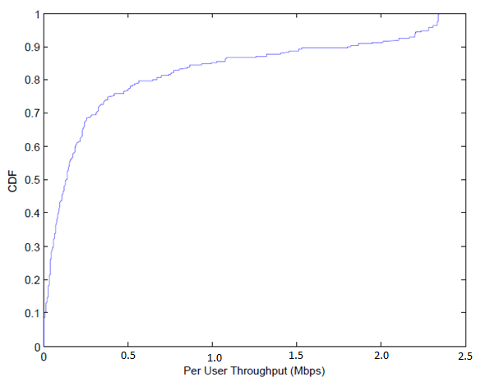
Appendix: Uplink Throughput Performance (5 APs, 10 STAs)
No RTS-CTS
With RTS-CTS
Average Throughput = 124.14Kbps
Average Throughput = 408.89Kbps

Slide 17
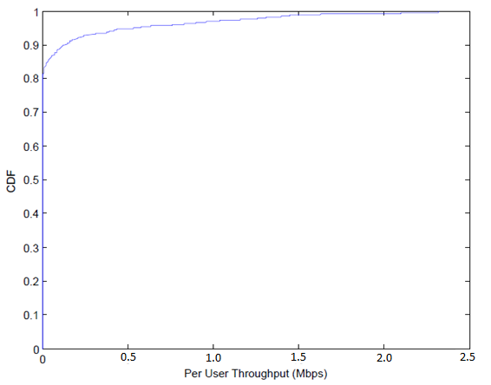
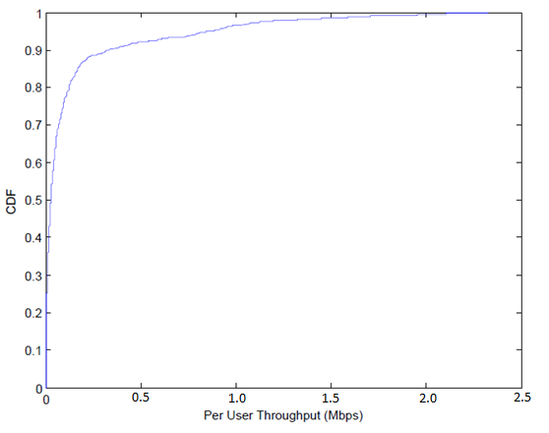
Appendix: Uplink Throughput Performance (20 APs, 40 STAs)
No RTS-CTS
With RTS-CTS
Average Throughput = 80.1Kbps
Average Throughput = 135.55Kbps

