Slide 1
DBand Encoding Examples
Date: 2012-01-17
Authors:

Slide 2
Motivation
To address CID 6002/6293
To illustrate the DBand PHY encoding steps so as to facilitate implementation.
To provide test vectors for design verification purposes.

Slide 3
Test Vectors
11-12/0077r0 describes DBand PHY encoding and modulation steps.
The description references test vectors provided as text files in a single ZIP file embedded in document 11-12/0078r0.
Depending on the node being illustrated, the text vector may represent bit data, symbol data or sample data;
  Time ordered sequence.
  Space separated.
  No carriage control characters.
  For bit data : 1 and 0 characters.
  For symbol data : signed integers.
  For sample data : complex values, formatted as ±<real>±<imag>j.
  Human and machine readable.
  Read using MATLAB dlmread('filename') command.

Slide 4
Coverage
Abbreviated Contents Page
L.5 DBAND EXAMPLE 1 - CPHY ENCODING
L.5.1 CPHY Preamble
L.5.2 CPHY Header
L.5.3 CPHY Payload
L.6 DBAND EXAMPLE 2 – SCPHY ENCODING
L.6.1 SCPHY Preamble
L.6.2 SCPHY Header
L.6.3 SCPHY Payload
L.6.3.1 SCPHY MCS1 Payload
L.6.3.2 SCPHY MCS5 Payload
L.6.3.3 SCPHY MCS7 Payload
L.6.3.4 SCPHY MCS12 Payload
L.7 DBAND EXAMPLE 3 – OFDMPHY ENCODING
L.7.1 OFDMPHY Preamble
L.7.2 OFDMPHY Header Coding
L.7.3 OFDMPHY Header Modulation
L.7.4 OFDMPHY Payload Coding
L.7.5 OFDMPHY MCS14 Payload Modulation
L.7.6 OFDMPHY MCS17 Payload Modulation
L.7.7 OFDMPHY MCS19 Payload Modulation
L.7.8 OFDMPHY MCS23 Payload Modulation
L.8 DBAND EXAMPLE 4 – LPSCPHY ENCODING
L.8.1 LPSCPHY Preamble
L.8.2 LPSCPHY Header
L.8.2.1 Header Bits
L.8.3 LPSCPHY MCS26 Payload
L.8.4 LPSCPHY MCS30 Payload

Slide 5
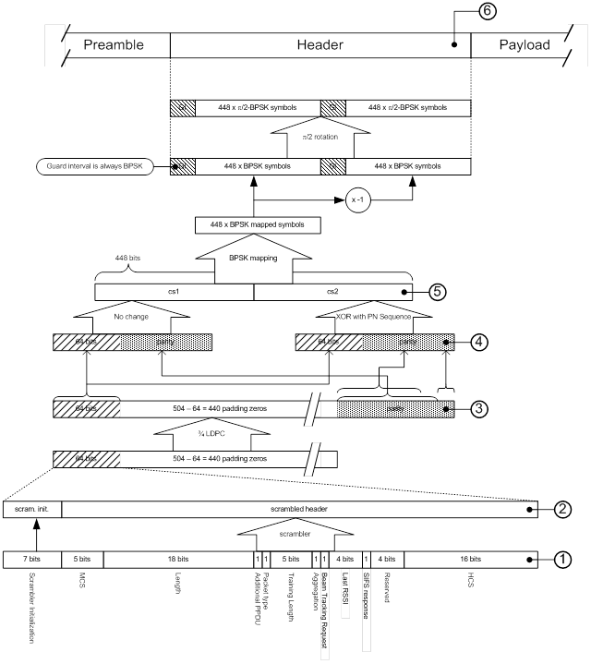
Organization
Each section starts with an informative illustration of the relevant part of the encoding process
  Not normative
  Intended to aid understanding
  Annotated with node numbers
Each node links to a brief textual description and reference to the relevant test vector.
e.g. SCPHY Header Coding and Modulation

