Slide 1
Service Discovery Protocol Options
Date: 2012-01-17
Authors:

Slide 2
Abstract
Non-exhaustive list of defined Service Discovery Protocols (SDP)

Slide 3
14 Service Discovery Protocol (SDP) choices
There are many service discovery protocols, including:
DNS Service Discovery (DNS-SD), part of Apple's Bonjour technology
Service Location Protocol (SLP)
Simple Service Discovery Protocol (SSDP) as used in Universal Plug and Play (UPnP)
Universal Description Discovery and Integration (UDDI) for web services
Jini for Java objects.
Bluetooth Service Discovery Protocol (SDP)
Salutation
XMPP Service Discovery (XEP-0030)
WS-Discovery (Web Services Dynamic Discovery)
multicast DHCP (MDHCP)
Internet Storage Name Service (iSNS)
Web Proxy Autodiscovery Protocol (WPAD)
Dynamic Host Configuration Protocol (DHCP)
XRDS (eXtensible Resource Descriptor Sequence) used by XRI, OpenID, OAuth, etc.

Slide 4
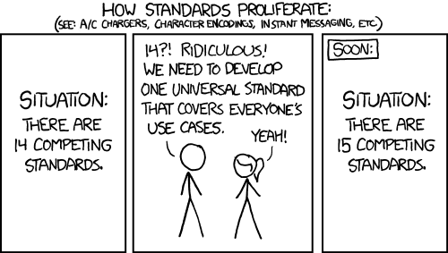
http://imgs.xkcd.com/comics/standards.png

