Slide 1
Sequence detection for parallel ACK
Date: 2012-01-xx
Authors:

Slide 2
Abstract
Contention-Free Probe & Pull MAC to support large network [1]
Framework for physical parallel ACK [2]
  Combination of code- and time-domain multiplexing
  Use of Zadoff-Chu (ZC) sequence
  Time slot structure
Provide simulation results with possible impairments

Slide 3

Parallel ACK Mechanism [1]
Partition STAs into groups
STAs with data to send transmit ACKs concurrently (in time-aligned manner)
AP resolves parallel ACKs
SIFS
SIFS
SIFS
SIFS
AP
PROBE
PULL
ACK
has data to send
STA 1
P-ACK
has data to send
STA 2
P-ACK
Data
$$⋮$$
has data to send
STA K
P-ACK

Slide 4
Sequences to Resolve Parallel ACKs
Propose combination of code- and time-domain
Use Zadoff-Chu (ZC) sequence to separate STAs in code-domain
Ordinary OFDM transmission
Time-domain
Code-domain
Sequence 1 (STA 1)
Sequence 2 (STA 2)
Sequence 3 (STA 3)
Sequence 4 (STA 4)
Sequence 1 (STA 5)
Sequence 2 (STA 6)
Sequence 3 (STA 7)
Sequence 4 (STA 8)
Sequence 1 (STA 9)
Sequence 2 (STA 10)
Sequence 3 (STA 11)
Sequence 4 (STA 12)
Sequence ID & time slot instance to identify STA ID
Time slot 1
Time slot 2
Time slot 3
Parallel ACK Frame

Slide 5
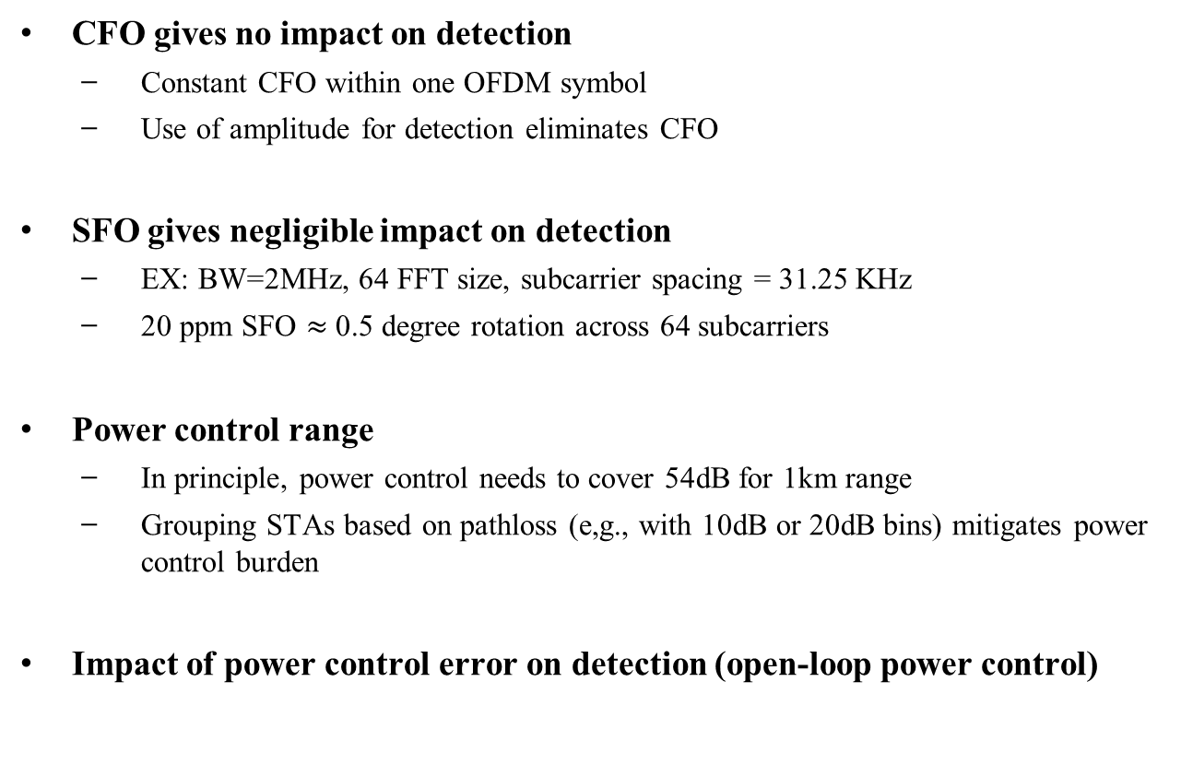
CFO, SFO, & Power Control Error
CFO gives no impact on detection
  Constant CFO within one OFDM symbol
  Use of amplitude for detection eliminates CFO
SFO gives negligible impact on detection
  EX: BW=2MHz, 64 FFT size, subcarrier spacing = 31.25 KHz
  20 ppm SFO $≈$ 0.5 degree rotation across 64 subcarriers
Power control range
  In principle, power control needs to cover 54dB for 1km range
  Grouping STAs based on pathloss (e,g., with 10dB or 20dB bins) mitigates power control burden
Impact of power control error on detection (open-loop power control)

Slide 6
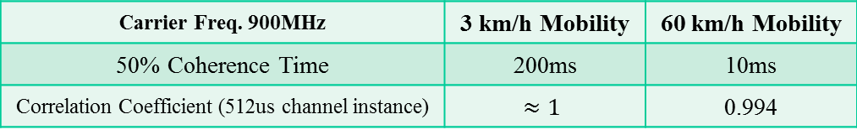
Synchronization with AP
Parallel ACK Frame (352us)
SIFS (160us)
AP
PROBE Message (840us)
Time slot 1 | Time slot 2 | … | Time slot 8
21 OFDM symbols,
PLCP: 10 symbols, PSDU: 11 symbols
One OFDM symbol per time slot,
one time slot (44us)
PROBE allows STAs to accurately estimate the pathloss at downlink
Channels between PROBE and Parallel ACK are almost static
TX power field and target RX power field in PROBE message
STA has enough knowledge to control the power
Carrier Freq. 900MHz | 3 km/h Mobility | 60 km/h Mobility
50% Coherence Time | 200ms | 10ms
Correlation Coefficient (512us channel instance) | $$≈1$$ | 0.994

Slide 7
Simulation Setup
Channel Bandwidth, Carrier Frequency |  |  |  |  | 2MHz, 900MHz
Channel Model |  |  |  |  | SCM Urban Micro [3]
Number of Subcarriers/FFT Size, FFT Period |  |  |  |  | 56/64, 32us
OFDM Symbol Duration |  |  |  |  | 40us (8us + 32us)
Guard Interval |  |  |  |  | 4us (>2us)
Number of STAs in a Group |  |  |  |  | 32
Max Number of STAs per Time Slot |  |  |  |  | 4
Number of OFDM Symbols per Time Slot |  |  |  |  | 1
Parallel ACK Frame Duration |  |  |  |  | 352us (= 44us* 8)
False Alarm Rate |  |  |  |  | 1%
Slot 1 | Slot2 | Slot 3 | … | Slot 8 | Sequence length | Root Index | Amount of Cyclic Shifts
STA 1 STA 2 STA 3 STA 4 | STA 5 STA 6 STA 7 STA 8 | STA 9 STA 10 STA 11 STA 12 | … | STA 29 STA 30 STA 31 STA 32 | Nzc=53 | q=3 | 0 13 26 39
Carrier Frequency Offset (CFO) |  |  |  |  | 10 ppm
Sampling Frequency Offset (SFO) |  |  |  |  | 20 ppm
Power Control Error |  |  |  |  | 5, 10 dB

Slide 8
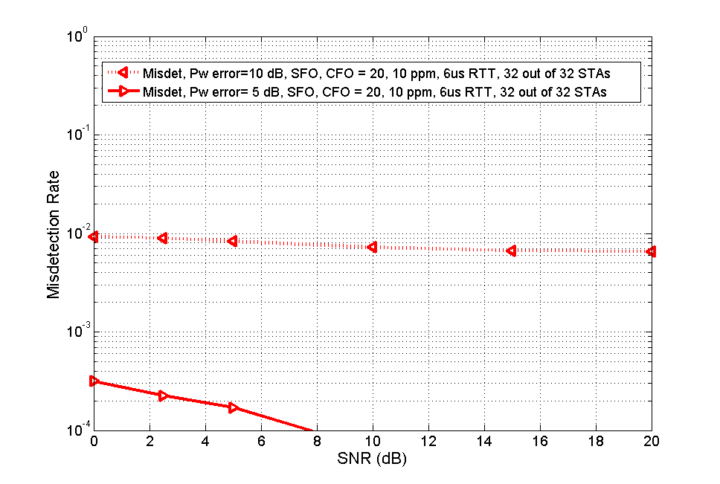
32 STAs / 32 STAs

Slide 9
Conclusions
Simulation results demonstrate robust detection capability with impairments for Parallel ACK

Slide 10
References
[1] 11-11-1512-00-00ahr4-mac-consideration-for-802.11ah
[2] 11-11-1564-01-00ahr4-sequency-design-for-parallel-ack
[3] J. Salo et al., “3GPP Spatial Channel Model,” [Online] Available: http://www.tkk.fi/Units/Radio/scm/

