Slide 1
Power Saving Possibilities for Networks Supporting a Large number of STAs
Date: 2012-01-09
Authors:

Slide 2
Abstract
We consider energy efficiency based on grouping and
sleeping modes for the DCF operation in 802.11ah

Slide 3
Motivation
Use case 1a Smart Grid - Meter to Pole (6000 STAs per AP) [1]
Traffic can be continuous/periodic/bursty
Sensors measure power/gas/water
DCF performance deteriorates when a large number of STAs contend for medium [2]
Overall number of MAC retries and total transmission delay grow exponentially with the number of STAs
Grouping based on contention factor was proposed in [3]
AP sends in Beacon contention factor Q in [0,1] and time interval T

Slide 4
Motivation
Before it contends for the channel a STA randomly and uniformly in (0,1) selects number r
If r$≤$ Q, then STA can contend
If r > Q, then STA does not contend until T elapses
STAs can be classified into groups with different priorities with different pairs of ($Q_{n}, T_{n}$) for group n

Slide 5
Sleep modes when inactive
Existing standard allows a STA to sleep when its buffer is empty
When a large number of STAs contend for the medium
A large proportion stays idle waiting for medium access
Buffers may be non-empty
Can we enable additional sleep modes to save energy under non-empty buffers?

Slide 6
Our proposal
Why can’t a STA go to sleep when
It does not contend during the duration T
When it is not transmitting
STAs select r randomly and uniformly in (0,1)
If r > Q, then STA does not contend and sleeps for time T
If r $≤$ Q, then the STA can contend
Wakes up randomly to contend/transmit and goes back to sleep
Within a group ($Q_{n}, T_{n}$) a STA can go to sleep if${ r}_{n}>Q_{n}$ for time $T_{n}$
This can reduce significantly the energy spent for overhearing

Slide 7
Simulations
100 STAs associated with an AP
STAs are uniformly distributed within a 1km radius
Traffic model
1 packet/s
Packets consist of 256 bytes
Slot = 37 microseconds
SIFS = 126 microseconds
Contention window takes values in [15 - 1023]

Slide 8
Simulation Scenarios
1 group or 3 groups (randomly created)
Scenarios
Three groups (1.0/0.0/0.0) no sleep simultaneous start
Only STAs in a single group can contend
DCF is used for the STAs that pass the “contention test”
If they have traffic, contend simultaneously
STAs that fail the test go to sleep
Group schedules alternate with time (short beacons can be used)
Three groups (1.0/0.0/0.0) sleep randomized start
DCF with randomization
Uniform in Beacon interval
STAs listen Beacons, sleep, wake up to transmit and sleep
1 group (1.0) no sleep simultaneous start (DCF like operation)
1 group (1.0) sleep randomized start (DCF with sleep option)

Slide 9
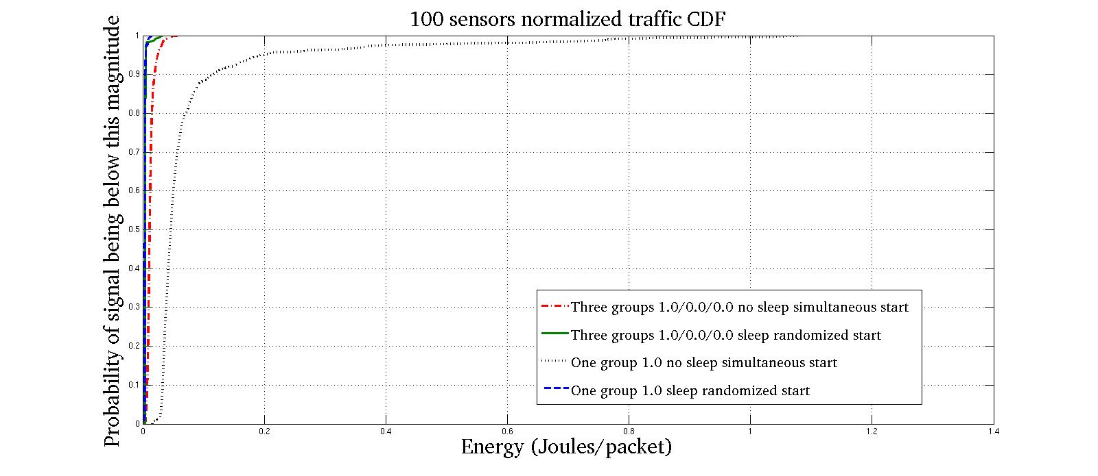
Energy CDF for Different Methods
DCF has the worst performance
Grouping reduces the energy consumption

Slide 10
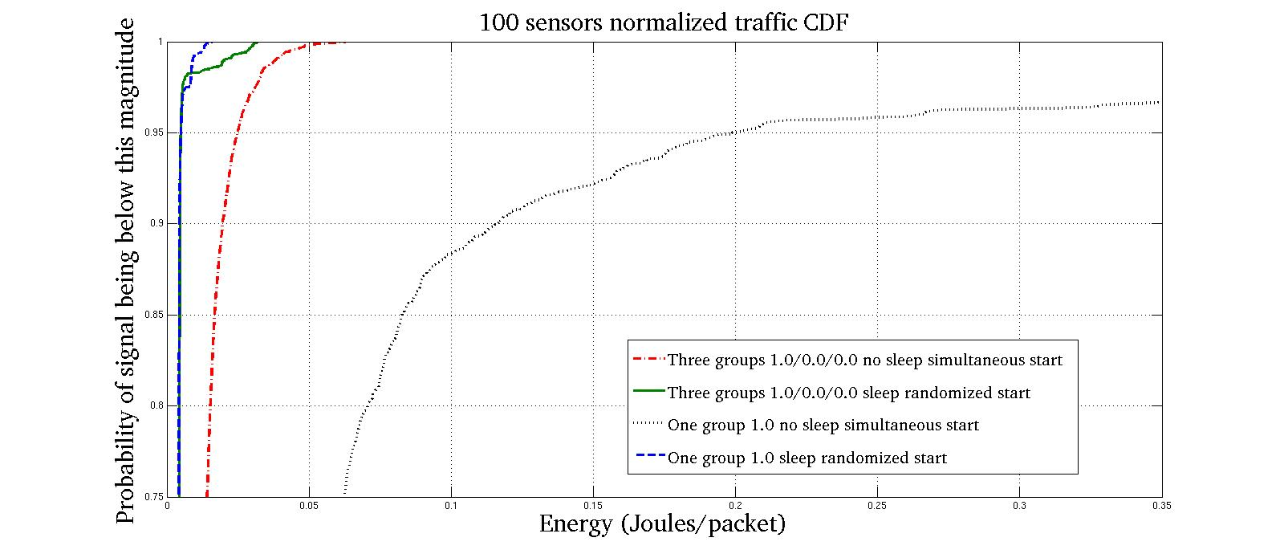
Energy CDF for Different Methods
Previous figure zoomed
DCF has the worst performance
Grouping reduces the energy consumption

Slide 11
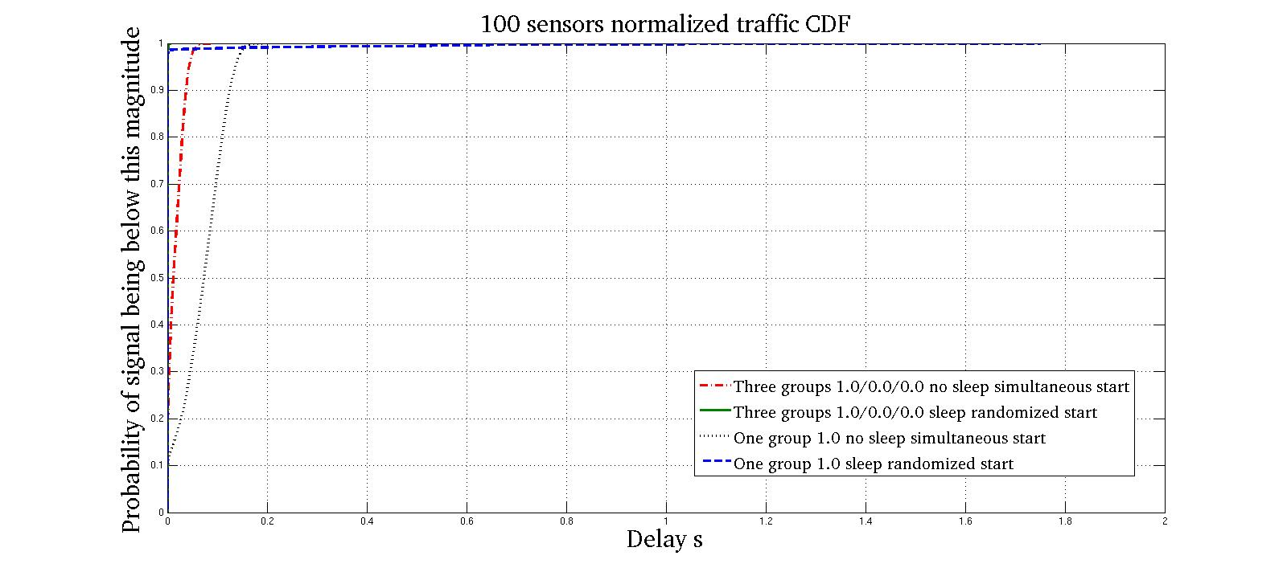
Delay CDF for Different Methods
Pure DCF has the worst performance
Grouping improves delay

Slide 12
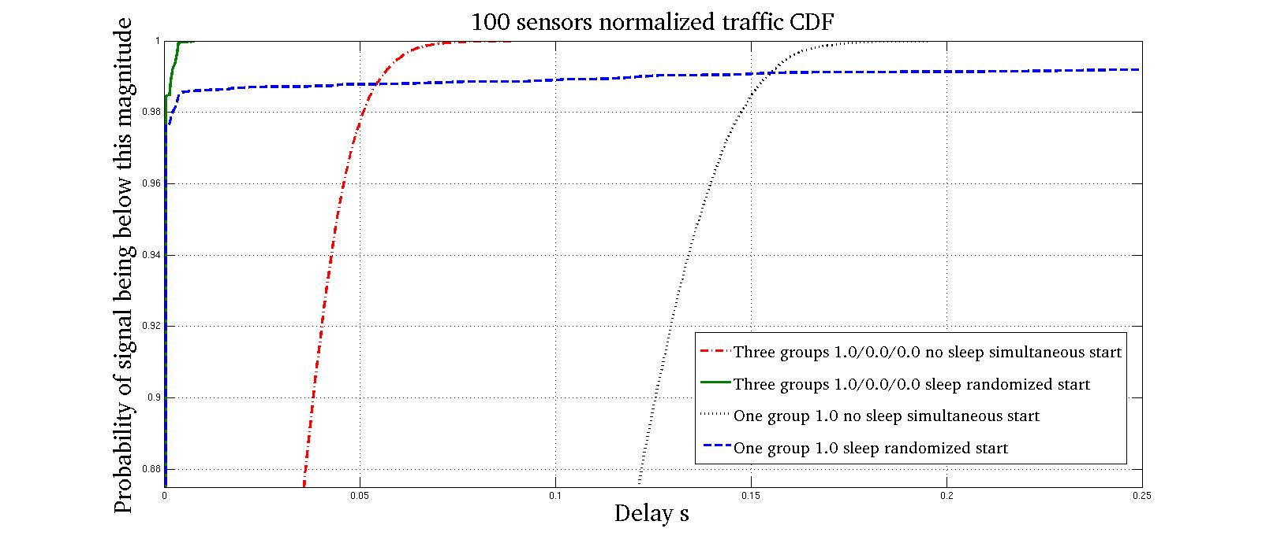
Delay CDF for Different Methods
Previous figure zoomed
Pure DCF has the worst performance
Grouping improves delay

Slide 13
Conclusions
Energy is one of the most important resource in sensor applications
Grouping with the additional sleeping capability improves both energy and delay under DCF operation

Slide 14
References
[1] 11-11-0457-00-00ah-potential-compromise-of-802-11ah-use-case-document
[2] 11-11-1019-01-00ah-simulation-large-number-of-stas-support
[3] 11-11-1255-00-00ah-dcf-enhancements-for-large-number-of-stas

