Slide 1
IP configuration for fast initial link setup
Date: 2011-01-12
Authors:
Name | Affiliations | Address | Phone | email
Jae-Hyung Song | LG Electronics | LG R&D Complex 533, Hogye-1dong, Dongan-Gu, Anyang, Kyungki, 431-749, Korea | +82-10-5778-0915 | Jaehyung.song@lge.com
Jihyun Lee | LG Electronics | LG R&D Complex 533, Hogye-1dong, Dongan-Gu, Anyang, Kyungki, 431-749, Korea | +82-31-450-1860 | Jihyun1220.lee@lge.com
Yongho Seok | LG Electronics | LG R&D Complex 533, Hogye-1dong, Dongan-Gu, Anyang, Kyungki, 431-749, Korea | +82-31-450-1947 | Yongho.seok@lge.com

Slide 2
Abstract
This presentation contains a proposal to allow 802.11 STAs to reduce initial link set up time through an enhanced IP configuration procedure.
Addition of subnet prefix information element into Beacon or Probe Response frame is proposed in this presentation.

Slide 3
Motivation
DHCP IP configuration requires 4-way handshaking procedure for the initial setup, the procedure that takes a considerable amount of time.
A STA has to perform the entire IP configuration process, when it attempts to create a connection with an AP.
If the STA knows the subnet, to which the AP belongs, ahead of the association, the process of IP configuration can be simplified.
If the subnet has not been changed, the STA may reuse the old IP configuration, if and only if that specific IP configuration is not assigned to another STA in the subnet.

Slide 4
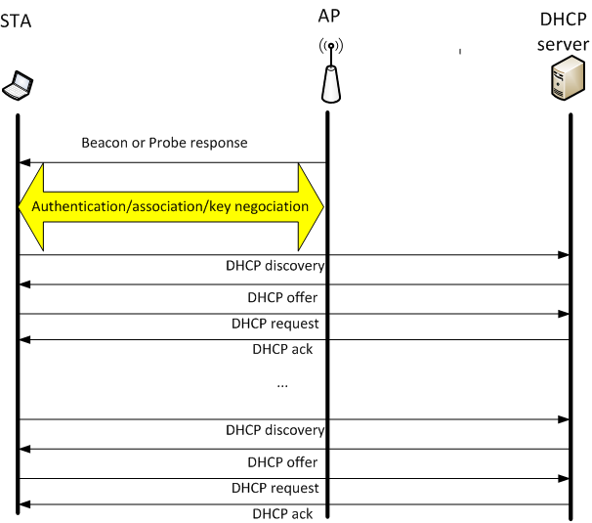
Previous method (1)
Single BSS

Slide 5
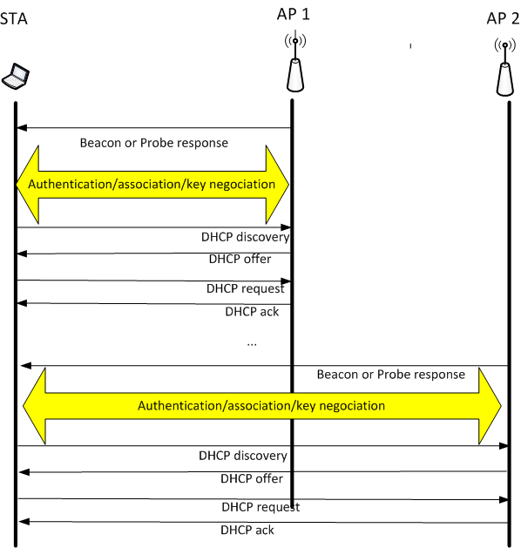
Previous method (2)
Multiple BSS

Slide 6
Proposal
Add subnet prefix IE in Beacon or Probe Response frames
  So that a STA can figure out whether a newly discovered AP belongs to the subnet, with which the STA has the a priori knowledge.
  If the AP belongs to the subnet, with which the STA has the a priori knowledge, the STA assumes that it is allowed to use the IP address that it used before, when it tries to associate with the AP.
  If the assumption of the STA verifies, the STA and AP can omit the DHCP Discovery and DHCP offer steps in the DHCP IP configuration.
  If there are multiple newly discovered APs, the STA can take the subnet information into account, in choosing the AP of interest.

Slide 7
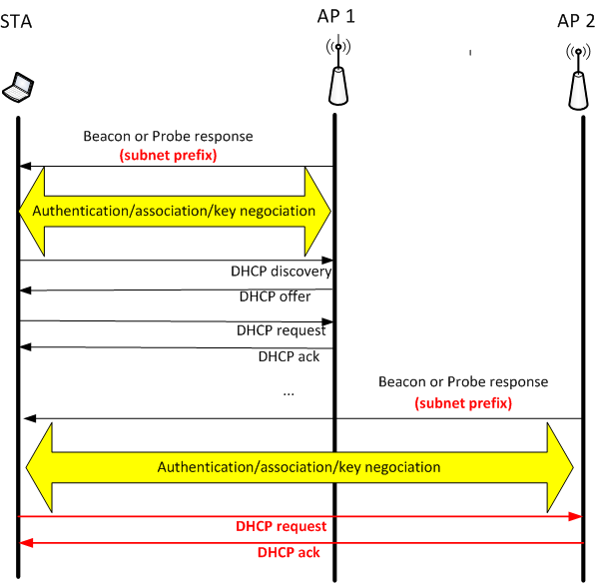
Proposed method
Proposed method
  Multiple BSS

Slide 8
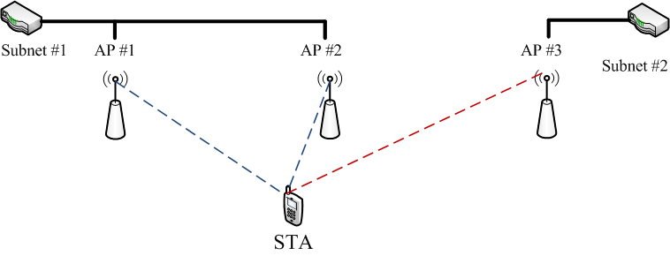
Proposed method – usage scenario
AP selection
  While scanning, the STA may find several candidate APs with different subnet prefix. The STA is likely to choose the one in the same subnet in which its old AP resides. By doing so, the STA may not perform DHCP discovery- DHCP offer process.

Slide 9
Frame format
Beacon frame format
  Insert the following row in Table 8-19:
Probe Response frame format
  Insert the following row in Table 8-27:
Order | Information | Notes
 | Subnet Prefix | The Subnet Prefix element may be present if dot11FILSActivated is true.
Order | Information | Notes
 | Subnet Prefix | The Subnet Prefix element may be present if dot11FILSActivated is true.

Slide 10
Frame format
Subnet Prefix IE format
  Subnet Prefix field indicates network address
  Subnet Prefix field format depends on the IP configuration method
    An example of IPv4 address: 233.1.8.x/24
 | Element ID | Length | Subnet Prefix
Octets: | 1 | 1 | Variable

