Slide 1
Smart Grid SC– November 2011
Name | Company | Address | Phone | email
Bruce Kraemer | Marvell | 5488 Marvell Lane, Santa Clara, CA, 95054 | +1-321-751-3988 | bkraemer@marvell.com
Date: 08 November 2011
Discussion topics during November Atlanta Session
Tuesday Abstract:
1 – NIST PAP2
2 – November Tutorial

Slide 2
Atlanta Agenda
High level
PAP02 GOALS, Work plan, Schedule,
Discussion of details as appropriate
Catalog of Standards
Modeling Tool
PAP02 Intro
Cyber Security
Publications and References
NIST Framework document – comment period open

Slide 3
NIST SGIP
PAP02 Update

Slide 4
802 Goals in the PAP02 Context
Recognition of IEEE 802 wireless standards in NIST Catalog of Standards
Acceptance of wireless standards as viable in Smart Grid deployments

Slide 5
Atlanta Meeting Goals
Information about NIST SGIP PAP02 status and plans
Discussion of best method for developing or reviewing key deliverables

Slide 6
Summary of NIST PAP02 Activities
November 2011
Date: 2011-11-08
Authors:
Slide 6
Farrokh Khatibi, Qualcomm Incorporated
Notes:
doc.: IEEE 802.11-11/1507r1
November 2011
Stephen McCann, RIM
Page 6

Slide 7
Status
November 2011
Published:
  NISTIR 7761: NIST Priority Action Plan 2
    Guidelines for Assessing Wireless Standards for Smart Grid Applications
  Wireless Capability Matrix
  Application Communication Requirements Matrix
New Work: Update of the Guidelines
Slide 7
Farrokh Khatibi, Qualcomm Incorporated

Slide 8
Table of Contents
November 2011
PREFACE
1 OVERVIEW OF THE PROCESS
2 ACRONYMS AND DEFINITIONS
3 SMART GRID CONCEPTUAL MODEL AND BUSINESS FUNCTIONAL REQUIREMENTS
4 WIRELESS TECHNOLOGY
5 MODELING AND EVALUATION APPROACH
6 FACTORS TO CONSIDER IN DETERMINING PERFORMANCE
7 CONCLUSIONS
8 REFERENCES
9 BIBLIOGRAPHY
ANNEX A IEEE 802.11
ANNEX B 3GPP LONG TERM EVOLUTION (LTE)
ANNEX C 3GPP HIGH SPEED PACKET ACCESS (HSPA)
ANNEX D CDMA2000 1X AND HIGH RATE PACKET DATA (HRPD)
ANNEX E IEEE 802.16/WIMAX NETWORK
Slide 8
Farrokh Khatibi, Qualcomm Incorporated

Slide 9
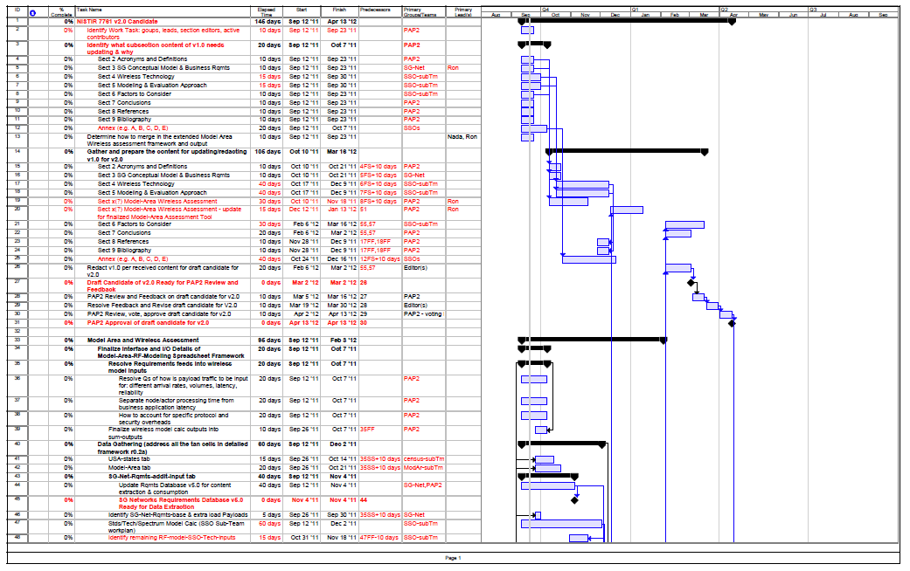
November 2011
Slide 9
Farrokh Khatibi, Qualcomm Incorporated

Slide 10
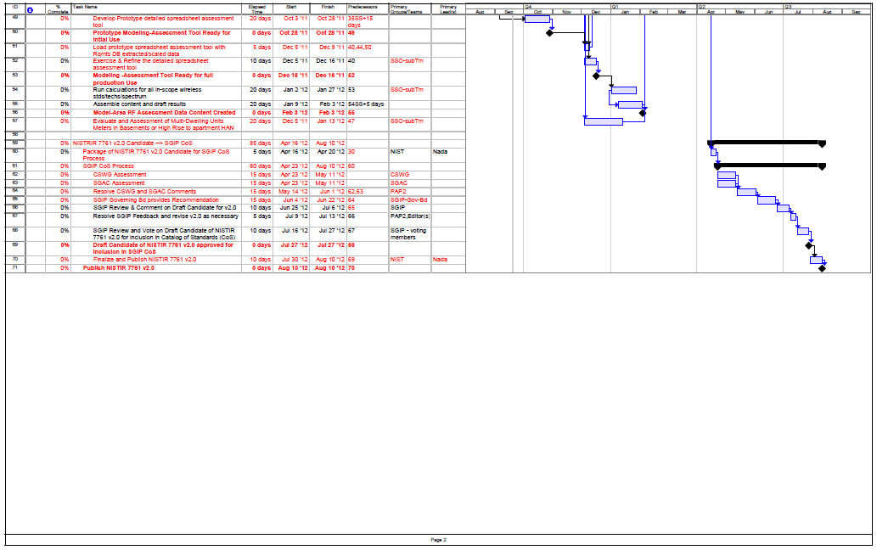
November 2011
Slide 10
Farrokh Khatibi, Qualcomm Incorporated

Slide 11
What needs to be done:
November 2011
Chapter 4:
Chapter 5:
Update:
Chapter 6:
Slide 11
Farrokh Khatibi, Qualcomm Incorporated

Slide 12
Major 802 Engagement Opportunities in SGIP
Participate in the PAP02 activity to develop Wireless Guideline 2.0
Prepare and Submit application paperwork for 802 standards to NIST for inclusion in the Catalog of Standards

Slide 13
Guideline Version 1
Attribute | Standard Information
Identifier of the standard | NIST IR 7761
Title of the standard | Guidelines for Assessing Wireless Standards for Smart Grid Applications
Name of owner organization | NIST
Latest versions, stages, dates | 1
URL(s) for the standard | http://collaborate.nist.gov/twiki-sggrid/pub/SmartGrid/PAP02Objective3/NIST_PAP2_Guidelines_for_Assessing_Wireless_Standards_for_Smart_Grid_Applications_1.0.pdf
http://collaborate.nist.gov/twiki-sggrid/bin/view/SmartGrid/SGIPCosSIFNISTIR7761

Slide 14
Guideline Sections
Sect 2 Acronyms and Definitions
Sect 3 SG Conceptual Model & Business Requirements
Sect 4 Wireless Technology
Sect 5 Modeling & Evaluation Approach
Sect 6 Factors to Consider
Sect 7 Conclusions
Sect 8 References
Sect 9 Bibliography
Annex (e.g. A, B, C, D, E)

Slide 15
Guideline 1 to 2 Differences
Provide a significantly better method for analyzing/comparing the performance of a wireless technology in a representative physical environment with a specified data load scenario
  Utilize realistic data loading (developed by OpenSG)
  Significantly extend the technology modeling (SDO sub com)
  Correct definitions contained in Section 4

Slide 16
PAP02 Guideline - Schedule Overview
Wireless Guideline 1 published – Jan 13, 2011
Finalize wireless model – Oct 7, 2011
Revise Sections 2,3,4,5,6,7,8,9,Annex - March 16, 2012
Collect all details on modeling scenarios – Nov 4, 2011
Exercise, refine, output model results – Feb 3, 2012
PAP02 vote on Guideline 2
Submit Guideline 2 to CoS process – April 16, 2012
Wireless Guideline 2 published – Aug 10, 2012

Slide 17
PAP02- Phase 2-SDO Sub Committee Charter
Intro
Thanks to Ron Cunningham for his diligent preparation of requirements for completion of Phase 2.
We propose that it is time for the wireless SDO’s to take a more active role in constructing the analytic
Proposal/Request
We request authorization from PAP2 members to form an “SDO subcommittee” committed to completing delivery of an operational analysis framework , and related descriptive text, in time for presentation to the Dec 05, 2011 SGIP board meeting.
Goals
Example of deliverables include: Definition of propagation model, ability to calculate quantity of wireless equipment required to cover a given demographic/topographic area and description of statistical confidence in reported numbers
Utility/GRID Input Requirements
Information regarding actor quantities by type, relative locations, topography, data traffic loads
Synchronization
“SDO subcommittee” will report progress to during currently scheduled biweekly PAP2 calls
Logistics
“SDO subcommittee” will convene a series of teleconferences scheduled to optimize SDO participation but open to all PAP2. SDO subcommittee will self organize , assign/delegate work. develop a milestone based project schedule. Webinar facilities will be available.
Membership
“SDO subcommittee” is a volunteer group initially underwritten by ATIS, IEEE, TIA, and WiMAX. Additional wireless SDO participants will be recruited

Slide 18
SDOs Subcommittee Update
We are considering a parallel approach:
  Completion of Guideline v2, and
  Submission of the CoS paperwork by the individual SDOs
Discussed Ron’s proposed Workplan and made appropriate changes. Notes:
  The timeline is based on the existing scope of the Subcommittee (see slide entitled “Model Acceptance questions” from last time)
  Ron will add a line item to capture additional work that may be required for “multi-unit dwellings”
Discussed updates to section 5:
  For the indoor path loss model, we will analyze and compare various models, but we will not recommend a specific one
  Whether we will recommend a specific outdoor path loss model is for further study.

Slide 19
PAP02 Activities
•Purpose: Biweekly meeting to discuss PAP 2 work items
•Webinar Info: https://www2.gotomeeting.com/register/798765194
August 16 - Teleconference 2:00pm ET
Tuesdays Aug 30, Sep 13, 27 - Teleconference 2:00pm ET
SDO Sub-group
•Purpose: Sub-group open to anyone with technical knowledge interested in contributing to clarifying SDO terms and generating estimates for covered equipment
•When: Occurs every Monday effective 8/8/2011 from 9:00 AM to 10:30 AM (UTC-08:00) Pacific Time (US & Canada).
•Conference Bridge Information Phone: +1-858-658-1111 Conference ID: 3827472 Passcode: 0681

Slide 20
SDO Activities
Complete all work by November
Verify completion criteria
  Deviation from standard procedure assumed – verifying
Complete propagation model
  One approach for all technologies?

