Slide 1
Flexibility on Channel Access Allocations
Date: 2011-11-08
Authors:
Name | Affiliation | Address | Phone | email
Antonio de la Oliva | University Carlos III of Madrid | Avnda. De la Universidad 30, Leganes, Madrid | +34916248803 | aoliva@it.uc3m.es
Ilenia Tinnirello | Consorzio Nazionale Interuniversitario per le Telecomunicazioni |  |  | ilenia.tinnirello@tti.unipa.it
Pablo Serrano | University Carlos III of Madrid |  |  | pablo@it.uc3m.es
Francesco Gringoli | Consorzio Nazionale Interuniversitario per le Telecomunicazioni |  |  | francesco.gringoli@ing.unibs.it

Slide 2
Objective
Currently TXOP defines the time the STA can keep hold of the channel to transmit its own frames.
We propose to extend this concept allowing for a bidirectional frame exchange.

Slide 3
Use of DATA+ACK
The winner of the contention has the right to transmit a data packet to a given destination node and to receive a data packet (without contention) from it.
The reply data packet avoids the contention by using a SIFS interval from the end of the previous data transmission
The reply data packet can carry a layer-2 ACK in piggybacking
Std DCF
DATA A->B
ACK
DATA B->A
ACK
OTHER
…
SIFS
DIFS
SIFS
DIFS
DIFS
No L2 ACK for this frame
Bi-directional DCF
DATA A->B
DATA B->A
OTHER
DATA B->A
DATA A->B
…
SIFS
DIFS
DIFS
SIFS
Implicit L2 ACK for previous data frame
Implicit L2 ACK for previous data frame

Slide 4
Motivation
There are some applications that are intrinsically bi-directional
  Delay on the response of the application may lead to extra delays due to the application own behavior
    the medium is already "reserved”
  Short frames (otherwise, idle times, see next)
  Examples
    TCP ACK’s
    Voice Frames

Slide 5
Performance Gain
Overhead reduction:
  Better use of the channel since no air time is lost in ACKs
Performance gains:
  TCP: Around 20%
  VoIP (Preliminary results): Almost duplicating the number of simultaneous calls

Slide 6
Applications
Two applications have already been implemented and tested
  Improve TCP performance by piggybacking TCP ACKs
  Improve voice traffic support

Slide 7
Transmitting TCP ACK in Piggybacking

Slide 8

Transmitting TCP ACK in Piggybacking
TX
RX
egress queue
egress queue
Check:
TCP ACK in queue
Check:
NO TCP ACK
Send L2 ACK

Slide 9
Performance Evaluation
Testbed & measurement
  Two peers, several other BSS
  One peer is the Access Point
while(1) {
  For 60 sec: exchange traffic with no PIGGYBACK
  Measure throughput T1 at rx
  For 60 sec: exchange traffic with PIGGYBACK
  Measure throughput T2 at rx
  Plot(T1, T2)
}

Slide 10
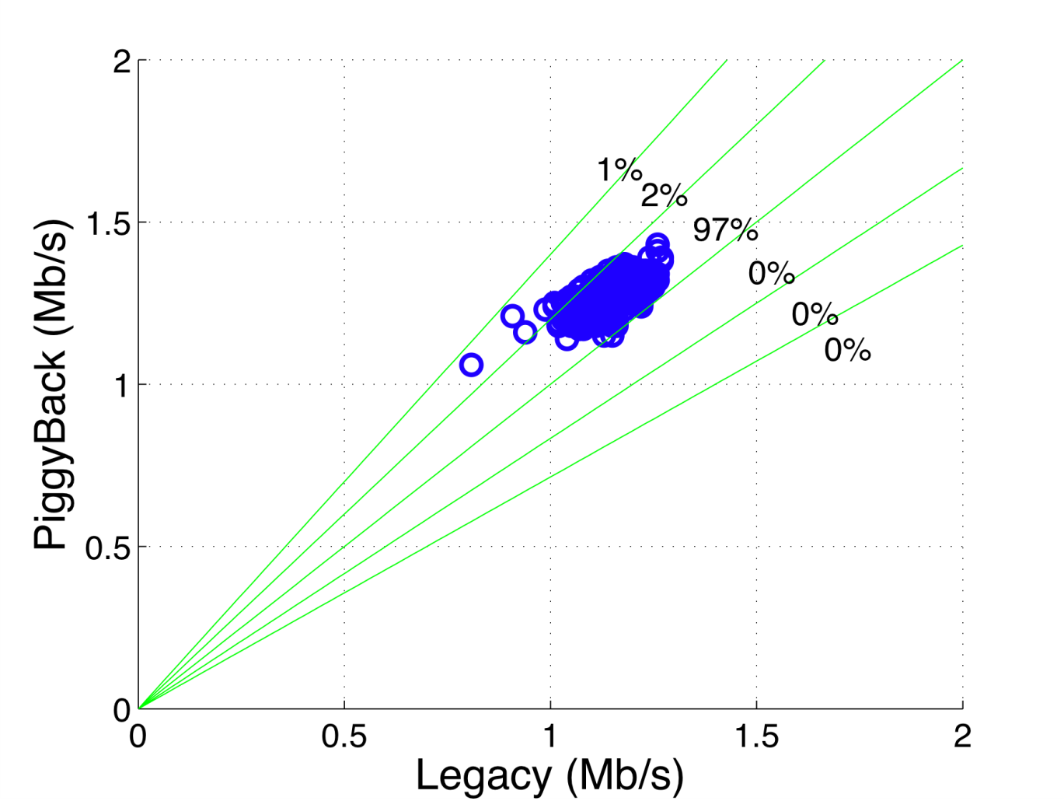
Performance evaluation
(Data rate fixed to 2Mbps)

Slide 11
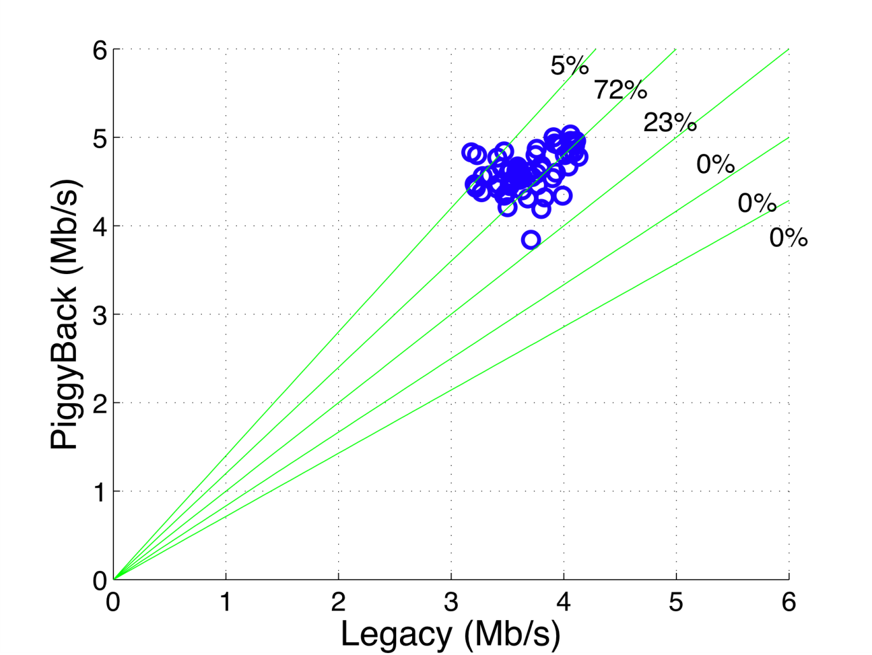
Performance Evaluation
(Data rate fixed to 11Mbps)

Slide 12
Implementation Requirements
Firmware-level @ rx
  Piggyback: only if a TCP DATA is received
    Avoid Ping-Pong
  Piggyback: only if a TCP ACK is in queue
    If not, send L2 ACK
  Piggyback: header is L2ACK, longer!
Kernel-level @ tx
  If DATA+ACK frame type (=>TCP ACK) received
    Forge and inject a recovered TCP ACK in the stack

Slide 13
Transmitting VoIP frames in Piggybacking

Slide 14
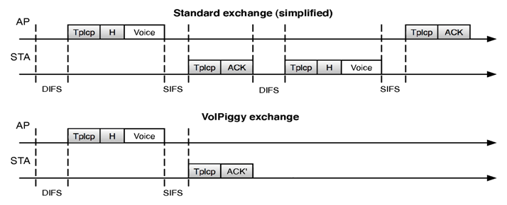
Transmitting VoIP frames in Piggybacking
Piggyback voice frames over MAC ACKs
  From STA to AP
Reduce MAC overhead
Decrease the contending traffic

Slide 15
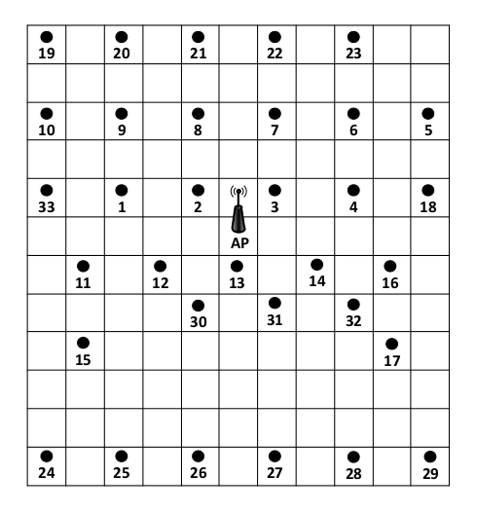
Testbed
33 nodes:
  PC-Engines Alix2d2
  CF card: kernel 2.6.29
Broadcom BCM4318 card
B43 driver
OpenFWWF firmware
2-dBi omnidirectional
antenna
7.2 m
6.6 m
Notes:
The deployment is set up under a raised floor, which protects devices from physical harm and provides radio shielding

Slide 16
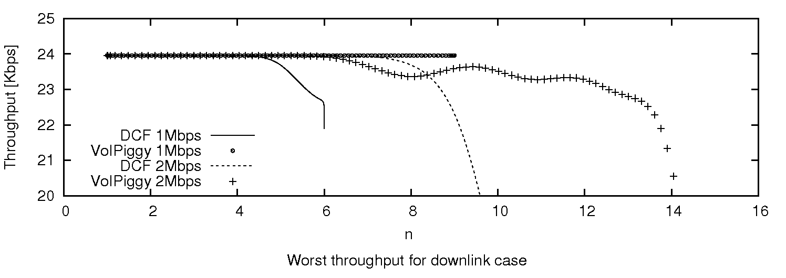
Voice-only: Throughput
MCS [Mbps] | 1 | 2
 | 6 | 10
 | 8 | 14
 | 8 | 13

Slide 17
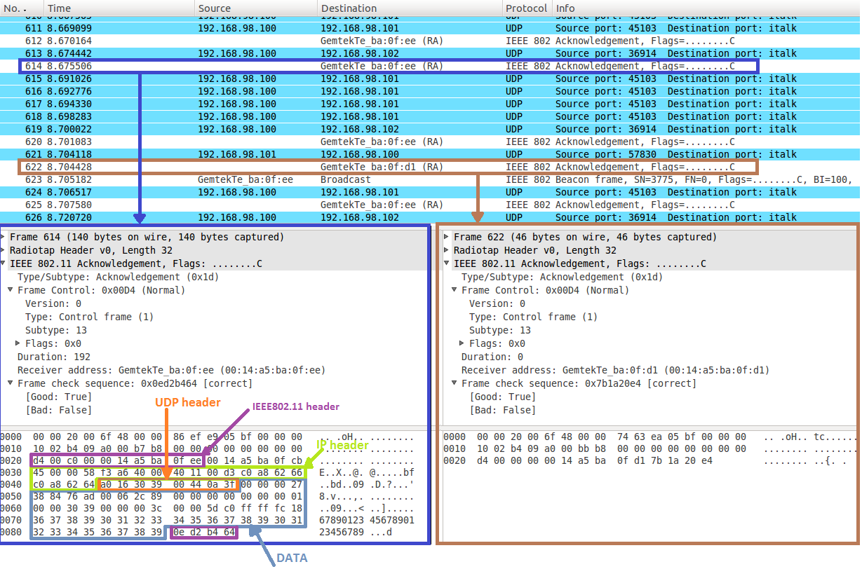
Prototype Validation

Slide 18
Improvement over current standard

Slide 19
Conclusions
Some other applications are being researched now
The performance gain seems to be worth the effort
  Specially for VoIP frames
Everything reduces to allowing for bidirectional allocations during a TXOP

Slide 20
Thanks for your attention!

