Slide 1
Preamble Format for 1 MHz
Date: 2011-11-07
Authors:

Slide 2
Abstract
Based on motions in document 1294r1, the group adopted the following:
  An 802.11ah STA shall support reception of 1 MHz and 2 MHz PHY transmissions.
Subsequently, in document 1311r0, the group motioned in:
  The 2 MHz PHY transmission shall be an OFDM based waveform consisting of a total of 64 tones (including tones allocated as pilot, guard and DC).
  The tone spacing for all other bandwidth modes shall be same as the tone spacing in the 2 MHz mode
Above implies that the 1MHz mode is based on 32 sub-carriers
This presentation proposes a preamble format for 1MHz
Outline of this presentation
  Lowest rate for 1MHz
    2x repetition is needed for the 1MHz mode to provide good in-home coverage
  Propose a preamble format for the 1MHz mode which can support 2x repetition
    Robust packet detection
    LTF section to provide accurate channel estimation
    Simple mode detection between 1MHz and 2MHz modes
    Initial thoughts on SIG Field Design
Notes:
doc.: IEEE 802.11-yy/xxxxr0

Slide 3
Lowest rate for 1MHz: Need for Repetition
Based on 900 MHz in-home measurement results shown in appendix, need 105 dB of pathloss for good in-home coverage
  2 out of 3 homes we did measurements in showed 105 dB as the worst case path-loss
Making the following assumptions for link budget,
  0 dBm output power (without PA)
  -4dBi TX antenna gain
  105dB pathloss
    Worst case pathloss seen in 2 out of 3 homes during measurements
  -3dBi RX antenna gain
  kTBW = -115dBm
  NF = 4dB
To close the link, the lowest MCS should be able to operate at -1 dB SNR or better in AWGN
  SNR = 0 – 4 – 105– 3 - (-115 + 4) = -1dB
Means we need 2x repetition for robust coverage
  2x repetition of 11ac MCS0 has 10^(-1) PER around -2 dB SNR in AWGN

Slide 4
Impact of not having repetition
11ah will be subjected to similar complaints about indoor coverage that exist in current WiFi standards
  In the SEP2.0 Market Requirement document, created with heavy input from utility companies, range of Wi-Fi networks was deemed insufficient in the case of some larger home configurations and in Multi Dwelling Units
Without repetition, the following options may be needed for improving range:
  Require customers to install higher-power sensors for “hard to reach places”
    Not practical to sell two types of sensors, those for the ‘easy to reach places’ and those for the ‘hard to reach places’
    “High-power sensors” cannot work with coin-cell batteries due to peak current drain
  Force customers to deploy multiple 11ah APs
    Choosing location & configuration of the APs non-trivial for average person

Slide 5
Observations
We believe a 2x repetition mode should be included in the 11ah standard
  Additional 1MHz preamble overhead required is manageable in our view, given a well-designed preamble.
Harder to justify 4x repetition due to burden placed on 1MHz normal rate high-MCS transmissions, caused by the shared preamble length overhead
  If 4x repetition is desired, best approach would be to separate 1MHz normal rate and low-rate repetition mode preambles which leads to proliferation of modes
Rest of the presentation proposes a 1MHz preamble format assuming a 2x repetition rate is present
  Common preamble for repetition and non-repetition MCSs

Slide 6
Packet Detection
Detection needs to be sensitive enough to support 2x repetition
There is possibility of power boost on STF
  PAPR of STF is much lower than data
STF Proposal
  Power boosted 4 symbol STF for 2x repetition MCS only [See appendix for details]
    Quantization error not an issue at rep-2 MCS, so receiver can be oblivious of the power boost
  Tone allocation to ensure same periodicity in 1MHz and 2MHz STFs
    For 2MHz: {±4 ±8 ±12 ±16 ±20 ±24}
    For 1MHz: {±4 ±8 ±12}

Slide 7
LTF section
Use 4 LTF symbols
  In order to extract ~ 3.0 dB gain out of 2x repetition, we need 4 LTF symbols [See Appendix]
  Add separate GI for 3rd and 4th LTF symbols to align LTF symbols with the SIG of 2MHz
LTF section
(4 repetitions of LTF1)
DGI
LTF symbol
LTF symbol
GI
LTF symbol
GI
LTF symbol

Slide 8
Mode Detection: 1 vs 2 MHz
Propose to have 2 methods of mode detection
Method 1: Orthogonal LTF sequences for 1MHz and 2MHz
  Can keep the 2MHz LTF the same
  The only “requirement” on the 1 MHz LTF is that it should be nearly orthogonal with the 2MHz LTF within the overlapping band
  Confirmed through simulations that freq domain cross-correlation approach is robust [See Appendix for results]
Method 2: QBPSK rotation on the 1st symbol of 2 MHz SIG
  Same as 11n GF HTSIG field modulation
  Differentiate from the 3rd LTF1 symbol (composed by ±1) of 1MHz

Slide 9
SIG Field
Encoded using MCS 0, rep 2
Number of symbols and sub-fields are TBD

Slide 10
Conclusions
DGI
LTS
LTS
GI
LTS
GI
LTS
Preamble Format for 1 MHz
We proposed 2x repetition as the lowest rate for 1MHz
We also proposed a preamble format shown above
  Robust and simple packet detection for up-to 2x repetition
  Accurate channel estimation which enables repetition mode to provide ~3 dB gain over MCS0
  Simple differentiation from 2MHz mode during LTFs and through QBPSK rotation of 2MHz SIG
  SIG sent using 2x repetition

Slide 11
Straw-poll 1
Do you agree to adopt MCS0 rep 2 as the lowest rate for 1 MHz ?

Slide 12
Straw-poll 2
Do you agree with having a 4 symbol packet detection section for the 1 MHz mode ?
  A 3 dB power boost is only applied for 2x repetition MCS
  Have same periodicity as 2 MHz STF with following tone allocations:
    For 2MHz {±4 ±8 ±12 ±16 ±20 ±24}
    For 1MHz {±4 ±8 ±12}.

Slide 13
Straw-poll 3
Do you agree with having a MCS0-rep2 based SIG-A for the 1 MHz mode ?
  Exact fields TBD

Slide 14
Straw-poll 4
Do you agree with having orthogonal (in frequency) LTF sequences for 1 and 2 MHz to enable mode detection ?
  Orthogonality should hold for both possible locations of 1 MHz in 2 MHz

Slide 15
Straw-poll 5
Do you agree with having a Q-BPSK rotation on the first symbol of 2 MHz SIG-A for 1 vs 2 MHz differentiation ?

Slide 16
Straw-poll 6
Do you agree with having a 4 symbol LTF1 section for the 1 MHz preamble ?
  Separate GI for each of the two additional LTF symbols
LTF section
(4 symbol)
DGI
LTS
LTS
GI
LTS
GI
LTS

Slide 17
Straw-poll 7
Do you agree with the general preamble structure for 1MHz SU packet as in the figure below?
  Applicable to both open-loop and SU-BFed packets.
    SU-BF steering starts from STF
  The relationship between NSTS and NLTF is the same as 11n/11ac (for 2 through 4 streams), using the same P matrix (for 1 through 4 streams)
DGI
LTS
LTS
GI
LTS
GI
LTS
Preamble Format for 1 MHz

Slide 18
Appendix
Measurement, Simulation Results

Slide 19
In-home Measurement Results
Conducted measurements in 3 homes
Home 1
  Two floor home, 5000 sq. ft
  House already equipped with ZigBee devices
  Kept the transmitter source where the ZigBee controller was located
    Same location as the primary WLAN AP in that home
  Measured pathloss to every location in the house that had a ZigBee sensor
    23 measurement points in total
  Worst case pathloss of 105 dB and 2 other locations with 95 dB pathloss
Home 2
  Three floor home, 2500 sq. ft.
  Transmitter on 1st floor and tested pathloss to 7 locations
  Measured Pathloss in every room on all 3 floors
    Typically 15 separate measurements were made in each room, moving the antenna ~1ft between each in order to spatially sample the fading environment.
  Worst case pathloss observed was 95 dB
Home 3
  Two floor home, 1900 sq ft
  Transmitter on 1st floor and tested pathloss to various rooms on both floors, and outdoor locations
  Worst case pathloss of 105 dB seen in backyard (water sprinkler location)
    The propagation path had 3 walls (including a garage wall)
General observation: ~20-25dB path loss variations seen within a single room in a house

Slide 20
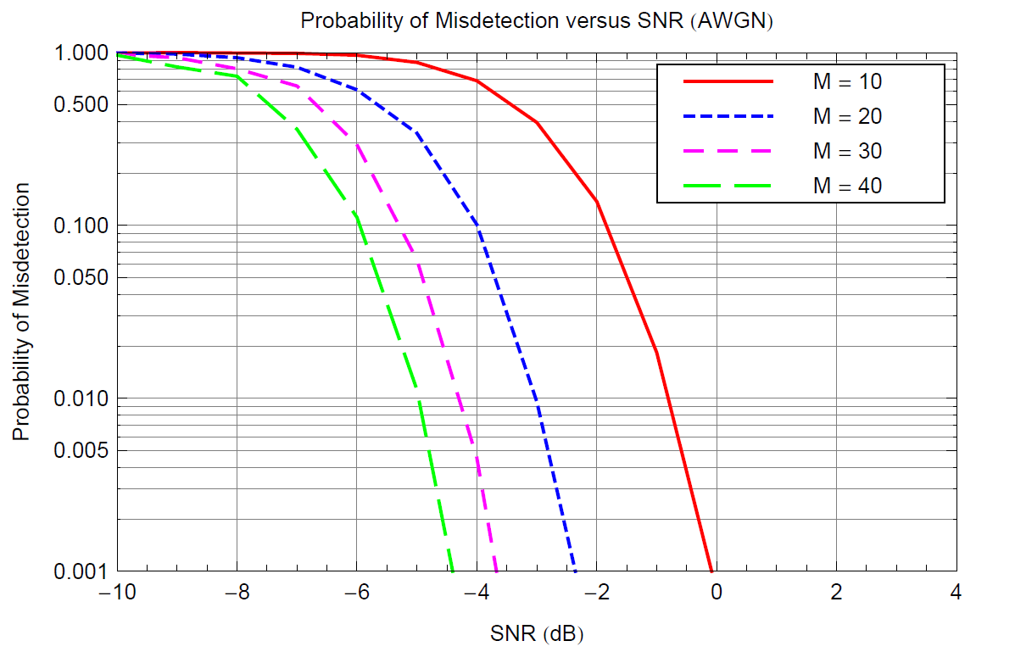
Packet detection Details
Explanation of 3 dB power boost on 4 symbols for 2x rep
  Looking at 2 MHz preamble as basis (since it is direct down-clock)
    2 OFDM symbols of packet detection section needed to get sufficient detection sensitivity for supporting MCS0
      Same number of symbols as 11n 20 MHz
  1 MHz preamble needs 4 symbols of packet detection to support MCS0
    We need double the number of symbols as the transmission is over 32 tones (less samples per symbol)
  To support 2x repetition at 1 MHz, need 3 dB power-boost on a 4 symbol packet detection section
Results on right confirm intuition above
  Auto-correlation based detector
  M is the number of STF periods used for auto-correlation
    1 OFDM symbol contains 5 STF periods (same as 11n)
  2x repetition has 10^(-1) PER at -2 dB in AWGN

Slide 21
LTF section
In order to extract ~ 3.0 dB gain out of 2x repetition, we need 4 LTF symbols
Simulation parameters
  1 MHz, FFT size of 32, with 24 data tones
  AWGN Channel
  250-byte packets
  No RF impairments
  Include channel estimation using 2, 4, and 8 channel estimation (LTF) symbols
  Results with smoothing over channel estimates
2x repetition (ideal CE)gives 3 dB gain at 10% PER
With 2x rep at 10% PER:
  CE based on 2 LTFs is 1.6 dB worse than ideal CE
  With 4 LTFs, this gap reduces to 0.8 dB
  Going from 2 to 4 LTFs provides 0.8 dB more gain

Slide 22
Mode Detection Simulation Assumptions
The simulation uses two LTF symbols with ideal combining (3dB gain)
Transmit power for 64FFT (56 tones) assumed to be the same as 32FFT packet (26 tones).
Plots show the probability of misclassification (not misdetection) 64FFT with 32FFT (Up or Down halves) and vice versa
  note there is no need to detect packet presence – that was done during the STF
SNR shown assumes noise in 2MHz
SISO only
=[0 0 0 -1 1 1 -1 1 -1 -1 1 -1 1 1 1 1 0 1 1 1 -1 1 1 1 -1 1 -1 -1 -1 1 0 0];
  We assumed 26 tones are used
  Sequence used has 2.4dB PAPR and good cross correlation properties with the 64FFT LTF sequence

Slide 23
Mode detection Simulation Results

Slide 24
Motion 1
Do you agree to adopt MCS0 rep 2 as the lowest rate for 1 MHz ?

Slide 25
Motion 2
Move to have a 4 symbol packet detection section for the 1 MHz mode ?
  A 3 dB power boost is only applied for 2x repetition MCS
  Have same periodicity as 2 MHz STF with following tone allocations:
    For 2MHz {±4 ±8 ±12 ±16 ±20 ±24}
    For 1MHz {±4 ±8 ±12}.

Slide 26
Motion 3
Move to have an MCS0-rep2 based SIG-A for the 1 MHz mode ?
  Exact fields TBD

Slide 27
Motion 4
Move to have orthogonal (in frequency) LTF sequences for 1 and 2 MHz to enable mode detection ?
  Orthogonality should hold for both possible locations of 1 MHz in 2 MHz

Slide 28
Motion 5
Move to have a Q-BPSK rotation on the first symbol of 2 MHz SIG-A for 1 vs 2 MHz differentiation ?

Slide 29
Motion 6
Move to have a 4 symbol LTF1 section for the 1 MHz preamble ?
  Separate GI for each of the two additional LTF symbols
LTF section
(4 symbol)
DGI
LTS
LTS
GI
LTS
GI
LTS

Slide 30
Motion 7
Move to have the general preamble structure for 1MHz SU packet as in the figure below?
  Applicable to both open-loop and SU-BFed packets.
    SU-BF steering starts from STF
  The relationship between NSTS and NLTF is the same as 11n/11ac (for 2 through 4 streams), using the same P matrix (for 1 through 4 streams)
DGI
LTS
LTS
GI
LTS
GI
LTS
Preamble Format for 1 MHz

