Slide 1
Supplementary Plenary Information - November 2011
Date: 2011-November-06
Authors:
Name
Company
Address
Phone
email
Bruce Kraemer
Marvell
5488 Marvell Lane,
Santa Clara, CA, 95054
+1 (321) 751-3958
bkraemer@
marvell
.com
Abstract: Additional Information on topics for 802 plenary meeting – November 2011

Slide 2
Monday

Slide 3
IEEE LOA Database
Monday Agenda Item 3.2.1
http://standards.ieee.org/about/sasb/patcom/pat802_11.html
18 entries with 2010 submission dates
30 entries with 2011 submission dates

Slide 4
Joint Meetings
Monday Agenda Item 4.1.3
External: TGAA and 802.1avb
Thursday am1
802.1& 802.3 “Packet Preemption” Regency V
Internal: Regulatory and TGai
Monday morning ad hoc 9-11

Slide 5
NEW PARS
Monday Agenda Item 4.1.4
The following PARs are to be considered November 06-11, 2011, during the 802 plenary meeting in Atlanta, GA:
from .15 - "Key Management Protocol" Rec Practice
https://mentor.ieee.org/802.15/dcn/11/15-11-0613-04-0kmp-key-management-protocol-par.pdf
https://mentor.ieee.org/802.15/dcn/11/15-11-0665-04-0kmp-kmp-5c-draft.doc
from .22 - 802.22b "Enhanced Broadband and Monitoring" Amendment
https://mentor.ieee.org/802.22/dcn/11/22-11-0118-01-rasg-par-for-enhanced-broadband-and-monitoring-amendment.pdf
https://mentor.ieee.org/802.22/dcn/11/22-11-0119-01-rasg-5c-for-enhanced-broadband-and-monitoring-amendment.pdf
Please go to http://www.ieee802.org/PARs.shtml for a additional details
The SASB meeting series where these will be reviewed begins Dec 6 2011
All PARs approved by NesCom/SASB

Slide 6
Other PARS
Monday Agenda Item 4.1.4
802.15.4e – One year extension
802.15.6 – One year extension and name change
Proposed Modification to P802.16n PAR
http://ieee802.org/16/docs/#11_0030
Continues project to amend IEEE Std 802.16.
Proposed P802.16.1a PAR
http://ieee802.org/16/docs/#11_0031
Starts project to amend IEEE Std 802.16.1, based on existing P802.16n.
Proposed Modification to P802.16p PAR
http://ieee802.org/16/docs/#11_0032
Continues project to amend IEEE Std 802.16.
Proposed P802.16.1b PAR
http://ieee802.org/16/docs/#11_0033
Starts project to amend IEEE Std 802.16.1, based on existing P802.16p.

Slide 7
Hotel meeting Levels
Monday Agenda Item 4.1.5
Lobby
Ballroom
Exhibit
Atlanta Conference Center

Slide 8
Group Room assignments
Monday Agenda Item 4.1.5
WG | Room | Level
16 | Learning Center, Fairlie, Greenbriar, Harris | ACC
18 | Piedmont | ACC
19 | Spring | ACC
21 | Techwood | ACC
22 | Baker | ACC

Slide 9
WG18 Agenda
Monday Agenda Item 4.1.6
Monday 1:30 - 6:00 pm
Tuesday 8:00 – 6:00 pm
Wednesday 8:00 – 6:00 pm
Thursday 8:00 – 6:00 pm
Review a recently approved Question ITU-R 236/1 that potentially may identify spectrum globally available for Smart Grid wireless applications Monday pm1
The question is available on the RR-TAG Mentor web site as 18-11-0079
Review and develop a response to a proposed change to the FCC’s 900 MHz ISM band rules that could adversely impact 802 technologies operating under Part 15 rules Monday pm2
https://mentor.ieee.org/802.18/documents

Slide 10
WG18 Agenda – New item
WG18 Agenda
ITU-R question
https://mentor.ieee.org/802.18/dcn/11/18-11-0079-00-0000-approval-of-1-new-itu-r-question-and-1-revised-itu-r-question.docx
900MHz change
https://mentor.ieee.org/802.18/dcn/11/18-11-0084-00-0000-lms-overview.pptx
September Output: Canadian Consultation on TVWS
https://mentor.ieee.org/802.18/dcn/11/18-11-0075-03-0000-ieee-802-response-to-canadian-tvws-consultation.doc

Slide 11
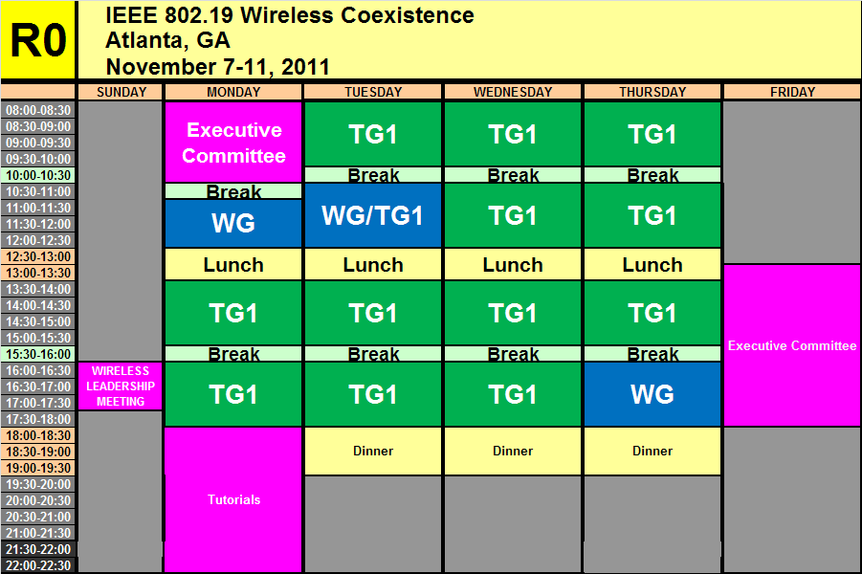
WG19 Agenda - November
Monday Agenda Item 4.1.7
https://mentor.ieee.org/802.19/dcn/11/19-11-0114-00-0000-nov-2011-wg-agenda.xls

Slide 12
Coexistence Assurance (CA) documents
Standard | Coexistence Assurance Document
IEEE 802.11af | IEEE 802.11-11/177r0
IEEE 802.11ad | IEEE 802.11-10/1025r5
IEEE 802.11y | IEEE 802.11-07/2066r1
IEEE 802.11n | IEEE 802.11-06/0338r4
IEEE 802.15.4f | IEEE 802.15-10/918r0
IEEE 802.15.4e | IEEE 802.15-10/737r4
IEEE 802.15.4g | IEEE 802.15-10/668r5
IEEE 802.15.4i | IEEE 802.15-10/808r0
IEEE 802.15.4a | IEEE 802.15.4 Standard. Annex E
IEEE 802.15.3c | IEEE 802.15-09/22r9
IEEE 802.15.4a | IEEE 802.15.4 Standard. Annex E
IEEE 802.15.4b | IEEE 802.15.4 Standard. Annex E
IEEE 802.16h | IEEE 802.19-09/07r0

Slide 13
802 Projects - CA plans
Project | Brief Description | Will Produce a CA Doc.
802.11aa | Audio/Video | No
802.11ac | Below 5 GHz | Yes
802.11ad | 60 GHz | Yes
802.11ae | Priority Management Frames | No
802.11af | TVWS | Yes
802.11ah | Sub 1 GHz | Yes
802.11ai | Fast Initial Link Setup | No
802.15.4e | China | Yes
802.15.4f | RFID | Yes
802.15.4g | SUN | Yes
802.15.4j | Medical Body Area Network | Yes
802.15.4k | Low Energy,Critical Infrastructure Monitoring Network | Yes
802.15.6 | BAN | Yes
802.15.7 | VLC | No
802.22 | WRAN | No
802.22.1 | Beacon | No
802.22.2 | Installation and Deployment | No

Slide 14
IEEE 802.19 CONTACT INFORMATION
IEEE 802.19 CONTACT INFORMATION
WG Chair: Steve Shellhammer
WG Vice Chair: Ivan Reede
WG Secretary: Junyi Wang
Technical Editor: James Gilb
Liaison to 802.11: Eldad Perahia
Liaison from 802.11: Prabodh Varshney
Liaison to 802.15: Shuzo Kato
Liaison from 802.15: Hyunduk Kang
Liaison from 802.18: Junyi Wang
IEEE 802.16 Liaison: Matthew Sherman
Liaison from 802.22: Ivan Reede

Slide 15
WG21 Agenda
Monday Agenda Item 4.1.8
 | Monday (Nov 07) | Tuesday (Nov 08) | Wednesday (Nov 09) | Thursday (Nov 10)
AM-1 8:00-10:00a | NA | Comment resolution- 802.21a | Comment resolution- 802.21b | Comment resolution- 802.21a
AM-2 10:30-12:30 | NA | SRHO TG | SRHO TG | Future Project Planning
PM-1 1:30 – 3:30p | 802.21 WG Opening Plenary | Comment resolution- 802.21b | Comment resolution- 802.21a | SRHO TG
PM-2 4:00 – 6:00p | Comment resolution- 802.21a | Future Project Planning | SRHO TG | 802.21 WG Closing Plenary
Eve 6:30 – 7:30p | Comment resolution- 802.21b /Tutorial | Future Project Planning | Social

Slide 16
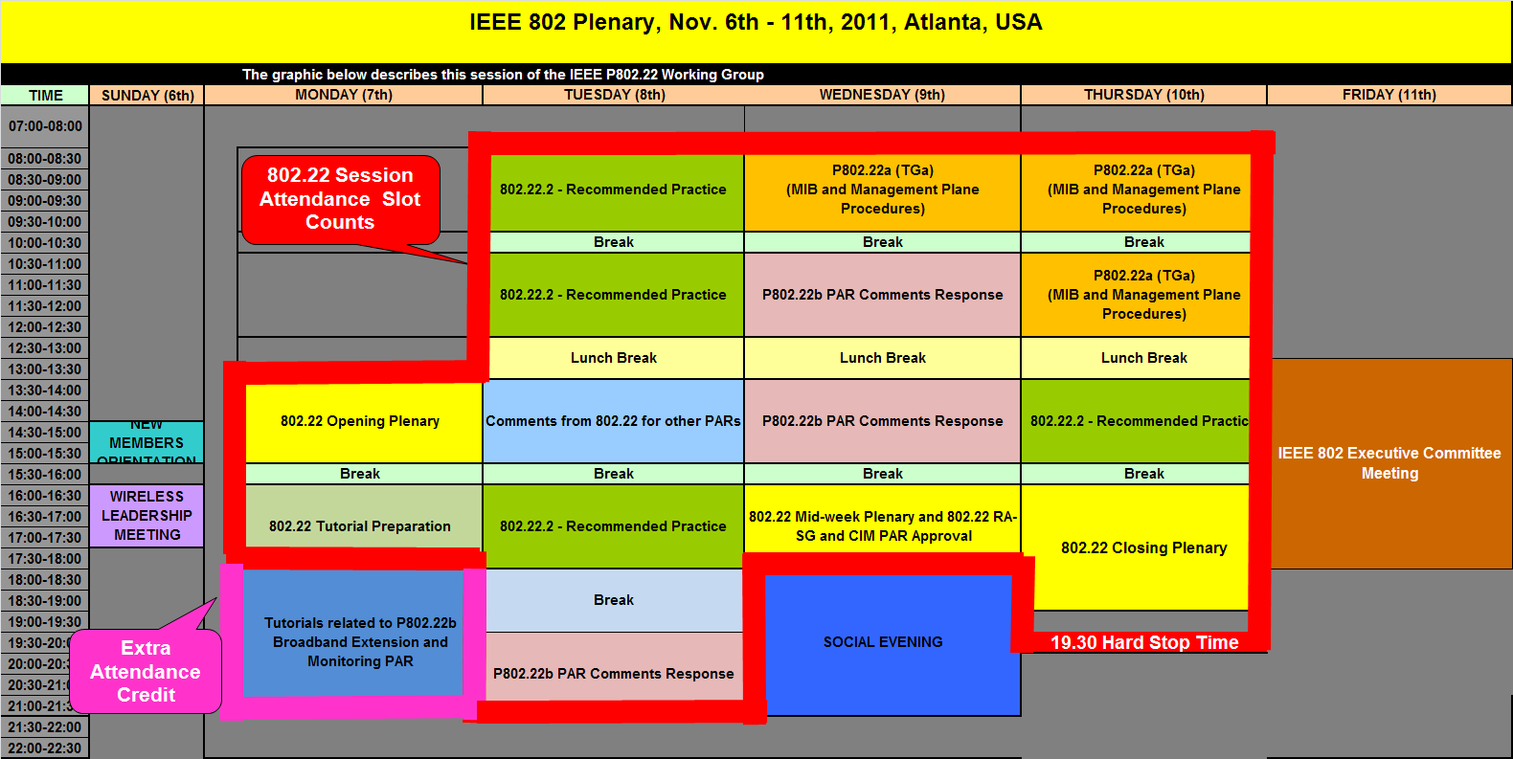
WG22 Agenda - November
Monday Agenda Item 4.1.9
https://mentor.ieee.org/802.22/dcn/11/22-11-0125-01-0000-november-plenary-working-group-agenda.xls

Slide 17
January Meeting – Jacksonville, Florida, US January 15 - 20
Monday Agenda Item 4.1.10
Hotel Registration open now
Meeting Registration opens Monday Nov 7
Early bird registration expires Dec 16

Slide 18
Other Special Events
Monday Agenda Item 4.1.11
TGs Awards and Photographs
Wednesday
~11:30

Slide 19
Topics since July EC
Monday Agenda Item 4.1.12
Press releases for TGS approved
EC workshop in November – Sat/Sun following plenary

Slide 20
802.11 Topics for November 2011 EC
Monday Agenda Item 4.1.12
Begin Sponsor Ballot
TGad
Requests to submit to RevCom?
New project PAR to NesCom ?
Nothing anticipated
PAR Extension ?
Nothing anticipated
Study Group start up?
Maybe

Slide 21
802.1 Architecture Document
Monday Agenda Item 4.1.13

Slide 22
Smart Grid Meetings
Monday Agenda Item 4.1.14
Two sessions
Tuesday pm2 - Hanover E
Thursday pm2 - Hanover C
Revision of NIST Smart Grid PAP#2 Guideline
Review NIST Framework document

Slide 23
November Tutorials
Monday Agenda Item 4.1.15
Tutorial #1 (6:00–7:30 pm)
Introduction to IEEE Std. 802.22-2011 and its Amendment PAR for P802.22b: Broadband Extension and Monitoring sponsored by Apurva Mody
Tutorial #2 (7:30–9:00 pm) Smart Grid Update - 2011 sponsored by Bruce Kraemer
http://ieee802.org/Tutorials.shtml

Slide 24
Wednesday

Slide 25
Wednesday Agenda Item 4.3
COMSOC P1900.7 Status
IEEE DySPAN SC working groups:
1900.1 Working Group on Terminology and Concepts for Next Generation Radio Systems and Spectrum Management
1900.2 Working Group on Recommended Practice for Interference and Coexistence Analysis
1900.3 Working Group on Recommended Practice for Conformance Evaluation of Software Defined Radio (SDR) Software Modules
1900.4 Working Group on Architectural Building Blocks Enabling Network-Device Distributed Decision Making for Optimized Radio Resource Usage in Heterogeneous Wireless Access Networks
1900.5 Working Group on Policy Language and Policy Architectures for Managing Cognitive Radio for Dynamic Spectrum Access Applications
1900.6 Working Group on Spectrum Sensing Interfaces and Data Structures for Dynamic Spectrum Access and other Advanced Radio Communication Systems
P1900.7 Working Group on Radio Interface for White Space Dynamic Spectrum Access Radio Systems Supporting Fixed and Mobile Operation

Slide 26
Wednesday Agenda Item 4.3
P1900.7 Background
On March 8, 2010 the ad hoc group on White Space Radio was created within IEEE SCC41 standardization committee
■ To consider interest in, feasibility of, and necessity of
developing standard defining radio interface (MAC and PHY layers) for white space communication system.
Usage models (31r0)
WS regulatory bands (13r0)
Requirements (35r0)
5C (30r8)
PAR (29r12)
All contributions are publically available at
■ http://grouper.ieee.org/groups/scc41/adhoc-wsr/contrib/

Slide 27
Wednesday Agenda Item 4.3
P1900.7 PAR
4.1 Type of Ballot: Individual
4.2 Expected Date of submission of draft to the IEEE-SA for Initial Sponsor Ballot: 6/2014
4.3 Projected Completion Date for Submittal to RevCom: 3/2015
5.1 Approximate number of people expected to be actively involved in the
development of this project: 70
5.2 Scope: This standard specifies a radio interface including medium access control (MAC) sublayer and physical (PHY) layer of white space dynamic spectrum access radio systems supporting fixed and mobile operation in white space frequency bands. The standard provides means to support other related IEEE 1900 standards.
5.3 Is the completion of this standard dependent upon the completion of another standard: No

Slide 28
Wednesday Agenda Item 4.3
P1900.7 Status
5.3 Is the completion of this standard dependent upon the completion of another
standard: No
2011-02-09 dyspan-ws-radio-11/9r0
5.4 Purpose: This standard enables the development of cost-effective, multi-vendor white space dynamic spectrum access radio systems capable of interoperable operation in white space frequency bands. This standard facilitates a variety of applications, including the ones capable to support high mobility, both low-power and high-power, short-, medium, and long-range, and a variety of network topologies.
5.5 Need for the Project: White space dynamic spectrum access radio systems
supporting fixed and mobile operation are expected to have broad international market potential. This standard will enable various applications of such radio systems by defining radio interface for white space frequency bands.

Slide 29
Wednesday Agenda Item 4.3
P1900.7 Status
Chair: Stanislav Filin, NICT
Based on initial meeting of 1900.7: 19 voting members from 9 affiliations
Participation during 1st PhC: 14 participants from 7 affiliations
Affiliations: mainly R&D. BBC / Brit. Telecom from industry
Note: PhC count as a regular meeting (no differentiation between face to face and PhC).
Participation in 2 consecutive meetings required for voting membership
https://mentor.ieee.org/802.19/dcn/11/19-11-0019-00-0000-p1900-7-introduction.pdf
https://mentor.ieee.org/802.19/dcn/11/19-11-0020-00-0000-p1900-7-par.pdf
https://mentor.ieee.org/802.19/dcn/11/19-11-0021-00-0000-p1900-7-5c.pdf

Slide 30
Wednesday Agenda Item 4.3
P1900.7 Status
Current discussion focused on procedural (P&Ps, elections, time plan) and informational (regulatory issues) material:
https://mentor.ieee.org/1900.7/dcn/11/7-11-0013-01-CNTR-white-space-regulatory-domains.pdf
Currently, no candidates for Vice Chair or Secretary. 1900.7 will need to reissue a call for nominations.
Possible establishment of Liaisons to 802 (802.11af) discussed. Decision postponed to next face to face meeting in December.
https://mentor.ieee.org/1900.7/dcn/11/7-11-0015-00-CNTR-liaisons.ppt
First call for contributions issued
https://mentor.ieee.org/1900.7/dcn/11/7-11-0010-00-CNTR-first-call-for-contributions.ppt
First presentations on use cases
https://mentor.ieee.org/1900.7/dcn/11/7-11-0009-02-CNTR-potential-use-cases-for-tvws.pdf
All documents (including meeting minutes) available on 1900.7 Mentor area https://mentor.ieee.org/1900.7/bp/StartPage
Next Teclo: November 14th
https://mentor.ieee.org/1900.7/dcn/11/7-11-0017-00-AGND-14-november-2011-teleconference-agenda.xlsx
Next Face to Face Meeting: December 12 -- 14th, Scottsdale, AZ

Slide 31
Wednesday Agenda Item 4.4
P1905.1 Convergent Digital Home Network Working Group
PAR
5.2 Scope: The standard defines an abstraction layer for multiple home networking technologies. The abstraction layer provides a common data and control Service Access Point to the heterogeneous home networking technologies described in the following specifications: IEEE P1901, IEEE 802.11, IEEE 802.3 and MoCA 1.1. The standard is extendable to work with other home networking technologies.
The abstraction layer supports dynamic interface selection for transmission of packets arriving from any interface (upper protocol layers or underlying network technologies). End-to-end Quality of Service (QoS) is supported.
Also specified are procedures, protocols and guidelines to provide a simplified user experience to add devices to the network, to set up encryption keys, to extend the network coverage, and to provide network management features to address issues related to neighbor discovery, topology discovery, path selection, QoS negotiation, and network control and management.

Slide 32
Wednesday Agenda Item 4.4
P1905.1 PAR
5.3 Is the completion of this standard dependent upon the completion of another standard: No
5.4 Purpose: The abstraction layer common interface allows applications and upper layer protocols to be agnostic to the underlying home networking technologies. The purpose of the standard is to facilitate the integration of P1901 with other home networking technologies.
Additionally the purpose of the standard is to define an abstraction layer that allows: Common Network Setup among heterogeneous network technologies defined in the PAR and provide same user experience in the process of adding a device to the network and the same user experience while setting an encryption key; Intelligent network interface and path selection for delivery of packets that provides Improved coverage performance, Improved data rate on poorest link, Improved network capacity, Improved network reliability and QoS, support for end-to-end Quality of Service (QoS) for different traffic classes; Seamless / transparent path switching; Real time mapping of connection links and paths for each traffic class / stream; Green - energy management.

Slide 33
Wednesday Agenda Item 4.4
1905.1 Convergent Digital Home Network Working Group
Meeting Information
17 November 2011 12-2pm EST
via teleconference REGISTER AGENDA 13-15 December 2011 Miami, FL, USA South Beach Marriott 106 Ocean Drive Miami Beach, FL 33139

Slide 34
Wednesday Agenda Item 5.2
Room Changes

Slide 35
Wednesday Agenda Item 5.2
Revised Agenda Graphic
If needed

Slide 36
Wednesday Agenda Item 5.3
Officer Changes
If needed

Slide 38
Friday

Slide 39
IEEE LOA Database
Friday Agenda Item 2.08
http://standards.ieee.org/db/patents/pat802_11.html
18 entries with 2010 submission dates
30 entries with 2011 submission dates

Slide 40
IEEE SA Contents - November 2011
Friday Agenda Item 2.09
Amendment | Draft in Shop Nov 06th | Draft in Members Area | Publication in Shop Nov 06th | Publication in Get 802 Nov 06th
11.2 | 1.01
S |  |  | Yes
802.11 Revision | 11.0 | 12.0
AA | 6.0 | 6.0
AE | 6.0 | 6.0
AC | - | 1.2
AD | - | 5.0
k, n, p, y, r, w, u, v, z |  |  |  | Yes
802.11-2007 |  |  |  | Yes
http://www.ieee.org/web/standards/home/index.html

Slide 41
802.11 drafts to ISO/IEC JTC1/SC6
Friday Agenda Item 2.10
Task Group | After Okinawa
TGae | D5.0
TGaa | D6.0
TGac | -
TGmb | D10.0
TGs | -
TGu | -
TGv | -
TGz | -
The WG told SC6 it will liaise 802.11ac as soon as it passes a LB
802.11-2012 will be submitted to SC6 when approved by the SASB – early 2012

Slide 42
myBallot - Sponsor Ballot Tool Change
Friday Agenda Item 6.1
Sponsor Ballot Vote Change allows a sponsor balloter to make a vote change, from Disapprove to either Approve or Abstain, after the ballot has closed.
The balloter simply logs onto myProject, myBallot Activity and changes their vote. This eliminates the need for the balloter to email the sponsor or working group chair with a vote change, the system will do that automatically. To help you better understand how the functionality works, click on the link below: https://mentor.ieee.org/etools_documentation/dcn/11/etools_documentation-11-0016-01-MYBA-vote-change.pdf If you have any questions, please contact myproject-admin@standards.ieee.org

Slide 43
EC November Workshop
Friday Agenda Item 6.2
International engagements of 802
ISO, ITU, CCSA, ETSI, …
802 operating procedures, tools, efficiency and changes in SA
myBallot, RevCom, NesCom, meeting fees, Get802, etc
Meeting tools
Strategic Discussions
Issues and opportunities in partnering with other SDOs
802 architecture
Organization of 802
IEEE as Standards service provider

Slide 44
Future Venues
Friday Agenda Item 6.3
2012
# 131 January 15-20, 2012 ----Hyatt Regency, Jacksonville, FL
Including 802.16 and 802.21
# 132 March 11-16, 2012 –Hilton Waikoloa, Big Island, HI
# 133 May 13-18, 2012, Hyatt Regency Atlanta, Atlanta, Georgia, USA
# 134 July 15-20, 2012 Grand Hyatt Manchester, San Diego, CA, USA
# 135 September 16-21, 2012, Hyatt Grand Champion, Indian Wells, CA
# 136 Nov 11-16, 2012 Grand Hyatt San Antonio, San Antonio, TX, USA

Slide 45
Future Venues
Friday Agenda Item 6.3
2013
# 137 January 13-18, 2013 - ----TBD – Los Angeles / Prague/ Berlin
# 138 March 17-22, 2013 –Caribe Royale, Orlando, FL, USA
# 139 May 12-17, 2013 ----Hilton Waikoloa, Big Island, HI
# 140 July 14-19, 2013 ----TBD – Geneva, CH ??
# 141 September 15-20, 2013----TBD – China ??
# 142 Nov 10-15, 2013 Hyatt Regency Dallas, TX, USA

