Slide 1
Supplementary Plenary Information - November 2011
Date: 2011-November-06
Authors:
Name
Company
Address
Phone
email
Bruce Kraemer
Marvell
5488 Marvell Lane,
Santa Clara, CA, 95054
+1 (321)
751-3958
bkraemer@
marvell
.com
Abstract: Additional Information on topics for 802 plenary meeting – November 2011

Slide 2
Monday

Slide 3
IEEE LOA Database
Monday Agenda Item 3.2.1
http://standards.ieee.org/about/sasb/patcom/pat802_11.html
18 entries with 2010 submission dates
30 entries with 2011 submission dates

Slide 4
Joint Meetings
Monday Agenda Item 4.1.3
External: TGAA and 802.1avb
Thursday am1
Internal: Regulatory and TGai
Monday morning ad hoc 9-11

Slide 5
NEW PARS
Monday Agenda Item 4.1.4
The following PARs are to be considered November 06-11, 2011, during the 802 plenary meeting in Atlanta, GA:
  from .15 - "Key Management Protocol" Rec Practice
https://mentor.ieee.org/802.15/dcn/11/15-11-0613-04-0kmp-key-management-protocol-par.pdf
https://mentor.ieee.org/802.15/dcn/11/15-11-0665-04-0kmp-kmp-5c-draft.doc
  from .22 - 802.22b "Enhanced Broadband and Monitoring" Amendment
https://mentor.ieee.org/802.22/dcn/11/22-11-0118-01-rasg-par-for-enhanced-broadband-and-monitoring-amendment.pdf
https://mentor.ieee.org/802.22/dcn/11/22-11-0119-01-rasg-5c-for-enhanced-broadband-and-monitoring-amendment.pdf
Please go to http://www.ieee802.org/PARs.shtml for a additional details
The SASB meeting series where these will be reviewed begins Dec 6 2011
All PARs approved by NesCom/SASB

Slide 6
Other PARS
Monday Agenda Item 4.1.4
  802.15.4e – One year extension
  802.15.6 – One year extension
Proposed Modification to P802.16n PAR
http://ieee802.org/16/docs/#11_0030
Continues project to amend IEEE Std 802.16.
Proposed P802.16.1a PAR
http://ieee802.org/16/docs/#11_0031
Starts project to amend IEEE Std 802.16.1, based on existing P802.16n.
Proposed Modification to P802.16p PAR
http://ieee802.org/16/docs/#11_0032
Continues project to amend IEEE Std 802.16.
Proposed P802.16.1b PAR
http://ieee802.org/16/docs/#11_0033
Starts project to amend IEEE Std 802.16.1, based on existing P802.16p.

Slide 7
Group Room assignments
Monday Agenda Item 4.1.5
WG | Room | Level
16 | Learning Center, Fairlie, Greenbriar, Harris | CC
18 | Piedmont | CC
19 | Spring | CC
21 | Techwood | CC
22 | Baker | CC

Slide 8
WG18 Agenda
Monday Agenda Item 4.1.6
Monday 1:30 - 6:00 pm
Tuesday 8:00 – 6:00 pm
Wednesday 8:00 – 6:00 pm
Thursday 8:00 – 6:00 pm
Review a recently approved Question ITU-R 236/1 that potentially may identify spectrum globally available for Smart Grid wireless applications
  The question is available on the RR-TAG Mentor web site as 18-11-0079
Review and develop a response to a proposed change to the FCC’s 900 MHz ISM band rules that could adversely impact 802 technologies operating under Part 15 rules
https://mentor.ieee.org/802.18/documents

Slide 9
WG18 Agenda – New item
WG18 Agenda
ITU-R question
https://mentor.ieee.org/802.18/dcn/11/18-11-0079-00-0000-approval-of-1-new-itu-r-question-and-1-revised-itu-r-question.docx
900MHz change
https://mentor.ieee.org/802.18/dcn/11/18-11-0084-00-0000-lms-overview.pptx
September Output: Canadian Consultation on TVWS
https://mentor.ieee.org/802.18/dcn/11/18-11-0075-03-0000-ieee-802-response-to-canadian-tvws-consultation.doc

Slide 10
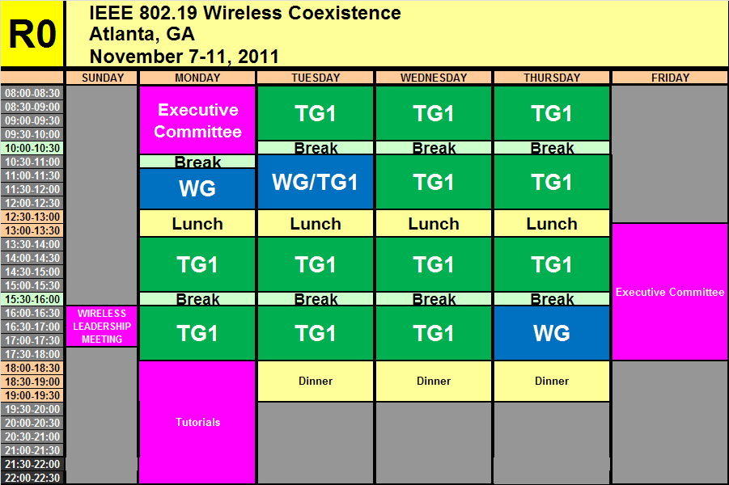
WG19 Agenda - November
Monday Agenda Item 4.1.7
https://mentor.ieee.org/802.19/dcn/11/19-11-0114-00-0000-nov-2011-wg-agenda.xls

Slide 11
Coexistence Assurance (CA) documents
Standard | Coexistence Assurance Document
IEEE 802.11af | IEEE 802.11-11/177r0
IEEE 802.11ad | IEEE 802.11-10/1025r5
IEEE 802.11y | IEEE 802.11-07/2066r1
IEEE 802.11n | IEEE 802.11-06/0338r4
IEEE 802.15.4f | IEEE 802.15-10/918r0
IEEE 802.15.4e | IEEE 802.15-10/737r4
IEEE 802.15.4g | IEEE 802.15-10/668r5
IEEE 802.15.4i | IEEE 802.15-10/808r0
IEEE 802.15.4a | IEEE 802.15.4 Standard. Annex E
IEEE 802.15.3c | IEEE 802.15-09/22r9
IEEE 802.15.4a | IEEE 802.15.4 Standard. Annex E
IEEE 802.15.4b | IEEE 802.15.4 Standard. Annex E
IEEE 802.16h | IEEE 802.19-09/07r0

Slide 12
802 Projects - CA plans
Project | Brief Description | Will Produce a CA Doc.
802.11aa | Audio/Video | No
802.11ac | Below 5 GHz | Yes
802.11ad | 60 GHz | Yes
802.11ae | Priority Management Frames | No
802.11af | TVWS | Yes
802.11ah | Sub 1 GHz | Yes
802.11ai | Fast Initial Link Setup | No
802.15.4e | China | Yes
802.15.4f | RFID | Yes
802.15.4g | SUN | Yes
802.15.4j | Medical Body Area Network | Yes
802.15.4k | Low Energy,Critical Infrastructure Monitoring Network | Yes
802.15.6 | BAN | Yes
802.15.7 | VLC | No
802.22 | WRAN | No
802.22.1 | Beacon | No
802.22.2 | Installation and Deployment | No

Slide 13
IEEE 802.19 CONTACT INFORMATION
IEEE 802.19 CONTACT INFORMATION
WG Chair: Steve Shellhammer
WG Vice Chair: Ivan Reede
WG Secretary: Junyi Wang
Technical Editor: James Gilb
Liaison to 802.11: Eldad Perahia
Liaison from 802.11: Prabodh Varshney
Liaison to 802.15: Shuzo Kato
Liaison from 802.15: Hyunduk Kang
Liaison from 802.18: Junyi Wang
IEEE 802.16 Liaison: Matthew Sherman
Liaison from 802.22: Ivan Reede

Slide 14
WG21 Agenda
Monday Agenda Item 4.1.8
 | Monday (Nov 07) | Tuesday (Nov 08) | Wednesday (Nov 09) | Thursday (Nov 10)
AM-1 8:00-10:00a | NA | Comment resolution- 802.21a | Comment resolution- 802.21b | Comment resolution- 802.21a
AM-2 10:30-12:30 | NA | SRHO TG | SRHO TG | Future Project Planning
PM-1 1:30 – 3:30p | 802.21 WG Opening Plenary | Comment resolution- 802.21b | Comment resolution- 802.21a | SRHO TG
PM-2 4:00 – 6:00p | Comment resolution- 802.21a | Future Project Planning | SRHO TG | 802.21 WG Closing Plenary
Eve 6:30 – 7:30p | Comment resolution- 802.21b /Tutorial | Future Project Planning | Social

Slide 15
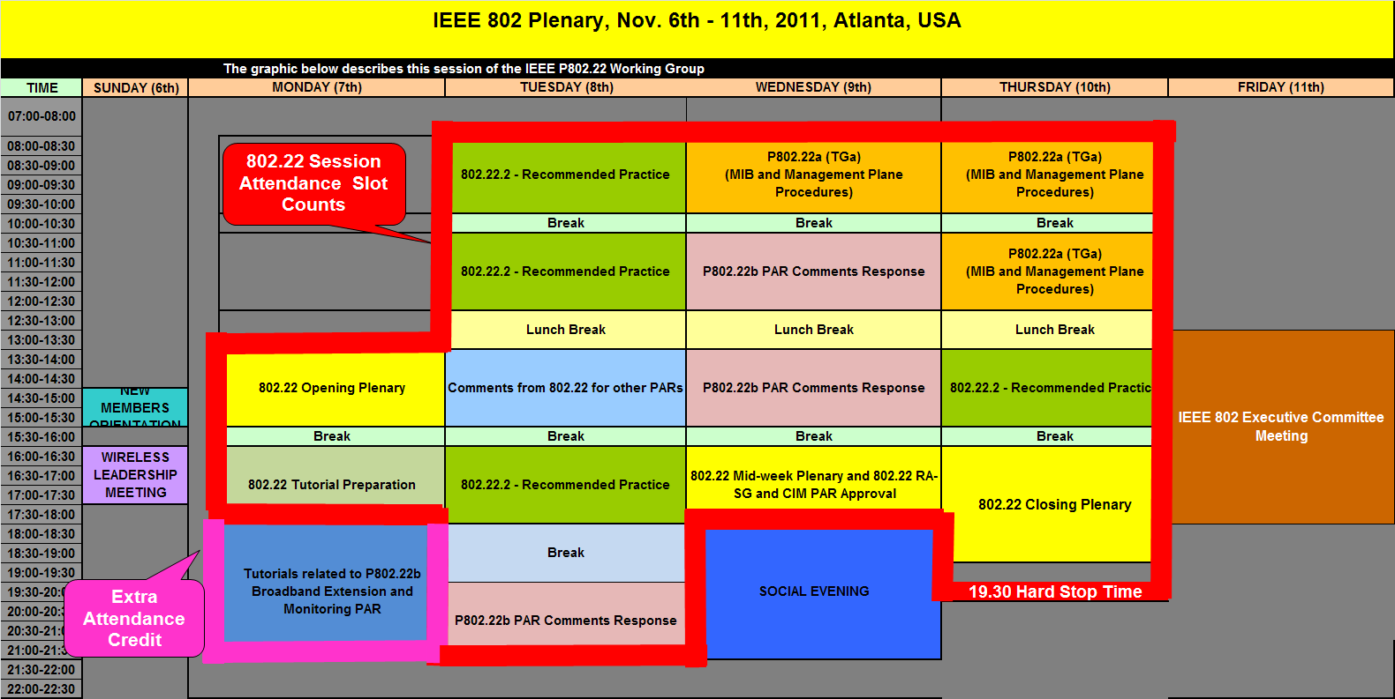
WG22 Agenda - November
Monday Agenda Item 4.1.9
https://mentor.ieee.org/802.22/dcn/11/22-11-0125-01-0000-november-plenary-working-group-agenda.xls

Slide 16
January Meeting – Jacksonville, Florida, US
January 15 - 20
Monday Agenda Item 4.1.10
Incomplete
Hotel Registration open now
Meeting Registration opens …..
Early bird registration expires Nov 18

Slide 17
Other Special Events
Monday Agenda Item 4.1.11
TGs Awards and Photographs
Wednesday
~11:30

Slide 18
Topics since July EC
Monday Agenda Item 4.1.12
Press releases for TGS approved
EC workshop in November – Sat/Sun following plenary

Slide 19
802.11 Topics for November 2011 EC
Monday Agenda Item 4.1.12
Begin Sponsor Ballot
  TGad
  Requests to submit to RevCom?
New project PAR to NesCom ?
  Nothing anticipated
PAR Extension ?
  Nothing anticipated
Study Group start up?
  Maybe

Slide 20

802.1 Architecture Document
Monday Agenda Item 4.1.13

Slide 21
Smart Grid Meetings
Monday Agenda Item 4.1.14
Incomplete
Two sessions
Tuesday pm2 - ??
Thursday pm2 - Hanover C
Revision of NIST Smart Grid PAP#2 Guideline
Review NIST Framework document

Slide 22
November Tutorials
Monday Agenda Item 4.1.15
Tutorial #1 (6:00–7:30 pm)
Introduction to IEEE Std. 802.22-2011 and its Amendment PAR for P802.22b: Broadband Extension and Monitoring sponsored by Apurva Mody
Tutorial #2 (7:30–9:00 pm) Smart Grid Update - 2011 sponsored by Bruce Kraemer
http://ieee802.org/Tutorials.shtml

Slide 23
Wednesday

Slide 24
Wednesday Agenda Item 5.2
Room Changes

Slide 25
Wednesday Agenda Item 5.2
Revised Agenda Graphic
If needed

Slide 26
Wednesday Agenda Item 5.3
Officer Changes
If needed

Slide 27
Friday

Slide 28
IEEE LOA Database
Friday Agenda Item 2.08
http://standards.ieee.org/db/patents/pat802_11.html
18 entries with 2010 submission dates
30 entries with 2011 submission dates

Slide 29
IEEE SA Contents - November 2011
Friday Agenda Item 2.09
Amendment | Draft in Shop Nov 06th | Draft in Members Area | Publication in Shop Nov 06th | Publication in Get 802 Nov 06th
11.2 | 1.01
S |  |  | Yes
802.11 Revision | 11.0 | 12.0
AA | 6.0 | 6.0
AE | 6.0 | 6.0
AC | - | 1.2
AD | - | 5.0
k, n, p, y, r, w, u, v, z |  |  |  | Yes
802.11-2007 |  |  |  | Yes
http://www.ieee.org/web/standards/home/index.html

Slide 30
802.11 drafts to ISO/IEC JTC1/SC6
Friday Agenda Item 2.10
Task Group | After Okinawa
TGae | D5.0
TGaa | D6.0
TGac | -
TGmb | D10.0
TGs | -
TGu | -
TGv | -
TGz | -
The WG told SC6 it will liaise 802.11ac as soon as it passes a LB
802.11-2012 will be submitted to SC6 when approved by the SASB – early 2012

Slide 31
myBallot - Sponsor Ballot Tool Change
Friday Agenda Item 6.1
Sponsor Ballot Vote Change allows a sponsor balloter to make a vote change, from Disapprove to either Approve or Abstain, after the ballot has closed.
The balloter simply logs onto myProject, myBallot Activity and changes their vote. This eliminates the need for the balloter to email the sponsor or working group chair with a vote change, the system will do that automatically.
To help you better understand how the functionality works, click on the link below:
https://mentor.ieee.org/etools_documentation/dcn/11/etools_documentation-11-0016-01-MYBA-vote-change.pdf
If you have any questions, please contact myproject-admin@standards.ieee.org

Slide 32
EC November Workshop
Friday Agenda Item 6.2
Incomplete
1. 802 operating procedures, tools, efficiency and changes in SA – opportunity to review, comment, improve
New myBallot sponsor balloting tools
Sponsor Ballot requirement change - 1/3 rule, Safety, Sponsor ballot category balance & categories
RevCom guidelines under development
NesCom Conventions when preparing PARs
802 Succession training and EC Alternate voting
802 Meeting fees and Get802 contributions

Slide 33
EC November Workshop
Friday Agenda Item 6.2
Incomplete
2. 802 standards in ISO/IEC/JTC1, ITU-T, ITU-R
Status of WAPI and other 802 replacement projects
3. Meeting provider contract review
4. Network/Audio, video service provider contract review
5. Competition and cooperation with other standards groups

Slide 34
Future Venues
Friday Agenda Item 6.3
2012
# 131 January 15-20, 2012 ----Hyatt Regency, Jacksonville, FL
Including 802.16 and 802.21
# 132 March 11-16, 2012 –Hilton Waikoloa, Big Island, HI
# 133 May 13-18, 2012, Hyatt Regency Atlanta, Atlanta, Georgia, USA
# 134 July 15-20, 2012 Grand Hyatt Manchester, San Diego, CA, USA
# 135 September 16-21, 2012, Hyatt Grand Champion, Indian Wells, CA
# 136 Nov 11-16, 2012 Grand Hyatt San Antonio, San Antonio, TX, USA

Slide 35
Future Venues
Friday Agenda Item 6.3
2013
# 137 January 13-18, 2013 ---- Los Angeles, CA ???
# 138 March 17-22, 2013 –Caribe Royale, Orlando, FL, USA
# 139 May 12-17, 2013 ----Hilton Waikoloa, Big Island, HI
# 140 July 14-19, 2013 ----TBD – Geneva, CH ??
# 141 September 15-20, 2013----TBD – China ??
# 142 Nov 10-15, 2013 Hyatt Regency Dallas, TX, USA

Slide 36
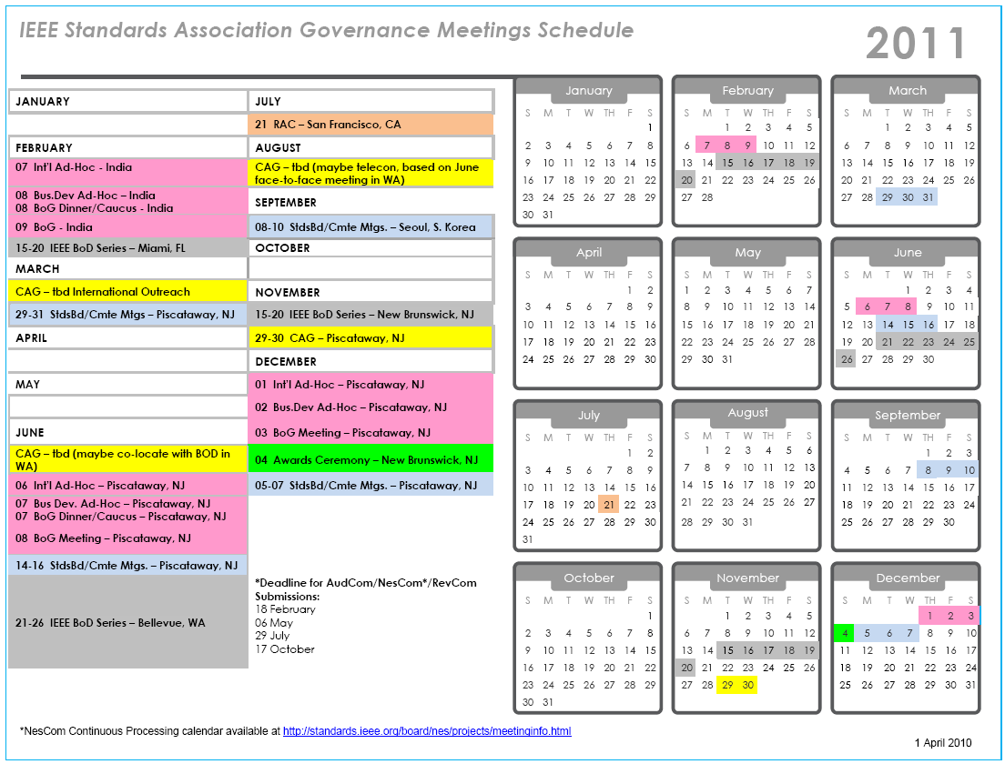

Slide 37
