Slide 1
Smart Grid SC– September 2011
Name | Company | Address | Phone | email
Bruce Kraemer | Marvell | 5488 Marvell Lane, Santa Clara, CA, 95054 | +1-321-751-3988 | bkraemer@marvell.com
Date: 22 September 2011
Discussion topics during September Okinawa Session
Tuesday Abstract:
1 – NIST PAP2
2 – November Tutorial

Slide 2
Okinawa Agenda
PAP02 GOALS, Work plan, Schedule,
Catalog of Standards
Framework Documents
Modeling Tool
PAP02 Intro
Cyber Security
Publications and References

Slide 3
NIST SGIP
PAP02 Update

Slide 4
802 Goals in the PAP02 Context
Recognition of IEEE 802 wireless standards in NIST Catalog of Standards
Acceptance of wireless standards as viable in Smart Grid deployments

Slide 5
Okinawa Meeting Goals
Information about NIST SGIP PAP02 status and plans
Determine best method for developing or reviewing key deliverables

Slide 6
Major 802 Engagement Opportunities in SGIP
Participate in the PAP02 activity to develop Wireless Guideline 2.0
Prepare and Submit application paperwork for 802 standards to NIST for inclusion in the Catalog of Standards

Slide 7
Guideline Version 1
Attribute | Standard Information
Identifier of the standard | NIST IR 7761
Title of the standard | Guidelines for Assessing Wireless Standards for Smart Grid Applications
Name of owner organization | NIST
Latest versions, stages, dates | 1
URL(s) for the standard | http://collaborate.nist.gov/twiki-sggrid/pub/SmartGrid/PAP02Objective3/NIST_PAP2_Guidelines_for_Assessing_Wireless_Standards_for_Smart_Grid_Applications_1.0.pdf
http://collaborate.nist.gov/twiki-sggrid/bin/view/SmartGrid/SGIPCosSIFNISTIR7761

Slide 8
Guideline Sections
Sect 2 Acronyms and Definitions
Sect 3 SG Conceptual Model & Business Requirements
Sect 4 Wireless Technology
Sect 5 Modeling & Evaluation Approach
Sect 6 Factors to Consider
Sect 7 Conclusions
Sect 8 References
Sect 9 Bibliography
Annex (e.g. A, B, C, D, E)

Slide 9
Guideline 1 to 2 Differences
Provide a significantly better method for analyzing/comparing the performance of a wireless technology in a representative physical environment with a specified data load scenario
  Utilize realistic data loading (developed by OpenSG)
  Significantly extend the technology modeling (SDO sub com)
  Correct definitions contained in Section 4

Slide 10
PAP02 Guideline - Schedule Overview
Wireless Guideline 1 published – Jan 13, 2011
Finalize wireless model – Oct 7, 2011
Revise Sections 2,3,4,5,6,7,8,9,Annex - March 16, 2012
Collect all details on modeling scenarios – Nov 4, 2011
Exercise, refine, output model results – Feb 3, 2012
PAP02 vote on Guideline 2
Submit Guideline 2 to CoS process – April 16, 2012
Wireless Guideline 2 published – Aug 10, 2012

Slide 11
Significant Work Items for 802
Which deliverables require explicit input & approval from 802? When? How to organize the activities?

Slide 12
Guideline - Division of Labor
NIST SGIP
PAP02
Board
Cyber Security
Architecture

Slide 13
PAP02- Phase 2-SDO Sub Committee Charter
Intro
Thanks to Ron Cunningham for his diligent preparation of requirements for completion of Phase 2.
We propose that it is time for the wireless SDO’s to take a more active role in constructing the analytic
Proposal/Request
We request authorization from PAP2 members to form an “SDO subcommittee” committed to completing delivery of an operational analysis framework , and related descriptive text, in time for presentation to the Dec 05, 2011 SGIP board meeting.
Goals
Example of deliverables include: Definition of propagation model, ability to calculate quantity of wireless equipment required to cover a given demographic/topographic area and description of statistical confidence in reported numbers
Utility/GRID Input Requirements
Information regarding actor quantities by type, relative locations, topography, data traffic loads
Synchronization
“SDO subcommittee” will report progress to during currently scheduled biweekly PAP2 calls
Logistics
“SDO subcommittee” will convene a series of teleconferences scheduled to optimize SDO participation but open to all PAP2. SDO subcommittee will self organize , assign/delegate work. develop a milestone based project schedule. Webinar facilities will be available.
Membership
“SDO subcommittee” is a volunteer group initially underwritten by ATIS, IEEE, TIA, and WiMAX. Additional wireless SDO participants will be recruited

Slide 14
SDOs Subcommittee Update
We are considering a parallel approach:
  Completion of Guideline v2, and
  Submission of the CoS paperwork by the individual SDOs
Discussed Ron’s proposed Workplan and made appropriate changes. Notes:
  The timeline is based on the existing scope of the Subcommittee (see slide entitled “Model Acceptance questions” from last time)
  Ron will add a line item to capture additional work that may be required for “multi-unit dwellings”
Discussed updates to section 5:
  For the indoor path loss model, we will analyze and compare various models, but we will not recommend a specific one
  Whether we will recommend a specific outdoor path loss model is for further study.

Slide 15
PAP02 Activities
•Purpose: Biweekly meeting to discuss PAP 2 work items
•Webinar Info: https://www2.gotomeeting.com/register/798765194
August 16 - Teleconference 2:00pm ET
Tuesdays Aug 30, Sep 13, 27 - Teleconference 2:00pm ET
SDO Sub-group
•Purpose: Sub-group open to anyone with technical knowledge interested in contributing to clarifying SDO terms and generating estimates for covered equipment
•When: Occurs every Monday effective 8/8/2011 from 9:00 AM to 10:30 AM (UTC-08:00) Pacific Time (US & Canada).
•Conference Bridge Information Phone: +1-858-658-1111 Conference ID: 3827472 Passcode: 0681

Slide 16
SDO Activities
Complete all work by November
Verify completion criteria
  Deviation from standard procedure assumed – verifying
Complete propagation model
  One approach for all technologies?

Slide 17
PAP02
Modeling Tool

Slide 18
SDO Update – Modeling Tool
Goal: Provide “easy-to-use” tool for utilities to do AT evaluations
  Generically applicable to “terrestrial-based” ATs for “apples-to-apples” comparisons of coverage and cell capacity
Inputs required:
  Cell-Edge Perf. ►System Gain ► Link Budget ► Range
  Propagation model (Erceg-SUI, Hata-Okumura, COST231, WINNER II, ITU-R M.2135-1)
  Application: Mobile Handset, AMI network, DAP backhaul, etc.
Key question: Can we get required performance detail for each AT to achieve our objective?
  Mod/coding vs. S/(N+I), HARQ differences, hand-offs, Interferences margins, etc
  Unlicensed vs. Licensed
Near term SDO Activity (next 1-2 weeks): Focus on Link Budget
  WiMAX, LTE, CDMA2000, 802.11, 802.15

Slide 19
SDO Update – Modeling Tool

Slide 20
PAP02
802 Work Plan

Slide 21
802 Work Plan Discussion
Determine best method for developing or reviewing key deliverables

Slide 23
NIST SGIP
Catalog of Standards

Slide 24
Guiding Principles for Identifying Standards for Implementation (part 1)
For Release 2.0, a standard, specification, or guideline was evaluated on whether it:
Is well-established and widely acknowledged as important to the Smart Grid.
Is an open, stable, and mature industry-level standard developed in a consensus process from a standards development organization (SDO).
Enables the transition of the legacy power grid to the Smart Grid.
Has, or is expected to have, significant implementations, adoption, and use.
Is supported by an SDO or users group to ensure that it is regularly revised and improved to meet changing requirements and that there is a strategy for continued relevance.
Is developed and adopted internationally, wherever practical.
Is integrated and harmonized, or there is a plan to integrate and harmonize it with complementing standards across the utility enterprise through the use of an industry architecture that documents key points of interoperability and interfaces.
http://www.nist.gov/smartgrid/
Conceptual Model

Slide 25
Guiding Principles for Identifying Standards for Implementation (part 2)
Enables one or more of the framework characteristics as defined by EISA* or enables one or more of the six chief characteristics of the envisioned Smart Grid.†
Addresses, or is likely to address, anticipated Smart Grid requirements identified through the NIST workshops and other stakeholder engagement.
Is applicable to one of the priority areas identified by FERC‡ and NIST:
  Demand Response and Consumer Energy Efficiency;
  Wide Area Situational Awareness;
  Electric Storage;
  Electric Transportation;
  Advanced Metering Infrastructure;
  Distribution Grid Management;
  Cybersecurity; and
  Network Communications.
http://www.nist.gov/smartgrid/
Conceptual Model

Slide 26
Catalog of Standards Process + Deliverables
Process to progress standard to "all artifacts completed" state
As each artifact is constructed, update this page's record by setting an "X" in the appropriate column
Construct TWiki Page (use procedure on this page CoSTWikiPageConstruction)
Complete Standard Information Form (SIF) with help of SSO proponent (SIF Template): note:check Catalog of Standards page for attached pdfs from earlier version of SIF
Complete Development Process Statement (DPS) (SDP Template)
Develop initial Criteria and Analysis Report (C&AR) (C&AR Template)
Perform SGAC, CSWG, SGTCC, IPRWG reviews -- attach review documents to standard's TWiki page and place summary of comments on page
http://collaborate.nist.gov/twiki-sggrid/bin/view/SmartGrid/CoSStandardsReviewQueueAndTrackingTool

Slide 27
CoS Standards Development Process
Submitter shall provide materials describing specification development process.
Must support maxims i thru v of OMB Circular A-119 with regard to Voluntary Consensus Standards
Openness
Balance of interests
An Appeals process
Consensus
http://collaborate.nist.gov/twiki-sggrid/bin/view/SmartGrid/SGIPCosSIFNISTIR7761

Slide 28
Development Process
http://collaborate.nist.gov/twiki-sggrid/pub/SmartGrid/SGIPCatalogOfStandards/SGIP_CoS_DevelopmentProcessStatement.doc

Slide 29
NIST SGIP
Cyber Security

Slide 30
CSWG Comments on 7761
The CSWG recommends the PAP-02 output document, Wireless Standards for the Smart Grid, be accepted as is, but that additional documents be developed in future efforts (in a DEWG or PAP) that:
• Address relevant key security requirements identified in the NISTIR 7628, Guidelines for Smart Grid Cyber Security, then add NISTIR 7628 as a normative reference. This effort would require completion of a risk assessment to determine applicable security requirements.
• Assess the various cybersecurity techniques used with wireless systems, as well as assess the impacts of these cybersecurity techniques on complete wireless systems, including the degree/type of security, performance considerations, configuration issues, and policies/procedures required to ensure their effectiveness.
• Develop additional Use Cases that cover wireless-specific cybersecurity requirements.
http://collaborate.nist.gov/twiki-sggrid/bin/view/SmartGrid/SGIPCosSIFNISTIR7761

Slide 31
November 2011
Smart Grid Tutorial

Slide 32
Proposed November 2011 Tutorial
Possible Topics and Speakers
IEEE Activities – Bill Ash
European Perspective (EC, ITU, ETSI) – Tom Siep, Larry Taylor
WiFi Status Report – Dave Halasz
SEP 2.0 Bob Heile
NIST SGIP PAP02 – Bruce Kraemer
EPRI Status Report – Tim Godfrey
15.4g Status Report – Phil Beecher
PAP15 & P1901 - ?

Slide 33
NIST SGIP
Framework Documents

Slide 34
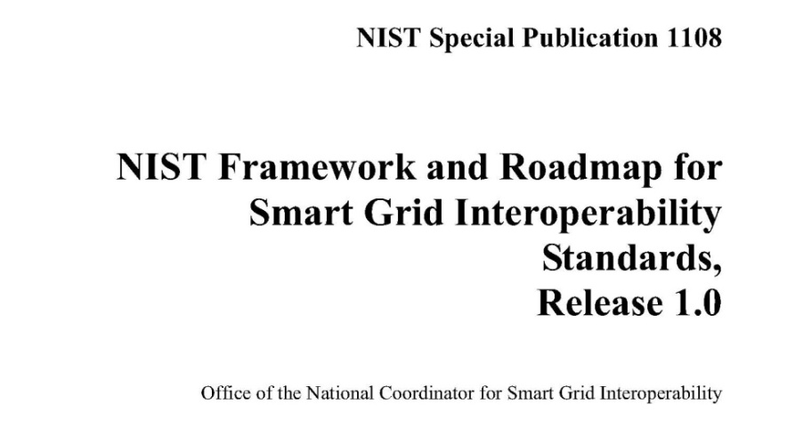
NIST Smart Grid Framework and Roadmap, Release 1.0
Published January 2010
http://www.nist.gov/smartgrid/
Contents
Purpose and Scope
Smart Grid Visions
Conceptual Reference Model
Standards Identified for Implementation
Priority Action Plans
Cyber Security Risk Management Framework and Strategy
Next Steps
Acronyms
Appendix: Specific Domain Diagrams
Conceptual Model
http://collaborate.nist.gov/twiki-sggrid/pub/SmartGrid/IKBFramework/NISTFrameworkAndRoadmapForSmartGridInteroperability_Release1final.pdf

Slide 35
NIST Smart Grid Framework and Roadmap, Release 2.0
Released for Comment July 2011
http://www.nist.gov/smartgrid/
Contents
Purpose and Scope
Smart Grid Visions
Conceptual Architectural Framework
Standards Identified for Implementation
Smart Grid Interoperability Panel
Cybersecurity Strategy
Framework for Smart Grid Interoperability
Next Steps
Acronyms
Appendix: Specific Domain Diagrams
Conceptual Model
http://collaborate.nist.gov/twiki-sggrid/pub/SmartGrid/IKBFramework/Draft_NIST_Framework_Release_2-0_7-11-2011_clean.docx

Slide 36
NIST SGIP
PAP02 Intro
Abstract:
This work area investigates the strengths, weaknesses, capabilities, and constraints of existing and emerging standards-based physical media for wireless communications. The approach is to work with the appropriate standard development organizations (SDOs) to determine the characteristics of each technology for Smart Grid application areas and types. Results are used to assess the appropriateness of wireless communications technologies for meeting Smart Grid applications.
http://collaborate.nist.gov/twiki-sggrid/bin/view/SmartGrid/PAP02Wireless

Slide 37
PAP2 Links
PAP02: Wireless Communications for the Smart Grid (6.1.5)
Contents of this topicUseful Hot LinksAbstract:
Status of PAP02: Wireless Communications for the Smart Grid (6.1.5)
Task Details:
Description:
Objectives:
Why:
Where:
Who:
2011 Upcoming Meetings
  May 10 - Teleconference 2:30pm ET
  May 24, June 7, June 21, July 5, July 19, Aug 2, Aug 16, Aug 30 - Teleconference 2:00pm ET
  July 12-14, 2011 - SGIP Summer Meeting, Montreal Canada

Slide 38
Subscription to NIST PAP#2
To see the complete NIST Priority Action Plan list go here:
http://collaborate.nist.gov/twiki-sggrid/bin/view/SmartGrid/PriorityActionPlans#Individual_PAP_Lists
To subscribe to PAP#2 mailing list go here:
http://www.smartgridlistserv.org/cgi/wa.exe?SUBED1=SGIP-PAP02WG&A=1

Slide 39
OpenSG
SharePoint Documents
http://osgug.ucaiug.org/UtiliComm/Shared%20Documents/Forms/AllItems.aspx

Slide 40
PAP#2 Version 1
Guideline for Assessing Wireless Standards for Smart Grid Applications
Version 1.0 released Jan 13, 2011
http://collaborate.nist.gov/twiki-sggrid/pub/SmartGrid/PAP02Objective3/NIST_PAP2_Guidelines_for_Assessing_Wireless_Standards_for_Smart_Grid_Applications_1.0.pdf

Slide 41
NIST SGIP
Cyber Security

Slide 42
Smart Grid Cyber Security Strategy
Cyber Security Coordination Task Group (CSCTG) to develop a set of recommended cyber security requirements
http://collaborate.nist.gov/twiki-sggrid/bin/view/SmartGrid/CyberSecurityCTG
Draft NIST Interagency Report (NISTIR) 7628, Smart Grid Cyber Security Strategy and Requirements
  Comments must be received on or before December 1, 2009
  How to provide comments:
  http://edocket.access.gpo.gov/2009/E9-24430.htm
  Final document planned for publication in March 2010.

Slide 43

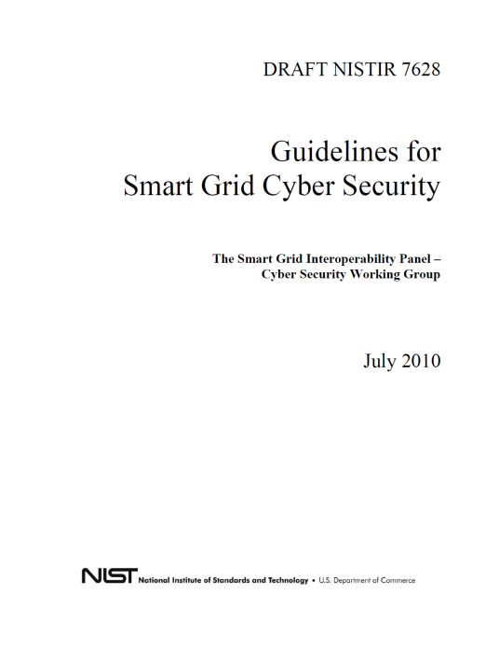
Cyber Security Working Group
Building cyber security in from the start has been a paramount concern
Permanent Working Group
  Over 460 public and private sector participants
August 2010 NIST publishes: Guidelines for Smart Grid Cyber Security
  Reflects Comments on Sept 2009 and Feb 2010 Draft Smart Grid Cyber Security Strategy and Requirements
Guideline includes:
  Risk assessment guidance for implementers
  Recommended security requirements
  Privacy recommendations
Notes:
43

Slide 44
NIST SGIP
Publications
&
References

Slide 45
Key SGIP Publications
Smart Grid Interoperability Panel Catalog of Standards
NIST-identified Standards for Consideration by Regulators, Release 1.0
GAO Report 11-117:Electricity Grid Modernization
NISTIR 7628 Guidelines for Smart Grid Cyber Security (3 vols.)
http://csrc.nist.gov/publications/nistir/ir7628/nistir-7628_vol1.pdf
http://csrc.nist.gov/publications/nistir/ir7628/nistir-7628_vol2.pdf
http://csrc.nist.gov/publications/nistir/ir7628/nistir-7628_vol3.pdf
NIST Framework and Roadmap for Smart Grid Interoperability Standards, Release 1.0
http://collaborate.nist.gov/twiki-sggrid/pub/SmartGrid/IKBFramework/NISTFrameworkAndRoadmapForSmartGridInteroperability_Release1final.pdf
NIST Framework and Roadmap for Smart Grid Interoperability Standards, Release 2.0 (204 pages)
http://collaborate.nist.gov/twiki-sggrid/pub/SmartGrid/IKBFramework/Draft_NIST_Framework_Release_2-0_7-11-2011_clean.docx
Charter for the Smart Grid Advisory Committee

Slide 46
Sources
NIST Smart Grid web site
  http://www.nist.gov/smartgrid/
NIST Smart Grid Twiki
  http://collaborate.nist.gov/twiki-sggrid/bin/view/SmartGrid/WebHome
IP Priority Action Plan
  http://collaborate.nist.gov/twiki-sggrid/bin/view/SmartGrid/PAP01InternetProfile
Wireless Priority Action Plan
  http://collaborate.nist.gov/twiki-sggrid/bin/view/SmartGrid/PAP02Wireless

