Slide 1
Status of IEEE 802.11ah and relevance to the Smart Grid
Date: 2011-9-4
Authors:

Slide 2
Abstract
The following presentation gives a status of IEEE 802.11ah and it’s relevance to the Smart Grid.

Slide 3
Activity leading up to IEEE 802.11 Sub 1 GHz Study Group
November 2009, Smart Grid Tutorial describes using IEEE 802.11 in Neighborhood Area Network going to electric meter and inside the home. [1]
January 2010, Presentation in IEEE 802.11 WNG describes creating an amendment in IEEE 802.11 for Sub 1 GHz operation. [2]
March 2010, Feedback on the January presentation was given. [3]
March 2010, IEEE 802.11 Study Group formation was approved.

Slide 4
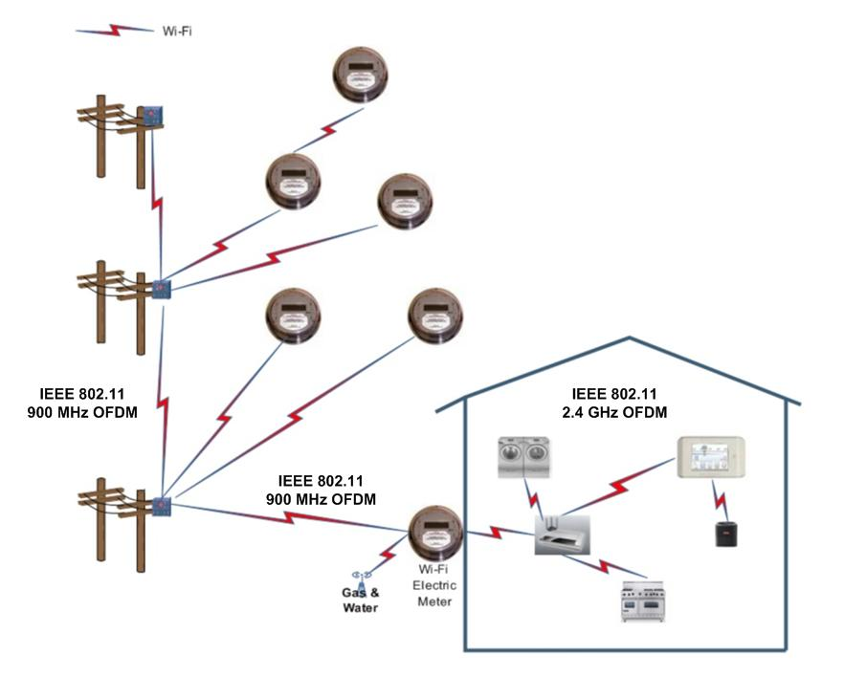
Initial thoughts
2.4 GHz already present inside the home.
Re-banding effort
Use common IEEE 802.11 MAC
Use sub 1 GHz for longer range
Star architecture for meter access
IEEE 802.11s mesh for backhaul

Slide 5
IEEE 802.11 Sub 1 GHz Study Group Activity
Purpose of SG is to create a Project Authorization Request (PAR). Define scope of work to be done.
PAR scope started as,
Re-banding effort of OFDM and add narrower channels
Major comments heard and responded to was,
Treat as new OFDM PHY rather than just re-banding of OFDM
Ended as [4],
Re-banding of 802.11 OFDM and other OFDM submissions are within scope
Exclude TV (not just TVWS) bands
Explicitly noted coexistence with .15 radios

Slide 6
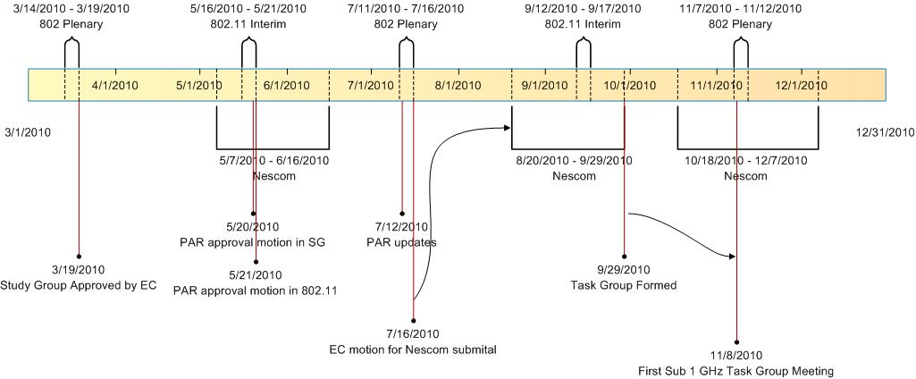
Study Group to Task Group timeline

Slide 7
Interest in IEEE 802.11 Sub 1 GHz grows
By 2nd Task Group meeting, attendance was growing. It was clear that some process was needed.
A specification development process document was approved in March of 2011 [5]. The process requires development of guiding documents.
Usage Model document
Channel Model document
Functional Requirements and evaluation methodology document
Specification Framework
Ad hoc sub groups develop IEEE 802.11ah draft text from Specification framework document.

Slide 8
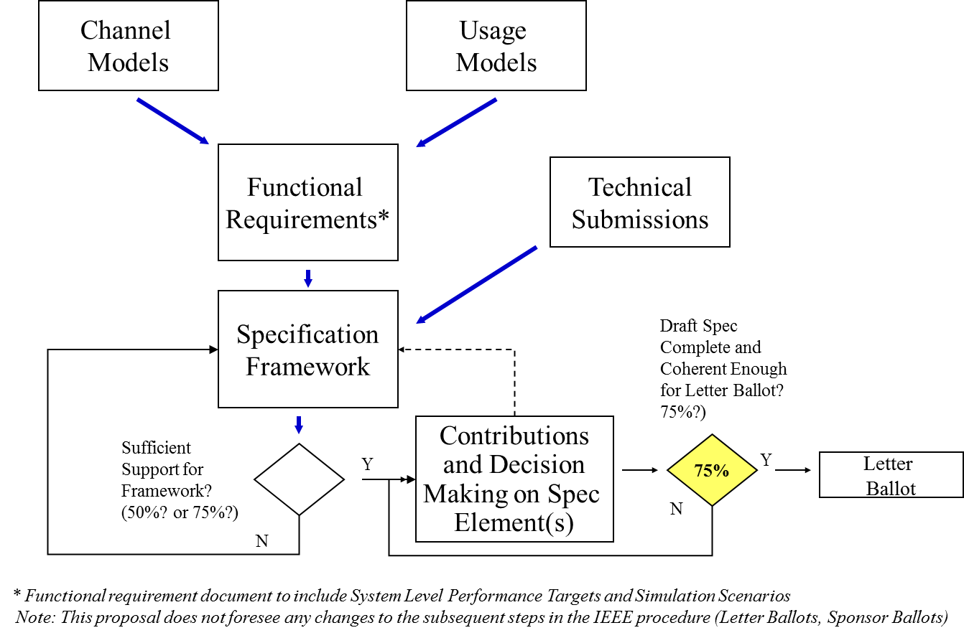
Specification Development Process
[5] page 5.

Slide 9
Specification Development Process Status
Guiding Documents | Ad Hoc Group Chair | Document | Adopted a revision?
Specification Development Process | Dave Halasz (Aclara) | 11/0239r02 | Yes, R2 in March 2011
Use Cases | Stefan Aust (NEC) | 11/0457r00 | Yes, R0 in March 2011
Channel Models | Jim Lansford (CSR) | 11/0968r01 | Yes, R1 in July 2011
Requirements | Minho Cheong (ETRI) | 11/0905r03 | Yes, R3 in July 2011
Specification Framework | Minyoung Park (Intel)
After initial draft text is adopted then the normal IEEE 802.11 Working Group Balloting process starts.
[5] page 1.

Slide 10
Use Cases
Use Case 1 : Sensors and meters
Use Case 2 : Backhaul Sensor and meter data
Use Case 3 : Extended range Wi-Fi
[6] page 3.

Slide 11
Use Cases cont.
Case 1
Use case document includes indoor and outdoor.
Case 2
Case 1
Case 1

Slide 12
Channel Models
Outdoor
Based on 3GPP/3GPP2 spatial channel model (SCM)
Indoor
Based on TGn (MIMO) channel models
[7] page 1.

Slide 13
Forecast on Specification framework
Instead of typical direction of speed improvements, go farther and more reliably.
Decide on channelization
Channel bandwidth
Number of carriers
etc.
Include repetition for improved reliability
etc.

Slide 14
Forecasted timeline
Use Cases
Chnl Mdls
Func Req
Spec Frm
JAN
MAR
MAY
JUL
SEP
NOV
JAN
MAR
MAY
JUL
SEP
NOV
JAN
TGah
First motion
Sub groups formed
[8] page 3.

Slide 15
Forecasted timeline cont.
Revcom approval of IEEE 802.11ah amendment in November of 2014.
[8] page 4.

Slide 16
References
https://mentor.ieee.org/802.11/dcn/09/11-09-1201-01-0000-802-opportunities-and-next-steps.pdf
https://mentor.ieee.org/802.11/dcn/09/11-09-1313-05-0wng-900-mhz-ism-band.ppt
https://mentor.ieee.org/802.11/dcn/10/11-10-0204-04-0wng-commentsonsub1ghz.ppt
https://mentor.ieee.org/802.11/dcn/10/11-10-0001-13-0wng-900mhz-par-and-5c.doc
https://mentor.ieee.org/802.11/dcn/11/11-11-0239-02-00ah-proposed-selection-procedure.docx

Slide 17
References cont.
https://mentor.ieee.org/802.11/dcn/11/11-11-0457-00-00ah-potential-compromise-of-802-11ah-use-case-document.pptx
https://mentor.ieee.org/802.11/dcn/11/11-11-0968-01-00ah-channel-model-text.docx
https://mentor.ieee.org/802.11/dcn/11/11-11-0285-02-00ah-timeline-projection.pptx

