Slide 1
Use Cases For FILS
Date: 2011-09-19
Authors:

Slide 2
What is 802.11ai?
802.11ai — Will define the way artificially intelligent robots overtake the world using Wi-Fi.*
Actually, that’s a lie.
No public info is yet available for 802.11ai.
*https://www.cwnp.com/cwnp_wifi_blog/802-11-alphabet-soup

Slide 3
Use Case Process
Prototypical use cases
Establishes a small set reference use cases
Provides summary all use cases accepted by TGai
Sets criteria for 802.11ai submissions
Full set of use case in
11-11-0238-19-00ai-Use-Case-Reference-List-for-TGai.docx

Slide 5
Definitions (1 of 2)
FILS = Fast Initial Link Setup
Device set
mobile STA
network access point
Use Case Differences
Link-Attempt Rate
Media Load
Coverage Interval
Link Setup Time

Slide 6
Definitions (2 of 2)
Link-Attempt Rate
Connection attempts per second
Media Load
“Busyness” of the medium
Coverage Interval
Time within the range
Link Setup Time
Tolerable time to connect

Slide 7
Tokyo Central Station

Slide 8
Tokyo Central Station Use Case
Very large number of pedestrians attempt to connect at virtually the same time
General internet access with graphics and video
Link-Attempt Rate: 100s/second
Media Load: 50%
Coverage Interval <10 sec
Link Setup Time 100 ms
Driver for the adoption of FILS

Slide 9
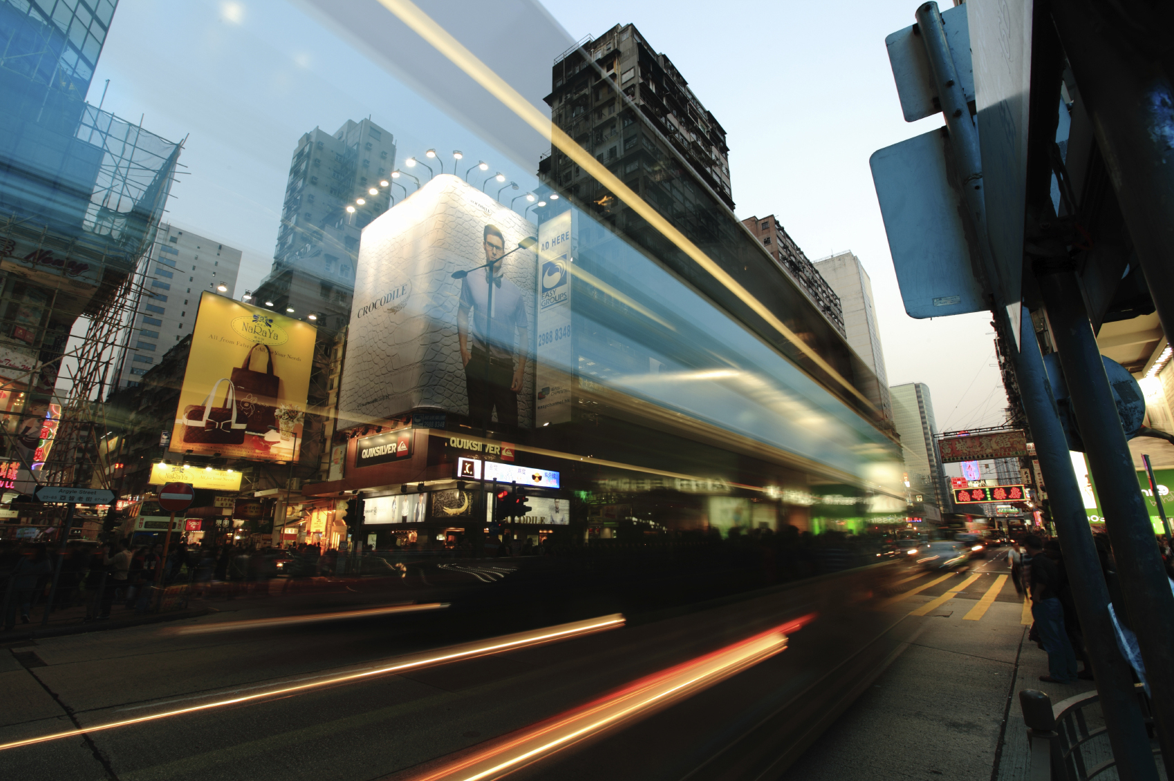
Drive-by Information

Slide 10
Drive-by Use Case
Large number of vehicles
uploading/downloading a large amount of information
only in range for a short time.
Includes text, graphics, video
Link-Attempt Rate <10
Media Load 10 to 50%
Coverage Interval <1 second
Link Setup Time <100 ms
FILS is required to make the use case viable for 802.11

Slide 11
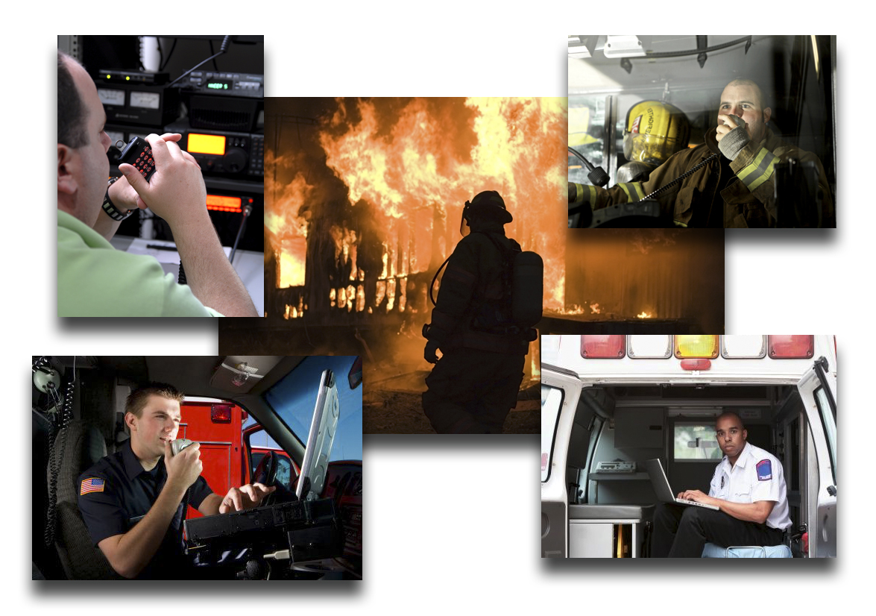
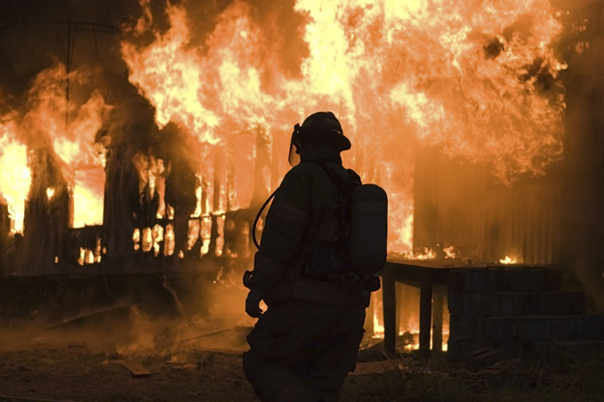
Emergency Coordination

Slide 12
Emergency Coordination Use Case
Establish a temporary infrastructure at an emergency
Includes: voice, text, graphics, video
Link-Attempt Rate 10
Media Load 10 - 50%
Coverage Interval >10 sec
Link Setup Time >2 seconds
Once FILS resides in the STA/AP, it will promote usage

Slide 13
Handover from Mobbile to Wi-Fi

Slide 14
Handover Use Case
Offload 3G/4G Mobile uses to WLAN
Includes: voice, text, graphics, video
Link-Attempt Rate <10
Media Load 10 - 50%
Coverage Interval >10 sec
Link Setup Time 200 milliseconds
Perhaps the “sleeper” application for FILS
Notes:
In an interactive session (for instance, Skype video) does not always survive when switching from 3G to WLAN because getting WLAN interface operational takes too long. FILS will allow parallelization of other configurations, such as IP address resolution. Use case is to switch off one interface then switch on the other so as to have only one radio on at a time. Pre-association has started, but no association or IP configuration done as yet.

Slide 15
Other Use Cases
Pedestrian
Electronic Payment
Traveller Information
Pedestrian Signal System
Vehicle
Electronic Payment
Internet Access
Emergency Services
Inspections
Resource Management
Transit
Station arrival
Passenger In-transit access
Station Lobby
Connection Protection
Dynamic Transit Operations
Notes:
Pedestrian
Electronic Payment
Traveller Information
Internet Access
Mobile Accessible Pedestrian Signal System
Vehicle
Electronic Payment
Traveller Information
Internet Access
Emergency Services
Inspections
Resource Management
Transit
Station arrival
Passenger In-transit access
Station Lobby
Connection Protection
Dynamic Transit Operations

Slide 16
References
11-10-1152-01-0fia-fast-initial-link-set-up-par.doc
11-11-0281-00-00ai-proposed-dynamic-mobility-use-cases-for-tgai.docx
11-11-0148-07-00ai-use-cases-for-tgai.docx
11-11-0122-00-00ai-3g-wlan-handover.pptx
11-11-0408-02-00ai-Use_Case_Characteristics_Discussion.pptx
11-11-0023-02-00ai-use-case-senario-for-tgai.pptx
11-11-0441-00-00ai-self-growing-use-cases-requiring-fast-initial-link-setup.docx
11-11-0746-00-00ai-discussion-on-how-many-aps-to-cover.ppt
11-11-0750-00-00ai-use-case-document-definitions.pptx
11-11-0619-00-00ai-use-case-network-mobility.pptx
11-11-0797-00-00ai-use-case-mobile-hotspot.pptx

