Slide 1
Use Cases For FILS
Date: YYYY-MM-DD
Authors:

Slide 2
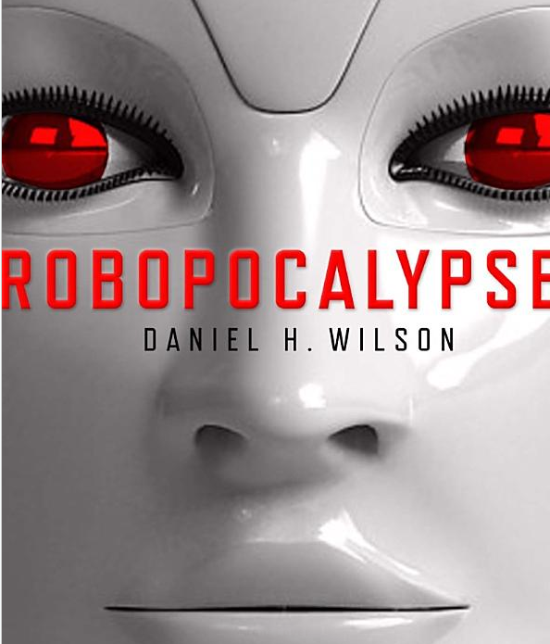
What is 802.11ai?*
802.11ai — Will define the way artificially intelligent robots overtake the world using Wi-Fi.
Actually, that’s a lie. No public info is yet available for 802.11ai.
*https://www.cwnp.com/cwnp_wifi_blog/802-11-alphabet-soup
Notes:
If possible, a background of something that alludes to robots taking over the world would be good here. I don’t know what the copyright implications are of using a book cover, but something vaguely sinister like the cover of Robopocalyspes would be work. (I lifted this snapshot from Amazon.com). Something like a 75% transparency may be best.

Slide 3
Use Case Process
Prototypical use cases
  Establishes a small set reference use cases
  Provides summary all use cases accepted by TGai
  Sets criteria for 802.11ai submissions
Full set of use case in
  11-11-0238-19-00ai-Use-Case-Reference-List-for-TGai.docx

Slide 4
Definitions (1 of 2)
FILS = Fast Initial Link Setup
For FILS, the device set is
  a mobile STA
  a network access point
The traits which differentiate
the use cases are:
  Link-Attempt Rate
  Media Load
  Coverage Interval
  Link Setup Time
Picture with lots of people getting connected to the Internet

Slide 5
Definitions (2 of 2)
Link-Attempt Rate
  The number attempting to
  link for the first time per second
Media Load
  “Busyness” percentage of time
  the medium is in use
Coverage Interval
  Time within the range
Link Setup Time
  Starts when elects to connect
  ends with a valid IP address
Picture with lots of people getting connected to the Internet (same as previous)
Notes:
NOTE: “link”, “association”, and “authentication” are as defined per 802.11

Slide 6
Tokyo Central Station Use Case
A very large number of relatively slow-moving pedestrians attempt to connect at virtually the same time at Tokyo Central Train Station
  Link-Attempt Rate: 100s/second
  Media Load: 50%
  Coverage Interval <10 sec
  Link Setup Time 100 ms
Driver for the adoption of FILS.

Slide 7
Tokyo Central Station
[picture of wall-to-wall people in a train station]
Picture of a busy train station with lots of people getting connected to the Internet

Slide 8
Drive-by Use Case
Large number of vehicles uploading/downloading a large amount of information, only in range for a short time.
  Link-Attempt Rate <10
  Media Load 10 to 50%
  Coverage Interval <1 second
  Link Setup Time <100 ms
Without FILS the use case is not addressed well enough to be a viable use case for 802.11

Slide 9
Drive-by Information
[picture of]
Picture of in-vehicle real-time information from local source being driven past

Slide 10
  Emergency coordination Use Case
Establish a temporary IP network on-site at an emergency site
Includes: voice, text, graphics, video
  Link-Attempt Rate 10
  Media Load 10 - 50%
  Coverage Interval >10 sec
  Link Setup Time >2 seconds
Unlikely to be the reason for migration to FILS, but once it resides in the STA/AP, it will promote usage.

Slide 11
Emergency Coordination
Picture of major fire or accident with audio/graphic/video communications devices

Slide 12
Handover from cell to Wi-Fi
Picture a crowded area (maybe a Starbucks or a stadium (or a Starbucks at a stadium)) where lots of people are using cell phones.

Slide 13
collage of other use cases
Picture of Handover between cell phone and
Pedestrian
  Electronic Payment
  Traveller Information
  Internet Access
  Mobile Accessible Pedestrian Signal System
Vehicle
  Electronic Payment
  Traveller Information
  Internet Access
  Emergency Services
  Inspections
  Resource Management
Transit
  Station arrival
  Passenger In-transit access
  Station Lobby
  Connection Protection
  Dynamic Transit Operations
Self-growing networking
  Handover between 3G and WLAN
  n

Slide 14
References
11-10-1152-01-0fia-fast-initial-link-set-up-par.doc
11-11-0281-00-00ai-proposed-dynamic-mobility-use-cases-for-tgai.docx
11-11-0148-07-00ai-use-cases-for-tgai.docx
11-11-0122-00-00ai-3g-wlan-handover.pptx
11-11-0408-02-00ai-Use_Case_Characteristics_Discussion.pptx
11-11-0023-02-00ai-use-case-senario-for-tgai.pptx
11-11-0441-00-00ai-self-growing-use-cases-requiring-fast-initial-link-setup.docx
11-11-0746-00-00ai-discussion-on-how-many-aps-to-cover.ppt
11-11-0750-00-00ai-use-case-document-definitions.pptx
11-11-0619-00-00ai-use-case-network-mobility.pptx
11-11-0797-00-00ai-use-case-mobile-hotspot.pptx

