Slide 1
Amendment Creation Process
Date: YYYY-MM-DD
Authors:

Slide 2
Abstract
Overview of process
Suggested areas which may need to be modified to create an 11ai amendment to 802.11mb Rev 9

Slide 3
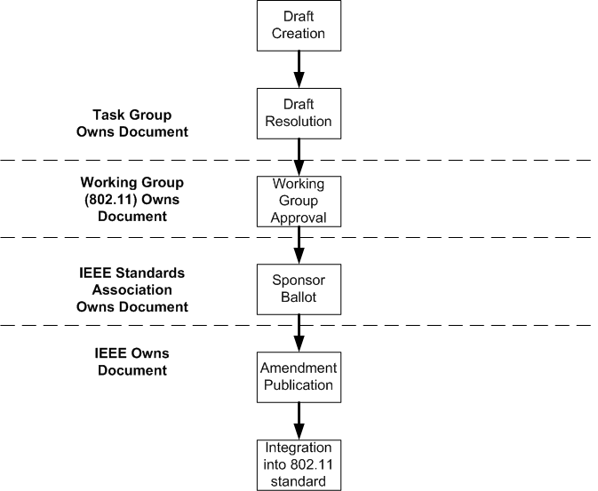
Overview of Process

Slide 4
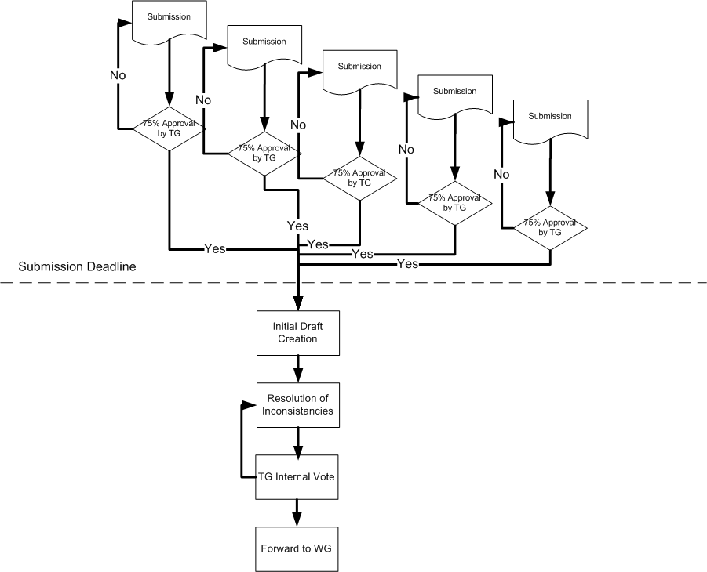
Draft Creation

Slide 5
Example of Standard Amendment Proposal Citation
Document 11/1014r0

Slide 6
Possible Areas for Modification
Section 3 – Definitions and Acronyms
Section 5 – MAC Service definition
Section 6 – Layer Management
Section 8 – Frame Formats
Section 9 – MAC sublayer functional description
Section 10 – MLME
Section 11 – Security
Section 12 – Fast BSS transition (?)
New section for AP functionality?

Slide 7
Section 3 – Definitions and Acronyms
Any new terms or acronyms
Examples
FILS
Link Setup Time

Slide 8
Section 5 – MAC Service definition
Service primitives
Interface definition to upper layers

Slide 9
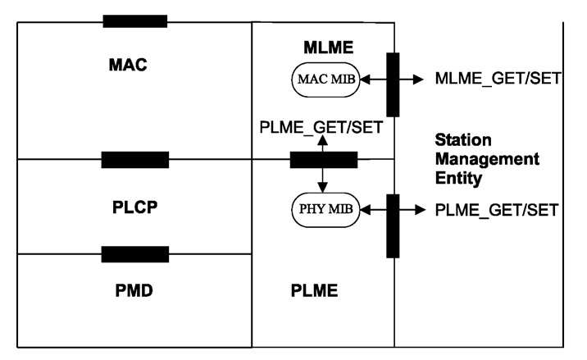
Section 6 – Layer Management

Slide 10
Section 8 – Frame Formats
Over the air communication between devices
Typically STA to AP (and back)

Slide 11
Section 9 – MAC sublayer functional description
Functions required to process FILS

Slide 12
Section 10 – MLME
Synchronization, Power management, Authentication, …
May want to add new section

Slide 13
Section 11 – Security
If changes
Complete description of change
Analysis of security to verify it is not compromised.

Slide 14
Section 12 – Fast BSS transition (?)

Slide 15
New section for AP functionality?

Slide 16
References
IEEE Draft P802.11-REVmb™/D9.0, May 2011
11-11-1014-00-00ai-ip-config-during-assoc-norm.docx

