Slide 1
Supplementary Plenary Information - September 2011
Date: 2011-September-19
Authors:
Name
Company
Address
Phone
email
Bruce Kraemer
Marvell
5488 Marvell Lane,
Santa Clara, CA, 95054
+1 (321)
751-3958
bkraemer@
marvell
.com
Abstract: Additional Information on topics for 802 interim meeting – September 2011

Slide 2
Monday

Slide 3
IEEE LOA Database
Monday Agenda Item 3.2.1
http://standards.ieee.org/db/patents/pat802_11.html
18 entries with 2010 submission dates
19 entries with 2011 submission dates

Slide 4
Naha⬄ Convention - Bus information
Downtown Naha → Convention center
9/19（Mon）～9/22（Thu）
Asahibashi (KDDI building) 7:00
Prefectural office ( palette Kumoji) 7:05
Makishi (Hotel Palm Royal) 7:10
9/19（Mon）
Convention center → Down town Naha
Convention center 18:45 / 21:45
9/20 (Tue)
LAGUNA GARDEN HOTEL→ Down town Naha
LAGUNA GARDEN HOTEL 21:45
9/21（Wed）、9/22（Thu)
Convention center → Down town Naha
Convention center 18:45
9/23 (Fri)
Convention center → Air port (email )
Convention center 12:10

Slide 5
Joint Meetings
Monday Agenda Item 4.1.3
External:
Internal
None Scheduled

Slide 6
NEW PARS
Monday Agenda Item 4.1.4
The following PARs were considered July 18-22, 2011, during the 802 plenary meeting in San Francisco, CA
802.1AXbq amendment for distributed resilient network interconnect, PAR and 5C
802.1ASbt amendment for timing and synchronization for time-sensitive applications, PAR and 5C
802.1 AS corrigendum, PAR,
802.1BR new standard for bridge port extension, PAR and 5C
802.3bj amendment for 100 Gb/s operation over backplanes and copper cables, PAR and 5C
802.15.4m amendment to 802.15.4 for TV white space PHY, PAR and 5C
802.22a amendment for management and control plane interfaces and procedures and management information base enhancements, PAR and 5C
Please go to http://www.ieee802.org/PARs.shtml for a complete details
All PARs approved by LMSC
All PARs approved by NesCom/SASB
No PAR review sessions scheduled for September interim

Slide 7
Other PARS
Monday Agenda Item 4.1.4
The following PARs were considered July 18-22, 2011, during the 802 plenary meeting in San Francisco, CA
Withdrawal
P802.1Qbh Bridge Port Extension
802.23 Emergency Services
Extensions
P802 Overview and Architecture extended until Dec 2013
P802.1aq Shortest Bridging Path extended until Sec 2012
All PARs approved by LMSC
All PARs approved by NesCom/SASB
No PAR review sessions scheduled for September interim

Slide 8
New Standards Approved
P802.1AEbn/D0.8 (C/LM) Standard for Local and Metropolitan Area Networks: Media Access Control (MAC) Security Amendment 1: Galois Counter Mode-Advanced Encryption Standard-256 (GCM-AES-256) Cipher Suite
P802.1BA/D2.6 (C/LM) Standard for Local and Metropolitan Area Networks - Audio Video Bridging (AVB) Systems
P802.11s/D12.0 (CLM) Standard for Information Technology - Telecommunications and Information Exchange Between Systems - Local and Metropolitan Area Networks - Specific Requirements - Part 11: Wireless LAN Medium Access Control (MAC) and Physical Layer (PHY) Specifications Amendment 10: Mesh Networking

Slide 9
Group Room assignments
Monday Agenda Item 4.1.5
WG | Room | Location
16 | - no meetings -
18 | B5
19 | B7
20 | - no meetings - | Hibernation
21 | - no meetings -
22 | C2
23 | - no meetings - | Withdrawn

Slide 10
WG18 Agenda
Monday Agenda Item 4.1.6
Monday 1:30- 6:00 pm
Tuesday 8:00 – 6:00 pm
Wednesday 8:00 – 6:00 pm
Thursday 8:00 – 6:00 pm
Noted Items

Slide 11
WG18 Agenda – New item
WG18 Agenda
https://mentor.ieee.org/802.18/dcn/11/18-11-0071-00-0000-rr-tag-agenda-sept-2011.xlsx
Canadian Consultation on TVWS
https://mentor.ieee.org/802.18/dcn/11/18-11-0072-00-0000-consultation-on-non-broadcasting-use-of-spectrum-below-698-mhz.pdf

Slide 12
WG19 Agenda - September
Monday Agenda Item 4.1.7
https://mentor.ieee.org/802.19/dcn/11/19-11-0066-01-0000-july-2011-wg-agenda.xls

Slide 13
Coexistence Assurance (CA) documents
Standard | Coexistence Assurance Document
IEEE 802.11af | IEEE 802.11-11/177r0
IEEE 802.11ad | IEEE 802.11-10/1025r5
IEEE 802.11y | IEEE 802.11-07/2066r1
IEEE 802.11n | IEEE 802.11-06/0338r4
IEEE 802.15.4f | IEEE 802.15-10/918r0
IEEE 802.15.4e | IEEE 802.15-10/737r4
IEEE 802.15.4g | IEEE 802.15-10/668r5
IEEE 802.15.4i | IEEE 802.15-10/808r0
IEEE 802.15.4a | IEEE 802.15.4 Standard. Annex E
IEEE 802.15.3c | IEEE 802.15-09/22r9
IEEE 802.15.4a | IEEE 802.15.4 Standard. Annex E
IEEE 802.15.4b | IEEE 802.15.4 Standard. Annex E
IEEE 802.16h | IEEE 802.19-09/07r0

Slide 14
802 Projects - CA plans
Project | Brief Description | Will Produce a CA Doc.
802.11aa | Audio/Video | No
802.11ac | Below 5 GHz | Yes
802.11ad | 60 GHz | Yes
802.11ae | Priority Management Frames | No
802.11af | TVWS | Yes
802.11ah | Sub 1 GHz | Yes
802.11ai | Fast Initial Link Setup | No
802.15.4e | China | Yes
802.15.4f | RFID | Yes
802.15.4g | SUN | Yes
802.15.4j | Medical Body Area Network | Yes
802.15.4k | Low Energy,Critical Infrastructure Monitoring Network | Yes
802.15.6 | BAN | Yes
802.15.7 | VLC | No
802.22 | WRAN | No
802.22.1 | Beacon | No
802.22.2 | Installation and Deployment | No

Slide 15
IEEE 802.19 CONTACT INFORMATION
IEEE 802.19 CONTACT INFORMATION
WG Chair: Steve Shellhammer
WG Vice Chair: Ivan Reede
WG Secretary: Junyi Wang
Technical Editor: James Gilb
Liaison to 802.11: Eldad Perahia
Liaison from 802.11: Prabodh Varshney
Liaison to 802.15: Shuzo Kato
Liaison from 802.15: Hyunduk Kang
Liaison from 802.18: Junyi Wang
IEEE 802.16 Liaison: Matthew Sherman
Liaison from 802.22: Ivan Reede

Slide 16
WG22 Agenda - September
Monday Agenda Item 4.1.8
https://mentor.ieee.org/802.22/dcn/11/22-11-0109-00-0000-agenda-for-the-september-interim.xls

Slide 17
Emergency Services SG – WG23
Monday Agenda Item 4.1.9
PAR Withdrawn

Slide 18
November Meeting – Atlanta, Georgia, US
November 6-11
Monday Agenda Item 4.1.10
Registration opened in September
Early bird registration expires Oct 7

Slide 19
Venue Logistics
September 2011
Monday Agenda Item 4.1.11
Program plan
http://www.arinex.com.au/ieee2011/docs/IEEE_2011_Program_Room.pdf
No breakfast or coffee prior to 8am meetings
  Coffee service starts at 10:00 am
Do not reconfigure tables – they are very hard wired
Tuesday Social – Laguna Hotel – 6:30 pm
Convention Center access: 7am to 10pm
Slide 19
Bruce Kraemer, Marvell

Slide 20
Monday Tutorial - 18:30-21:30, September 19, 2011
Standardization activities in Japan (15.4 & 11ai)
Conference room A1, Okinawa Convention Center
Moderators Hiroshi Harada (NICT) and Hiroshi Mano (Root Inc.)
Session 1 / 802.15.4 topics 18:30-19:30
1a. What Japan Utility Telemetering Association (JUTA) has done and will do on next-generation Gas metering system in Japan
Hajime Furusawa (Japan Utility Telemetering Association)
1b. Research, development, and testbed on Smart Utility Network by IEEE standard
Fumihide Kojima (NICT)
Session 2 802.11ai (FILS) topics 19:30-21:30
2a. 11ai over view (PAR, Scope and current status) Hiroshi Mano (Root,Inc.) 2b. Prospected Use case reference Tom Siep (CSR) 2c. Basic technical ideas Marc Emmelmann (Fokus) 2d. Security requirements to IEEE802.11ai Paul Lambert (Marvell)

Slide 21
Topics since July EC
Monday Agenda Item 4.1.12
IEEE store revamp – you will now go to:
http://www.techstreet.com/ieeegate.html
Press releases for TGS approved
EC workshop in November – Sat/Sun following plenary

Slide 22
802.11 Topics for November 2011 EC
Monday Agenda Item 4.1.12
Begin Sponsor Ballot
  TGad
  Requests to submit to RevCom?
New project PAR to NesCom ?
  Nothing anticipated
PAR Extension ?
  Nothing anticipated
Study Group start up?
  Nothing anticipated

Slide 23
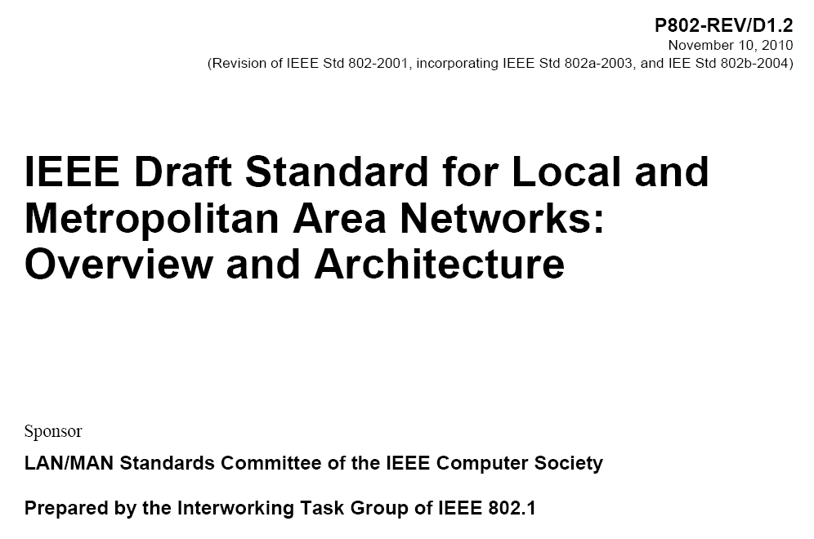
802.1 Architecture Document
Monday Agenda Item 4.1.13

Slide 24
Smart Grid Meetings
Monday Agenda Item 4.1.14
One session
Thursday am2 - B2
Revision of NIST Smart Grid PAP#2 Guideline

Slide 25
November Tutorials
Monday Agenda Item 4.1.15
Smart Grid Update
Any other Suggestions?
http://ieee802.org/Tutorials.shtml

Slide 26
Wednesday

Slide 27
1. Opening remarks (16:00-16:05)
Hiroshi Harada
Director, Smart Wireless Laboratory NICT
2. Standardization Strategies of ICT in Japan (16:05-16:45) Hideo Fuseda Director, Standardization Division, Global ICT Strategy Bureau Ministry of Internal Affairs and Communications
3. Radio Policy in Japan (16:45-17:25)
Yoshiaki Takeuchi
Director, Radio Policy Division Radio Department Telecommunications Bureau Ministry of Internal Affairs and Communications
4. Conformity Certification to Technical Standard in Japan (17:25-18:00) Tohru Koshima Manager, Radio Equipment Group Overseas Testing & Certification Department Telecom Engineering Center (TELEC)
Wednesday Agenda Item 2.2.7
Wednesday Tutorial
https://mentor.ieee.org/802.11/dcn/11/11-11-1243-01-0000-standardization-activities-in-japan.ppt

Slide 28
SC 6 Update
Wednesday Agenda Item 3.2.5
2011. 9. 21
Dae Young KIM
dykim@cnu.kr

Slide 29
WAPI
3 telecons since Aug. 10
hundreds of emails with tens of threads
not much converging /w endless rebuttals
next telecon on Nov. 21
prospect of CRM in the fog

Slide 30
Wednesday Agenda Item 5.1
Room Changes
If needed
Add time slots for TGmb
  Thursday am2 – Waiting Room 0
  Thursday pm2 – Make Up room 1
  Adjourn Tgad
  Release Wed pm1
  Release Thursday pm1
  Thursday am1
  Move TGaf from A2 to A1

Slide 31
Wednesday Agenda Item 5.1
Revised Agenda Graphic
If needed

Slide 32
Wednesday Agenda Item 5.2
Officer Changes
If needed

Slide 33
Friday

Slide 34
IEEE LOA Database
Friday Agenda Item 2.08
http://standards.ieee.org/db/patents/pat802_11.html
18 entries with 2010 submission dates
19 entries with 2011 submission dates

Slide 35
Request to Remove from IEEE Shop - Nov 2010
Friday Agenda Item 2.09
Amendment |  |  |  | Nov 7, 2010 Store
k | All drafts prior to publication |  |  | Publication
w | All drafts prior to publication |  |  | Publication
U | All drafts prior to D12 |  |  | 12.0
V | All drafts prior to D15 |  |  | 15.0
Z | All drafts prior to publication |  |  | Publication
j | All drafts prior to publication |  |  | Publication
r | All drafts prior to publication |  |  | Publication
n | All drafts prior to publication |  |  | Publication
http://www.ieee.org/web/standards/home/index.html

Slide 36
IEEE SA Contents - September 2011
Friday Agenda Item 2.09
Amendment | Draft in Shop Sep 18th | Draft in Members Area | Publication in Shop Sep 18th | Publication in Get 802 Sep 18th
11.2 | 1.01
U |  |  | Yes | Yes
V |  |  | Yes | Yes
S |  | 12.0 | Yes
Revision | 10.0 | 10.1
Z |  |  |  | Yes
AE
k, n, p, y, r, w |  |  |  | Yes
802.11-2007 |  |  |  | Yes
http://www.ieee.org/web/standards/home/index.html

Slide 37
Future Venues
Friday Agenda Item 6.2
2011
# 129 September 18-23, 2011, Okinawa Convention Center, Okinawa, Japan
# 130 November 6-11, 2011, Atlanta Regency Hyatt, Atlanta, USA

Slide 38
Future Venues
Friday Agenda Item 6.2
2012
# 131 January 15-20, 2012 ----Hyatt Regency, Jacksonville, FL
# 132 March 11-16, 2012 –Hilton Waikoloa, Big Island, HI
# 133 May 13-18, 2012, Hyatt Regency Atlanta, Atlanta, Georgia, USA
# 134 July 15-20, 2012 Grand Hyatt Manchester, San Diego, CA, USA
# 135 September 16-21, 2012, Hyatt Grand Champion, Indian Wells, CA
# 136 Nov 11-16, 2012 Grand Hyatt San Antonio, San Antonio, TX, USA

Slide 39
Future Venues
Friday Agenda Item 6.2
2012
# 131 January 15-20, 2012 ----Hyatt Regency, Jacksonville, FL
Confirmed that 802.16 and 802.21 will join the fray in January

Slide 40
Future Venues
Friday Agenda Item 6.2
2013
# 137 January 13-18, 2013 ---- Los Angeles, CA ???
# 138 March 17-22, 2013 –Caribe Royale, Orlando, FL, USA
# 139 May 12-17, 2013 ----Hilton Waikoloa, Big Island, HI
# 140 July 14-19, 2013 ----TBD – Geneva, CH ??
# 141 September 15-20, 2013----TBD – China ??
# 142 Nov 10-15, 2013 Hyatt Regency Dallas, TX, USA

Slide 41
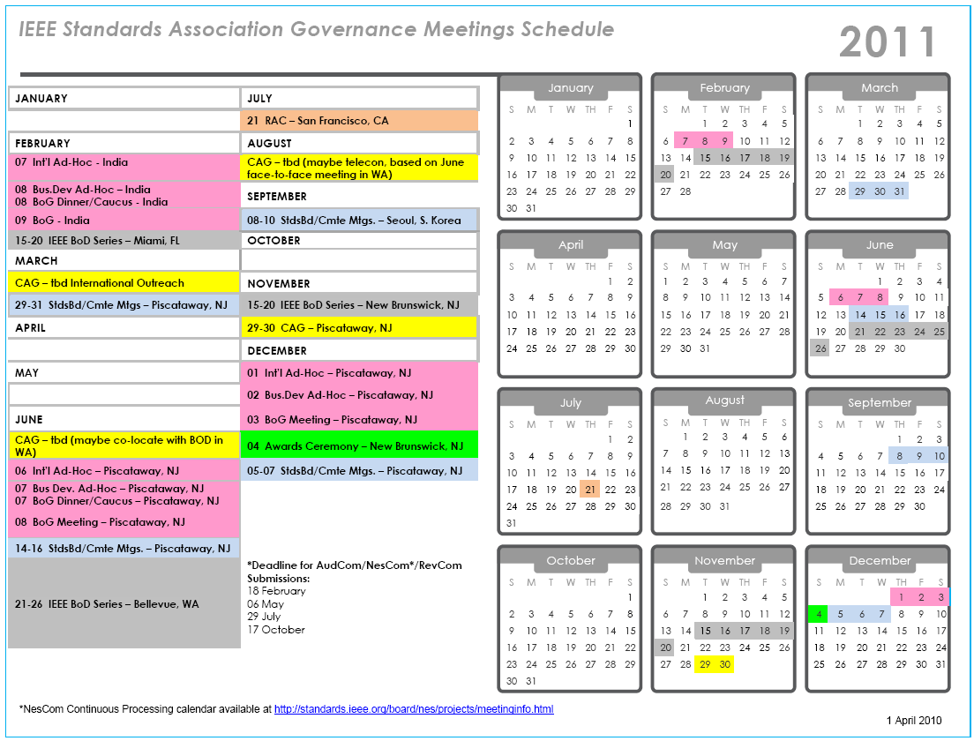

Slide 42
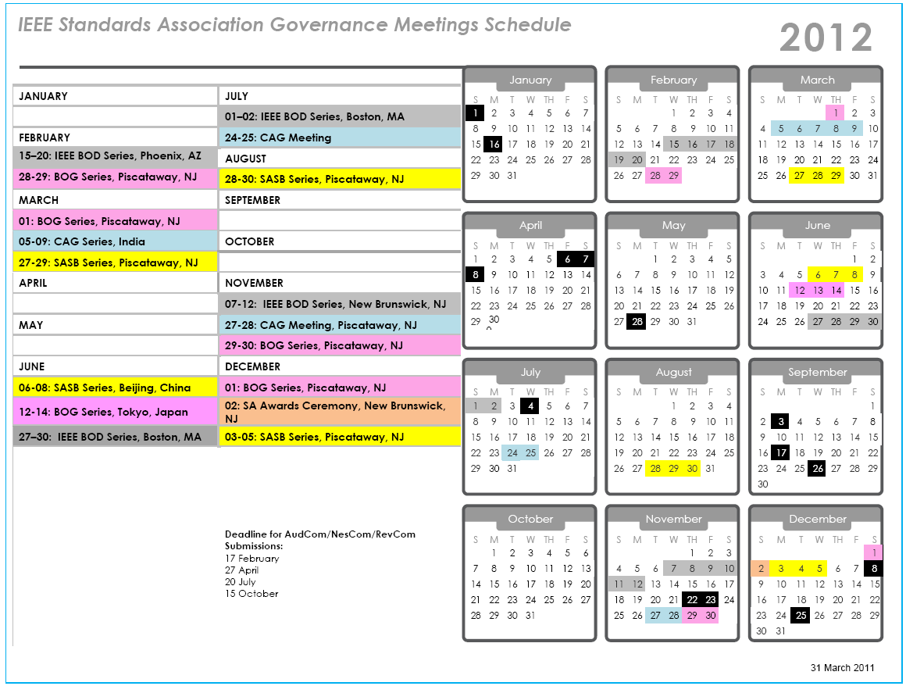

Slide 43
Amendment Drafts in Sponsor Ballot sent to ISO since March
S
802.11 Revision
Need to update revision

