Slide 1
Performance Evaluation of Multiple STAs’ Authentication and Association Process
Date: 2011-07-18
Authors:

Slide 2
Abstract
For use case 1a Smart Grid – Meter to Pole ^{[1]},the requirement is to support up to 6000 STAs in one AP.
In this contribution, we present some simulation results of large numbers of STAs’ authentication and association performance.
The objective of our research is to discover if there is potential possibility of supporting large number of STAs join the network at the same time based on the current 802.11 architecture.

Slide 3
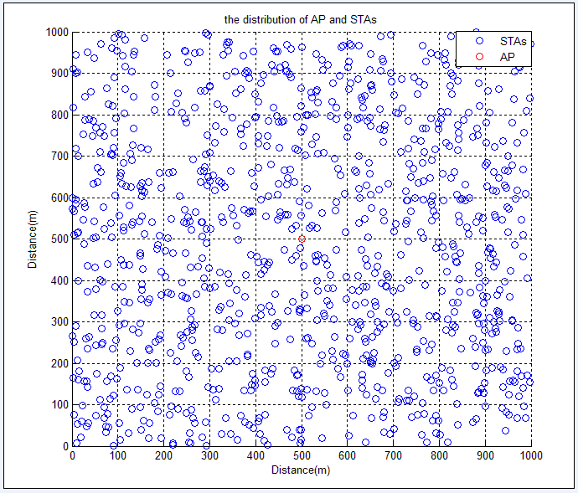
Simulation topology
In order to simplify the simulation ,we assume the communication area is 1000*1000 and AP is located at the center of this area. The non-AP STAs are distributed randomly in AP’s coverage. The figure below shows the location of 1 AP and 1000 STAs.

Slide 4
Simulation Process
A non-AP STA waits for a ChannelTime which is longer than a Beacon Interval to ensure the reception of Beacon.
After receiving a Beacon from a AP , the STA constructs Authentication Request frame and performs Backoff procedure for transmission.
Once the medium is not determined to be busy ,the STA proceeds to transmit. A Timeout is defined for the STA to sent Authentication Request frame and wait for the corresponding response frame. If no response frame is received until the Timeout goes out, the STA retransmits the Authentication Request frame.
The AP also performs backoff before transmitting Authentication Response frame and set a ACKTimer to wait for ACK frame.
STA performs Association following nearly the same procedure as Authentication .

Slide 5
Simulation parameters(1/2)
Beacon Interval | 100ms
Channel Bandwidth | 20MHz
Data rate | 1Mbps
The number of STAs per AP(min,max) | (100,6000)
Association Request Length | 28Byte
Association Response Length | 30Byte
Authenticate Request Length | 34Byte
Authenticate Response Length | 34Byte
SIFS | 16µs
Slot Time | 9µs
CWmin | 15
CWmax | 1023

Slide 6
Simulation parameters(2/2)
ChannelTime* | 0.12s
Timeout** | 0.15s
*ChannelTime: Since Beacon interval is set to 100ms , we assume a ChannelTime of 120ms for a STA to wait before the reception of Beacon.
**Timeout: Defined as the time for a STA to wait from transmitting a frame till the time receiving the response frame.

Slide 7
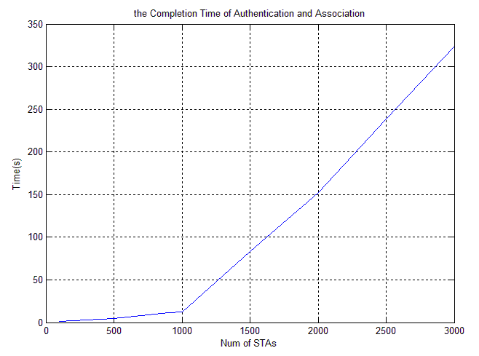
Simulation Results
Num of STAs | Authentication and association time (s)
100 | 1.53094
500 | 4.6366
900 | 11.2495
1000 | 12.345
1500 | 82.9897
2000 | 152.024
2500 | 238.603
3000 | 323.556

Slide 8
Conclusion
We evaluated authentication and association efficiency per the number of STAs, assuming all the STAs started accessing to the network at the same time.
-The authentication and association time increases rapidly along with the growing number of STAs.
-Network access delay approximately reaches 5 minutes when three thousands of STAs join at the same time.
Considering the use case smart grid, further study is needed on authentication and association optimization to support up to 6000 STAs join at the same time within a reasonable time delay range for TGah.

Slide 9
References
[1] 11-11-0457-00-00ah-potential-compromise-of-802-11ah-use-case-document
[2] IEEE Draft P802.11-REVmb™/D9.0, May 2011
[3] 11-11-0725-01-00ah-large-number-of-stas-support

Slide 10
Thank you!

