Slide 1
Process for Creating TGai Draft
Date: 2011-09-10
Authors:

Slide 2
Abstract
Documentation of the process to be used to evaluate submissions and create a draft for 802.11ai to submit to 802.11 Working Group for WG letter ballot

Slide 3
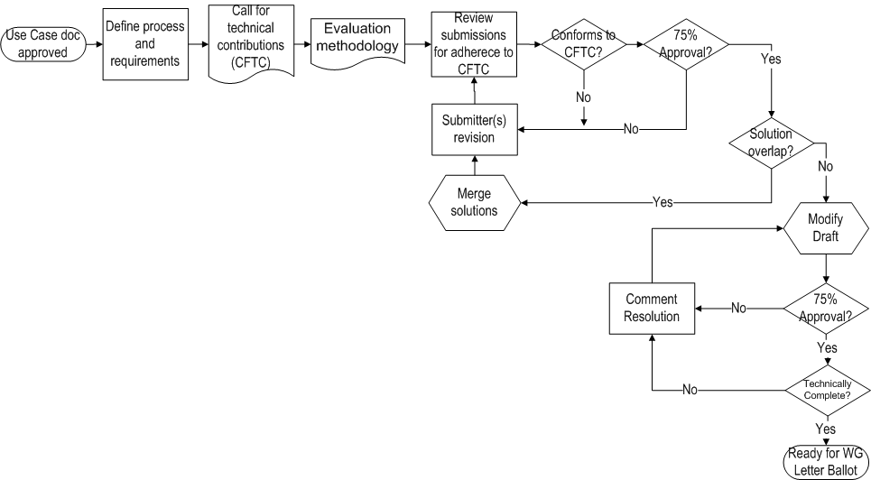
Process Flow

Slide 4
Description of steps
Define process and requirements
Call for Proposals (CFP)
Evaluation Methodology
Review submissions for adherence to CFP
Conforms to CFP?
Submitter(s) revision
Solution overlap?
Merge solutions
75% Approval? (Submissions)
Prepare Draft
75% Approval? (Drafts)
Comment Resolution
Technically Complete?
Ready for WG Ballot

Slide 5
Define process and requirements
Process
  This document, when approved, describes the process TGai will use in processing potential solutions for the Amendment to 802.11 standard
  Process may be amended by >50% vote of TGai
Requirements
  Separate document
  11-11-0745-05-00ai-TGai-functional-requirements.docx

Slide 6
2. Call for Technical Contributions (CFTC)
Requesting technical inputs for consideration
Example:
  11-11-0198-00-00ah-call-for-technical-contributions.docx

Slide 7
Call for submissions (1 of 3)
Any individual intending to present a proposal must notify the IEEE 802.11ai Task Group chair, Hiroshi Mano, via email at hiroshi@manosan.org by July 1th, 2011. Presentations of introductory proposal submissions material shall be submitted to the IEEE 802.11 document server prior to July18th, 2011 for presentation and discussion during the July IEEE 802 Wireless Plenary session.
Final proposals and related documents shall be submitted to the IEEE 802.11 document server prior to September 9th, 2011 for presentation and discussion during the September plenary session.
Time permitting, proposals arising at or during meeting time and after the stated due dates may be allowed by the chair.

Slide 8
Call for submissions (2 of 3)
Background information is available in the following documents in document server is available at the following location, https://mentor.ieee.org/802.11/documents
11-10/1152r01: Fast Initial Link Set-UP Project Authorizaiton Request
11-10/1152r01: Fast Initial Link Set-Up PAR
11-10/0238: TGai Use Cases
11-11-0811: TGai Evaluation Methodology

Slide 9
Call for submissions (3 of 3)
All presenters should be familiar with the following documents regarding IEEE policies and procedures:
- IEEE Patent Policy - http://standards.ieee.org/board/pat/pat-slideset.ppt
- Patent FAQ - http://standards.ieee.org/board/pat/faq.pdf
- LoA Form - http://standards.ieee.org/board/pat/loa.pdf
- Affiliation FAQ - http://standards.ieee.org/faqs/affiliationFAQ.html
- Anti-Trust FAQ - http://standards.ieee.org/resources/antitrust-guidelines.pdf
- Ethics - http://www.ieee.org/portal/cms_docs/about/CoE_poster.pdf
- IEEE 802.11 Working Group Policies and Procedures -
https://mentor.ieee.org/802.11/public-file/07/11-07-0360-04-0000-802-11-policies-and-procedures.doc

Slide 10
3. Evaluation Methodology
Evaluation
  Separate document
  11-11-0811-xx-00ai-TGai-Evaluation-Methodology.docx
Estimated availability: earliest is end of July

Slide 11
4. Review submissions for adherence to CFTC
The chair, vice chair, and technical editor of TGai should review submissions to determine if they are in scope for the
See 0139r1

Slide 12
5. Conforms to Requirements?
Contributors will be notified by the chair if their submissions fall outside the scope of TGai and will be encouraged to modify them
Submitters who choose to present submissions which have been determined to be out of scope may ask for a vote of the TG membership to have their submission considered.
50% majority of attendees are required to approve.

Slide 13
6. Submitter(s) revision
Submissions which have had deficits identified during the TGai process will have the opportunity to modify their submissions and resubmit in a timely manner.

Slide 14
7. Solution overlap?
It is possible that more than one submission will be found to be acceptable to the WG
There must be a determination by the WG whether or not an overlap in functionality exists
The WG may express an preference for resolution of the duplication, but it is up to the submitters to resolve and merge the solutions

Slide 15
8. Merge solutions
Solution merging is generally an offline activity between submitters
Others may be included by mutual consent

Slide 16
9. 75% Approval? (Submissions)
Technical proposals are required to pass a TG vote by a 75% margin
In the submissions phase of the standards process, it is not necessary to be orthogonal with all other solutions
  Overlaps may exist
  Some or all features in an approved submission may be removed as a result of the merging process

Slide 17
10. Prepare Draft
The technical editor is responsible for accurately translating the material in approved submissions into a Draft Amendment
Members of TGai may be invited to assist
The work will be done in consultation with the WG technical editor and the editors

Slide 18
11. 75% Approval? (Drafts)
The TGai Draft is required to pass a TG vote by a 75% margin
This will not be a formal letter ballot process

Slide 19
12. Comment Resolution
Comment resolution may be done by the group as a whole or by a subset of TGai.
This activity may be performed during Interim, Plenary or Ad Hoc meetings
  Ad Hoc meetings will be called in accordance with 802.11 rules

Slide 20
13. Technically Complete?
As part of the preparation for WG Letter Ballot, the Draft will have a final review for completeness and correctness
  Technically complete
  Able to pass 802.11 MEC or mechanisms defined for passing it

Slide 21
14. Ready for WG Ballot
Submit to WG ballot process

