Slide 1
Process for Creating TGai Draft
Date: 2011-09-10
Authors:

Slide 2
Abstract
Documentation of the process to be used to evaluate submissions and translate them into a draft for 802.11ai

Slide 3
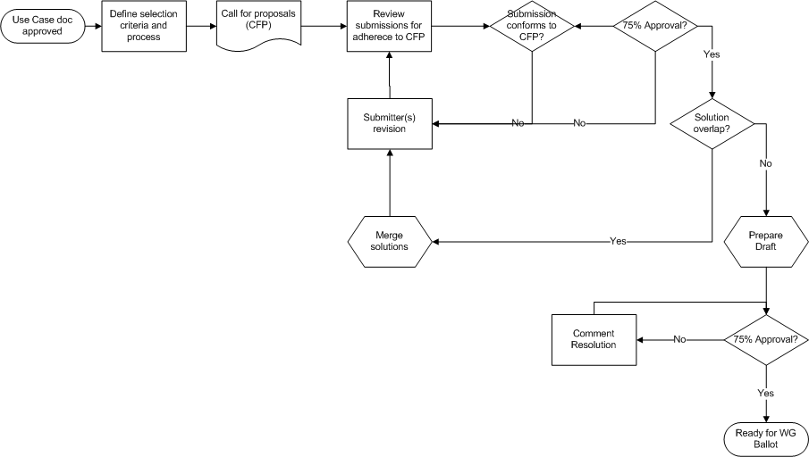
Process Flow

Slide 4
Description of steps
TBD after first review

