Slide 1
3G < -- > WLAN handover
Gabor Bajko
Nokia

Slide 2


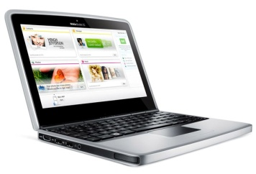
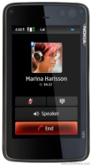
Experiment
Internet
V6
V4
Upstream-router
DSMIP6 Home Agent
V6
V4
DSMIP6-HA
802.3
WiFi
HSPA

Slide 3
Experiment
Internet
V6
V4
Upstream-router
DSMIP6 Home Agent
V6
V4
DSMIP6-HA
802.3
WiFi
HSPA

Slide 4
Experiment details
Device ifaces:
  Device with only one iface active at a time
  Device with both ifaces active until the second is IP configured
In case 1 an interactive session (skype video) not always survives when switching from 3G to WLAN
In case 2, the session mostly survives
  If switching from wlan to wlan, this mode N/A (wifi chipset does not connect to 2 networks simultaneously)

Slide 5
Source of problems
Getting WLAN iface operational takes a long time
Most of the time is spent with IP configuration
  Depends on whether the network is a home, public or enterprise

Slide 6
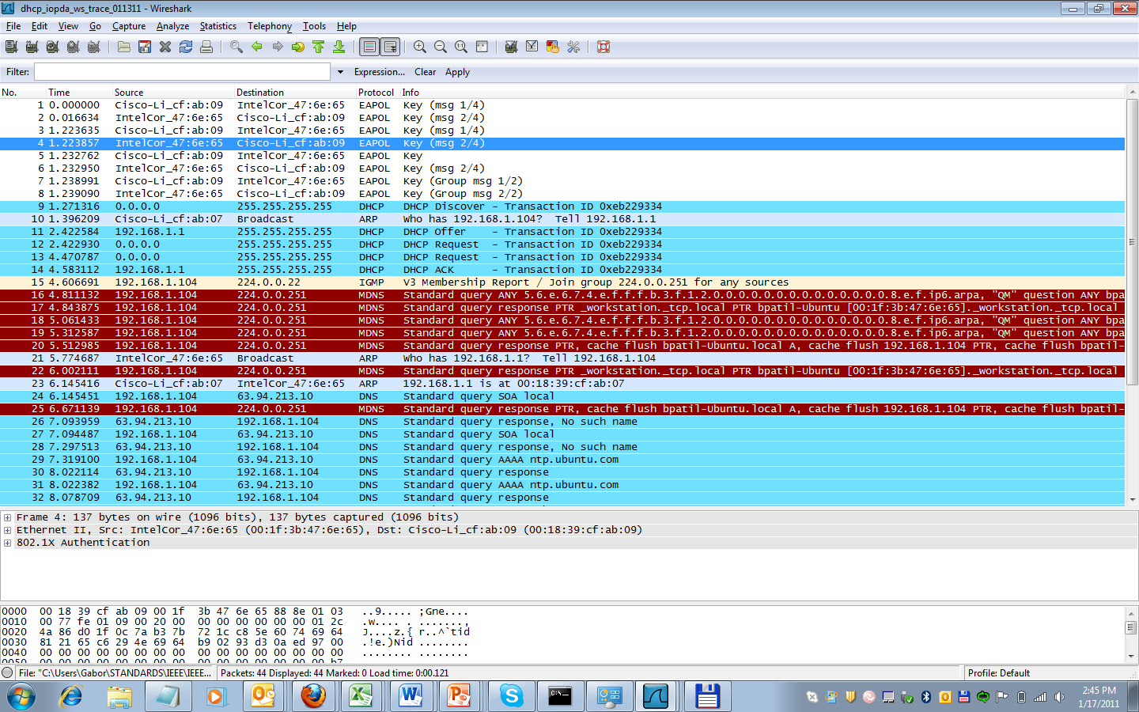
Measurements -1

Slide 7
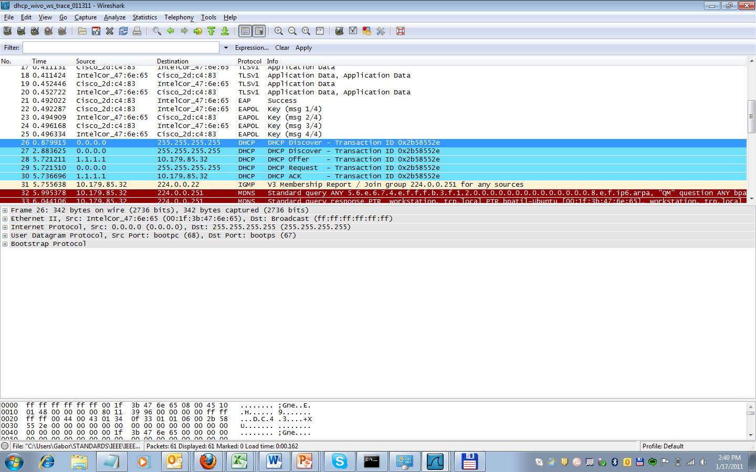
Measurements -2-

Slide 8
Possible remedy
IP configure the client during the L2 association
  Similar thing happens in 3G/4G today, ie IP address configuration is done during the link layer setup (proven to work, everyone is using it)
But be backward compatible

Slide 9
Potential solution
AP indicates in the beacon if is capable of providing IP config during association
Assoc req to indicate if the client is capable of receiving IP config in assoc resp
Assoc resp to contain IP config data
  IPv4/v6 address, lease time, netmask/prefix, default-gw address, DNS address, DHCP server address, RA options (v6)
AP or AC to ask the DHCP server (if not co-located) for a pool of IP addresses in advance, and allocate from that pool to the client during assoc
Advanced DHCP config can still be done by the client placing a dhcp req

