Slide 1
Association ID management for TGah
Date: 2011-01-16
Authors:

Slide 2
Some applications for TGah
Type | Example | Data rate | Power limitation | # of nodes
Smart Grid | Energy/water/gas metering | Low | As low as possible | A lot
Factory automation | Cargo system, machine tool control | Low | Tolerable | A lot
Consumer electronics | Smart home/office (refrigerator, washing machine control, etc. ) | Low | Tolerable | A little
eHealth | Blood pressure, heart rate monitoring | Low | Ultra low power | A little
If we can support smart grid, other applications can be easily applied

Slide 3
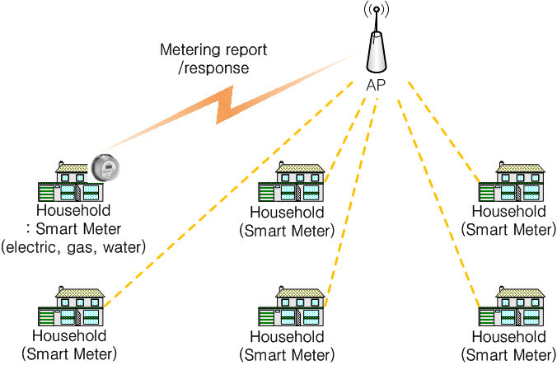
Use case – Smart Grid
Metering management
  Smart meters report metering data
  AP responses with management or/and pricing information

Slide 4
Use case – Smart Grid
Considering points in TGah
  Low data rate traffic
  Burst traffic characteristics: e.g) 2 hours reporting period
  Periodic traffic characteristics
  Deployment cost
  Good propagation characteristic

Slide 5
Association ID management
From this statistics, it may be helpful to support more than 2008 nodes in 802.11
Two alternative solutions for more than 2008 nodes support
  Using reserved AID field (2008~16383)
  Duplicated AID allocation
 | Average number of households/km² [1] | Average number of household/cell
Seoul | 6800 | 21384
Suburban Seoul | 2500 | 7879
[1]“Korean Statistical Information Service", http://kosis.kr

Slide 6
Association ID management
Using reserved AID field
  TIM element (bitmap size) change should be considered
  Very large bitmap size has problems: further optimization may be required
Duplicated AID allocation
  STAs with the same AID may have different Beacon Interval
  If an AP would have much more traffic to the STA with shared AID, then the AP may assign a new AID to the STA
  If an AP would have no traffic to the STA with the unique AID, then the AP may assign a shared AID to the STA

Slide 7
Association ID management
Operational Example of Duplicated AID allocation

