Slide 1
Performance evaluation of MU-RTS under OBSS environment
Date: 2010-11-08
Authors:
Name | Affiliations | Address | Phone | email
B. A. Hirantha Sithira Abeysekera | NTT | 1-1, Hikarino-oka, Yokosuka-shi, Japan | +81-46-859-8266 | hirantha.abeysekera@lab.ntt.co.jp
Shoko Shinohara | NTT | 1-1, Hikarino-oka, Yokosuka-shi, Japan | +81-46-859-5107 | shinohara.shoko@lab.ntt.co.jp
Yusuke Asai | NTT | 1-1, Hikarino-oka, Yokosuka-shi, Japan | +81-46-859-3494 | asai.yusuke@lab.ntt.co.jp
Yasuhiko Inoue | NTT | 1-1, Hikarino-oka, Yokosuka-shi, Japan | +81-46-859-5097 | inoue.yasuhiko@lab.ntt.co.jp
Takeo Ichikawa | NTT | 1-1, Hikarino-oka, Yokosuka-shi, Japan | +81-46-859-3079 | ichikawa.takeo@lab.ntt.co.jp
Masato Mizoguchi | NTT | 1-1, Hikarino-oka, Yokosuka-shi, Japan | +81-46-859-3758 | mizoguchi.masato@lab.ntt.co.jp

Slide 2
Abstract
In this document, we first present some results of a statistical analysis of housing conditions in Japan, and show that more than 40% among all dwellings are the apartment houses.
Then, we show the numerical results of the number of OBSSs that can be happen in such an apartment environment.
Finally, we present simulation results of a simple OBSS scenario, and as an operator, we show the importance of a MAC protection mechanism for TGac.

Slide 3
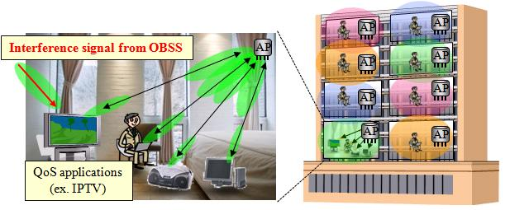
Statistical analysis for the number of OBSSs according to “Housing and Land Survey*” in Japan
The Japanese governmental survey shows:
More than 40% houses are apartment houses (about 20 million in all of 49.6 million dwellings).
The average area of floor space per dwelling in apartment house is about 520 ft² (= 48 m²).
About 75% apartment houses are made of reinforced steel-framed concrete.
Operators’ perspective:
It is expected that 11ac standard will extend capacity of wireless home network which conveys network services (ex. on-demand video streaming services) to subscribers not only detached house but also apartment house users.
It is important to examine the wireless environment in apartment house users
*“Housing and Land Survey in 2008” done by
Statistics Bureau in Ministry of Internal Affairs and Communications, Japan. http://www.stat.go.jp/english/data/jyutaku/index.htm

Slide 4
Statistical analysis for the number of OBSSs according to “Housing and Land Survey*” in Japan
* Based on the “Housing and Land Survey, 2008.”
Evaluation conditions:
Ave. dimensions of each apartment*: W / L / H = 16.5 / 33 / 10 [ft]
Tx power: 17 dBm@5GHz
Power loss of room wall and floor [1]: 13 [dB]
APs location: Each AP is placed at the center of each apartment house
Carrier sense level (which is equal to interference threshold):
-82dBm@20MHz / -79dBm@40MHz / -76dBm@80MHz / -73dBm@160MHz
Bandwidth expansion to more than 40MHz causes one or more OBSSs in above apartment environment.
Some kinds of techniques to reduce the influence of OBSSs should be considered.
** IEEE 802.11n channel model B – Residential.
Bandwidth per channel | The # of interfering BSSs | The # of available channels | The # of OBSSs in expectation
20MHz | 12 | 19 | 0
40MHz | 10 | 9 | 0.22
80MHz | 10 | 4 | 1.75
160MHz | 10 | 2 | 4.50
Interference level [dBm] in each apartment because of the AP in the top left apartment**.
(AP)
-56.33
-79.87
-48.72
-71.71
-93.53
-72.25
-89.20
-108.2
-91.42
-106.4
-123.2

Slide 5
OBSS issue
Consider frame transmissions using 80MHz (or 160 MHz) channel bandwidth.
As shown in previous slide, OBSS is likely to happen due to lack of channels when using 80MHz (or 160MHz) bandwidth.
This increases the frame collision probability at STAs which are placed in OBSS environment (especially, when APs are hidden to each other).
Moreover, TGac allows transmitting very large (up to 1 MB) A-MPDUs in one transmission attempt.
Therefore, the duration of a frame transmission becomes longer (ex. 1MB/270Mbps = 30ms).
This also may increase the frame collision probability especially at STAs in OBSS environment.

Slide 6
TGac background
DL MU-MIMO, which allows simultaneous frame transmissions to different STAs, is a key feature in TGac.
Multi-RTS [2], Multiple CTSs [3] schemes (hereafter called MU-RTS scheme) were presented in September 2010 meeting, and showed qualitatively the importance of MAC protection mechanism [4] for TGac.
Straw Poll results are summarised in page 3 of Ref. [5].
Even though OBSS scenarios are complicated [6], TGac agrees to see how 11ac devices behave in OBSS environment [7, 8].
So far, however, not that much evaluation results were presented.
In next slides we show some OBSS simulation results.

Slide 7
Simulation topology
Consider only downlink UDP traffic
Two overlapping BSSs
Each BSS consists of one AP and 4 STAs
All STAs hear signal of both AP-1 and AP-2
APs are hidden or non-hidden to each other
STAs can receive any frames correctly unless there
are collisions (bit errors caused by thermal noise or
channel fading are not considered)
MPDUs for each STA are generated at the corresponding
AP by i.i.d.
Case-1: APs are hidden
Case-2: APs are non-hidden
1
1
2
2
3
AP-1
3
AP-2
4
4
This figure illustrates the hidden AP case
(i.e., Case-1)
BSS-1
BSS-2

Slide 8
Simulation topology
Consider only downlink UDP traffic
Two overlapping BSSs
Each BSS consists of one AP and 4 STAs
All STAs hear signal of both AP-1 and AP-2
APs are hidden or non-hidden to each other
STAs can receive any frames correctly unless there
are collisions (bit errors caused by thermal noise or
channel fading are not considered)
MPDUs for each STA are generated at the corresponding
AP by i.i.d.
Case-1: APs are hidden
Case-2: APs are non-hidden
1
1
2
2
3
AP-1
3
AP-2
4
4
This figure illustrates the non-hidden AP case
(i.e., Case-2)
BSS-1
BSS-2

Slide 9
Parameter values
Parameter | Value
Bandwidth per channel | 80 [MHz]
The # of subcarrier per spatial stream | 216
MCS | 64QAM, 5/6
Data rate | 270 [Mbps]
Basic rate | 6 [Mbps]
The # of APs | 2
The # of STAs per AP | 4
The # of antennas per AP | 8
The # of antennas per STA | 2
The # of streams towards STA in a single transmission | 2
Parameter | Value
MU-RTS length | 37[B]=76 [usec]
CTS length | 14[B]=44 [usec]
BA length | 28[B]=52 [usec]
SIFS | 16 [usec]
DIFS | 34 [usec]
SlotTime | 9 [usec]
ACK timeout interval | 58 [usec]
MSDU size | 1,500 [B]
Max. A-MPDU size | 65,535 [B]
CWmin | 15
CWmax | 1,023
Retry Limit (Long, Short) | (4, 7)
Simulator: OPNET 15.0.A

Slide 10
Frame sequence
Length of an A-MPDU depends on the current number of MSDUs buffered at the AP.
AP can transmit A-MPDUs to up to 4 STAs simultaneously using DL MU-MIMO technique.
When AP accesses to medium, it first transmits a MU-RTS [2, 3].
DATA (AP STA-1)
DATA (AP STA-2)
…
max (N) = 4
MU-RTS
SIFS
DATA (AP STA-N)
AP
STA-1
CTS
BA
STA-2
CTS
…
BA
…
…
STA-N
CTS
BA
Each STA responds with a CTS frame if it is ready to receive DATA frame from the AP.
All BAs are scheduled and transmitted in the same order as CTSs.

Slide 11
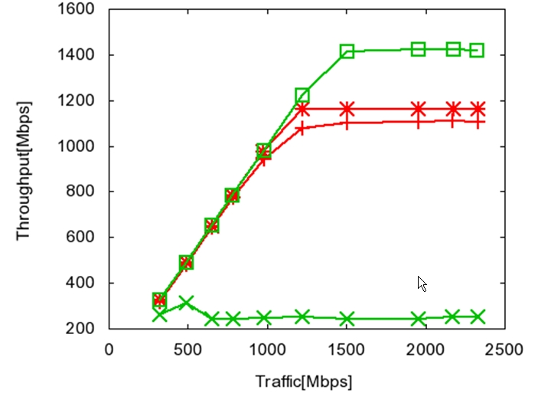
Simulation results
non-hidden AP,
without MU-RTS
1400 Mbps
non-hidden AP,
with MU-RTS
1200 Mbps
1100 Mbps
hidden AP,
with MU-RTS
hidden AP,
without MU-RTS
250 Mbps

Slide 12
Summary
We evaluate the performance of MU-RTS scheme.
MU-RTS scheme slightly degrades the system throughput when APs are known (non-hidden) to each other, because of the additional overhead due to MU-RTS and multiple CTSs.
When APs are hidden, MU-RTS greatly improves the system throughput.
Needs some sort of protection mechanism for TGac.
Frame sequences, Frame formats, and ACK mechanism (polled or scheduled) are TBD.

Slide 13
References
[1] Rec. ITU-R P.1238-3, "Propagation data and prediction methods for the planning of indoor radio communication systems and radio local are networks in the frequency range 900MHz to 100GHz," ITU-R Recommendation P Series, 2003.
[2] Y. Morioka et al., “Multi-RTS Proposal,” Doc.: IEEE 802.11-10/1124r2.
[3] T. Kaibo et al., “Multiple CTSs in MU-MIMO Transmission,” Doc.: IEEE 802.11-10/1067r0.
[4] Y. J. Kim et al., “Considerations on MU-MIMO Protection in 11ac,” Doc.: IEEE 802.11-10/0335r1.
[5] B. Hart et al., “TGac MU-MIMO Ad Hoc Minutes,” Doc.: IEEE 802.11-10/1161r0.
[6] A. Ashley et al., “OBSS Requirements,” Doc.: IEEE 802.11-08/0944r7.
[7] Y. Takatori, “Importance of Overlapped BSS issue in 802.11ac,” Doc.: IEEE 802.11-09/0630r1.
[8] P. Loc et al., “TGac Functional Requirements and Evaluations Methodology Rev. 15,” Doc.: IEEE 802.11-09/0451r15.

Slide 14
Thank you!

