Slide 1
RTS/CTS Operation for Wider Bandwidths
Date: 2010-10-31
Authors:

Slide 2
Outline
Overview of 802.11n RTS/CTS operation
RTS/CTS operation rules for wider bandwidth
Simulation results
  Two 40MHz BSSs and one 80MHz BSS (hidden nodes)
Conclusions

Slide 3
Current RTS/CTS rule for wider channels becomes out-dated when 11ac starts to use more secondary channels
Under current RTS/CTS rules for wider channels, a responder responds with CTS on all subchannels
If an initiator receives a CTS on primary, it responds with Data on all subchannels
This rule does not account for hidden node collisions on secondary channels
This hidden node problem becomes more severe in 11ac
  There are at most two non-overlapping 160MHz channels in 5 GHz
Primary
RTS
CTS
Secondary
RTS
CTS
time
RTS
CTS
time
Secondary40
time
RTS
CTS
time
SIFS
Interference at responder

Slide 4
Definitions: dynamic BW operation and static BW operation
Dynamic BW: 20/40/80 MHz
  If 80 MHz is free, transmit using 80 MHz, else
  If 40 MHz (including primary) is free, transmit using 40 MHz, else
  If the secondary channel is not free, data is transmitted over the primary channel.
Static BW: 0/80MHz
  If at least one of the secondary channels is busy, the transmitter restarts the backoff procedure over the primary channel without incrementing the retry counter.

Slide 5
RTS/CTS rules should be adjusted to account for secondary channel CCA
Both initiator and responder are capable of dynamic BW operation
  RTS is transmitted on channels that are sensed free at the initiator
  CTS response is only sent on channels that are occupied by the RTS and are determined to be free at the responder (a valid PHY mode is used, meaning only 20/40/80/160MHz transmissions allowed)
  RTS/CTS frames carry the available bandwidth information
  Initiator transmits data only over channels indicated free by CTS response
RTS
CTS
Data
BA
RTS
CTS
time
BA
RTS
time
RTS
time
time
Interference at responder

Slide 6
The initiator informs the responder whether it is capable of dynamic BW operation
Depending on the initiator’s capability, the responder may or may not transmit a CTS frame
If the initiator is only capable of static BW operation, the responder would not reply a CTS frame if any of the channels is busy
Include a bit in the RTS frame to indicate whether a STA is using dynamic BW operation
  If the bit is set to 1, the initiator is using dynamic BW operation
In the following figure, the capability bit is set to 0
  The responder does not transmit a CTS frame if any of the secondary channel is busy
RTS
RTS
time
RTS
time
RTS
time
time
Interference at responder

Slide 7
Simulation parameters
TXOP limit: 3ms
20MHz: 52 data subcarriers, 4 pilot tones
40MHz: 108 data subcarriers, 6 pilot tones
80MHz: 234 data subcarriers, 8 pilot tones
Channel B
SIFS=16 us, aSlotTime=9 us
Packet size: 1500 bytes
Data rate: MCS5 (64QAM, r=2/3)
Control rate: MCS3 (16QAM, r=1/2)
CWmin=7, CWmax=63
Max A-MPDU size: 128K octets
UDP traffic

Slide 8
Simulation Scenario
Two 40MHz BSSs and one 80MHz BSS
  AP1 and AP2 are hidden nodes with respect to each other on the secondary channels (CCA sensitivity = -82dB on all channels since 80MHz BSS’s secondary_40 overlaps with BSS_40MHz_1’s primary channel)
  STA1 and STA2 can hear both AP1 and AP2’s transmission
BSS_40MHz_1
Channels:
44(p)+48
BSS_80MHz
Channels: 36(p)+40+44+48
BSS_40MHz_2
Channels:
36(p)+40
AP2
STA3
AP1
STA2
STA1
AP3

Slide 9
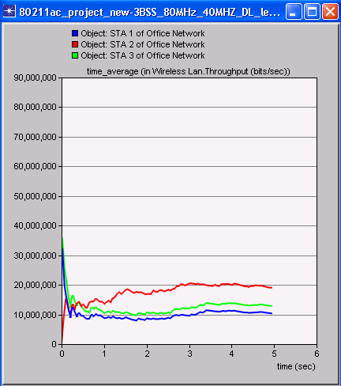
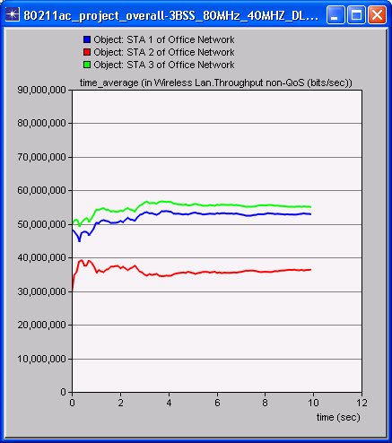
RTS/CTS with receiver CCA improves the throughput of all three BSSs
BSS_40MHz_2 (green)
Per BSS throughput (Mbps)
BSS_40MHz_1 (blue)
BSS_80MHz (STA2)
BSS_80MHz (STA2)
BSS_40MHz_1 (blue)
11n RTS/CTS (no receiver CCA )
RTS/CTS with BW indication

Slide 10
Without BW indication in RTS/CTS and receiver CCA, 80MHz STA suffers from constant collisions
With RTS/CTS and receiver CCA, the initiator transmits RTS over all channels that it has sensed free; the receiver transmits CTS over the channels that meet the following conditions
  1) The channel was indicated in the RTS frame
  2) The channel was determined to be idle
Because CTS indicates the channels that the receiver has sensed free, the initiator can avoid collisions over the subsequent data frame
BSS_80MHz primary
RTS
CTS
BA
RTS
CTS
time
BA
BSS_40MHz_1 primary
RTS
time
RTS
time
time

Slide 11
Define the channel width selection rules to allow CTS being transmitted over narrower channels
CH_BANDWIDTH RXVECTOR value | CH_BANDWIDTH TXVECTOR value
NON_HT_CBW20 | NON_HT_CBW20
NON_HT_CBW40 | NON_HT_CBW20 or NON_HT_CBW40
NON_HT_CBW80 | NON_HT_CBW20 or NON_HT_CBW40 or NON_HT_CBW80
NON_HT_CBW160 | NON_HT_CBW20 or NON_HT_CBW40 or NON_HT_CBW80 or NON_HT_CBW160

Slide 12
Conclusions
RTS/CTS accounting for secondary channel CCA can significantly improve the performance of an 80MHz STA in a hidden node scenario
  It is beneficial for both 40MHz STAs and 80MHz STAs that utilize wider channels
Propose the following signaling method:
  Dynamic BW operation can be indicated in the RTS frame
  Channel bandwidth can be indicated in RTS/CTS frames
Propose the following protocol rules:
  If the initiator is capable of dynamic BW operation, CTS sent in response to RTS shall be sent over channels occupied by the RTS AND that are determined to be idle at the responder
  If the initiator is incapable of dynamic BW operation, the responder shall not reply a CTS if one of the secondary channels is sensed busy at the responder
  Upon receiving a CTS frame, an initiator shall not transmit frames that occupy more bandwidth than the BW indicated in the CTS frame

Slide 13
Pre-motion 1
Do you support updating the TGac spec framework to include the following signaling method?
  One bit in TBD-RTS frame to indicate dynamic BW operation (the bit setting to 1 indicates a transmitting STA uses dynamic BW operation)
  Two bits in TBD-RTS frame and TBD-CTS frame to indicate available bandwidth (i.e. 20/40/80/160 MHz)

Slide 14
Pre-motion 2
Do you support updating the TGac spec framework to include the channel width selection rules for TBD-RTS/TBD-CTS defined as follows?
CH_BANDWIDTH RXVECTOR value | CH_BANDWIDTH TXVECTOR value
NON_HT_CBW20 | NON_HT_CBW20
NON_HT_CBW40 | NON_HT_CBW20 or NON_HT_CBW40
NON_HT_CBW80 | NON_HT_CBW20 or NON_HT_CBW40 or NON_HT_CBW80
NON_HT_CBW160 | NON_HT_CBW20 or NON_HT_CBW40 or NON_HT_CBW80 or NON_HT_CBW160

Slide 15
Pre-motion 3
Do you support updating the TGac spec framework to include the following protocol rule?
If an initiator operates in dynamic operation mode:
  Upon receiving a TBD-RTS frame and if NAV at the responder is not set, a responder shall respond with a non-HT TBD-CTS over the primary channel and may respond over the secondary channels that are indicated in the TBD-RTS and that have been detected idle by the responder (all transmissions shall use a valid PHY mode, i.e. 20/40/80/80+80/160MHz)

Slide 16
Pre-motion 4
Do you support updating the TGac spec framework to include the following protocol rule?
If an initiator does not operate in dynamic operation mode:
  Upon receiving a TBD-RTS frame, a responder shall not respond with a non-HT duplicate TBD-CTS frame if at least one secondary channel indicated in the TBD-RTS frame has been detected busy by the responder

Slide 17
Pre-motion 5
  Do you support updating the TGac spec framework to include the following protocol rule?
  Upon receiving a TBD-CTS frame, an initiator shall not transmit data frames using more bandwidth than the BW indicated by the TBD-CTS frame (all transmissions shall use a valid PHY mode, i.e. 20/40/80/80+80/160MHz)

