Slide 1
On DL Precoding for 11ac
Date: 2010-09-14
Name | Affiliations | Address | Phone | email
Vish Ponnampalam | Mediatek | 2860 Junction Ave, San Jose CA 95134 | +1-408-526-1899 | vish.ponnampalam@mediatek.com
James Wang | Mediatek | 2860 Junction Ave, San Jose CA 95134 | +1-408-526-1899 | James.wang@mediatek.com
Jianhan Liu | Mediatek | 2860 Junction Ave, San Jose CA 95134 | +1-408-526-1899 | Jianhan.Liu@mediatek.com
Alvin Hsu | Mediatek | No. 1, Dusing Rd, 1, Hsinchu Science Park, Hsinchu, Taiwan 300, R.O.C. | +886-3-567-0766 | alvin.hsu@mediatek.com

Slide 2
MU-MIMO in 11ac
DL MU-MIMO is a good fit for TGac
  Moves HW complexity/power consumption to AP
    Enhanced system throughput with low complexity terminals
  Slowly varying channels
    feedback overhead is manageable
A wide selection of precoding algorithms are available
  Dirty Paper Coding (DPC)
  Vector perturbation
  Linear precoding based on ZF/MMSE/BD, etc
Linear precoding techniques perform significantly worse compared to nonlinear precoding algorithms
  Nevertheless, the gap in performance shrinks if user selection/scheduling is done effectively
Non-linear

Slide 3
Support for Multiple Precoding Schemes
IEEE 802.11ac characteristics
  Typically (very) small number of active users per AP
  OFDMA is not supported
    Wideband channel will experience significant channel selectivity
User selection is not possible/feasible due to the above
  Limited multi-user diversity
  User selection over wideband channel is non-trivial
Linear precoding without (effective) user selection will give limited gains
Hence 11ac protocol framework should also support the use of nonlinear precoding algorithms

Slide 4
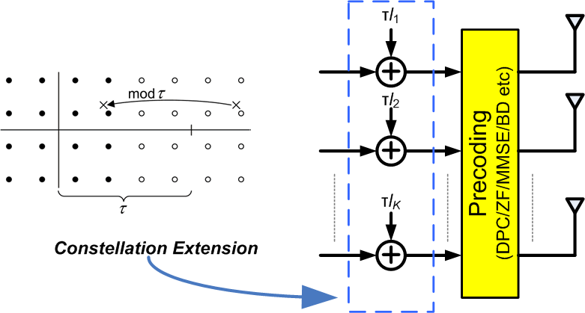
Non-linear precoding with Constellation Extension
Constellation extension is a key feature of non-linear precoding algorithms, especially
  THP [1][2] and
  Vector Perturbation [3][4]

Slide 5
Proposal
During capability exchange
  each STA will indicate to the AP if it can receive extended constellation
AP will perform precoding and autonomously decide whether to apply constellation extension for each user
  Only in the case when STA has indicated if it can receive extended constellation
  Possible to perform linear and non-linear precoding in same MU packet
VHT-SIG-A field will indicate if constellation extension has been applied to each user in that packet

Slide 6
Spec Requirements
Introduce Constellation Extension Indicator field in VHT-SIG-A
  Length = 4 bits
  1 bit per user; 1->constellation extension 0->otherwise
Add a bit to in the Capability Information field to indicate Constellation Extension capability
Constellation extension should be specified
  Standard periodic extension

Slide 7
Conclusions
11ac should support both linear and non-linear precoding algorithms
  Allowing only linear precoding will result in no/limited throughput improvement in the absence of MU diversity
Non-linear precoding algorithms are coupled with constellation extension
We propose a simple framework that can support all known classes of precoding algorithms

Slide 8
References
[1] M. Tomlinson, “New automatic equalizer employing modulo arithmetic,” Electron. Lett., vol. 7, pp. 138–139, Mar. 1971.
[2] M. Costa, “Writing on dirty paper,” IEEE Trans. Inf. Theory, vol. IT-29, pp. 439–441, May 1983.
[3] B. M. Hochwald, C. B. Peel, and A. L. Swindlehurst, “A vector-perturbation technique for near-capacity multiantenna multiuser communication—part I: perturbation,” IEEE Trans. on Commun., vol. 53, no. 1, pp. 195-202, Jan 2005
[4] B. M. Hochwald, C. B. Peel, and A. L. Swindlehurst, “A vector-perturbation technique for near-capacity multiantenna multiuser communication—part II: perturbation,” IEEE Trans. on Commun., vol. 53, no. 3, pp. 537-544, March 2005

