Slide 1
Medium Access for Wider Bandwidth
Date: 2010-09-12
Authors:

Slide 2
Outline
Overview of medium access scheme for wider bandwidth
Simulation scenario 1
One 40MHz BSS (BSS_N) and one 80MHz BSS (BSS_AC)
Simulation scenario 2
Three 20MHz BSSs (BSS_N) and one 80MHz BSS (BSS_AC)
Conclusions

Slide 3
The goal of this work is to validate the fairness of the PIFS medium access scheme
The existing 802.11n PIFS medium access scheme can be straightforwardly extended to 80MHz:
A STA only backs off on the primary channel
It performs CCA on the secondary channels. If the medium has been free for a PIFS when the backoff counter reaches zero, the corresponding secondary channel is considered available and may be used for transmission
AIFS + backoff
Primary Channel
BA
Secondary Channel
PIFS
time
BA
Tertiary Channel
PIFS
time
BA
Quaternary Channel
PIFS
time
BA
SIFS
time

Slide 4
Two operating modes are simulated and analyzed
Dynamic BW: 20/40/80 MHz
If 80 MHz is free, transmit using 80 MHz, else
If 40 MHz (including primary) is free, transmit using 40 MHz, else
If the secondary channel is not free, data is transmitted over the primary channel.
Static BW: 0/80MHz
If at least one of the secondary channels is busy, the transmitter restarts the backoff procedure over the primary channel without incrementing the retry counter.

Slide 5
Simulation parameters
TXOP limit: 3ms
20MHz: 52 data subcarriers, 4 pilot tones
40MHz: 108 data subcarriers, 6 pilot tones
80MHz: 234 data subcarriers, 8 pilot tones
SIFS=16 us, aSlotTime=9 us
Packet size: 1500 bytes
Data rate: MCS5 (64QAM, r=2/3)
Control rate: MCS3 (16QAM, r=1/2)
CWmin=7, CWmax=63
Max A-MPDU size: 128K octets
UDP traffic

Slide 6
Simulation scenario 1
One 40MHz BSS_N and one 80MHz BSS_AC
BSS_N (11n)
Channels:
44(p)+48
BSS_AC (11ac)
Channels: 36(p)+40+44+48
AP2
AP1
STA7

Slide 7
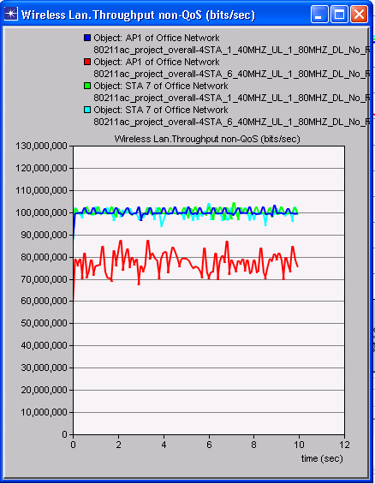
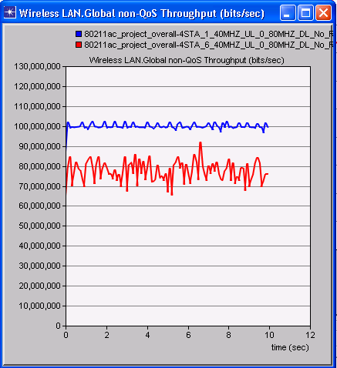
Dynamic BW operation (Both BSSs are fully loaded, 1 STA in BSS_AC, 1 or 6 STAs in BSS_N)
BSS_N (1 STA)
BSS_AC (1 STA in BSS_N)
BSS_AC (6 STAs in BSS_N)
BSS_N (1 STA)
Per BSS throughput (Mbps)
BSS_N (6 STAs)
BSS_N (6 STAs)
Per BSS throughput (Mbps)
BSS_N with BSS_AC operating
BSS_N with BSS_AC turned off

Slide 8
Dynamic BW operation (Both BSSs are fully loaded, 1 STA in BSS_AC, 1 or 6 STAs in BSS_N)
When both BSSs are fully loaded, the throughput of BSS_N does not change regardless of whether there is an 80MHz BSS_AC in the neighbourhood
With dynamic operation, BSS_AC operates only over channel 36 and channel 40 if BSS_N is fully loaded
Because the traffic in BSS_AC and the traffic in BSS_N are not synchronized, idle time periods over the two primary channels barely overlap
80MHz BSS primary
AIFS
PIFS
40MHz BSS primary
AIFS
slot
PIFS

Slide 9
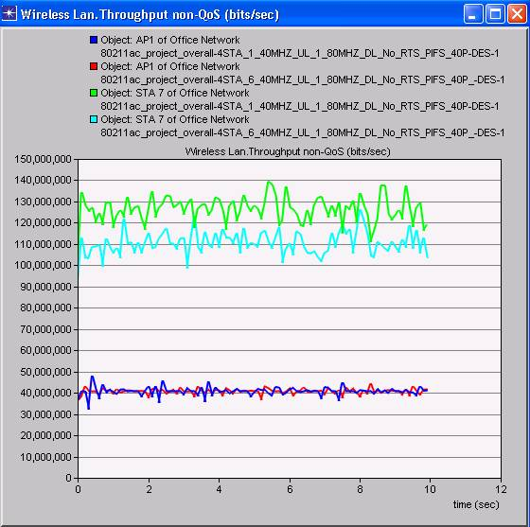
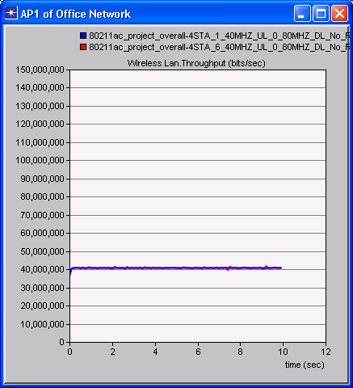
Dynamic BW operation (BSS_N is 40% loaded, 1 STA in BSS_AC, 1 or 6 STAs in BSS_N)
BSS_AC ( 1 STA in BSS_N)
Per BSS throughput (Mbps)
BSS_AC ( 6 STAs in BSS_N)
Per BSS throughput (Mbps)
BSS_N (1 STA, blue)
BSS_N (1 STA, blue)
BSS_N (6 STAs, red)
BSS_N (6 STAs, red)
BSS_N with BSS_AC operating
BSS_N with BSS_AC turned off

Slide 10
Dynamic BW operation (40MHz BSS is 40% loaded, 1 STA in BSS_AC, 1 or 6 STAs in BSS_N)
When BSS_N is lightly loaded, its throughput does not change regardless of whether there is an 80MHz BSS_AC in the neighbourhood
When BSS_N is lightly loaded, BSS_AC can gain some transmission opportunities to 80MHz bandwidth
Because there is more idle time on the primary channel of BSS_N, the idle time periods over the two primary channels have some overlap
Simulation results show that the throughput of BSS_N is not affected even when BSS_AC gain 80MHz access from time to time

Slide 11
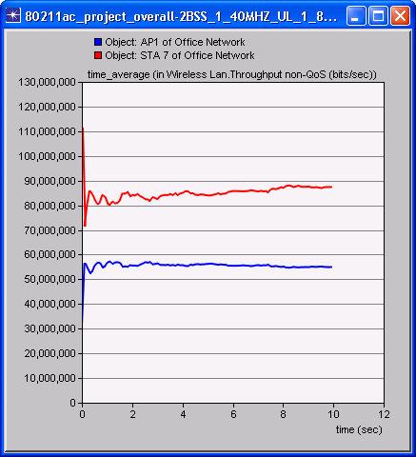
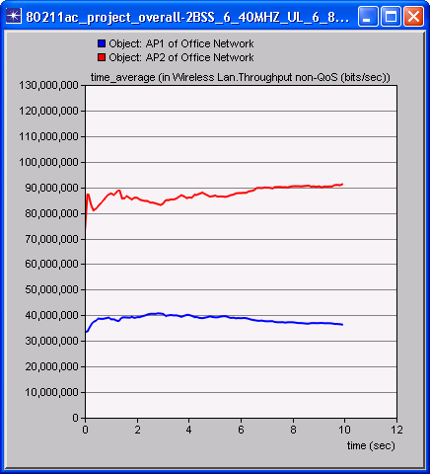
Static BW operation (both BSSs are fully loaded and have equal number of contending STAs)
BSS_AC
BSS_AC
Per BSS throughput (Mbps)
BSS_N
Per BSS throughput (Mbps)
BSS_N
1 STA in each BSS
6 STAs in each BSS
BSS_AC: ~45% max attainable throughput
BSS_N: ~55% max attainable throughput
BSS_AC: ~45% max attainable throughput
BSS_N: ~40% max attainable throughput

Slide 12
Static BW operation (both BSSs are fully loaded and have equal number of contending STAs)
With static BW operation, when both BSSs are fully loaded and have equal number of STAs, each BSS consumes similar percentage of the medium
The percentage of medium can be estimated based on the percentage of max attainable throughput and the collision rates
When there are equal number of STAs in BSS_AC and BSS_N, all STAs have similar collision rates

Slide 13
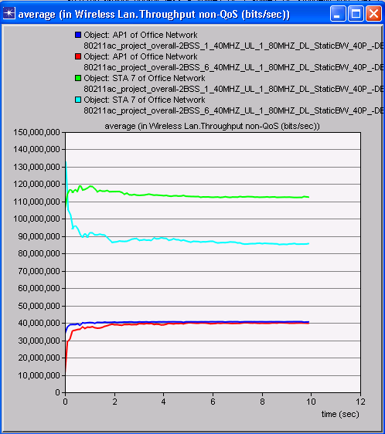
Static BW operation (BSS_N is 40% loaded, 1 STA in BSS_AC, 1 or 6 STAs in BSS_N)
The overall throughput of BSS_N does not decrease with an increase in the number of STAs
BSS_AC ( 1 STA in BSS_N)
Per BSS throughput (Mbps)
BSS_AC ( 6 STAs in BSS_N)
The throughput of BSS_AC decreases due to its reduced transmission opportunity when the number of STAs in BSS_N increases from 1 to 6
BSS_N (1 STA, blue)
BSS_N ( 6 STAs, red)

Slide 14
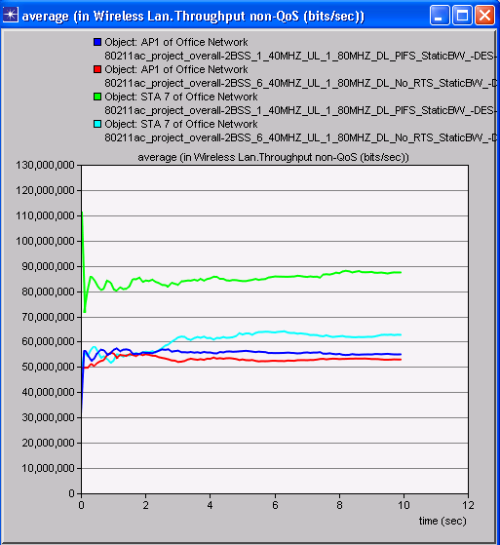
Static BW operation(1 STA in BSS_AC, 1 or 6 STAs in BSS_N, both BSSs are fully loaded)
The overall throughput of BSS_N does not decrease with an increase in the number of STAs (BSS_N consumes more than 50% medium)
BSS_AC ( 1STA in BSS_N)
Per BSS throughput (Mbps)
The throughput of BSS_AC decreases due to its reduced transmission opportunity when the number of STAs in BSS_N increases from 1 to 6
BSS_AC (6 STAs in BSS_N, light blue)
BSS_N (1 STA, blue)
BSS_N (6 STAs, red)

Slide 15
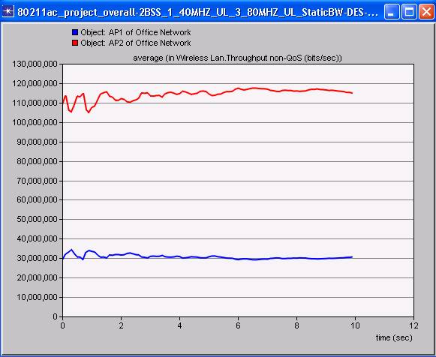
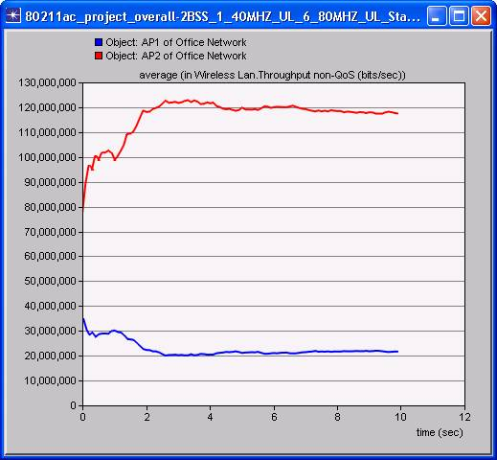
Static BW operation(3 or 6 STA in BSS_AC, 1 STA in BSS_N, both BSSs are fully loaded)
BSS_AC (6 STAs)
BSS_AC (3 STAs)
Per BSS throughput (Mbps)
Per BSS throughput (Mbps)
BSS_N (1 STA)
BSS_N (1 STA)
BSS_N: ~30% max attainable throughput
BSS_N: ~20% max attainable throughput

Slide 16
Static BW operation(3 or 6 STA in BSS_AC, 1 STA in BSS_N, both BSSs are fully loaded)
When there are more STAs in BSS_AC, the STA in BSS_N consumes more medium time than each of the STA in BSS_AC
There is less contention in BSS_N. Thus, the STA in BSS_N has more transmission opportunities

Slide 17
Analysis of Static BW operation
Due to different contending STAs, traffic conditions and TXOP durations over different sub-channels, the backoff of 80MHz STAs is independent of the backoff of 40MHz STAs except right after an 80MHz transmission or a collision where the 80MHz transmission lasts longer
Because an 80MHz STA senses CCA on secondary channels for PIFS, the 80MHz transmission opportunity over the 40MHz channel is related to the percentage of idle period on the 40MHz channel
The percentage of idle period on the 40MHz channel decreases when the number of contending STAs or the load in the 40MHz BSS increases
Thus, Pr(medium is free over a random PIFS period) decreases
80MHz BSS primary
slot
PIFS
40MHz BSS primary
AIFS
slot

Slide 18
Simulation scenario 2
Three 20MHz BSSs (BSS_N, each 40% loaded) and one 80MHz BSS (BSS_AC, fully loaded)
BSS_AC (11ac)
Channels: 36(p)+40+44+48
AP1 (40)
AP2
AP3 (44)
AP4 (48)

Slide 19
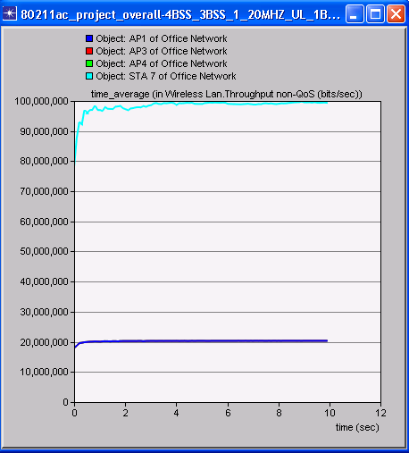
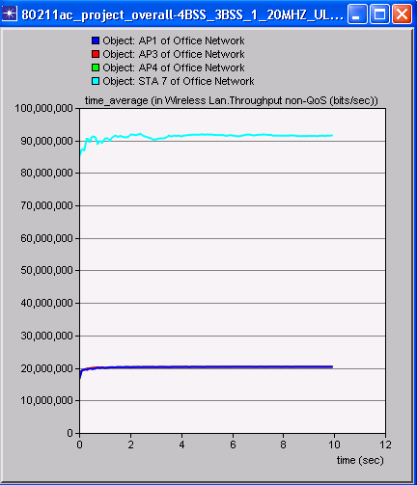
Per BSS throughput, 1 STA in each 20MHz BSS (Static vs Dynamic)
BSS_AC
BSS_AC
BSS_N
BSS_N
Static BW
(BSS_AC: ~50% max attainable throughput)
Dynamic BW

Slide 20
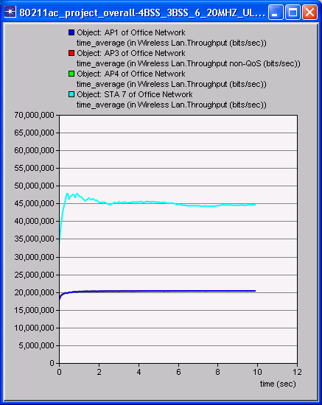
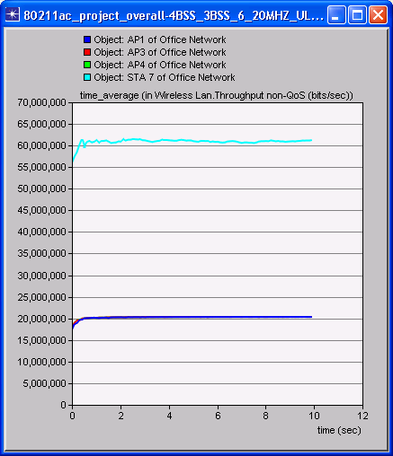
Per BSS throughput, 6 STAs in each 20MHz BSS (Static vs Dynamic)
BSS_AC
BSS_AC
BSS_N
BSS_N
Static BW
(BSS_AC: ~23% max attainable throughput)
Dynamic BW

Slide 21
Analysis of scenario 2
Dynamic BW:
Throughput of 20MHz BSSs is not affected by BSS_AC
80MHz BSS_AC operates over its primary channel at all times
Due to asynchronous operation on different secondary channels, BSS_AC gains access to 40MHz and 80MHz BW from time to time
Static BW:
Throughput of 20MHz BSSs is not affected by BSS_AC
Throughput of 80MHz BSS_AC decreases more significantly when it needs to contend with more STAs in more BSSs
Pr(medium is free over a random PIFS period on all secondary channels) decreases more significantly with a decrease in available idle time on each secondary channel
Primary (36)
Backoff
Backoff
Channel 40
Channel 44
Channel 48

Slide 22
Conclusions
The PIFS medium access rule is not unfair to 40MHz and 20MHz BSSs that overlap only secondary channels of the 80 MHz BSS
In the scenarios considered in this work:
Dynamic BW operation
Throughput of an overlapping 40MHz or 20MHz BSS does not change when an 80MHz BSS starts operating in the neighborhood
Static BW operation
When there are equal numbers of contending STAs in overlapping 80MHz and 20/40MHz BSSs, they each occupy roughly equal medium time
When the number of STAs in the 20/40MHz BSS is larger than the 80MHz BSS, the 20/40MHz BSS consumes more medium time than the 80MHz BSS
When there are more STAs in the 80MHz BSS, the percentage of medium consumed by each 40MHz STA is higher than that of an 80MHz STA

Slide 23
Straw Poll
Do you support updating the TGac spec framework document to extend the 802.11n PIFS medium access mechanism to 80MHz and 160MHz operation, as described below?
AIFS deferral and random backoff based on the primary channel activity
All transmissions shall occupy the primary channel and
Secondary channels occupied by the transmission shall be sensed idle PIFS prior to the transmission

