Slide 1
Two decades 802 dot 11
Date: 2010-09-15
Authors:

Slide 2
Abstract
Interesting facts observed during the two decades of the continuing existence of the IEEE 802.11 Standards Working Group for Wireless LANs.

Slide 3
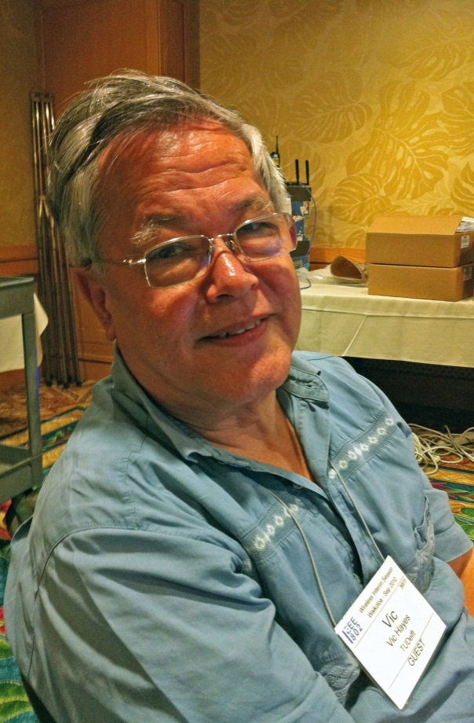

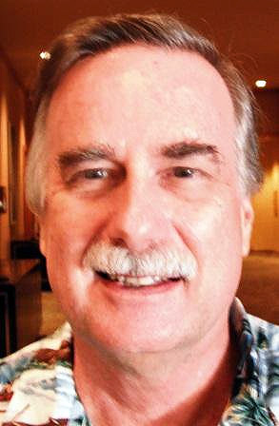
20 Years - Three IEEE 802.11 chairs
Vic Hayes, 1990-2000 Stuart Kerry, 2000-2008 Bruce Kraemer, 2008-Now

Slide 4
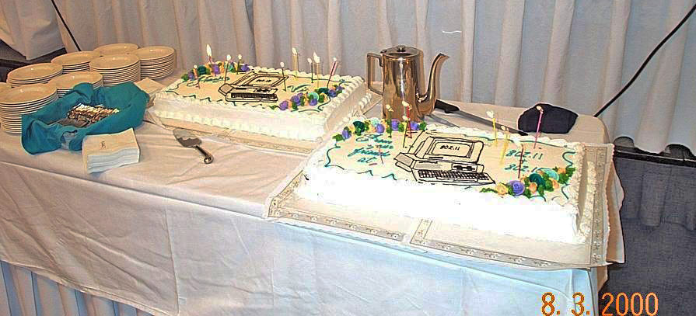

Congratulations on 20 years of perseverance
Notes:
Those two huge cakes were presented to me at the end of my chairmanship of 802.11. The two were supposedly connected wirelessly.

Slide 5
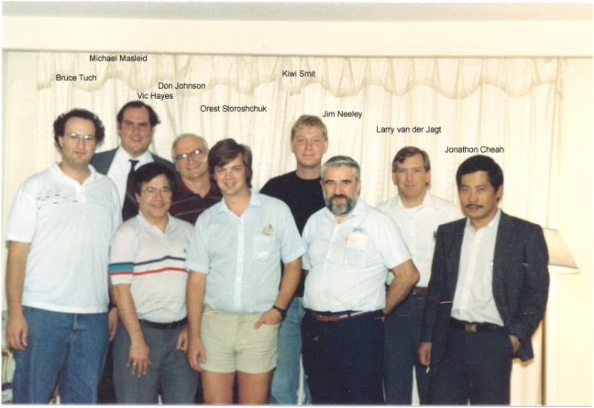
Social at first meeting September 1990

Slide 6
Notes:
In the first 10 years the level of attendance was much lower than during the mid second 10 years.

Slide 7
Sponsor Ballots
Submission RevCOM
Technology selection
Technology proposal time
WG Ballots
Notes:
Lets concentrate on the first 10 years.
Watch the plenary versus interim trend in attendance level. What are the other waves?
Let us add the main activities.
Before the Technology proposal time we
responded to FCC proceedings,
sent letters to the ITU-R representatives of the various Administrations ,
Did a requirements study
Studied the indoor spectrum characteristics
After the technology selection we made the draft and made a few updates, but nobody reacted on the requests for comments.
Hence I started the WG ballot procedure.
That speeded up the conversion to the final draft
And agreed on a vocabulary

Slide 8
Appr PAR a
Submission RevCOM
WG Blt a
SPR Blt a
Appr PAR b
SPR Blt b
WG Blt b
Appr PAR b corr
Appr PAR c
WG Blt c
SPR Blt c
Appr PAR d
Appr PAR rev
WG Blt rev
SPR Blt rev
Notes:
After the submission we had a team that knew how to make standards and all had heard the cry from the market for higher data rates.
We were eager to get an ISO standard and had submitted a number of drafts, but at the end it was needed to revise the standard. The synchronization between processes made us ballet dancers.
Project PAR Appr WG Ballot Sponsor Blt RevCOM Subm
a 9/97 D2.0 11/98 D6 4/99 D7 8/99
b 12/97 D1.0 9/98 D5 4/99 D7 8/99
c 12/97 D1 12/97 D5 3/98 D6.1 7/98
Rev 12/97 D1.1 12/97 D4 3/98 D? 8/98
B Corr 1/00 D1.0 11/99 D1.5 5/01 D? 7/01
D 6/99 D111/99 D? 1/01 D? 5/01

Slide 9
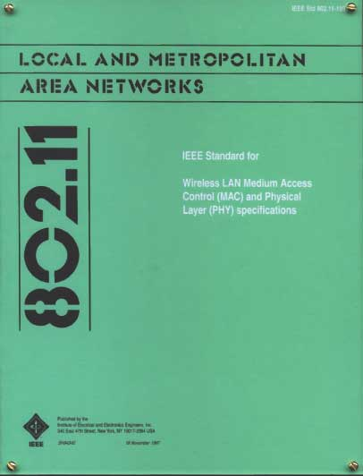
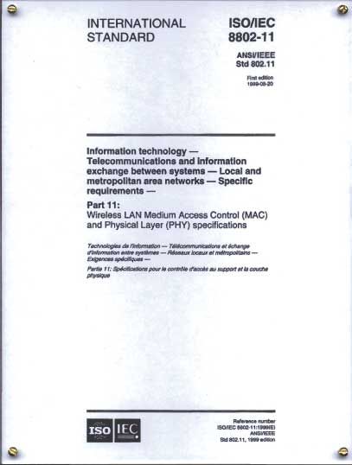
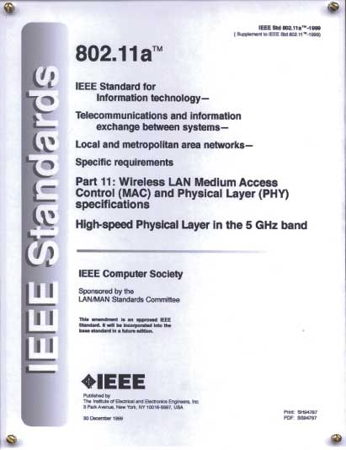
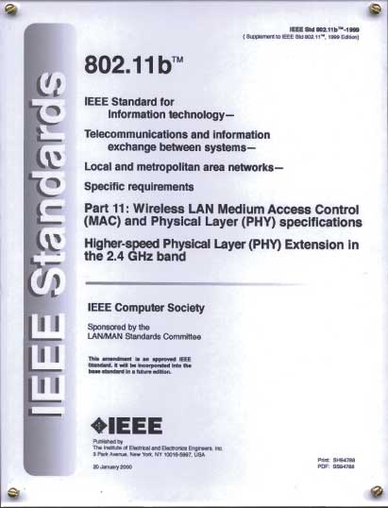
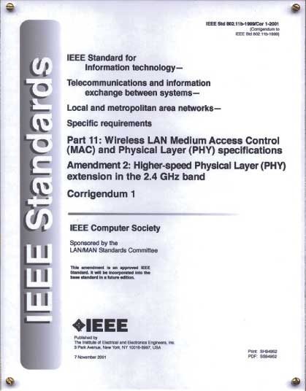
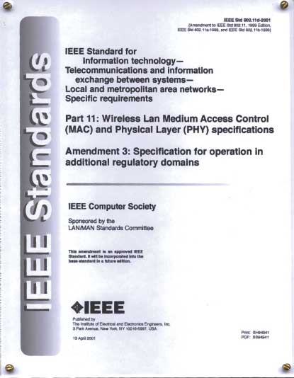
Completed Standards & Amendments
1997
802.11™ Standard
1999
8802.11
ISO Standard
1999
802.11a™
1999
802.11b™
2001
802.11b-Cor1™
2001
802.11d™

Slide 10
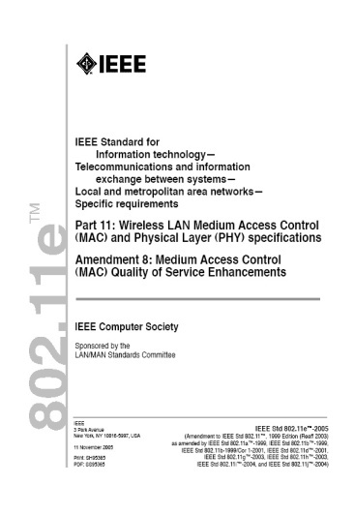
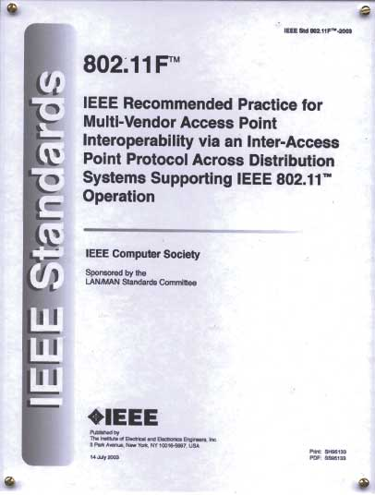
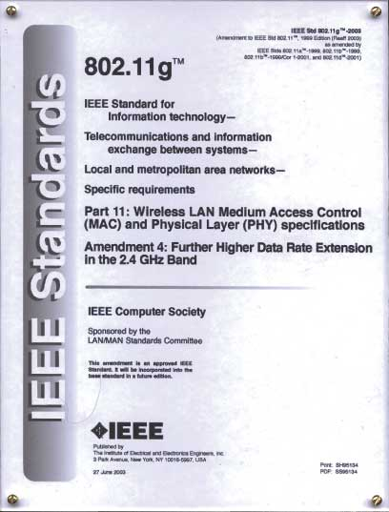
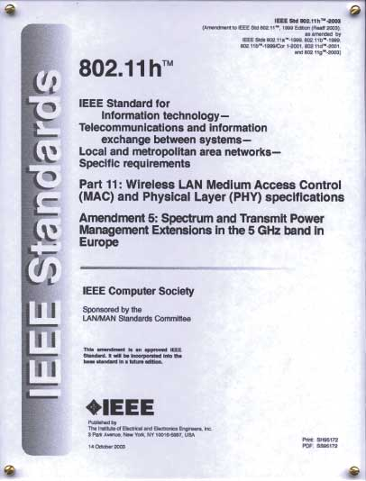
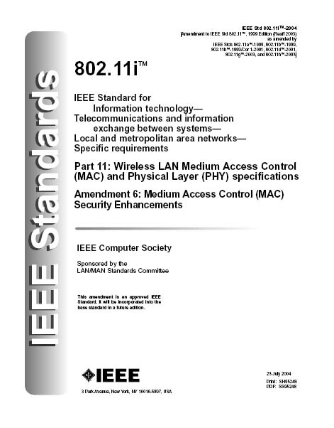
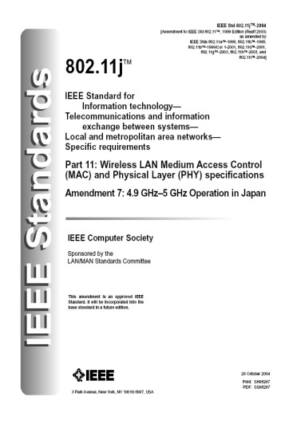
Completed Standards & Amendments
2005
802.11e™
2003
802.11F™
2004
802.11g™
2003
802.11h ™
2004
802.11i™
2004
802.11j™

Slide 11
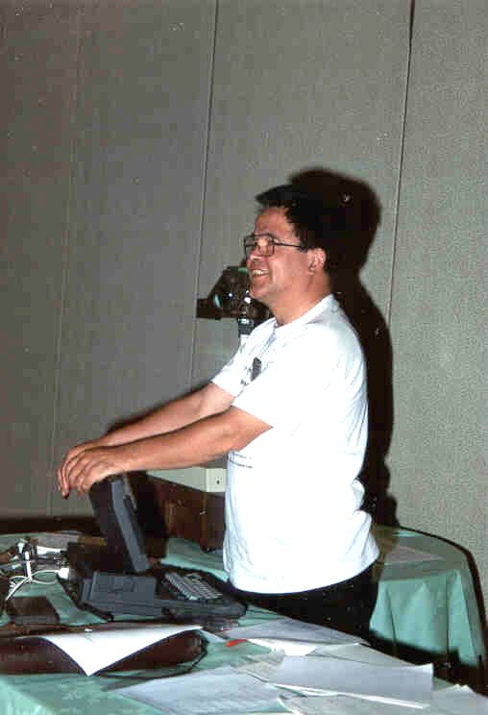
Meeting governance July 1991
From first meeting on we conducted the meeting from PC and screen
Notes:
At that time the PC was still not the laptop we know today. This “luggable” PC:
Weight, including bag and power adapter:
8 kg
Input/output:
2,5” floppy
9,6 kbit/s modem

Slide 12
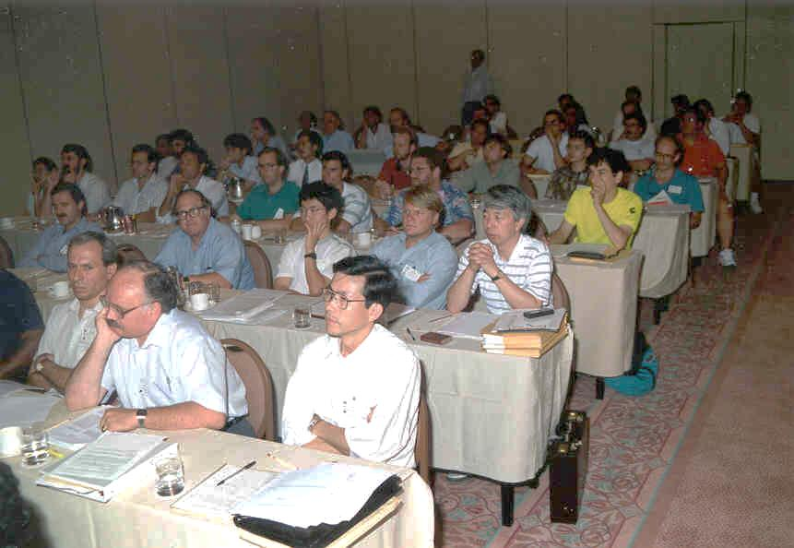
Notes:
But PCs in the meeting room were rare. Just look at the stacks of paper.

Slide 13
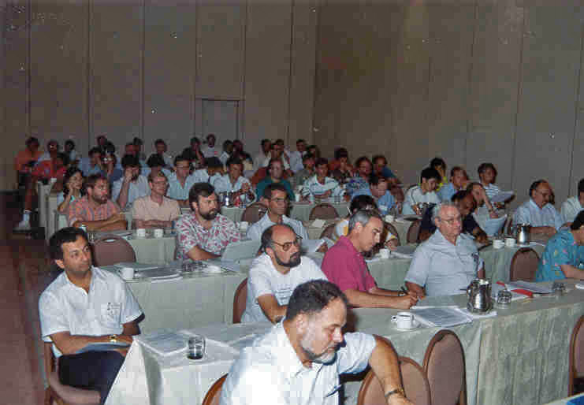
Notes:
Ken Biba had his PC, it was probably an Apple Computer.
Tom Phinney would have his Macintosh under the desk and put the parts on the table as soon as he was volunteered to do some work.

Slide 14
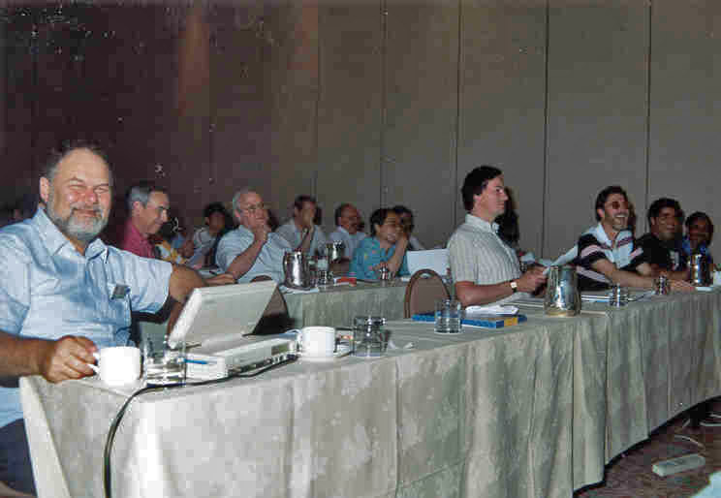
Notes:
And then Bob Crowder had a luggable PC.

Slide 15
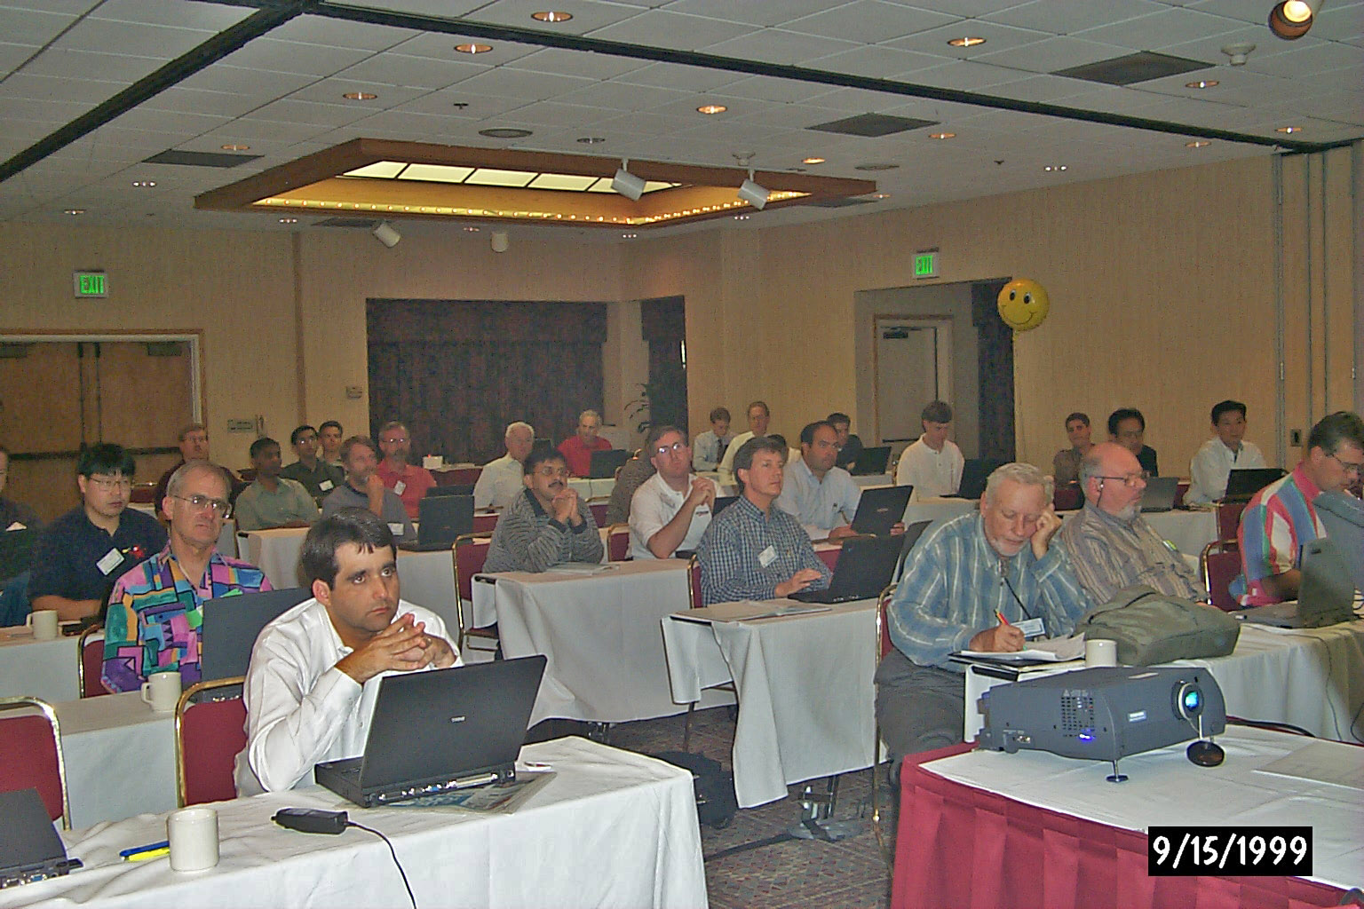
Meeting governance September 1999
Notes:
In 1999 you can see nearly all attendees behind Laptops. Also watch the LCD projector and the Helium balloon that watches our assets like the flashcards and the attendance book.

Slide 16
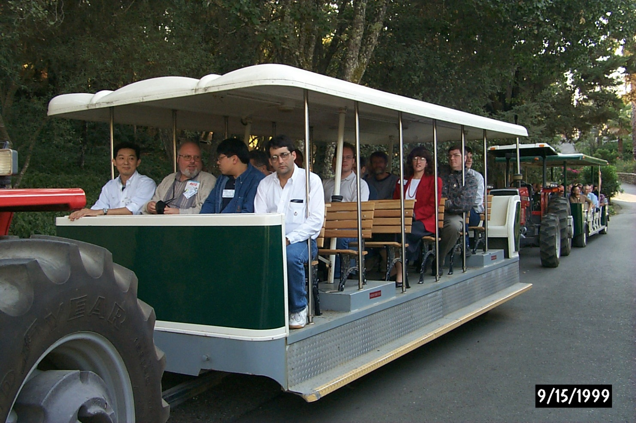
Social at which the flash cards were stolen
Notes:
Well, the balloons did not protect us during the social at a winery: when we returned the 2 flashcards were stolen.

Slide 17
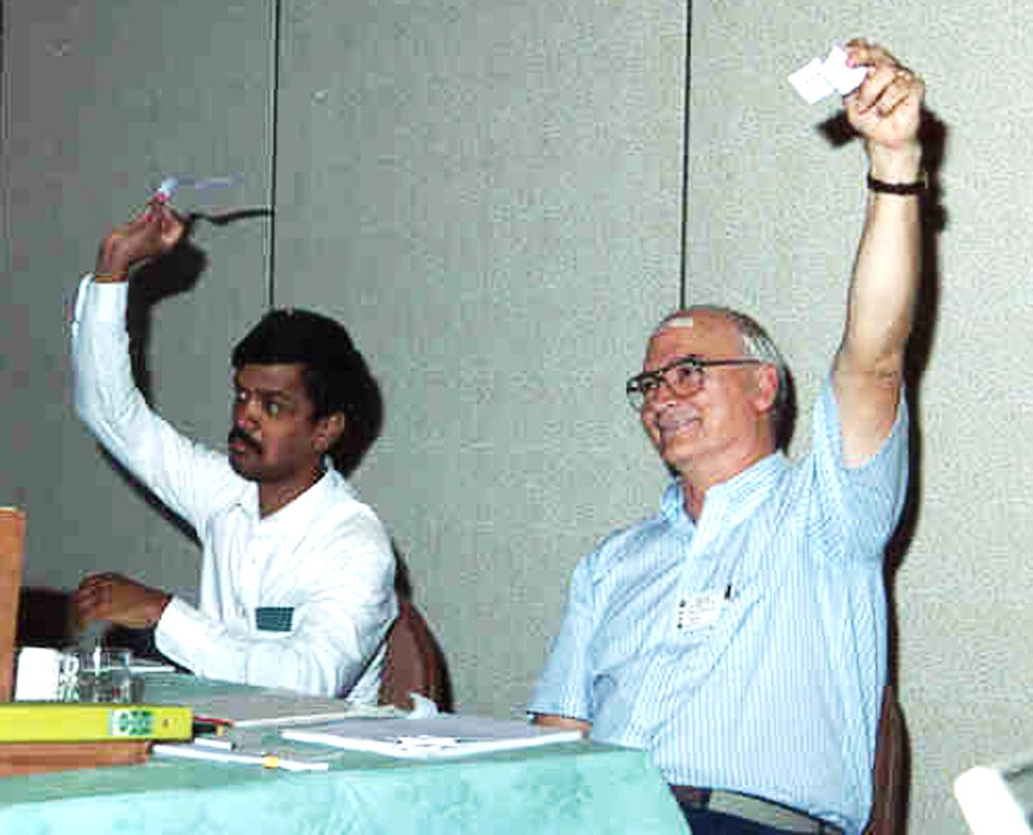
Meeting governance
Voting tokens
Notes:
For recognizing who had voting rights, each voter had a token.

Slide 18
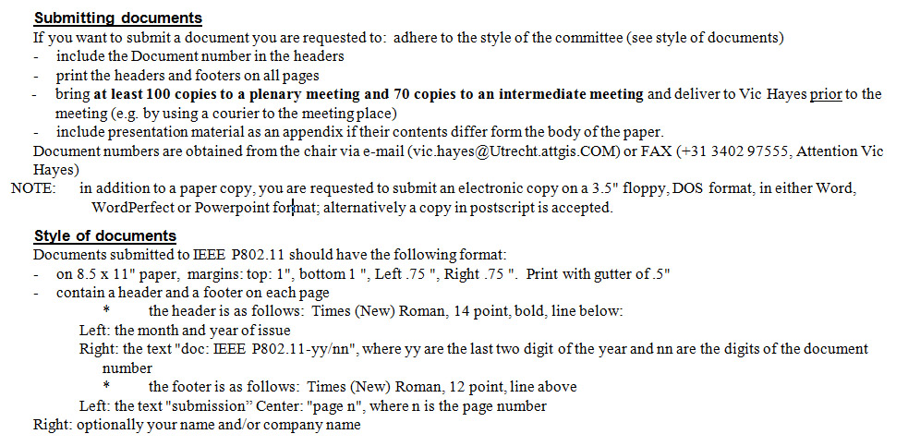
Meeting governance
Document rules
Very strict rules for documents
Notes:
Each cover letter for distribution of documents cotained the rules for submission of documents.
There was no mention of templates for a ;ong time.

Slide 19
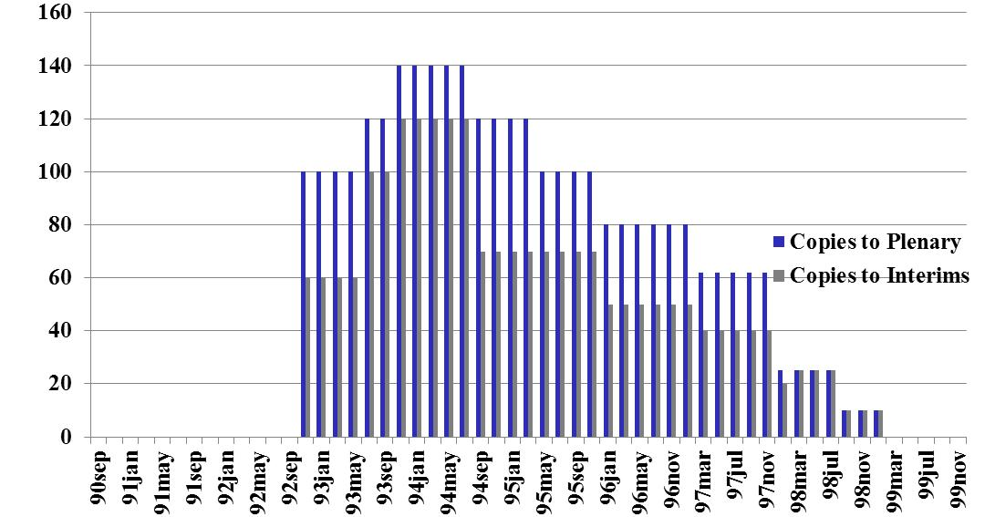
Number of copies to be brought for submissions
Notes:
Participants were required to bring sufficient documents to the meetings.
At the January 1999 meeting the observation was made that at the last 3 meetings no paper documents were taken, so the decision was taken that no papers were distributed any more at meetings.

Slide 20
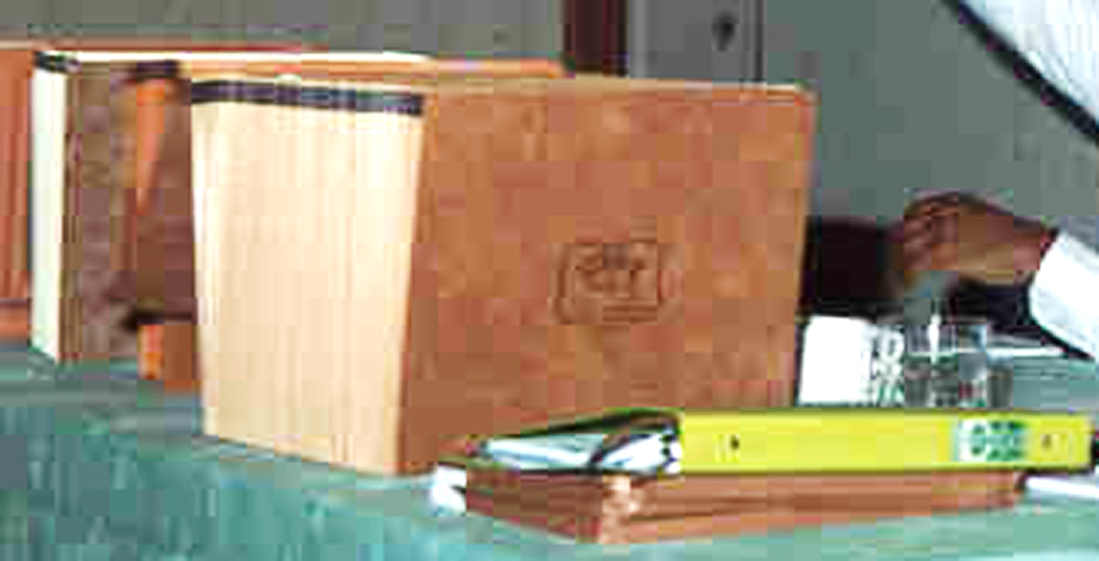
Document distribution during meeting, paper
Notes:
At other working groups documents were placed in stacks at the back of the rooms. Many people ended up picking multiple copies of the same documents, others were deprived from them.
To prevent that I mimicked the pigeonhole systems used at the ITU headquarters in Geneva.

Slide 21
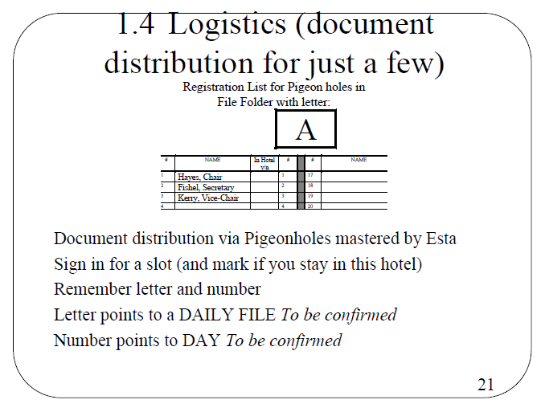
Notes:
Each member reserved a slot and that slot was for him. Volunteers stuffed the slots and so we were ensured that each participant received one but no more than one…

Slide 22
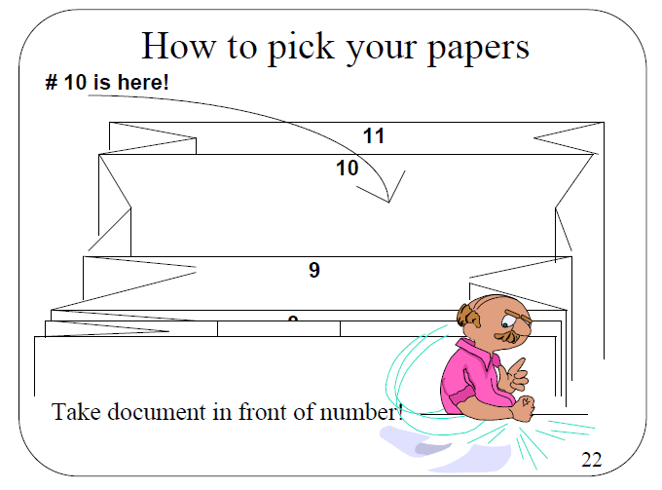
Notes:
That is: if you took the documents from the right place.

Slide 23
Other means of information dissemination
DEC reflector
IEEE majordomo reflector
Diskettes
Flash cards
802.11 network
Notes:
July 1998: 10 copies only, no pigeonholes
January 1999: termination of paper distribution
At the last three meetings paper copies of documents were offered and not taken. It was determined that paper copies were not needed and will not be available in the future meetings.
Distribution lists
November 1993: Bob Egan, DEC, provides two reflector,
mailer@feenix.lkg.dec.com
July 1995: switching to IEEE majordomo
stds-802-11@ieee.org
May 1995: first proprietary WLAN network used
January 1998: Motion to select flash card (40 MB for $ 500)
March 1998: Mention of flashcards as well as Network and diskettes
Donated Laptop with server software
Several accesspoints and cards (a.o. Netwave)
Evaluation report by Darwin Engwer
Donated 2 lcd projectors
November 1998 last meeting with diskettes for distribution
September 1999, Santa Rosa: 2 flash cards stolen during social event at winery
Internet access at meetings
From March 1998 on we had 802.11 network

Slide 24
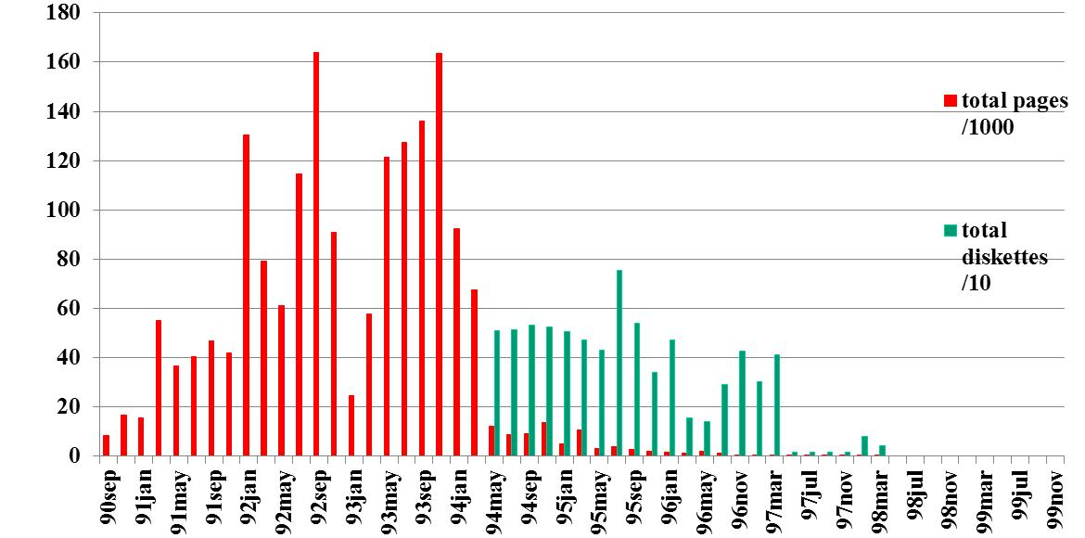
Document distribution outside meetings
Notes:
September 1990: Distribution on paper
1990 and 1991 done by myself in Netherlands. 1992 moved to reprographics in Dayton Ohio
March 1994: Distribution on diskettes replaces paper distribution
May 1997: Termination of mailing service, only for a few I continued, but May 1998 was the real end.

Slide 25
How much paper sent around?
40 year | old | tree
diameter | 0.3 | m
height | 22 | m
specific mass | 550 | kg/m3
area mainstem | 0.0707 | m2
total pages | 1,771,624 | pages
total sheets | 885,812 | sheets
total weight | 4,872 | kg
total volume | 8.86 | m3
total length | 125.3 | m
trees | 5.7 | Trees

Slide 26
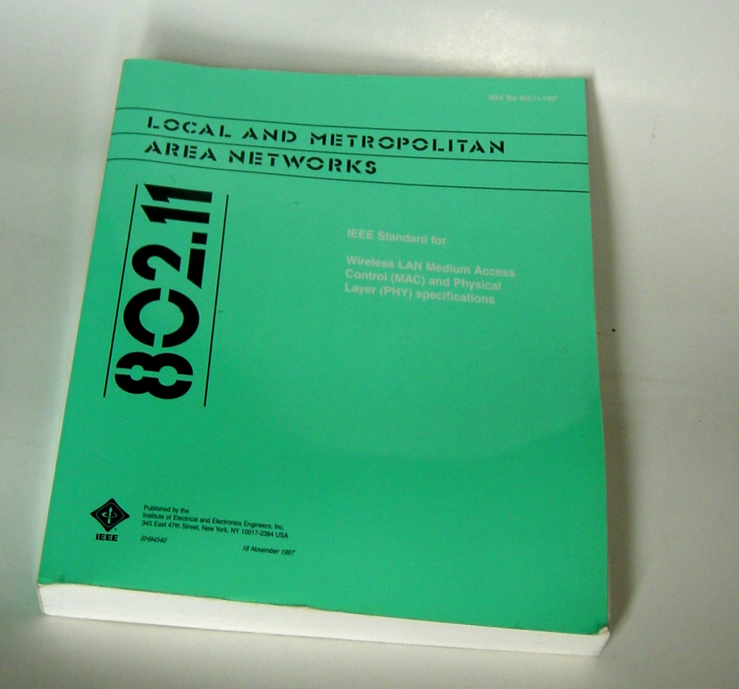
The metamorphosis

Slide 27
Document distribution outside meetings
Alphagraphics order service
Document order service
Document subscription service
Atg.apple.com
ftp.cs.utwente.nl
Stdsbbs.ieee.org
Notes:
The graph shows the packages made and submitted to the service.
The order service existed prior to 802.11and terminated in 1999.
In March 1993 a document subscription service was started. Als at that time I received permission to immediately send packs to the service. Before, the packs of the previous Plenary and interim meetings were collected and given to Buzz Rigsbee for sending to Buzz’s archive, Alphagrahics and the IEEE.
Websites
July 1993: Apple Computer opens web server for our documents
atg.apple.com (17.255.4.30)
November 1993: Student opens shadow web server
ftp.cs.utwente.nl (130.89.10.247)
August 1995: IEEE website available for document publication
stdsbbs.ieee.org (140.98.1.11)
October 1997, Apple Computer pulled the plug on the server, probably not knowing that our server was on the engine. The Twente shadow site immediately deleted all files to remain an image of the apple site.
It is a compliment to the Twente IT server to know that the site was up within an hour of discovery from the latest back-up.

Slide 28
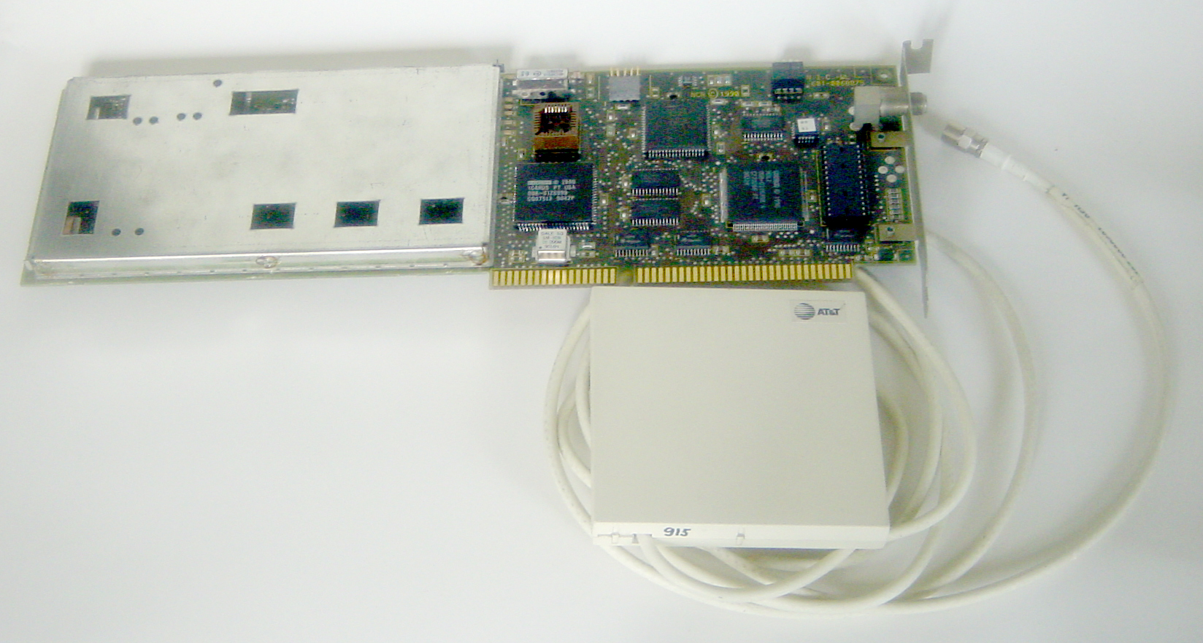
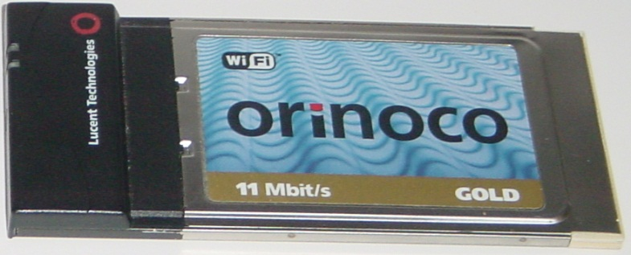
Form factor evolution
1990
Now,
a chip, built in!
2000

Slide 29
Change during the two decades of dot11
  From paper to electronic document dissemination
    From 8 hour lead time to immediate access of documents
  From LCD screen on top of Overhead projector to LCD projector
  From minimal PC use to full PC use
  From non-internet to internet use
    Distribution lists
    Document server
    On-line attendance recording
  The form factor of electronics constantly decreased
  From batch processing, face-to-face only, to continuous processing using electronic means and teleconferencing way of working
All added by the good support of the meeting planners!

Slide 30
20 Year Perspective
How do you recall 20 years of time passed?
What Milestones or events do you remember?
What will the world look like in 20 years?

Slide 31
IEEE 802.11 Standards Pipeline
802.11mb
Maintenance
k+r+y
802.11z
TDLS
802.11 -2007
MAC
802.11aa
Video Transport
e
QoS
802.11s
Mesh
802.11u
WIEN
802.11r
Fast Roam
h
DFS & TPC
802.11V
Network
Management
802.11k
RRM
i
Security
802.11Y
Contention
Based
Protocol
f
Inter AP
Smart Grid
802.11ae
QoS Mgmt Frm
FIA
802.11p
WAVE
802.11af
TVWS
a 54 Mbps
5GHz
S1G
802.11n
High
Throughput
(>100 Mbps)
802.11ac
VHT 5GHz
g
54 Mbps
2.4GHz
802.11ad
VHT 60GHz
802.11W
Management
Frame
Security
802.11b (’99)
11 Mbps
2.4GHz
Discussion Topics
Study
groups
TG
Letter Ballot
Sponsor
Ballot
Published
Amendment
TG without draft
Published
Standard
PHY

Slide 32
1990 - World Leaders
Germany | Chancellor | Helmut Kohl
Australia | Prime Minister | John Hawke
US | President | George H. W. Bush
India | Prime Minister | V. P Singh Chandra Shekhar Singh
UK | Prime Minister | Margaret Thatcher John Major
Canada | Prime Minister | Brian Mulroney
South Korea | President | Roh Tae-woo
Israel | Prime Minister | Yitzhak Shamir
Japan | Prime Minister | Toshiki Kaifu
France | President | Fancois Mitterrand
China | Premier | Li Peng
Netherlands | Prime Minister | Maria Liberia Peters
Soviet | President | Mikhail Gorbachev

Slide 33
20 year Technology Perspective
CPU
Bus Tech
OS
Storage
Internet
LAN
Mobile
Wireless
SDOs/SSOs
Future
2010
2000 -
2009
1991-
1999
1990
1980-
1989

Slide 34
20 year Technology Perspective
CPU
Bus Tech
OS
Storage
Internet
LAN
Mobile
Wireless
SDOs/SSOs

Slide 35
20 year Technology Perspective
CPU
Bus Tech
OS
Storage
Internet
LAN
Mobile
Wireless
SDOs/SSOs
Future
2010
i7-980, 6core 3.33 GHz,
32 nm, 1117MX
i7-965, 4 core,3.2 GHz
, 731MX
Pentium 4-2000
2000 -
2009
68040
i486DX, 33MHz,
1000 nm, 1.2MHz
Pentium 3 -1999
1991-
1999
Pentium 2 -1999
Pentium -1997
68040
1990
i486DX, 33MHz,
1000 nm, 1.2MHz
1980-
1989

Slide 36
20 year Technology Perspective
CPU
Bus Tech
OS
Storage
Internet
LAN
Mobile
Wireless
SDOs/SSOs
Future
Light Peak 10G
2010
i7-980, 6core 3.33 GHz,
32 nm, 1117MX
i7-965, 4 core,3.2 GHz
, 731MX
SATA 3 spec (2008)
USB 3.0 spec (2008)
IEEE 1394-2008 (1600-3200)
PCI Express (2007)
Pentium 4-2000
PCI Bus (2002)
Serial ATA (2002)
USB 2.0 spec
480 Mbps (2001)
USB 1.0
IEEE 1394
2000 -
2009
IEEE 1394b (800)- 2002
Pentium 3 -1999
IEEE 1394a (400)- 2000
USB 1.1 spec
12 Mbps (1998)
1991-
1999
Pentium 2 -1999
USB 1.0 spec
1.5 Mbps (1996)
VESA bus
Pentium -1997
IEEE 1394 (400)- 1995
PC Card
SCSI - 2
68040
PC Card
1990
i486DX, 33MHz,
1000 nm, 1.2MX
SCSI-2
SCSI
IDE - 1989
ISA bus
Parallel ATA - 1986
1980-
1989

Slide 37
20 year Technology Perspective
CPU
Bus Tech
OS
Storage
Internet
LAN
Mobile
Wireless
SDOs/SSOs
Future
Light Peak 10G
i7-980, 6core 3.33 GHz,
32 nm, 1117MX
Windows 7.0
2010
Windows 7
i7-965, 4 core,3.2 GHz
, 731MX
SATA 3 spec (2008)
USB 3.0 spec (2008)
IEEE 1394-2008 (1600-3200)
Windows 7
OS X
Vista -2007
Win XP - 2001
Windows Me -2000
Win 2000 -2000
PCI Express (2007)
Pentium 4-2000
PCI Bus (2002)
Serial ATA (2002)
USB 2.0 spec
480 Mbps (2001)
2000 -
2009
IEEE 1394b (800)- 2002
Pentium 3 -1999
IEEE 1394a (400)- 2000
USB 1.1 spec
12 Mbps (1998)
Windows 98 -1998
1991-
1999
Pentium 2 -1999
USB 1.0 spec
1.5 Mbps (1996)
VESA bus
Windows 95 -1995
Pentium -1997
IEEE 1394 (400)- 1995
Windows 3.0
68040
PC Card
1990
i486DX, 33MHz,
1000 nm, 1.2MX
SCSI-2
Windows 3.0
SCSI
IDE - 1989
ISA bus
Parallel ATA - 1986
1980-
1989

Slide 38
20 year Technology Perspective
CPU
Bus Tech
OS
Storage
Internet
LAN
Mobile
Wireless
SDOs/SSOs
Future
Light Peak 10G
Blu-ray 2
USB Flash 256 GB
2TB drive
1TB - $69.99
80GB – $35.99
USB Flash 256 GB
2TB drive
1TB - $69.99
2010
i7-980, 6core 3.33 GHz,
32 nm, 1117MX
Windows 7
80GB – $35.99
i7-965, 4 core,3.2 GHz
, 731MX
SATA 3 spec (2008)
USB 3.0 spec (2008)
IEEE 1394-2008 (1600-3200)
Windows 7
OS X
Vista -2007
Win XP - 2001
Windows Me -2000
Win 2000 -2000
2TB drive
PCI Express (2007)
Blu-ray -2006
Pentium 4-2000
PCI Bus (2002)
Serial ATA (2002)
USB 2.0 spec
480 Mbps (2001)
2000 -
2009
1st USB Thumb
8 MB
1st USB Thumb
8 MB
IEEE 1394b (800)- 2002
Pentium 3 -1999
IEEE 1394a (400)- 2000
USB 1.1 spec
12 Mbps (1998)
Windows 98 -1998
1991-
1999
Pentium 2 -1999
USB 1.0 spec
1.5 Mbps (1996)
VESA bus
Windows 95 -1995
DVD -1996
CDC Imprimis Elite
5 ¼, 1.5 GB, SCSI-2, $3995
Pentium -1997
IEEE 1394 (400)- 1995
68040
PC Card
1990
i486DX, 33MHz,
1000 nm, 1.2MX
SCSI-2
Windows 3.0
CDC Imprimis Elite
5 ¼, 1.5 GB, SCSI-2, $3995
SCSI
IDE - 1989
ISA bus
Parallel ATA - 1986
2.5” HDD
CD-Rom
3.5” Floppy - 1980
VHS Beta -1997
1980-
1989

Slide 39
20 year Technology Perspective
CPU
Bus Tech
OS
Storage
Internet
LAN
Mobile
Wireless
SDOs/SSOs
Future
Light Peak 10G
Blu-ray 2
USB Flash 256 GB
2TB drive
1TB - $69.99
2010
i7-980, 6core 3.33 GHz,
32 nm, 1117MX
Windows 7
80GB – $35.99
i7-965, 4 core,3.2 GHz
, 731MX
SATA 3 spec (2008)
USB 3.0 spec (2008)
IEEE 1394-2008 (1600-3200)
Windows 7
OS X
Vista -2007
Win XP - 2001
Windows Me -2000
Win 2000 -2000
2TB drive
PCI Express (2007)
Blu-ray -2006
Pentium 4-2000
PCI Bus (2002)
Serial ATA (2002)
USB 2.0 spec
480 Mbps (2001)
2000 -
2009
1st USB Thumb
8 MB
NCSA Mosaic (1993)
IEEE 1394b (800)- 2002
Pentium 3 -1999
IEEE 1394a (400)- 2000
USB 1.1 spec
12 Mbps (1998)
Windows 98 -1998
IE 1.0 (1995)
1991-
1999
Pentium 2 -1999
USB 1.0 spec
1.5 Mbps (1996)
VESA bus
Windows 95 -1995
DVD -1996
Netscape Navigator (1994)
NCSA Mosaic (1993)
Pentium -1997
IEEE 1394 (400)- 1995
www browser & HTML
(Berners-Lee 1991)
68040
PC Card
IETF formed (1986)
1990
i486DX, 33MHz,
1000 nm, 1.2MX
SCSI-2
Windows 3.0
CDC Imprimis Elite
5 ¼, 1.5 GB, SCSI-2, $3995
SCSI
IDE - 1989
ISA bus
Parallel ATA - 1986
2.5” HDD
CD-Rom
3.5” Floppy - 1980
IETF formed (1986)
1980-
1989
UDP RFC 768 - 1980
TCP RFC 761 - 1980
IP RFC 760 - 1980

Slide 40
20 year Technology Perspective
CPU
Bus Tech
OS
Storage
Internet
LAN
Mobile
Wireless
SDOs/SSOs
Future
Light Peak 10G
Blu-ray 2
USB Flash 256 GB
2TB drive
1TB - $69.99
2010
i7-980, 6core 3.33 GHz,
32 nm, 1117MX
Windows 7
80GB – $35.99
i7-965, 4 core,3.2 GHz
, 731MX
SATA 3 spec (2008)
USB 3.0 spec (2008)
IEEE 1394-2008 (1600-3200)
Windows 7
OS X
Vista -2007
Win XP - 2001
Windows Me -2000
Win 2000 -2000
2TB drive
10GBaseT (.3an) (2006)
PCI Express (2007)
Blu-ray -2006
1000BaseT (.3ab) (1999)
Pentium 4-2000
PCI Bus (2002)
Serial ATA (2002)
USB 2.0 spec
480 Mbps (2001)
2000 -
2009
1st USB Thumb
8 MB
IEEE 1394b (800)- 2002
Pentium 3 -1999
IEEE 1394a (400)- 2000
USB 1.1 spec
12 Mbps (1998)
Windows 98 -1998
IE 1.0 (1995)
1000BaseT (.3ab) (1999)
1991-
1999
Pentium 2 -1999
USB 1.0 spec
1.5 Mbps (1996)
VESA bus
Windows 95 -1995
DVD -1996
Netscape Navigator (1994)
1000BaseT (.3ab) (1999)
NCSA Mosaic (1993)
100BaseT (.3y) (1995)
Pentium -1997
IEEE 1394 (400)- 1995
www browser & HTML
(Berners-Lee 1991)
68040
PC Card
1st Enet switch
1990
10BaseT (.3i) (1990)
i486DX, 33MHz,
1000 nm, 1.2MX
SCSI-2
Windows 3.0
CDC Imprimis Elite
5 ¼, 1.5 GB, SCSI-2, $3995
SCSI
IDE - 1989
ISA bus
Parallel ATA - 1986
2.5” HDD
CD-Rom
3.5” Floppy - 1980
1st Enet switch
IETF formed (1986)
1980-
1989
UDP RFC 768 - 1980
10Mbps Coax
TCP RFC 761 - 1980
IP RFC 760 - 1980

Slide 41
20 year Technology Perspective
CPU
Bus Tech
OS
Storage
Internet
LAN
Mobile
Wireless
SDOs/SSOs
Future
Light Peak 10G
Blu-ray 2
USB Flash 256 GB
2TB drive
1TB - $69.99
i7-980, 6core 3.33 GHz,
32 nm, 1117MX
5B WW mobile subs
2010
Windows 7
80GB – $35.99
LTE
i7-965, 4 core,3.2 GHz
, 731MX
SATA 3 spec (2008)
USB 3.0 spec (2008)
4B WW mobile subs
IEEE 1394-2008 (1600-3200)
Windows 7
OS X
Vista -2007
Win XP - 2001
Windows Me -2000
Win 2000 -2000
2TB drive
10GBaseT (.3an) (2006)
PCI Express (2007)
TD-SCDMA
WiMAX
GSM Edge (2003)
Pentium 4-2000
PCI Bus (2002)
Serial ATA (2002)
USB 2.0 spec
480 Mbps (2001)
Blu-ray -2006
2000 -
2009
100 M WW mobile subs
1st USB Thumb
8 MB
1B WW mobile subs
1st Bluetooth phone
IEEE 1394b (800)- 2002
1st GSM call (1991)
Pentium 3 -1999
IEEE 1394a (400)- 2000
USB 1.1 spec
12 Mbps (1998)
Windows 98 -1998
IE 1.0 (1995)
1000BaseT (.3ab) (1999)
100 M WW mobile subs
1991-
1999
Pentium 2 -1999
USB 1.0 spec
1.5 Mbps (1996)
VESA bus
Windows 95 -1995
DVD -1996
Netscape Navigator (1994)
NCSA Mosaic (1993)
100BaseT (.3y) (1995)
IS-95 CDMA
IS-54 TDMA
1st GSM call (1991)
Pentium -1997
IEEE 1394 (400)- 1995
www browser & HTML
(Berners-Lee 1991)
10 M WW mobile subs
68040
PC Card
10 M WW mobile subs
1990
10BaseT (.3i) (1990)
i486DX, 33MHz,
1000 nm, 1.2MX
SCSI-2
Windows 3.0
CDC Imprimis Elite
5 ¼, 1.5 GB, SCSI-2, $3995
SCSI
IDE - 1989
ISA bus
Parallel ATA - 1986
2.5” HDD
CD-Rom
3.5” Floppy - 1980
1st Enet switch
IETF formed (1986)
AMPS
TACs
1980-
1989
UDP RFC 768 - 1980
10Mbps Coax
TCP RFC 761 - 1980
IP RFC 760 - 1980

Slide 42
20 year Technology Perspective
CPU
Bus Tech
OS
Storage
Internet
LAN
Mobile
Wireless
SDOs/SSOs
Future
Light Peak 10G
Blu-ray 2
WiMAX 16m
USB Flash 256 GB
2TB drive
1TB - $69.99
i7-980, 6core 3.33 GHz,
32 nm, 1117MX
5B WW mobile subs
2010
Windows 7
80GB – $35.99
LTE
i7-965, 4 core,3.2 GHz
, 731MX
SATA 3 spec (2008)
USB 3.0 spec (2008)
4B WW mobile subs
Bluetooth 3.0 (2009)
IEEE 1394-2008 (1600-3200)
Windows 7
OS X
Vista -2007
Win XP - 2001
Windows Me -2000
Win 2000 -2000
2TB drive
10GBaseT (.3an) (2006)
PCI Express (2007)
TD-SCDMA
WiMAX
GSM Edge (2003)
802.11n (2009)
Pentium 4-2000
PCI Bus (2002)
Serial ATA (2002)
USB 2.0 spec
480 Mbps (2001)
Blu-ray -2006
Bluetooth 2.0 (2004)
2000 -
2009
802.15.4 (2003)
1st USB Thumb
8 MB
1B WW mobile subs
1st Bluetooth phone
Bluetooth 1.0 spec (1999)
IEEE 1394b (800)- 2002
1st Bluetooth device (2000)
Pentium 3 -1999
IEEE 1394a (400)- 2000
Bluetooth 1.0 spec (1999)
USB 1.1 spec
12 Mbps (1998)
Windows 98 -1998
IE 1.0 (1995)
1000BaseT (.3ab) (1999)
100 M WW mobile subs
1st 802.11 card (1997)
1991-
1999
Pentium 2 -1999
USB 1.0 spec
1.5 Mbps (1996)
VESA bus
Windows 95 -1995
DVD -1996
Netscape Navigator (1994)
NCSA Mosaic (1993)
100BaseT (.3y) (1995)
IS-95 CDMA
IS-54 TDMA
1st GSM call (1991)
1st 802.11 card (1997)
Pentium -1997
IEEE 1394 (400)- 1995
www browser & HTML
(Berners-Lee 1991)
68040
PC Card
10 M WW mobile subs
1990
10BaseT (.3i) (1990)
i486DX, 33MHz,
1000 nm, 1.2MX
SCSI-2
Windows 3.0
CDC Imprimis Elite
5 ¼, 1.5 GB, SCSI-2, $3995
SCSI
IDE - 1989
ISA bus
Parallel ATA - 1986
2.5” HDD
CD-Rom
3.5” Floppy - 1980
1st Enet switch
IETF formed (1986)
AMPS
TACs
1980-
1989
UDP RFC 768 - 1980
10Mbps Coax
TCP RFC 761 - 1980
IP RFC 760 - 1980

Slide 43
20 year Technology Perspective
CPU
Bus Tech
OS
Storage
Internet
LAN
Mobile
Wireless
SDOs/SSOs
Future
Light Peak 10G
Blu-ray 2
WiMAX 16m
USB Flash 256 GB
2TB drive
1TB - $69.99
802.15 & 802.16 formed (1999)
5B WW mobile subs
2010
i7-980, 6core 3.33 GHz,
32 nm, 1117MX
Windows 7
80GB – $35.99
LTE
i7-965, 4 core,3.2 GHz
, 731MX
SATA 3 spec (2008)
USB 3.0 spec (2008)
4B WW mobile subs
Bluetooth 3.0 (2009)
IEEE 1394-2008 (1600-3200)
Windows 7
OS X
Vista -2007
Win XP - 2001
Windows Me -2000
Win 2000 -2000
2TB drive
10GBaseT (.3an) (2006)
WFA formed (1999)
TD-SCDMA
WiMAX
GSM Edge (2003)
802.11n (2009)
PCI Express (2007)
Blu-ray -2006
Pentium 4-2000
PCI Bus (2002)
Serial ATA (2002)
USB 2.0 spec
480 Mbps (2001)
Bluetooth 2.0 (2004)
802.20 formed (2002)
2000 -
2009
802.15.4 (2003)
WiMAX formed (2001)
1st USB Thumb
8 MB
1B WW mobile subs
1st Bluetooth phone
Bluetooth SIG formed (1998)
IEEE 1394b (800)- 2002
1st Bluetooth device (2000)
Pentium 3 -1999
IEEE 1394a (400)- 2000
Bluetooth 1.0 spec (1999)
WFA formed (1999)
802.15 formed (1999)
802.16 formed (1999)
Bluetooth SIG formed (1998)
USB SIG formed (1994)
USB 1.1 spec
12 Mbps (1998)
Windows 98 -1998
IE 1.0 (1995)
1000BaseT (.3ab) (1999)
100 M WW mobile subs
1st 802.11 card (1997)
1991-
1999
Pentium 2 -1999
USB 1.0 spec
1.5 Mbps (1996)
VESA bus
Windows 95 -1995
DVD -1996
Netscape Navigator (1994)
NCSA Mosaic (1993)
100BaseT (.3y) (1995)
IS-95 CDMA
IS-54 TDMA
1st GSM call (1991)
Pentium -1997
IEEE 1394 (400)- 1995
www browser & HTML
(Berners-Lee 1991)
802.11 formed (1990)
68040
PC Card
10 M WW mobile subs
1990
10BaseT (.3i) (1990)
i486DX, 33MHz,
1000 nm, 1.2MX
Windows 3.0
802.11 formed (1990)
SCSI-2
ETSI formed (1989)
CDC Imprimis Elite
5 ¼, 1.5 GB, SCSI-2, $3995
SCSI
IDE - 1989
ISA bus
Parallel ATA - 1986
2.5” HDD
CD-Rom
3.5” Floppy - 1980
1st Enet switch
ETSI formed (1989)
PCMCIA formed (1989)
1394 WG formed (1986)
IETF formed (1986)
AMPS
TACs
1980-
1989
UDP RFC 768 - 1980
10Mbps Coax
TCP RFC 761 - 1980
CTIA formed (1984)
IP RFC 760 - 1980
802 Formed (1980)

Slide 44
20 year Technology Perspective
CPU
Bus Tech
OS
Storage
Internet
LAN
Mobile
Wireless
SDOs/SSOs
Future
Light Peak 10G
Blu-ray 2
USB Flash 256 GB
2TB drive
1TB - $69.99
i7-980, 6core 3.33 GHz,
32 nm, 1117MX
5B WW mobile subs
2010
Windows 7
80GB – $35.99
LTE
LTE
i7-965, 4 core,3.2 GHz
, 731MX
SATA 3 spec (2008)
USB 3.0 spec (2008)
4B WW mobile subs
Bluetooth 3.0 (2009)
IEEE 1394-2008 (1600-3200)
Windows 7
OS X
Vista -2007
Win XP - 2001
Windows Me -2000
Win 2000 -2000
2TB drive
10GBaseT (.3an) (2006)
PCI Express (2007)
TD-SCDMA
WiMAX
GSM Edge (2003)
802.11n (2009)
Pentium 4-2000
PCI Bus (2002)
Serial ATA (2002)
USB 2.0 spec
480 Mbps (2001)
Blu-ray -2006
Bluetooth 2.0 (2004)
802.20 formed (2002)
2000 -
2009
802.15.4 (2003)
WiMAX formed (2001)
1st USB Thumb
8 MB
1B WW mobile subs
1st Bluetooth phone
IEEE 1394b (800)- 2002
1st Bluetooth device (2000)
Pentium 3 -1999
IEEE 1394a (400)- 2000
Bluetooth 1.0 spec (1999)
WFA formed (1999)
802.15 formed (1999)
802.16 formed (1999)
Bluetooth SIG formed (1998)
USB SIG formed (1994)
USB 1.1 spec
12 Mbps (1998)
Windows 98 -1998
IE 1.0 (1995)
1000BaseT (.3ab) (1999)
100 M WW mobile subs
1st 802.11 card (1997)
1991-
1999
Pentium 2 -1999
USB 1.0 spec
1.5 Mbps (1996)
VESA bus
Windows 95 -1995
DVD -1996
Netscape Navigator (1994)
NCSA Mosaic (1993)
100BaseT (.3y) (1995)
IS-95 CDMA
IS-54 TDMA
1st GSM call (1991)
Pentium -1997
IEEE 1394 (400)- 1995
www browser & HTML
(Berners-Lee 1991)
68040
PC Card
10 M WW mobile subs
1990
10BaseT (.3i) (1990)
i486DX, 33MHz,
1000 nm, 1.2MX
SCSI-2
Windows 3.0
802.11 formed (1990)
CDC Imprimis Elite
5 ¼, 1.5 GB, SCSI-2, $3995
SCSI
IDE - 1989
ISA bus
Parallel ATA - 1986
2.5” HDD
CD-Rom
3.5” Floppy - 1980
1st Enet switch
ETSI formed (1989)
PCMCIA formed (1989)
1394 WG formed (1986)
IETF formed (1986)
AMPS
TACs
1980-
1989
UDP RFC 768 - 1980
10Mbps Coax
TCP RFC 761 - 1980
CTIA formed (1984)
IP RFC 760 - 1980
802 Formed (1980)

Slide 45
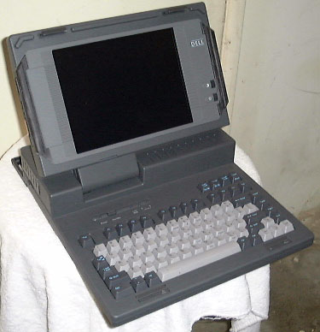
1st Dell Laptop
Winner of 4-way comparison
InfoWorld May 21, 1990
Dell 316LT $3499
Grid 1450sx $4995
NEC Prospeed 386sx $5799
Toshiba T3100sx $5999
November 6, 1989
316LT
$3499
15 lb with Battery
16MHz 80386SX
20MB HDD
1.4MB floppy
1MB RAM
Internal modem
640x480 mono display

Slide 46
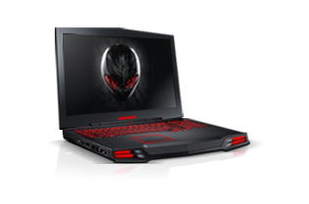
Dell Alien M17x
Processor:
Intel® Core™ i7 920XM 2.0GHz (3.2GHz Turbo Mode, 8MB Cache)
Operating System:
Genuine Windows® 7 Home Premium, 64bit, English
Service:
1 Year Basic Service Plan
Video Card:
1GB ATI Radeon™ Mobility HD 5870
Display Panels:
17-inch WideUXGA 1920 x 1200 RGB LED (1200p)
Memory:
8GB Dual Channel DDR3 at 1333MHz
Hard Drive:
1.2TB Raid 0 (2x 640GB 5,400RPM)
CD ROM/DVD ROM:
Slot-Loading Dual Layer Blu-ray Burner (BR-R, DVD+-RW, CD-RW)
Sound:
Internal High-Definition 5.1 Surround Sound Audio
Bluetooth:
Internal Wireless Bluetooth® 2.1 with EDR
Wireless:
Intel® Ultimate N WiFi Link 6300 a/g/n 3x3 MIMO Technology
TV Tuners:
ExpressCard Digital TV Tuner
$ 4016

Slide 47
20 year Technology Perspective
CPU
Bus Tech
OS
Storage
Internet
LAN
Mobile
Wireless
SDOs/SSOs
Future
?
?
?
?
?
?
?
?
2030
2020 -
2029
2011-
2119
USB Flash 256 GB
2TB drive
1TB - $69.99
i7-980, 6core 3.33 GHz,
32 nm, 1117MX
5B WW mobile subs
2010
Windows 7
LTE
80GB – $35.99
i7-965, 4 core,3.2 GHz
, 731MX
SATA 3 spec (2008)
USB 3.0 spec (2008)
4B WW mobile subs
Bluetooth 3.0 (2009)
IEEE 1394-2008 (1600-3200)
Windows 7
OS X
Vista -2007
Win XP - 2001
Windows Me -2000
Win 2000 -2000
2TB drive
10GBaseT (.3an) (2006)
PCI Express (2007)
TD-SCDMA
WiMAX
GSM Edge (2003)
802.11n (2009)
2000-
2009
Pentium 4-2000
PCI Bus (2002)
Serial ATA (2002)
USB 2.0 spec
480 Mbps (2001)
Blu-ray -2006
Bluetooth 2.0 (2004)
802.20 formed (2002)
802.15.4 (2003)
WiMAX formed (2001)
1st USB Thumb
8 MB
1B WW mobile subs
1st Bluetooth phone
IEEE 1394b (800)- 2002
1st Bluetooth device (2000)
IEEE 1394a (400)- 2000

Slide 48

 | "Our dream of having the standard implemented in all PCs came true. Moreover, it surpassed our dreams because implementations are also in PDAs and mobile telephones and, thanks to user innovation and community initiatives, brings broadband Internet access and telephone services in rural areas otherwise not served. It dramatically improves the economic and social situation there. I am proud of the group I led for the first decade because it continues to broaden the horizon of capabilities. Congratulations and continue the good works!" - Vic Hayes, Chair of the very first 802.11 Working Group, established in September 1990

Slide 49
 | "Without the brains, creativity and vision of the 802.11 Working Group, we would still be tied to phone and computer cords, no mobile anything. Productivity as we know it today, on the go, would also be tied to a cord, tethered and held back. Standards carry the burden of being called 'boring' but how can anyone call boring the thing that literally lets our communications fly? The 802.11 Working Group has accomplished amazing things and it isn't done yet. Prepare to be astounded.“ - Stuart J. Kerry, "Lifelong WG Member," IEEE 802.11 WG Ex-Chair 2000 - 2008 and IEEE 802.11 WG Vice-Chair 1994 - 2000

Slide 50
 | "The standards produced by the IEEE 802.11 Working Group have provided untethered, low cost, high rate data communications that dramatically influence our everyday lives and will continue to do so well into the future. The high quality and broad commercial acceptance of the IEEE 802.11 standard is a testament to all of the members' dedication, innovation, and vision. IEEE 802.11 continues to push the boundaries of innovation two decades after its inception.“ - Bruce Kraemer, Chairman of the 802.11 Working Group

Slide 51
Looking to the future …
It’s Now, it’s Easy, it’s a No Brainer
People Don’t know what it’s name is, but it has to be there
Complements Wired Access
The standard will be there in another 20 years similar to what Ethernet has shown in its continuing long life
Has an growing Future of Innovations and Applications
On-going support of industry and individual engineers for a bright future in the world of global standards

Slide 52
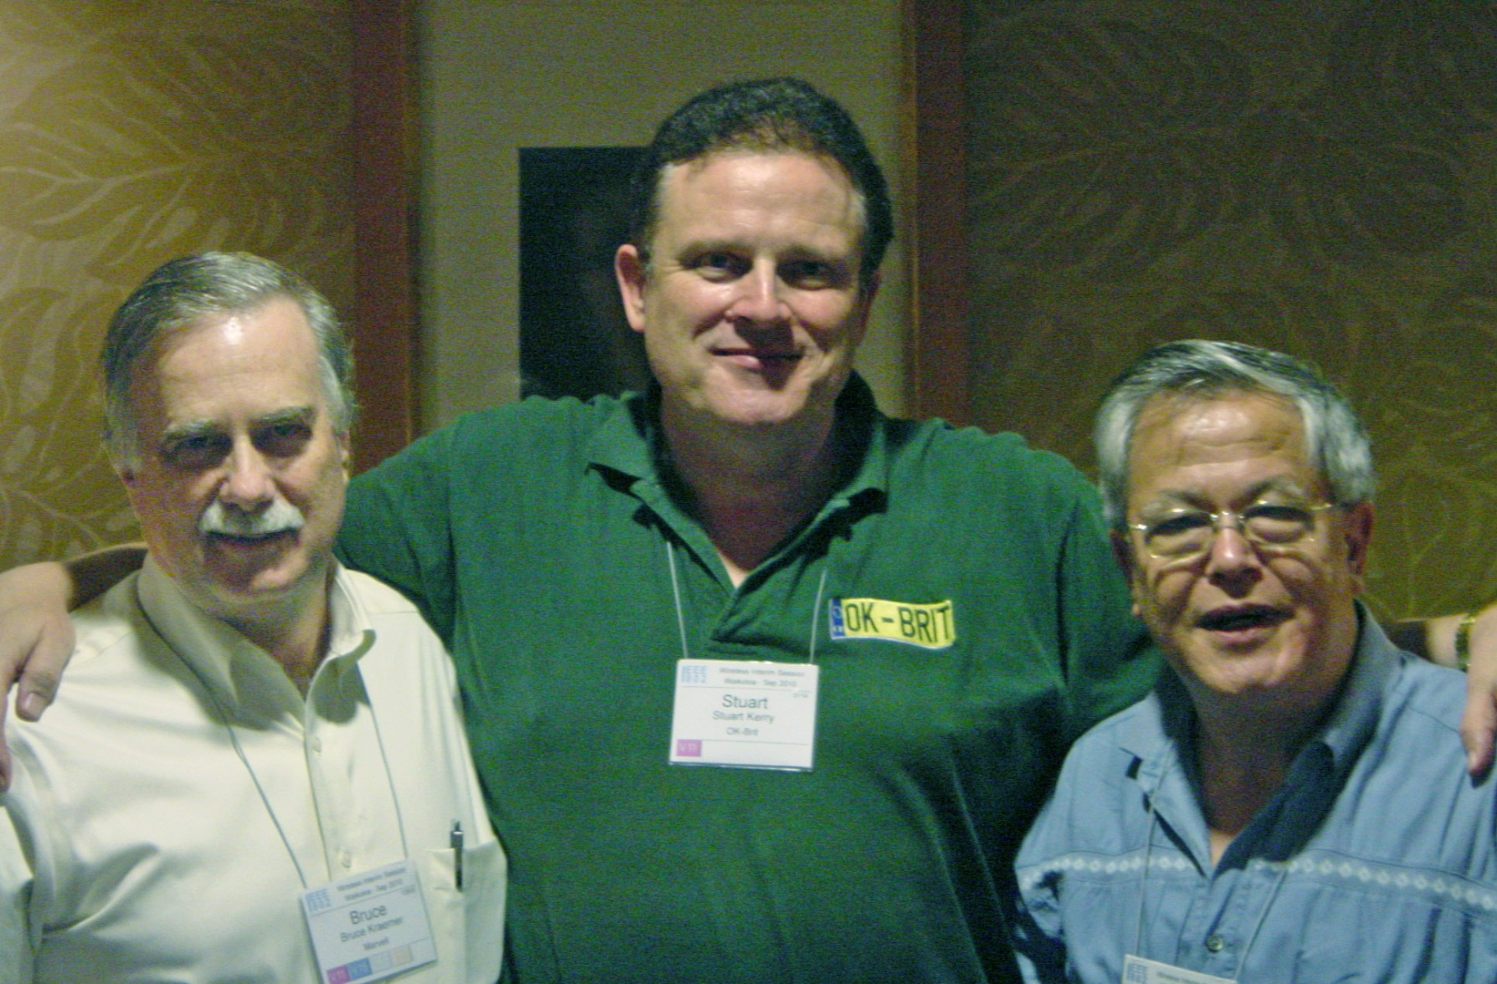
Thanks to all the members for allowing us to be part of this history
Notes:
The three chairs thank the members of the working group for their support on behalf of the world population.

Slide 53
Others may have memories and comments to share…

Slide 54

Stay tuned, more to come in

Slide 56
References
For community networks
For more unlicensed spectrum
For the quotes on the 20th anniversary
802.11 website
http://en.wikipedia.org/wiki/List_of_wireless_community_networks_by_region
www.openspectrum.eu
Facebook link
http://grouper.ieee.org/groups/802/11/
Notes:
As you know, our standard is eagerly used by end-users to bring social and economic benefits to people. The fist link shows you where such networks are.
For more unlicensed spectrum, volunteers are joint together in the Open Spectrum Alliance. The second link is towards its website.

