Slide 1
OakTree LCRA Spectrum Analysis Study
July 2010
Name | Company | Address | Phone | email
Garth Hillman | OakTree Consulting | 310 Seashell Austin, TX 78734 | +1-512-751-0062 | Garth.hillman@oaktreewireless .com
Date: 2010-July-13
Abstract: Summary of Spectrum Analysis experiment at the Fayette Coal Fired Power Plant for July 802.11 Smart Grid Ad Hoc meeting
Slide 1
Garth Hillman, OakTree Consulting
Notes:
doc.: IEEE 802.11-10/xxxxr0
July 2010
Page 1

Slide 2
Proposal
July 2010
OakTree Consulting in association with ETS-Lindgren, Aruba Networks, Firetide, and Aclara Technologies engaged with the LCRA (Lower Colorado River Authority) to measure, analyze and report on the interference present in typical G&T facilities.
There have been claims and counter claims regarding the level of interference and concomitant performance of wireless equipment operating in unlicensed bands in G&T environments.
The goal of this engagement would be to measure the actual spectral signatures being found in a representative G&T facility. While there is a wide range of circumstances and equipment, we would like to start by assessing a typical substation such as is present within the LCRA
Slide 2
Garth Hillman, OakTree Consulting
Notes:
2
doc.: IEEE 802.11-10/xxxxr0

Slide 3
LCRA Spectrum Study
July 2010
To briefly run several representative systems in the environment to determine if popular COTS equipment can operate in some or all of the environment and to run a baseline spectrum analysis test
The first test was to take several soundings around a G&T facility with a spectrum analyzer such as the Agilent N9912A Fieldfox RF Analyzer.
Aruba Networks performed a passive site survey of the Wi-Fi spectrum using industry standard tools and will setup a sample network and use the Aruba system’s internal diagnostics abilities to look for interference that may be from the G&T facility or other local or nearby sources. ISM bands 2.4 MHz and 5 GHz operation will be examined.
The Third test will be to set up an Firetide/Aclara demo that will show real time monitoring of a meter and control of a sensor through a web interface on a mobile computing device. 802.11 operations in 900 MHz ISM bands will be examined
Slide 3
Garth Hillman, OakTree Consulting
Notes:
3
doc.: IEEE 802.11-10/xxxxr0

Slide 4
Location
July 2010
Slide 4
Garth Hillman, OakTree Consulting
Notes:
4
doc.: IEEE 802.11-10/xxxxr0

Slide 5
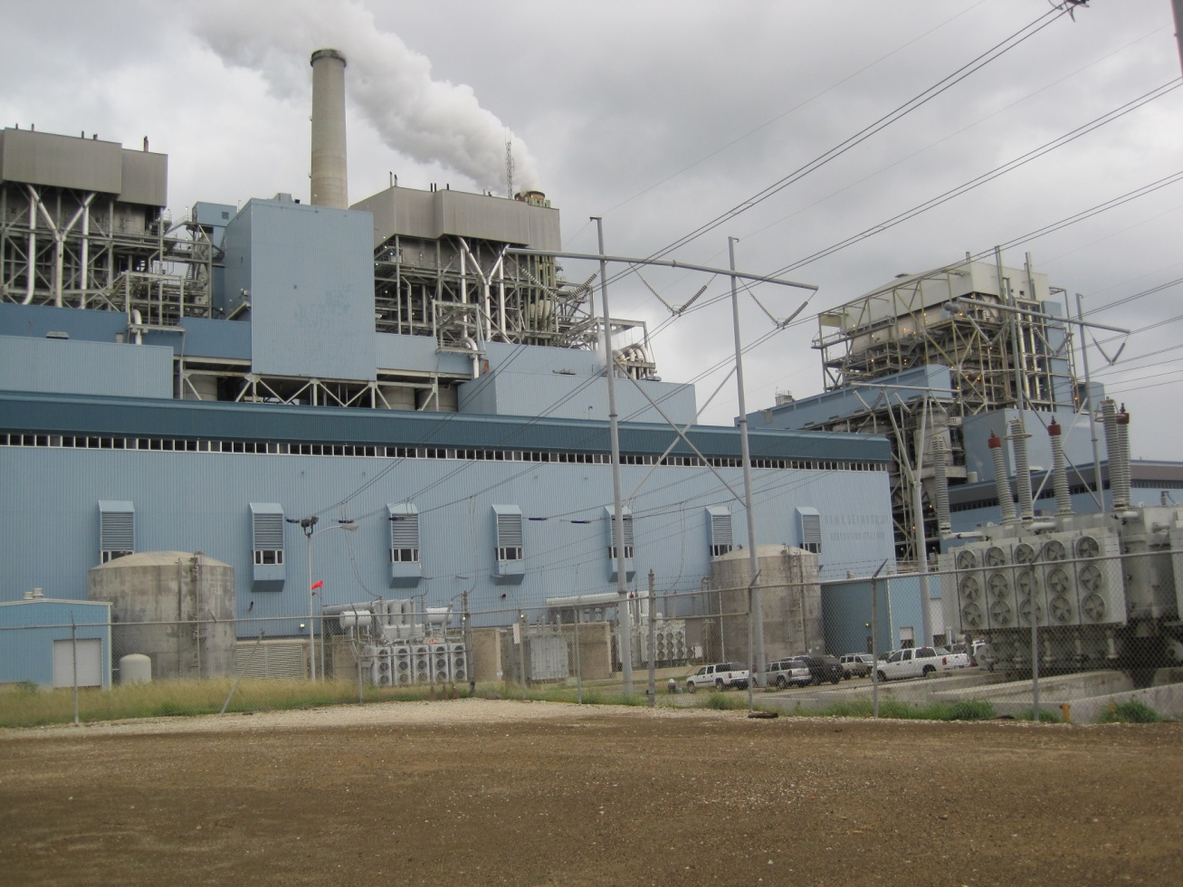
Fayette Power Project – Coal Fired Power Plant
July 2010
Unit 1, completed in 1979, with a generating capacity of 615 megawatts
Unit 2, completed in 1980, with a generating capacity of 615 megawatts
Unit 3, completed in 1988, with a generating capacity of 460 megawatts
Slide 5
Garth Hillman, OakTree Consulting
Notes:
5
doc.: IEEE 802.11-10/xxxxr0

Slide 6
Physical consideration – safety training
July 2010
Slide 6
Garth Hillman, OakTree Consulting
Notes:
6
doc.: IEEE 802.11-10/xxxxr0

Slide 7
The Group
July 2010
Slide 7
Garth Hillman, OakTree Consulting
Notes:
7
doc.: IEEE 802.11-10/xxxxr0

Slide 8
Test 1
July 2010
Slide 8
Garth Hillman, OakTree Consulting
Notes:
8
doc.: IEEE 802.11-10/xxxxr0

Slide 9
July 2010
Slide 9
Garth Hillman, OakTree Consulting
Notes:
9
doc.: IEEE 802.11-10/xxxxr0

Slide 10
July 2010
Slide 10
Garth Hillman, OakTree Consulting
Notes:
10
doc.: IEEE 802.11-10/xxxxr0

Slide 11
July 2010
Slide 11
Garth Hillman, OakTree Consulting
Notes:
11
doc.: IEEE 802.11-10/xxxxr0

Slide 12
July 2010
Slide 12
Garth Hillman, OakTree Consulting
Notes:
12
doc.: IEEE 802.11-10/xxxxr0

Slide 13
Test 2
July 2010
Slide 13
Garth Hillman, OakTree Consulting
Notes:
13
doc.: IEEE 802.11-10/xxxxr0

Slide 14
July 2010
Slide 14
Garth Hillman, OakTree Consulting
Notes:
14
doc.: IEEE 802.11-10/xxxxr0

Slide 15
Lunch
July 2010
Slide 15
Garth Hillman, OakTree Consulting
Notes:
15
doc.: IEEE 802.11-10/xxxxr0

Slide 16
July 2010
Slide 16
Garth Hillman, OakTree Consulting
Notes:
16
doc.: IEEE 802.11-10/xxxxr0

Slide 17
July 2010
Slide 17
Garth Hillman, OakTree Consulting
Notes:
17
doc.: IEEE 802.11-10/xxxxr0

Slide 18
Test 3
July 2010
Slide 18
Garth Hillman, OakTree Consulting
Notes:
18
doc.: IEEE 802.11-10/xxxxr0

Slide 19
900 MHz Mesh results
July 2010
Slide 19
Garth Hillman, OakTree Consulting
Notes:
19
doc.: IEEE 802.11-10/xxxxr0

Slide 20
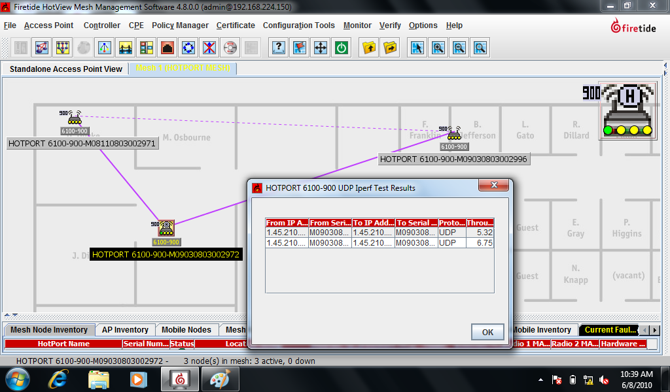
July 2010
Firetide IPERF test – Plant Floor
Slide 20
Garth Hillman, OakTree Consulting
Notes:
20
doc.: IEEE 802.11-10/xxxxr0

Slide 21
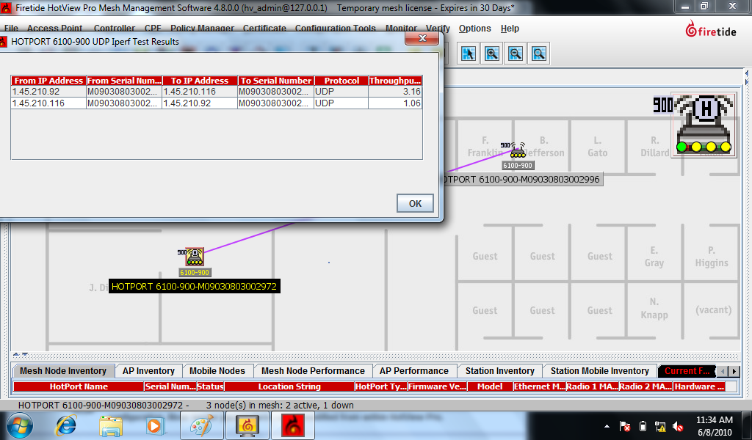
July 2010
Firetide IPERF test – Yard #1
Slide 21
Garth Hillman, OakTree Consulting
Notes:
21
doc.: IEEE 802.11-10/xxxxr0

Slide 22
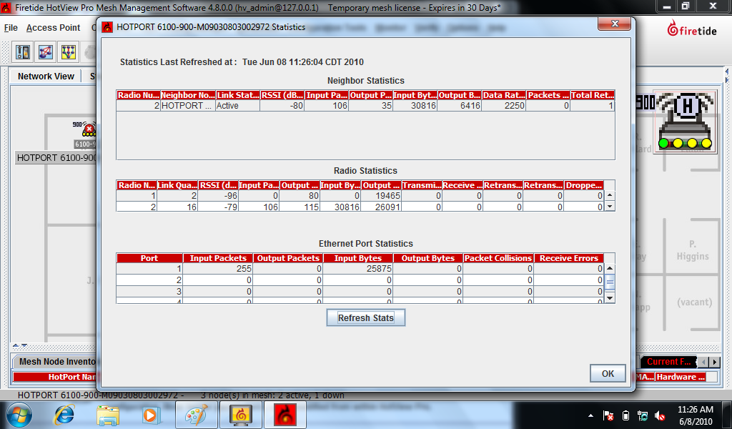
July 2010
Firetide stats – Yard #1
Slide 22
Garth Hillman, OakTree Consulting
Notes:
22
doc.: IEEE 802.11-10/xxxxr0

Slide 23
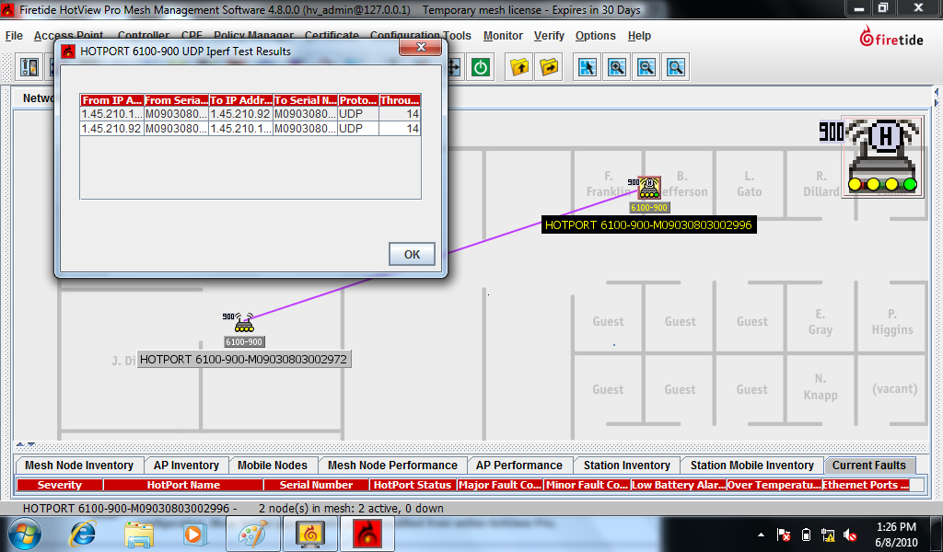
July 2010
Firetide IPERF test – Yard #2
Slide 23
Garth Hillman, OakTree Consulting
Notes:
23
doc.: IEEE 802.11-10/xxxxr0

Slide 24
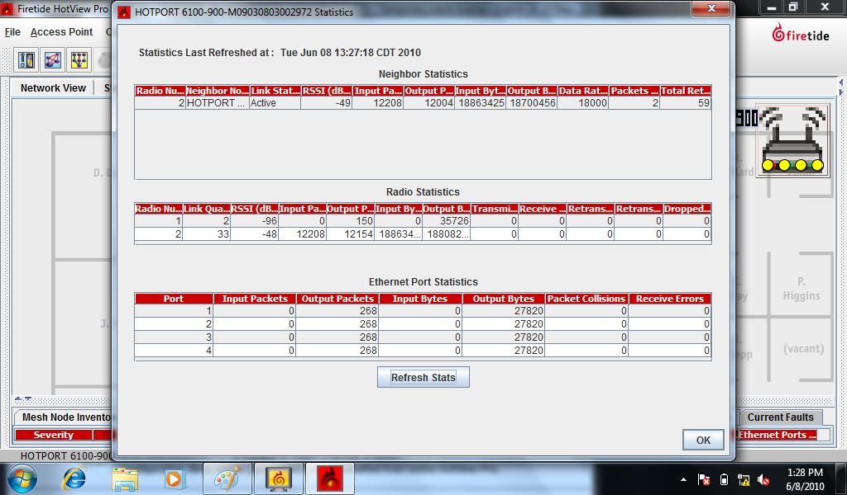
July 2010
Firetide stats – Yard #2
Slide 24
Garth Hillman, OakTree Consulting
Notes:
24
doc.: IEEE 802.11-10/xxxxr0

Slide 25
Spectrum Analysis
July 2010
Slide 25
Garth Hillman, OakTree Consulting
Notes:
25
doc.: IEEE 802.11-10/xxxxr0

Slide 26
July 2010
Generators
Slide 26
Garth Hillman, OakTree Consulting
Notes:
26
doc.: IEEE 802.11-10/xxxxr0

Slide 27
July 2010
1st Yard
Slide 27
Garth Hillman, OakTree Consulting
Notes:
27
doc.: IEEE 802.11-10/xxxxr0

Slide 28
July 2010
2nd Yard
Slide 28
Garth Hillman, OakTree Consulting
Notes:
28
doc.: IEEE 802.11-10/xxxxr0

Slide 29
Participants
July 2010
Jimmy Don Havens - LCRA
Jim Raab - OakTree Consulting
Vincente Rodriguez - ETS Lindgren
Clark Vitek - Aruba Networks
Scott McGrath - Aruba Neworks
Mike Intag - Firetide
Mark Thompson - Aclara
Slide 29
Garth Hillman, OakTree Consulting
Notes:
29
doc.: IEEE 802.11-10/xxxxr0

