Slide 1
MU with Frequency Domain Multiplexing
Authors:

Slide 2
Motivation
A 11ac BSS can employ spatial diversity technique, DL-MU-MIMO, to increase the throughput of a 11ac BSS.
An 11ac AP is capable of supporting channels of wider bandwidth, up to 160 MHz
But,
  A 11ac BSS comprises a variety of 802.11 STAs including legacy STAs.
  The bandwidth supported by STAs of a 11ac BSS may range from 20 MHz up to 160MHz
The channel bandwidth available for each DL-MU-MIMO group is gated by the participating STAs with the smallest channel bandwidth

Slide 3
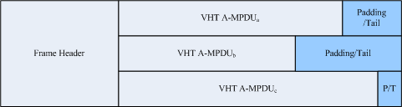
Currently Proposed DL-MU-MIMO
By using Spatial Domain Diversity
An 11ac AP coalesces one or more 20MHz channels into one wide band channel
The drawing below shows a DL-MU-MIMO TXOP period in time domain

Slide 4
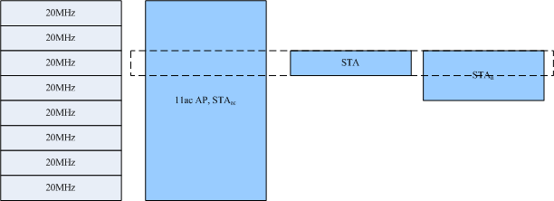
Deficiencies of the current approach - 1
Underutilization of channel bandwidth
  In the current DL-MU-MIMO scheme, channels not involved in the current DL-MU-MIMO operation are left un-utilized.
  In the Figure below, only one 20MHz channel is utilized when the indicated DL-MU-MIMO group is active.
An 11ac AP can not manage the channels used by its STAs.
  STAs support a range of channel widths, from 20MHz, 40MHz, up to 160MHz bandwidth.

Slide 5
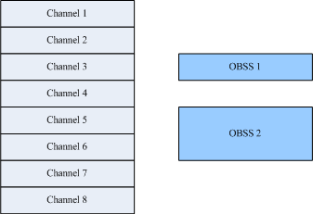
Deficiencies of the current approach - 2
In coexistence with legacy OBSSs, an 11ac AP can not actively manage its channel utilization.
  OBSSs occupying 20MHz or 40 MHz band may prevent an 11ac AP from acquiring a wider channel.
  The following figure illustrates the situation

Slide 6
Proposed MU with Frequency Domain Multiplexing
An 11ac AP forms a BSS by coalescing all available channels and selecting a primary channel
MU DL-FDM
  11ac AP manages channel selection of member STAs.
  Member STAs include legacy STAs and 11ac STAs.
  Each 11ac STA operate on a group of one or more 20MHz channels.
  One or more such non-overlapping channel groups may operate concurrently.

Slide 7
Allow Multiple MU Mechanisms
An 11ac AP can support MU DL traffic with the following mechanisms
  MU DL-MIMO
    11ac AP selects a sub-set of coalesced channels for DL-MIMO operation
  MU DL-FDM
    11ac AP instructs target STAs to switch to corresponding channels and DL traffic is sent to the corresponding channels
  MU DL-OFDMA
    11ac AP selects a sub-set of coalesced channels for OFDMA-based DL-MIMO

Slide 8
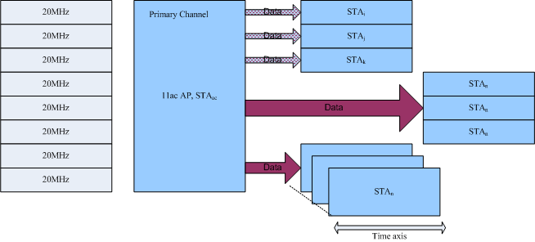
Proposed MU DL mechanisms
MU DL – FDM
MU DL – OFDMA
MU DL – MIMO

Slide 9
Proposed STA–to-STA(s) MU with Frequency Domain Multiplexing
An STA establishes DLS with one or more destination STAs
The STA requests channel time from 11ac AP
  The request include channel bandwidth and TXOP
11ac AP grants the request and instructs the participating STAs switch to the subset of channel with request bandwidth

Slide 10
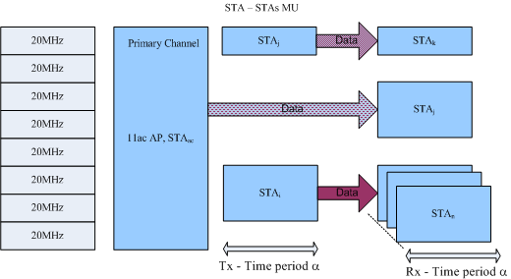
STA–to-STA(s) MU supports with Frequency Domain Multiplexing

Slide 11
MAC Proposal to Supporting MU
11ac AP assembles more than one 20Mhz channel to form a wideband channel and starts a 11ac BSS
  The bandwidth of the wideband channel is determined by the 11ac AP based on channel conditions and AP/STA capabilities.
All STAs of the BSS receives preamble sent by 11ac AP covering up to 160Mhz.
  Beacon is repeated on every 20MHz channel supported by the AP.
  One of the 20Mhz channel is designated as the primary channel
11ac AP announces the primary channel
  STAs understanding the announcement moves the announced primary channel

Slide 12
Additional Protocol Elements
11ac AP forms a 11ac BSS by coalescing all available channels and elects a primary channel
  The channel can be contiguous or non- contiguous
  Channel Coalescing
    11ac AP amasses all the clear channels
  OBSS Migration
    11ac AP instructs other OBSSs to move to other channel in order to obtain contiguous channels
The 11ac AP shall scans all channels, exchanges channel information with STAs and APs of OBSSs

Slide 13
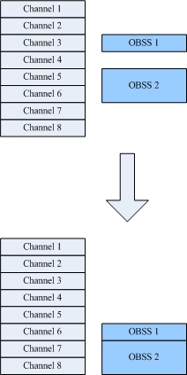
OBSS migration

Slide 14
Protocol for Herding 11ac STAs
Upon receiving beacons from 11ac AP
  STAs of 11ac BSS AP join the 11ac BSS at primary channel
STAs and 11ac AP exchange management data via primary channel

Slide 15
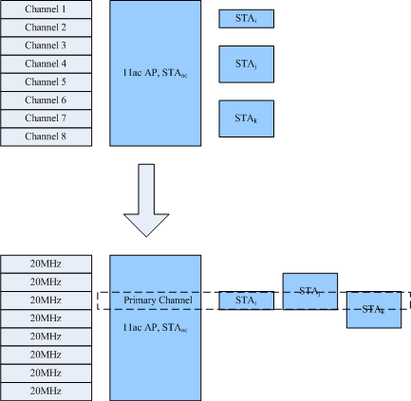
STAs at Primary Channel

Slide 16
Straw Poll
Move to add to the specification framework document (IEEE 802.11-09/0992r9) a section describing multi-user (MU) Frequency Domain Multiplexing (FDM) support
  Yes
  No
  Abstain

