Slide 1
11ac Auto-Detection Using the VHT-SIG-A Field
Date: 2010-07-05
Authors:

Slide 2
Introduction
11ac auto-detection issue has been considered in the past meetings
  10/0459: TGac Preamble Auto-detection Comparisons
  10/0628: 802.11ac preamble for VHT auto-detection
  10/0680: Proposed TGac Preamble
Agreement so far (09/992r11): “The 1st symbol of VHT-SIG-A shall be BPSK modulated. The subsequent symbol(s) of VHT-SIG-A shall be TBD modulated for VHT auto-detect.”
We propose a modulation format for the second VHT-SIG-A symbol which
  Decreases VHT-SIG-A error rate in multipath channels and
  Reduces false auto-detection in 11n devices using both HT-SIG symbols

Slide 3
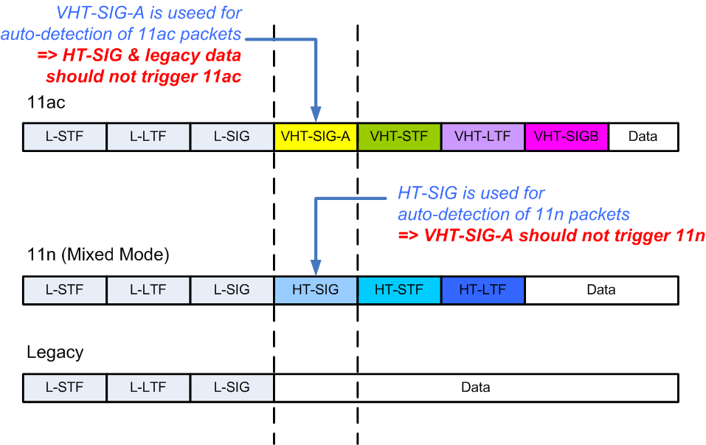
Auto-detection & Backward Compatibility

Slide 4
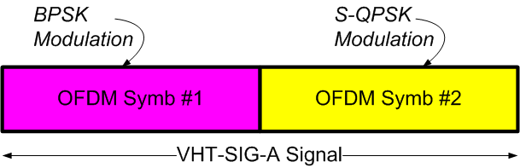
Proposed VHT-SIG-A Format
Scheme | OFDM Symbol #1 | OFDM Symbol #2
Proposed (10-0750) | BPSK | S-QPSK
10-0459 | BPSK | QBPSK
10-0628 | BPSK | BPSK and QBPSK on different tones

Slide 5
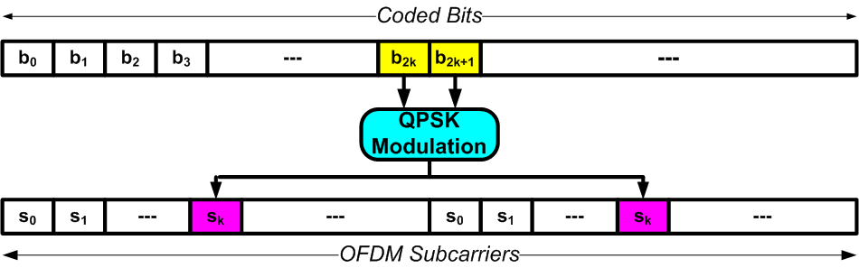
Spread-QPSK (S-QPSK)
OFDM
Symb #2
(slide 4)
S-QPSK offers same rate as BPSK modulation
  Used in 802.11ad as alternative to BPSK with OFDM
Basics idea (see above figure)
  QPSK Modulation applied to data bits
  Each QPSK symbol is mapped to two OFDM subcarriers (maximally apart in the freq. domain)
    Providing frequency diversity in multipath channels
Characteristics
  Min. Euclidean distance between constellation points is the same as BPSK
    Performance identical to BPSK in AWGN channel
  Demodulation/LLR generation is very simple – MRC combination
    Requires one additional adder compared to BPSK LLR generator

Slide 6
S-QPSK Demodulation/LLR Generation
Suppose bits b1 and b2 are QPSK modulated to symbol s is transmitted on the i-th and j-th subcarriers
Received signal is given by
LLR of the bits is given by

Slide 7
11ac Auto-detection with Proposed Scheme
When L-SIG indicates 6Mbps the 2 OFDM symbols after L-SIG carry
  VHT-SIG-A (in the case of 11ac)
  HT-SIG (in the case of 11n) or
  BPSK modulated payload (in the case of legacy)
First OFDM symbol after L-SIG is
  BPSK modulated in 11ac and legacy cases or
  QBPSK modulated in the11n case
Second OFDM symbol after L-SIG is
  BPSK modulated in the legacy case or
  S-QPSK modulated in the 11ac case
Hence 11ac auto-detection can be done as

Slide 8
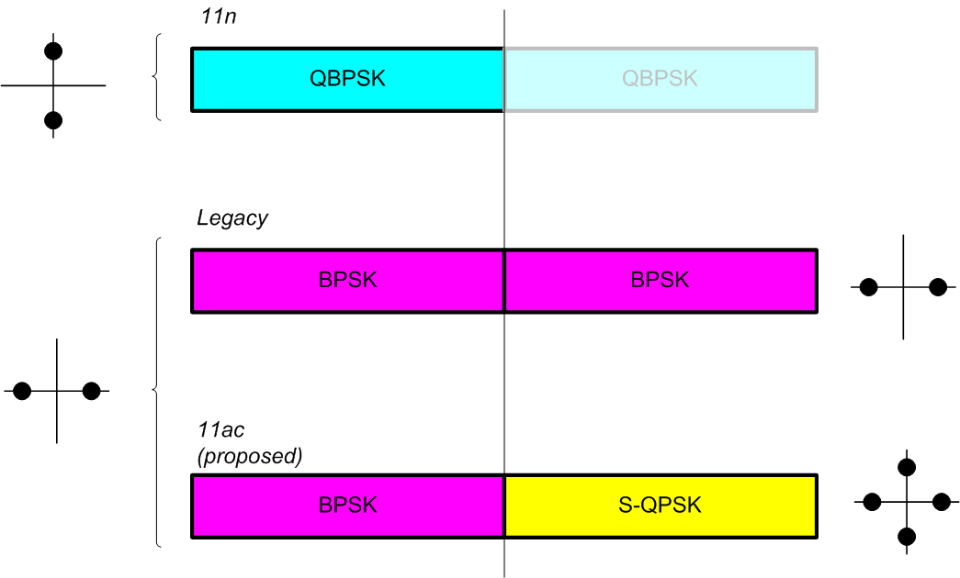
11ac/11n Auto-detection
11n can be detected/ruled-out
by deciding QBPSK vs. BPSK
11ac can be detected by deciding
BPSK vs. (S-)QPSK

Slide 9
Motivation for Proposed Scheme
Better detection of VHT-SIG-A bits in multipath
  S-QPSK is significantly more robust to frequency selective fading relative to BPSK
  Hence second OFDM symbol will have fewer (un-coded) bit errors compared to the first OFDM symbol
  Overall 0.5-1dB SNR gain
More friendly to 11n devices that use both OFDM symbols of HT-SIG for auto-detection
We can consider using S-QPSK modulation
  For VHT-SIG-B and Data Payload
  Better choice than BPSK with OFDM

Slide 10
Simulation Conditions
20 MHz Channel
Channel Model: DNLOS
  Channel profiles are not normalized
Channel Estimation (non-ideal)
SISO System
Consider Three Scenarios:
  AC packets are sent to AC Receiver
    Check miss detection rate and packet error rate of VHT-SIG-A;
  Legacy packets are sent to AC Receiver
    Check false detection rate of BPSK modulated date symbols (worst case for BPSK+SQPSK scheme)
  SQPSK used for VHT-SIG-B
    Check Packet Error Rate

Slide 11
AC packets to AC Receivers

Slide 12
AC Packets to 11n Receivers

Slide 13
VHT-SIG-B Performance
Assuming VHT-SIG-B carries 42 information bits and thus occupies 2 OFDM symbols
with 1/2 –Rate coding; Channel Model D

Slide 14
Conclusions
We propose that the second VHT-SIG-A symbol be modulated using S-QPSK
This approach has two main advantages
  VHT-SIG-A error rate improves in multipath channels
    We show 0.5-1dB gain in Channel D (42 information bits)
    Will be even higher for longer VHT-SIG-A lengths (if more bits are required)
  Lower false alarm rate for 11n receivers
S-QPSK can also be used in 11ac for
  VHT-SIG-B
    We show >2dB gain in Channel D
  Data Payload
    Even higher gains with higher rate coding

