Slide 1
[Intra cluster response model and parameter for the enterprise cubicle environments at 60GHz (Part3)]
Date: 2010-5-19
Authors:

Slide 2
Abstract
Intra cluster channel model is developed by high resolution measurement for the enterprise cubicle environments.
For far location
  The channel model parameter k_{b} and γ_{b} for far location are re-measured and confirmed reasonably low compared with the previous our report(372r0)
  This leads to the necessity of a cluster model - 23.4 dB down from LOS component
For near location
  The channel model parameter k_{b} and γ_{b} are re-measured and confirmed as reasonable values compared with the previous our report(372r0)
  One ray cluster model is good to represent this environment

Slide 3
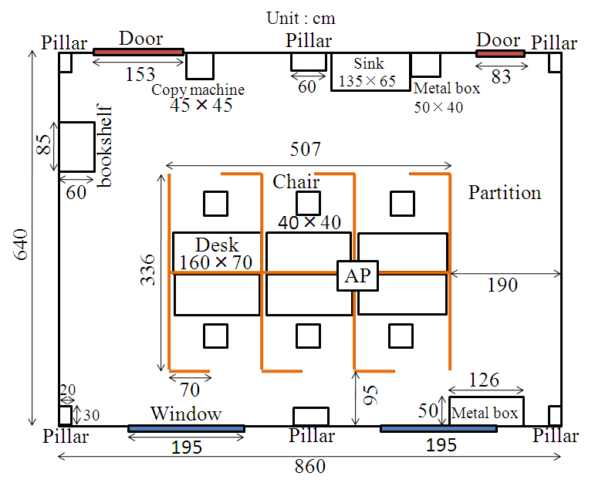
Floor plan of cubicle environments
Far location
Near location
AP height:2.5m
STA height:0.7m
from floor
Impulse responses are measured at each location
STA
STA
Desk
160×70

Slide 4
Direct and reflection wave paths in cubicle environments
Tx
Direct wave
Reflection wave
Near location
Far location
Multiple-time-reflected waves on desktop were observed
Reflection wave characteristics from ceiling should be clarified for channel modeling

Slide 5
High resolution measurements for cubicle environment
Measured points (Total: 26)
50cm
70cm
10cm
20cm
160cm
15cm
Additional measured points on desktop
High resolution measurements have been carried out with 2 lines separated by 30 cm and 13 measurement points per line, 10 cm separated each other on the desk top

Slide 6
Measurement system for cubicle environments
Tx antenna is near the ceiling(AP)
Network
Analyzer
Rx antenna is on the desktop(STA)

Slide 7
High Resolution Measurement set up forTGad defined enterprise cubicle environment
Parameter | Value
Center frequency | 62.5 GHz
Band width | 3 GHz
Number of frequency points | 801
Frequency step | 3.75 MHz
Antenna type | Conical horn
HPBW of antenna | 30 degree (STA), 90 degree (AP)
Polarization | Vertical(STA), Circular(AP)
Calibration | Direct port connection without antennas

Slide 8
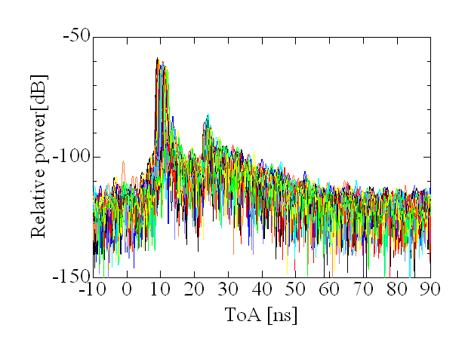
High resolution measurement results (far location)
Direct waves
Reflection waves
23.4dB
30.8dB
k_{b}=7.4dB
Total number of measured response is 26
Direct path and single ray will be enough as the channel model for cubicle environment (far location)

Slide 9
Intra-cluster parameters for cubicle environments(far location)
Environments Far location |  | k_{f} [dB] | k_{b} [dB] | γ_{f} [ns⁻¹] | γ_{b} [ns⁻¹] | λ_{f} [ns⁻¹] | λ_{b} [ns⁻¹] | Distribution, for forward | Distribution for backward
Cubicle AP-STA | High resolution | 5.1 | 7.4 | 3.1 | 6.0 | 0.55 | 0.53 | Rayleigh | Rayleigh
 | Previous Estimation Doc.10/372r0 | N/A | 22.5 | N/A | 14 | N/A | 0.81 | N/A | Rayleigh
k_{b} and γ_{b} are reasonably low compared with the previous report
Central ray of intra-cluster
k_{f}
kb
Rayleigh distribution
Tx antenna (AP)
HPBW: 90deg
C pol.
Rx antenna (STA)
HPBW: 30deg
V pol.
Rayleigh distribution
Ray decay factor, γ_{f}
Ray decay factor, γ_{b}
t = 0
Time of arrival
Arrival rate, λ_{b}
Arrival rate, λ_{f}

Slide 10
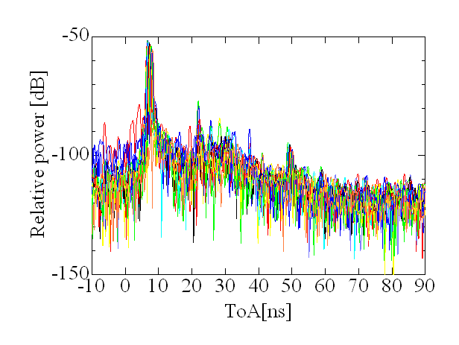
High resolution measurement results (near location)
Direct waves
Reflection waves
25.3dB
40.6dB
Total number of measured response is 26
k_{b}=15.3dB
Direct path and one ray will be enough as the channel model

Slide 11
Intra-cluster parameters (near location)
Environments Near location |  | k_{f} [dB] | k_{b} [dB] | γ_{f} [ns⁻¹] | γ_{b} [ns⁻¹] | λ_{f} [ns⁻¹] | λ_{b} [ns⁻¹] | Distribution, for forward | Distribution for backward
Cubicle AP-STA | High resolution | 5.4 | 15.3 | 0.80 | 5.5 | 1.6 | 2.2 | Rayleigh | Rayleigh
 | Previous estimation Doc.10/372r0 | N/A | 24.5 | N/A | 0.690 | N/A | 1.13 | N/A | Rayleigh
Central ray of intra-cluster
k_{f}
kb
Rayleigh distribution
Tx antenna (AP)
HPBW: 90deg
C pol.
Rx antenna (STA)
HPBW: 30deg
V pol.
Rayleigh distribution
Ray decay factor, γ_{f}
Ray decay factor, γ_{b}
t = 0
Time of arrival
Arrival rate, λ_{b}
Arrival rate, λ_{f}

Slide 12
Conclusion
Intra cluster channel model is developed by high resolution measurement for the enterprise cubicle environments.
For far location
  The channel model parameter k_{b} and γ_{b} for far location are re-measured and confirmed reasonably low compared with the previous our report(372r0)
  This leads to the necessity of a cluster model - 23.4 dB down from LOS component
For near location
  The channel model parameter k_{b} and γ_{b} are re-measured and confirmed as reasonable values compared with the previous our report(372r0)
  One ray cluster model is good to represent this environment

Slide 13
Appendix: Measurement for reflected wave by ceiling
for the cubicle environment (near location)
1m
Reflection wave
1m
3m
Tx
Rx
1m
Measurement system
Measurement points
in the room
The reflected waves by ceiling are measured at each grid point (separated by 1m) in the room (Total measured points are 20).

Slide 14
Reflection Wave Measurement Set up (from ceiling)
Parameter | Value
Center frequency | 62.5 GHz
Band width | 3 GHz
Number of frequency points | 801
Frequency step | 3.75 MHz
Antenna type | Conical horn
HPBW of antenna | 30degree
Polarization | Vertical
Calibration | Direct port connection without antennas

Slide 15
Measured impulse response examples
Metal frame reflection
Pipe reflection
Concrete wall reflection
15dB
Reflected waves by metal frame, pipe and concrete wall were observed in measured impulse responses
Reflected wave power varies up to 15dB depending on the position

Slide 16
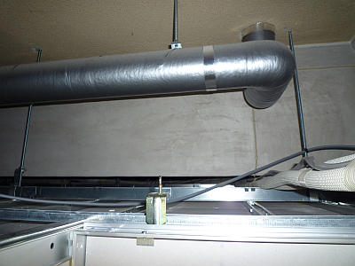
Cause of reflected wave power variation
Concrete
Concrete wall
Pipe
60cm
Shielded pipe
Metal frame
30cm
Plaster board
Cable
Metal frame
Incident wave
Behind the ceiling
Detail of two reflected waves
The behind the ceiling are metal frames, pipes , and concrete wall
Metal frames cause strongest reflection waves

Slide 17
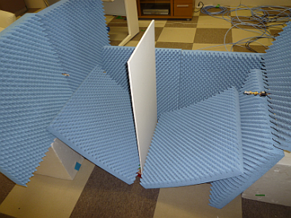
Plaster board penetration loss measurement
Rx
Tx
Snap shot of penetration loss measurement
Penetration loss
Penetration loss is about 0.7～2dB
Plaster board does not reflect strongly

Slide 18
Reflected wave power
12dB down in average
Power difference are about average 12dB in each position
Reflected wave power in cubicle environment depends heavily on the position

Slide 19
Impulse responses of AP-STA
(AP antenna HPBW:90deg, C pol., STA antenna HPBW:30deg, V pol.)
Direct waves
Reflection waves
18dB
12dB
No metal
frame
Near location scenario
The strong reflection wave by metal frame is included.
If there is no metal frame, reflection wave power is very small

Slide 20
Consideration of the channel model for the cubicle environment (near location)
There are two situations for reflected waves by ceiling.
Intra cluster channel model including reflection wave by metal frame is required for the simulation of worst case (See slide 19).
On the other hand, reflection wave is very small (30dB lower than direct wave) when there is no metal frame in the ceiling. In this case, channel model may not be required.

Slide 21
Intra-cluster parameters for cubicle environments (near location)
Environments Near location |  | k_{f} [dB] | k_{b} [dB] | γ_{f} [ns⁻¹] | γ_{b} [ns⁻¹] | λ_{f} [ns⁻¹] | λ_{b} [ns⁻¹] | Distribution, for forward | Distribution for backward
Cubicle AP-STA | For worst case※ | 7.2 | 12 | 0.46 | 1.8 | 0.47 | 0.88 | Rayleigh | Rayleigh
 | Previous estimation Doc.10/372r0 | N/A | 24.5 | N/A | 0.690 | N/A | 1.13 | N/A | Rayleigh
※The parameters are extracted from reflected waves by ceiling
Central ray of intra-cluster
k_{f}
kb
Rayleigh distribution
Tx antenna (AP)
HPBW: 90deg
C pol.
Rx antenna (STA)
HPBW: 30deg
V pol.
Rayleigh distribution
Ray decay factor, γ_{f}
Ray decay factor, γ_{b}
t = 0
Time of arrival
Arrival rate, λ_{b}
Arrival rate, λ_{f}

