Slide 1
802 Standards
Principles and Process
Date: 2012-09-15
Authors:
Name
Company
Address
Phone
email
Bruce Kraemer
Marvell
5488 Marvell Lane,
Santa Clara, CA, 95054
+1 (321)
427-4098
bkraemer@
marvell
.com
IEEE-SA
Piscataway , NJ
Notes:
doc: 802.11-10/0274r0doc.: IEEE 802.11-06/0528r0
March 2010May 2006
Adrian Stephens, IntelBruce Kraemer, Marvell
Page 1
doc.: IEEE 802.11-06/0528r0
May 2006
Bruce Kraemer, Marvell
Page 1

Slide 2
Principles
Notes:
doc: 802.11-10/0274r0doc.: IEEE 802.11-06/0528r0
March 2010May 2006
Adrian Stephens, IntelBruce Kraemer, Marvell
Page 2
doc.: IEEE 802.11-06/0528r0
May 2006
Bruce Kraemer, Marvell
Page 2

Slide 3
IEEE: Advancing Technology for Humanity
Membership & Services
IEEE participates in integration of technological innovation across many technical communities
IEEE engages the technical experts at the ground level
IEEE serves as a link between government organizations and private sector
IEEE facilitates the research and sharing of member and volunteer-driven activities around the world
Societies & Communities
Publications
Standards
Conferences & Events
Education & Careers
3
27-Sep-12

Slide 4

IEEE-SA Values
Five principles guide IEEE standards development
To ensure
Collaboration and community building
Global and timely market relevance
Technical integrity and excellence
Due process
Openness
Balance
Right of appeal
Consensus
Notes:
Consensus = most of the people agreeing most of the time. It does not mean unanimity.
Due process = having procedures, making them publicly available, and following them
Openness = allowing anyone to participate if they meet the requirements
Right of appeal = the ability to be heard if you feel your due process rights have not been met
9/27/2012
4

Slide 5
Participants
Notes:
doc: 802.11-10/0274r0doc.: IEEE 802.11-06/0528r0
March 2010May 2006
Adrian Stephens, IntelBruce Kraemer, Marvell
Page 5
doc.: IEEE 802.11-06/0528r0
May 2006
Bruce Kraemer, Marvell
Page 5

Slide 6




IEEE Standards Association
(IEEE-SA)
Oversees development of standards within IEEE
Global membership today
  7 000+ individual members
  Approximately 150 corporate members
  Approximately 20 000 participants
Broad standards portfolio
  1 000 active standards
  400 standards in development
Governed by volunteers
An independent organization
  Participants come together to develop
  standards independent of any government organization
Notes:
9/27/2012
6

Slide 7

IEEE Global Presence 400,000+ Members
Europe
57,000+
North America
220,000+
Africa
6,000+
Asia
100,000+
Latin America
& Caribbean
17,000+
Oceania
9,000+
Notes:
IEEE is big. With more than 400,000 members in more than 160 countries as of 2011, IEEE is the world’s largest technology professional society. IEEE numbers 2,173 student branches at colleges and universities in 80 countries; offers more than 3 million documents in the IEEE Xplore Digital Library with more than 8 million downloads each month; publishes more than 148 transactions, journals and magazines, and sponsors more than 1,300 conferences in 81 countries. The point is that everybody knows who IEEE is. Consequently, when you have an IEEE standard, it carries weight.

Slide 8
What the IEEE-SA offers
Standards development
International Recognition & Participation
Industry Connections
Conformity Assessment (ISTO)
Education
Integration of communities
Notes:
8

Slide 9





IEEE Standards Are Pervasive
Addresses a broad spectrum of technologies
Aerospace Electronics
Broadband Over Power Lines
Broadcast Technology
Clean Technology
Cognitive Radio
Design Automation
Electromagnetic Compatibility
Green Technology
LAN/MAN
Medical Device Communications
Nanotechnology
National Electrical Safety Code
Next Generation Service Overlay Networks
Organic Components
Portable Battery Technology
Power Electronics
Power & Energy
Radiation/Nuclear
Reliability
Transportation Technology
Test Technology

Slide 10









IEEE-SA Agreements
Notes:
IEC
Approved IEEE Standards are eligible for submission to IEC (IEC adoption takes about six months)
Dual Logo Standards currently exist in: Design Automation; Microprocessors; Switchgear;Transformers
Joint Development addendum to agreement enables both organizations to work collaboratively
Joint copyright and distribution rights
Maintenance procedures developed
ISO
Addresses adoptions and joint development work
The IEEE is a Sector Member of ITU-R (Radiocommunications); ITU-T(Telecommunications); ITU-D (Developing Nations)
Example technical areas: Radio regulatory activities; Mobile broadband wireless access
Joint workshops
2009: Geneva Auto Show Networked Car Workshop
2008: ITU-T/IEEE Workshop on Next Generation Optical Access Systems
2007: ITU-T/IEEE Workshop on Carrier-Class Ethernet
9/27/2012
10

Slide 11
IEEE-SA Participation from China
IEEE P1888™
Draft Standard for Ubiquitous Green Community Control Network Protocol
BII
Beijing Jiatong
Beijing University of Post & Telecommunications (BUPT)
China Telecommunications
Tsinghua University
IEEE P1903™
Draft Standard Next Generation Service Overlay Network (NGSON)
ZTE
Huawei
China Mobile Communications
RITT
IEEE P1904.1™
Draft Standard for Service Interoperability in Ethernet Passive Optical Networks (SIEPON)
ZTE
Huawei
Opulan
FibreHome Technologies
China Mobile
China Telecommunications
IEEE 802;
IEEE Std 802.15.4c-2009
IEEE P2030™
Draft Guide for Smart Grid Interoperability of Energy Technology and Information Technology Operation with the Electric Power System (EPS), and End-Use Applications and Loads
802.11aj
Huawei
Southeast University
Tsinghua
HiSilicon
SIMIT
CESI
GreatingTech
ZTE
StateGrid
IMECAS
Hangzhou Milliwave
BUPT
802.11
ZTE
China Mobile
Huawei

Slide 12
Process
Slide 12
Slide 12
Notes:
doc: 802.11-10/0274r0doc.: IEEE 802.11-06/0528r0
March 2010May 2006
Adrian Stephens, IntelBruce Kraemer, Marvell
Page 12
doc.: IEEE 802.11-06/0528r0
May 2006
Bruce Kraemer, Marvell
Page 12

Slide 13
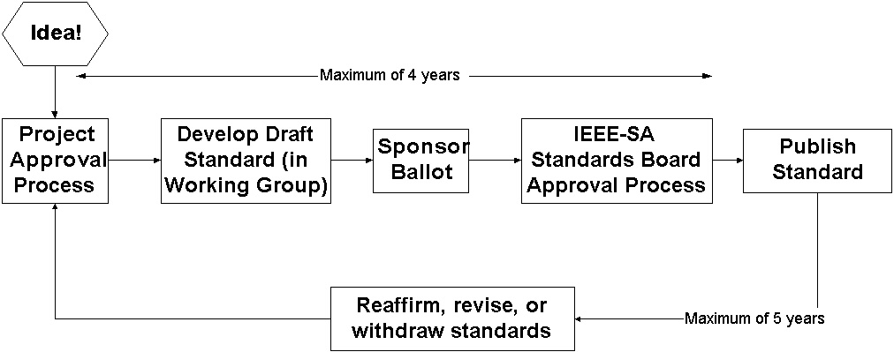



IEEE Standards Development: Process Flow
Notes:
13
This chart illustrates the whole standards process in simplified form.
Idea: The idea for a standard is usually developed by a group of people, and the responsibility for the idea is assumed by the sponsor. The sponsor is usually a society or an existing standards committee.
Project Approval Process: This idea is then transferred onto a form called the Project Authorization Request (PAR) and submitted to the New Standards Committee (NesCom) for approval.
Develop draft standard: The draft is then developed and revised by the working group.
Ballot draft: When the draft work is finalized, the sponsor forms the balloting group and ballots the standard.
Standards Board Approval: After your ballot has achieved consensus, the draft then goes to the Review Committee (RevCom) and the Standards Board for approval. The amount of time from PAR to Board approval is 4 years (an extension can be made if absolutely necessary).
Publish Standard: The draft is then edited and formatted by an IEEE Project Editor and published.
The standard is valid for 5 years before it must be reaffirmed, revised, or withdrawn.

Slide 14
IEEE Standards Development: Getting Started
Technical
Determine technical area of interest
Existing?
Is there an IEEE working on a standards project in this area? = Join existing group
New!
New area of interest = Begin new project
http://standards.ieee.org/db/status/index.shtml (Projects)
http://grouper.ieee.org/groups/index.html (Working groups)
http://standards.ieee.org/db/balloting/ballotform.html (Ballot)

Slide 15
IEEE Standards Development: Project Approval Process
Find a technical group within IEEE to “sponsor” the project
A Sponsor does not have a financial role
Submit a Project Authorization Request (PAR) form for approval
Develop scope and purpose of the project
Any individual or company with a technical idea may start a project
Determine need for project
A Sponsor provides guidance and support
Notes:
15
Approval of a PAR means that the work is authorized by the IEEE-SA Standards Board
The PAR is the means by which IEEE can extend the umbrella of indemnification (or protection) to its standards developers

Slide 16
IEEE Standards Development: Develop Draft Standard
Standard is written by working group
Working group writes initial draft or develops draft from existing documents and specifications
Draft document is revised and reviewed
Working group follows the policies and procedures of the Technical Committee
Notes:
16

Slide 17
IEEE Standards Development: Ballot = Vote
IEEE-SA members are invited to ballot on draft standards
Balloters receive document, review it, and vote on it
Notes:
17
Vote approve, disapprove, or abstain
Comments received must be considered
Need 75% response from the ballot group, and 75% approval votes

Slide 18
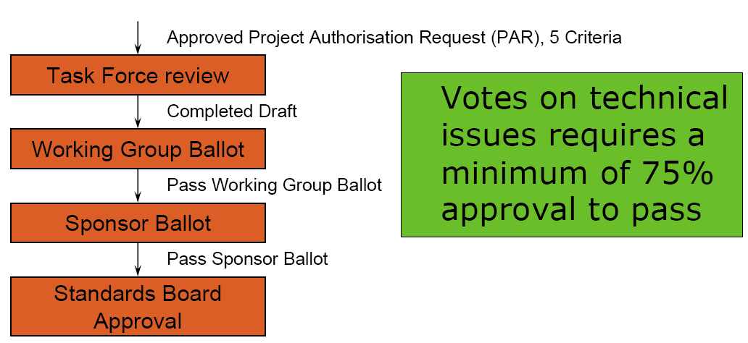
Ballot Process

Slide 19
IEEE Standards Development: Approval Process → Publication
Submit the final draft standard to Review Committee (RevCom)
RevCom recommends approval to IEEE-SA Standards Board
IEEE-SA Standards Board approves the draft standard
Publish standard
Notes:
9/27/2012
19

Slide 20
IEEE Standards Development: Process Flow
Notes:
20
This chart illustrates the whole standards process in simplified form.
Idea: The idea for a standard is usually developed by a group of people, and the responsibility for the idea is assumed by the sponsor. The sponsor is usually a society or an existing standards committee.
Project Approval Process: This idea is then transferred onto a form called the Project Authorization Request (PAR) and submitted to the New Standards Committee (NesCom) for approval.
Develop draft standard: The draft is then developed and revised by the working group.
Ballot draft: When the draft work is finalized, the sponsor forms the balloting group and ballots the standard.
Standards Board Approval: After your ballot has achieved consensus, the draft then goes to the Review Committee (RevCom) and the Standards Board for approval. The amount of time from PAR to Board approval is 4 years (an extension can be made if absolutely necessary).
Publish Standard: The draft is then edited and formatted by an IEEE Project Editor and published.
The standard is valid for 5 years before it must be reaffirmed, revised, or withdrawn.

Slide 21
IEEE-SA Information & Materials
IEEE-SA Web site
  http://standards.ieee.org/
IEEE-SA News
  https://standards.ieee.org/sa-mem/central/sanews.html
IEEE Xplore = Standards!
  http://ieeexplore.ieee.org/xpl/standards.jsp
IEEE Standards Information Network: Guides, Handbooks, and Tutorials
  http://standards.ieee.org/standardspress/index.html
Press Releases
  http://standards.ieee.org/announcements/index.html
Notes:
9/27/2012
21

Slide 22
Questions ?
Notes:
doc: 802.11-10/0274r0doc.: IEEE 802.11-06/0528r0
March 2010May 2006
Adrian Stephens, IntelBruce Kraemer, Marvell
Page 22
doc.: IEEE 802.11-06/0528r0
May 2006
Bruce Kraemer, Marvell
Page 22

