Slide 1
Grouping Process for MU-MIMO
Date: 2010-05-16
Authors:

Slide 2
Outline
Typical problem definition
MU solution details:
Optimal linear solution [1]
Single and multi-spatial stream users
Grouping algorithm
Real-time implementation issues
Qualifying candidate groupings
Regrouping, adding/subtracting users from groups
Use of pre-coded NDP sounding packets for group management
T. Paré et al. , Ralink Technology

Slide 3
MU problem set-up: 3 users
Composite channel:
Received signal
T. Paré et al. , Ralink Technology

Slide 4
Finding the precoding matrices
Precoded MU transmission:
Need to find V:
Necessary condition:
Two step problem
Find appropriate Null spaces for each MU user i
Find best Vi in the Null space for good reception at STAi
T. Paré et al. , Ralink Technology

Slide 5
Problem necessary conditions
Two conditions to satisfy:
Null space requirement:
Good Tx gain, can’t have:
T. Paré et al. , Ralink Technology

Slide 6
Problem statement
Constrained optimization problem:
Maximize the transmission through the ith channel, subject to Null space constraint
T. Paré et al. , Ralink Technology

Slide 7
Typical 3-user example
AP: 8x8
Three users:
STA1 and STA2: 2x2
STA3: 1x1
MU Channel dimensions:
Corresponding Nullspaces:
Find nullspaces using QR decomposition

Slide 8
Precoder for STA3: 1SS user
Nullspace:
Assume linear solution:
Find a that maximizes Y3, where:
Let:
Optimal solution (2-norm):
T. Paré et al. , Ralink Technology

Slide 9
Multi-stream Users: STA1,2
Larger nullspace:
Solution form:
Find A (5X2) that maximizes Y1, where
SVD solution to find optimal directions:
Optimal solution (2-norm):
T. Paré et al. , Ralink Technology

Slide 10
Grouping Algorithm: Iterative solution to find feasible groups
T. Paré et al. , Ralink Technology

Slide 11
Observations
1SS vs multi-SS clients
Should 2SS be split up and treated individually?
This could potentially penalize the 2SS device
Let AP decide number of SS for each multi-SS device
Client does not need to know details of spatial stream selection
Incompatible pairs of users requires re-computation of nullspaces, precoders
Good: Solution for reduced set of clients improves
Bad: Could require many QR operations
Include a mechanism to minimize/guarantee suitable groups are formed
T. Paré et al. , Ralink Technology

Slide 12
MU-Sounding Mode (1/3)
Design results in precoded MU channel:
By design:
Off-diagonal terms are zero
Non-zero indicates interference between users
MU-Sounding recommendation:
Include BF-NDP or precoded-NDP mode for direct measure of MU channel
T. Paré et al. , Ralink Technology

Slide 13
MU-Sounding Mode (2/3)
Possible MU-Sounding Formats
Precoded-NDP
Staggered Precoded-LTF
Feedback
BF-CSI
Transparent to users
SINR metrics
Reduced overhead
Per User interference level
Per STS interference level
T. Paré et al. , Ralink Technology

Slide 14
MU-Sounding Mode (3/3)
Benefits for MU operation
Validate initial Group Formation Algorithm
Detect poor initial CSI, or
Practical imperfections in antenna/RF circuits
Assist MU MCS selection (similar to FLA in .11n)
Provide specific info on particular interfering pairs
Streamline re-grouping process
Minimize QR re-computation process
Detect changing channel conditions
Allow AP to maintain/schedule interference metrics
AP suspend, regroup and re-initiate MU operation
T. Paré et al. , Ralink Technology

Slide 15
SINR report simulation
2x2 user:
SINR lower on 2nd SS
Less impact co-existing with 1SS STA
1x1 STA
Symmetric interference from 2x2 STAs
T. Paré et al. , Ralink Technology

Slide 16
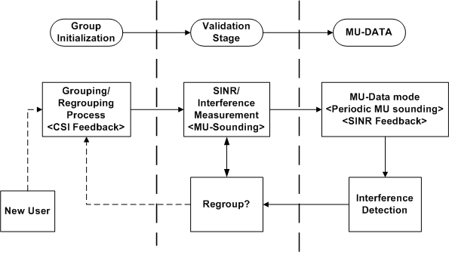
Group maintenance process
Group stages: Formation, validation, and maintanence
T. Paré et al. , Ralink Technology

Slide 17
Summary
Proposed MU-sounding mode (BF or Precoded NDP)
Direct Interference measure
Qualify candidate groupings
Assist MU link adaptation
Periodic MU-Sounding
Staggered BF LTF, or periodic Precoded-NDP
Real-time assessment of grouping validity
SINR feedback for reduced overhead
Allow single user to belong to multiple groups
Streamlines group formation process
Allow groups to add/subtract users seamlessly
T. Paré et al. , Ralink Technology

Slide 18
Reference
[1] Q. H. Spencer, A. L. Swindlehurst, and M. Haardt, “Zero-forcing methods for downlink spatial multiplexing in multiuser MIMO channels” IEEE Trans. Sig. Proc., vol. 52, pp. 461–471 , Feb. 2004
T. Paré et al. , Ralink Technology

