Slide 1
DL MU MIMO Analysis and OBSS Simulation Results
Authors:
Date: 2010-05-15

Slide 2
Outline
Motivation
Overview of simulated schemes
  DL MU MIMO with polled ack
  DL MU MIMO with scheduled ack
Overview of MAC protection
Overview of error handling at the AP
  Two medium access behaviors
Simulation parameters
Simulation scenarios and simulation results
Conclusion

Slide 3
Motivation
Downlink Multi-user MIMO is identified as a key technology to improve the overall network performance
  Two DL MU MIMO Ack mechanisms were proposed in 11-09-1172/r0
The goals of the simulation are
  To study the behavior of the two DL MU MIMO ack mechanisms
  To evaluate the performance difference of the two different AP medium access schemes in different scenarios

Slide 4
DL MU MIMO with scheduled Ack
The AP contends for the medium using EDCA
  The AP transmits a downlink MU MIMO burst to multiple STAs
  Each data packet defines an offset value such that each STA knows when to transmit back a BA
Scheduled Ack introduces less overhead but a STA needs to schedule its BA transmission
Data (STA1)
Data (STA2)
pad
Data (STA3)
pad
BA
BA
SIFS
SIFS or RIFS
BA
SIFS or RIFS

Slide 5
Scheduled scheme does not handle the hidden node scenario well without RTS/CTS
Data (STA1)
EIFS = 94us
EIFS covers the duration of only one BA
STAs that cannot decode the DL MU MIMO transmission would contend after EIFS and collide with the remaining BAs (NAV from RTS/CTS is required)
Data (STA2)
CCA idle
Data (STA3)
STA1
BA
STA2
BA
STA3
SIFS
BA
STA1
STA6
AP1
AP2
STA3
STA4
STA2
STA5

Slide 6
DL MU MIMO with Polled ACKs
The AP contends for the medium using EDCA
  The AP transmits a downlink MU MIMO burst to multiple STAs
  One STA will transmit a BA immediately after receiving the data packet
  The AP sends BAR frames to poll the remaining STAs for BAs
Polled Ack introduces more overhead yet STAs don’t need to schedule BA transmissions
Data (STA1)
BAR
BAR
Data (STA2)
pad
Data (STA3)
pad
BA
BA
SIFS
SIFS
SIFS
SIFS
SIFS
BA

Slide 7
Polled ack scheme can handle the following hidden node scenario without RTS/CTS
EIFS = 94us
STAs defer based on carrier sense + EIFS for DL MU-MIMO transmission
STAs defer based on carrier sense + NAV for BAR/BA
Data (STA1)
Data (STA2)
CCA idle
BAR
BAR
Data (STA3)
STA1
BA
STA2
SIFS
BA
STA3
BA
STA1
STA6
AP1
AP2
STA3
STA4
STA2
STA5

Slide 8
Overview of MAC protection
Dynamic MAC protection:
  One RTS or QoS-Null frame is transmitted to a STA that has failed to respond to a previous transmission
  Upon receiving a RTS/QoS-Null frame, the STA replies with a CTS or an ACK
AP
RTS
Data (STA1)
Data (STA2)
Data (STA3)
BA
STA2
CTS
BA
SIFS
SIFS
SIFS or RIFS
BA
SIFS or RIFS

Slide 9
Dynamic MAC protection combined with error handling
If a STA does not correctly respond to a data transmission, the AP flags the STA
When packets destined to the flagged STA are ready to be transmitted, the AP transmits a RTS or a QoS-Null to the flagged STA
The AP resets the flag to zero for the STA if it responds with a CTS or an ack correctly

Slide 10
AP’s medium access behavior (option 1)
As long as one BA is received by the AP (or at least one received BA indicates correctly received new packets) , the AP treats the DL SDMA transmission as a success
  CW = CWmin
If no BA is received (or no received BA indicates correctly received new packets) , the AP treats the DL SDMA transmission as a failure and initiates exponential backoff
  CW = (CW+1)*2-1
Backoff
(CWmin)
Data (STA1)
Data (STA1)
Data (STA2)
Data (STA2)
Data (STA3)
Data (STA3)
BA
BA
BA
BA
SIFS or RIFS
BA

Slide 11
AP’s medium access behavior (option 2)
If all BAs are received by the AP (or all received BA indicate correctly received new packets) , the AP treats the DL SDMA transmission as a success
  CW = CWmin
If at least one BA is not received (or a received BA doesn’t indicate any correctly received packet), the AP treats the DL SDMA transmission as a failure and initiates exponential backoff
  CW = (CW+1)*2-1
Exponential backoff
Data (STA1)
Data (STA1)
Data (STA2)
Data (STA2)
Data (STA3)
Data (STA3)
BA
BA
BA
BA
SIFS or RIFS
BA

Slide 12
Simulation parameters
One AP (4 antennas), three STAs (each with 2 antennas) in one BSS
    TXOP limit: 3 ms
    20MHz: 52 data subcarriers, 4 pilot tones
    SIFS=16 us, RIFS=2us, aSlotTime=9 us
    Data packet size: 1500 bytes
    CWmin=7, CWmax=63 for AC_VI; CWmin=15, CWmax=1023 for AC_BE
Data rates:
    802.11a, 16QAM, r=1/2 for control rate (BAR/BA), 802.11n MCS7 (64QAM, r=5/6, nSS=1) for downlink data rate
    Assumption: each STA needs 2 antennas to receive one spatial stream in DL SDMA (MMSE precoding and MMSE receiver for resolvable LTFs)
Comparison:
    Response mechanisms
      DL SDMA with scheduled ACK (SIFS)
      DL SDMA with scheduled ACK (RIFS)
      DL SDMA with polled ACK
    AP’s medium access behavior
      Two options

Slide 13
Simulation scenario one
Two overlapping BSSes
  One AP and multiple STAs in one BSS
  Both APs are DL SDMA capable
Fully loaded network:
  Downlink and uplink UDP traffic
Goal:
  Evaluate two DL SDMA response mechanisms when there are hidden nodes in the network
STA1
STA6
AP1
AP2
STA3
STA4
STA2
STA5

Slide 14
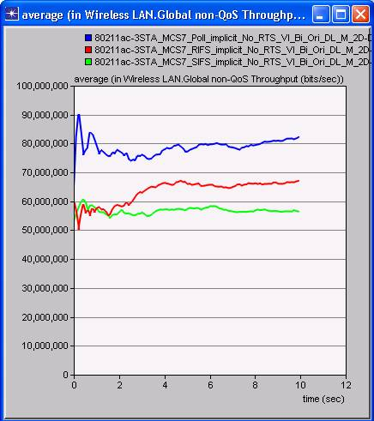
Without MAC protection, polled ack performs significantly better than scheduled ack
EIFS = 94us
Data (STA1)
Data (STA2)
Data (STA3)
Polled ack
STA1
BA
STA2
BA
STA3
SIFS
BA
EIFS can protect only one BA
Scheduled ack (SIFS)
STAs that cannot decode the DL SDMA transmission can contend and collide with the remaining BA
Aggregated network throughput

Slide 15
Simulation scenario two
Two overlapping BSSes
  All STAs can hear each other
  Two cases:
    Case 1: AP1 is DL SDMA capable but AP2 is a legacy AP
    Case 2: Both APs are legacy APs
Downlink UDP traffic
Goal:
  Study fairness in terms of each STA’s throughput
STA3
AP1
STA2
STA1
AP2
STA6
STA4
STA5

Slide 16
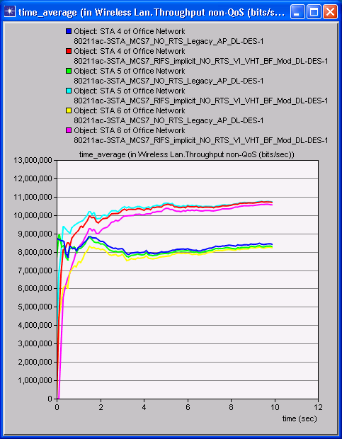
An AP utilizing a scheduled ack scheme is disadvantaged when there are legacy STAs
TXOP
Data (STA1)
Data (STA2)
Data (STA3)
Case 1
SIFS or RIFS
SIFS or RIFS
SIFS or RIFS
Utilizing the scheduled ack scheme, the AP needs to wait for the duration of three BAs
Case 2
Per STA throughput for legacy STA
Legacy STAs recover more quickly from a random access collision

Slide 17
Simulation scenario three
Two overlapping BSSes
  One AP and multiple STAs in one BSS
  AP1 and AP2 are hidden nodes
  Two cases:
    Case 1: AP1 is a DL SDMA capable AP; AP2 is a legacy AP
    Case 2: both APs are legacy APs
Fully loaded network:
  Downlink UDP traffic
Dynamic MAC protection:
Goal:
  Evaluate two medium access options
  Study fairness in terms of each STA’s throughput
STA3
AP1
AP2
STA6
STA2
STA4
STA1
STA5

Slide 18
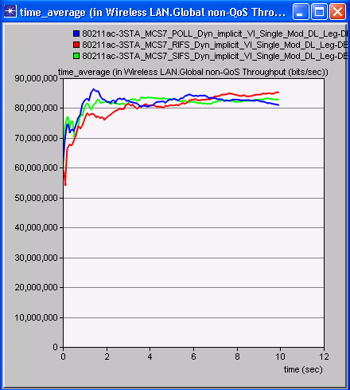
With MAC protection, three response schemes have similar performance

Slide 19
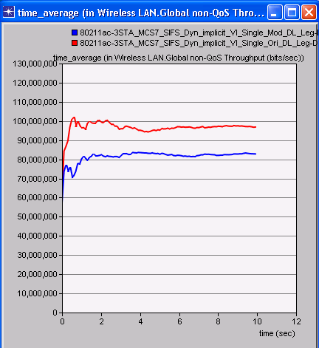
Medium access option 1 yields better overall performance
Case 1: AP1 (DL SDMA capable)
AP2 (legacy)
Case 1, Option 1
Medium access option 1: the AP initiates success backoff if at least one A-MPDU is successfully delivered
Case 1, Option 2
Medium access option 2: the AP initiates exponential backoff if at least one A-MPDU is not successfully delivered

Slide 20
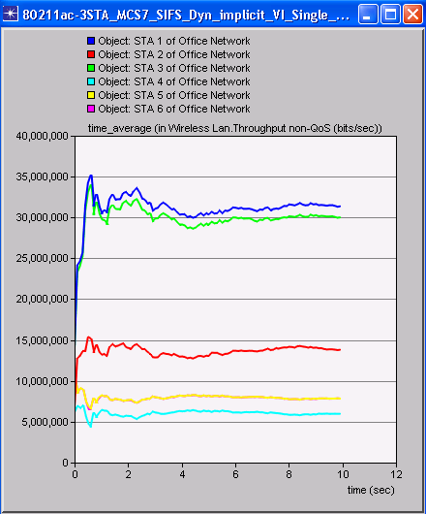
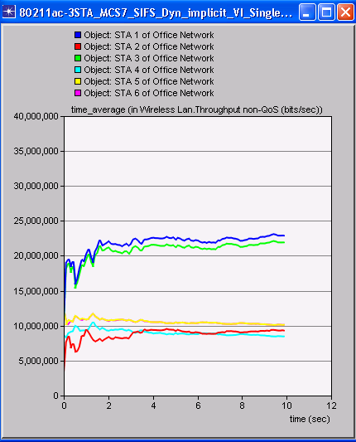
With Option 1, STAs that support DL SDMA have higher throughput
Case 1, Option 1
Case 1, Option 2

Slide 21
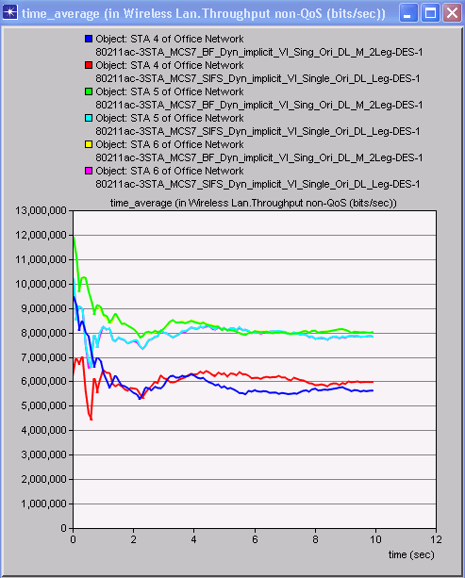
Option 1 does not disadvantage legacy STAs
Case 1: AP1 (DL SDMA capable)
AP2 (legacy)
STA5 and 6 in both case 1 and case 2
Case 2: both APs are legacy APs
STA4 in both case 1 and case 2
Per STA throughput for legacy STA
(Case 1, Option 1) vs Case 2

Slide 22
Conclusion
Three DL MU MIMO response schemes
  With MAC protection, the three response mechanisms have similar performance
  Without MAC protection, polled ack mechanism has better performance
Medium access schemes
  Option 1: The AP initiates success backoff when at least one A-MPDU is successfully delivered
  Option 2: The AP initiates exponential backoff when at least one A-MPDU is not successfully delivered
  The two options become the same when all DL MU MIMO packets are corrupted in a medium access collision
Medium access scheme option 1 offers better overall performance when there are legacy STAs in the vicinity and it does not disadvantage legacy STAs

