Slide 1
carrier-grade 802.11 operating in paired spectrum
Date: 2010-05-18
Authors:

Slide 2
introduction
previously, we described desire for Frequency Division Multiplex (FDM) in 802.11 [ref: 11-10-0287-03]
  for operation in paired spectrum, or TVWS
we presented at WNG because the idea seems long term and of broader interest
  with FDM, new (licensed) spectrum becomes available
  regulators often allocate different downlink and uplink spectrum
here, we illustrate candidate spectrum, and discuss pros and cons of FDM for 802.11
  we share evaluation results and collect feedback

Slide 3
outline
summary of 11-10-0287-03
scenarios in which 802.11 FDM may be beneficial
  802.11 FDM in TVWS
  802.11 in licensed paired spectrum
pros and cons of various approaches for FDM
  half-duplex and full-duplex
  feedback channel & collision detection
conclusion and outlook

Slide 4
a modification of 802.11 was discussed in 11-10-0287-03
objective: to connect wireless devices in theme parks
  including toys & consumer products (hence chosing 802.11)
  with full coverage, carrier-grade quality, at low-cost
802.11 is our natural choice, but still has shortcomings
  larger number of APs is difficult to install in theme parks
  low-frequency TVWS regulation is complex: not enough channels available
we argued that modifying 802.11 towards FDM enables a new type of 802.11 that meets our needs
  FDM enables paired spectrum operation with uplink / downlink separation
  any paired spectrum, e.g., much of licensed LTE / WiMAX becomes available
  also beneficial for TVWS secondary spectrum usage
  larger 802.11 cell sizes and cellular-like network deployment become feasible

Slide 5
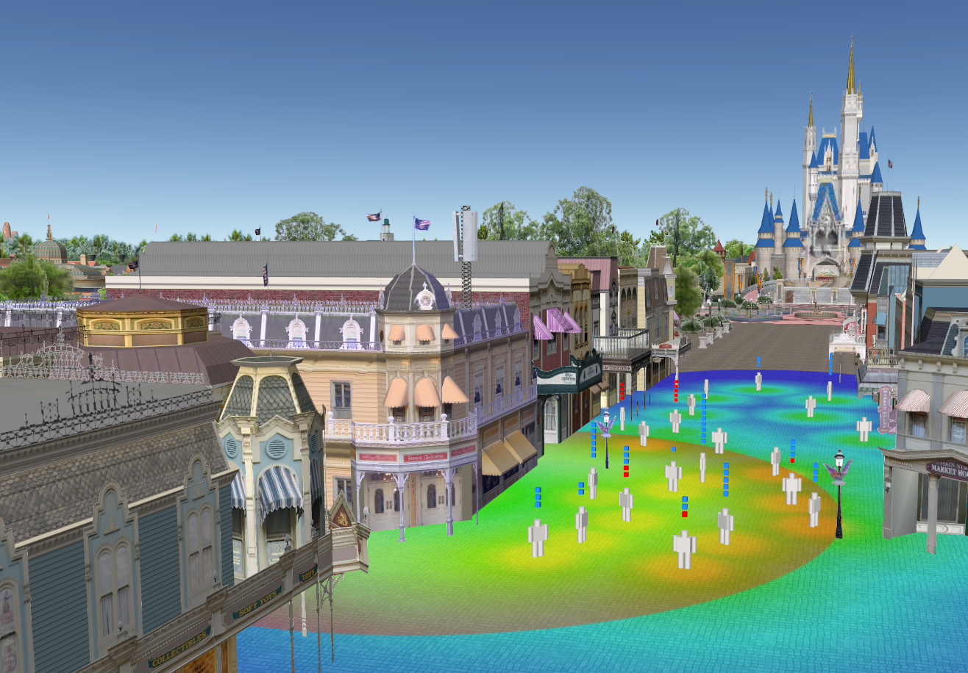
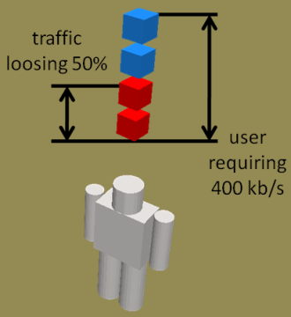
  carrier-grade 802.11 deployment area
outdoor coverage in theme park
unwanted
antennas
indicator for quality per user
large number of devices in hotspot
This is jemula802.

Slide 6
frequency division multiplex

Slide 7
  802.11 FDM in TVWS - regulation
FCC regulation separates fixed and portable channels
  example: TV channel 14: downlink only, no uplink
rules for
portable (uplink)
rules for fixed (downlink)
example

Slide 8
  802.11 FDM in TVWS - Disneyworld
In Disneyworld, FDM helps TVWS operation
  example: use TV channel 9 for fixed/downlink and use TV channel 28 for portable/uplink (assuming no Part 74 devices around)
advantageous to separate downlink and uplink
TV channel 9 could be used for fixed (downlink)
TV channel 28 could be used for portable (uplink)

Slide 9
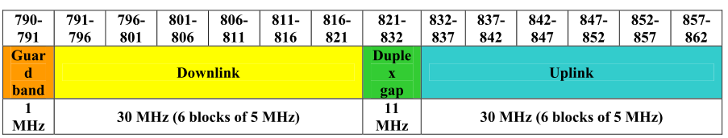
  802.11 in LTE paired spectrum
preferred harmonized frequency arrangement for the band 790-862 MHz [ref: CEPT (2009)]
other LTE bands:
  1.8 GHz, 2 GHz, 2.6 GHz mainly paired spectrum
  “technology neutral“ regulation: there is no reason for regulators to mandate a standard → 802.11 might as well be deployed

Slide 10
simple half-duplex with single radio
(CCA on both channels, separate rx and tx)
advantages:
  low-cost & simple to implement
disadvantages:
  potential loss in spectrum efficiency in single BSS scenarios

Slide 11
full-duplex with dual radio
(CCA on single channel, separate rx and tx)
advantages:
  spectrum efficient, leverages all FDM characteristics known from cellular environments
disadvantages:
  complexity, power consumption

Slide 12
uplink collision detection with feedback channel
advantages:
  protocol efficiency, potential improvement for cross-layer performance with TCP
disadvantage:
  complexity

Slide 13
performance analysis of uplink collision detection
modified analytics [ref: BIANCHI, G. (2000)]
  actual results depend on TXOP duration (frame body length) versus duration of collision detection
  802.11 with ACK 802.11 FDM with collision detection

Slide 14
802.11 FDM advantages
more TVWS channels available for 802.11
802.11 could be deployed in paired spectrum
  WiMAX, LTE, including 700 MHz
allows to reserve capacity to the access point
uplink collision detection instead of collision avoidance
802.11 with FDM can be backward compatible

Slide 15
802.11 FDM disadvantages
modifying 802.11 towards FDM would require
  single transmitter for half duplex: dual channel CCA & NAV
  coordinated dual-radio for full duplex: dual channel CCA & NAV
  modified NAV rules, other
careful evaluation is needed in the areas of
  complexity: similar to dual radio?
  power consumption: state-of-art sleep modes sufficient?
  backward compatibility: coexistence and interoperability feasible at what cost?

Slide 16
conclusion and outlook
FDM is a step towards carrier-grade 802.11
  enables use of other spectrum
outlook
  verify and evaluate open questions about complexity, performance, backward compatibility

Slide 17
references
MANGOLD, S. AND AIELLO, R. (2010a) Towards carrier-grade 802.11 at Disney theme parks. IEEE 802.11 working document, March 2010. 11-10-0287-03.
BIANCHI, G. (2000) Performance Analysis of the IEEE 802.11 Distributed Coordination Function. IEEE Journal of Selected Areas in Communications, 18 (3), 535-547.
CEPT (2009) Technical considerations regarding harmonization options for the digital dividend in the European Union – Frequency (channeling) arrangements for the 790-862 MHz band” . Final Report 31 by ECC within CEPT. Oct. 2009.

Slide 18
thank you for your attention! www.disneyresearch.com

