Slide 1
[Intra cluster response model and parameter for the enterprise cubicle environments at 60GHz (Part2)]
Date: 2010-4-29
Authors:

Slide 2
Abstract
This paper shows reflection wave characteristics by ceiling for the enterprise cubicle environment channel modeling
For near location
Intra cluster channel model is developed “including reflection wave by metal frame” for the simulation of worst case.
The other case, the channel model may not be required.
For far location
High resolution measurement have clarified that k_{b} and γ_{b} are reasonably low compared with the previous report
This lead to unnecessity channel model (direct path only)

Slide 3
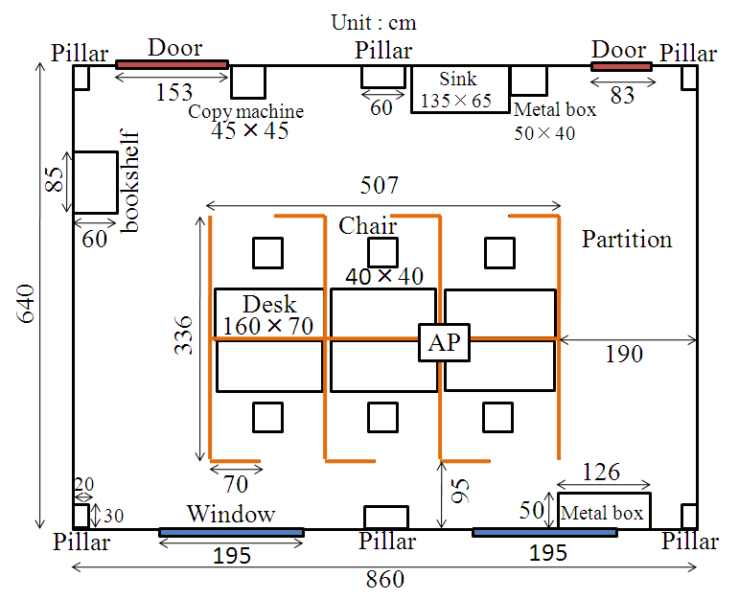
Floor plan of cubicle environments
Far location
Near location
AP height:2.5m
STA height:0.7m
from floor
Impulse responses are measured at the left, center, right positions on desktop
STA
STA
Desk
160×70

Slide 4
Direct and reflection wave paths in cubicle environments
Tx
Direct wave
Reflection wave
Near location
Far location
Multiple-time-reflected waves on desktop was observed
Reflection wave characteristics from ceiling should be clarified for channel modeling

Slide 5
Measurement for reflected wave by ceiling
for the cubicle environment (near location)
1m
Reflection wave
1m
3m
Tx
Rx
1m
Measurement system
Measurement points
in the room
The reflected waves by ceiling are measured at each grid point (separated by 1m) in the room (Total measured points are 20).

Slide 6
Measurement set up of reflection wave by ceiling
Parameter | Value
Center frequency | 62.5 GHz
Band width | 3 GHz
Number of frequency points | 801
Frequency step | 3.75 MHz
Antenna type | Conical horn
HPBW of antenna | 30degree
Polarization | Vertical
Calibration | Direct port connection without antennas

Slide 7
Measured impulse response examples
Metal frame reflection
Pipe reflection
Concrete wall reflection
15dB
Reflected waves by metal frame, pipe and concrete wall were observed in measured impulse responses
Reflected wave power varies up to 15dB depending on the position

Slide 8
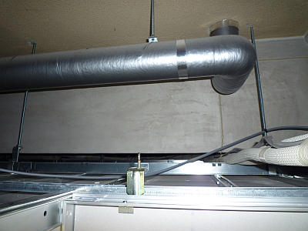
Cause of reflected wave power variation
Concrete
Concrete wall
Pipe
60cm
Shielded pipe
Metal frame
30cm
Plaster board
Cable
Metal frame
Incident wave
Behind the ceiling
Detail of two reflected waves
The behind the ceiling are metal frames, pipes , and concrete wall
Metal frames cause strongest reflection waves

Slide 9
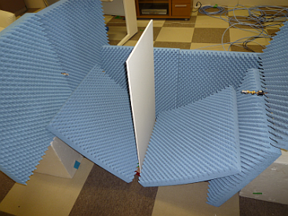
Plaster board penetration loss measurement
Rx
Tx
Snap shot of penetration loss measurement
Penetration loss
Penetration loss is about 0.7～2dB
Plaster board does not reflect strongly

Slide 10
Reflected wave power
12dB down in average
Power difference are about average 12dB in each position
Reflected wave power in cubicle environment depends heavily on the position

Slide 11
Impulse responses of AP-STA
(AP antenna HPBW:90deg, C pol., STA antenna HPBW:30deg, V pol.)
Direct waves
Reflection waves
18dB
12dB
No metal
frame
Near location scenario
The strong reflection wave by metal frame is included.
If there is no metal frame, reflection wave power is very small

Slide 12
Consideration of the channel model for the cubicle environment (near location)
There are two situations for reflected waves by ceiling.
Intra cluster channel model including reflection wave by metal frame is required for the simulation of worst case (See slide 13).
On the other hand, reflection wave is very small (30dB lower than direct wave) when there is no metal frame in the ceiling. In this case, channel model may not be required.

Slide 13
Intra-cluster parameters for cubicle environments (near location)
Environments Far location |  | k_{f} [dB] | k_{b} [dB] | γ_{f} [ns⁻¹] | γ_{b} [ns⁻¹] | λ_{f} [ns⁻¹] | λ_{b} [ns⁻¹] | Distribution, for forward | Distribution for backward
Cubicle AP-STA | For worst case※ | 7.2 | 12 | 0.46 | 1.8 | 0.47 | 0.88 | Rayleigh | Rayleigh
 | Previous estimation Doc.10/372r0 | N/A | 24.5 | N/A | 0.690 | N/A | 1.13 | N/A | Rayleigh
※The parameters are extracted from reflected waves by ceiling
Central ray of intra-cluster
k_{f}
kb
Rayleigh distribution
Tx antenna (AP)
HPBW: 90deg
C pol.
Rx antenna (STA)
HPBW: 30deg
V pol.
Rayleigh distribution
Ray decay factor, γ_{f}
Ray decay factor, γ_{b}
t = 0
Time of arrival
Arrival rate, λ_{b}
Arrival rate, λ_{f}

Slide 14
High resolution measurements for cubicle environment (far location)

Slide 15
High resolution measurements for cubicle environment (far location)
Measured points (Total: 26)
50cm
70cm
10cm
20cm
160cm
15cm
Additional measured points on desktop
Small number of measurement makes a specific intra-cluster channel model, since multi-reflection waves depends heavily on the position
Measurement points were added at 10cm step×2 lines on desktop
The channel model parameter are re-extracted

Slide 16
Measurement system for cubicle environments (far location)
Tx antenna is near the ceiling(AP)
Network
Analyzer
Rx antenna is on the desktop(STA)
Instrument: Vector network analyzer

Slide 17
Measurement set up for high resolution TGad defined enterprise cubicle environment (Far location)
Parameter | Value
Center frequency | 62.5 GHz
Band width | 3 GHz
Number of frequency points | 801
Frequency step | 3.75 MHz
Antenna type | Conical horn
HPBW of antenna | 30degree(STA), 90 degree(AP)
Polarization | Vertical(STA), Circular(AP)
Calibration | Direct port connection without antennas

Slide 18
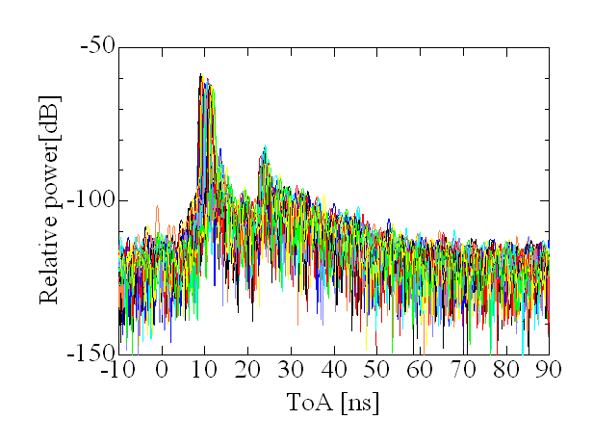
High resolution measurement for cubicle environment (far location)
Direct waves
Reflection waves
23.4dB
30.8dB
k_{b}=7.4dB
Total number of measured response is 26
Direct path and single ray may be enough as the channel model for cubicle environment (far location)

Slide 19
Revised intra-cluster parameters for cubicle environments
Environments Far location |  | k_{f} [dB] | k_{b} [dB] | γ_{f} [ns⁻¹] | γ_{b} [ns⁻¹] | λ_{f} [ns⁻¹] | λ_{b} [ns⁻¹] | Distribution, for forward | Distribution for backward
Cubicle AP-STA | High resolution | 5.1 | 7.4 | 3.1 | 6.0 | 0.55 | 0.53 | Rayleigh | Rayleigh
 | Previous Estimation Doc.10/372r0 | N/A | 22.5 | N/A | 14 | N/A | 0.81 | N/A | Rayleigh
k_{b} and γ_{b} are reasonably low compared with the previous report
Central ray of intra-cluster
k_{f}
kb
Rayleigh distribution
Tx antenna (AP)
HPBW: 90deg
C pol.
Rx antenna (STA)
HPBW: 30deg
V pol.
Rayleigh distribution
Ray decay factor, γ_{f}
Ray decay factor, γ_{b}
t = 0
Time of arrival
Arrival rate, λ_{b}
Arrival rate, λ_{f}

Slide 20
Conclusion
For near location
Intra cluster channel model is developed “including reflection wave by metal frame” for the simulation of worst case.
The other case, the channel model may not be required.
For far location
High resolution measurement have clarified that k_{b} and γ_{b} are reasonably low compared with the previous report
This lead to unnecessity channel model (direct path only)

