Slide 1
Mechanism for Inter-system Coexistence
Date: 2010-05-16
Authors:

Slide 2
Summary
This document presents a coexistence mechanism for the ongoing 802.11ad and the completed 802.15.3c
Two alternative coexistence mechanism are proposed
A simple procedure to manage network discovery between heterogeneous systems is proposed
A ‘common platform’ to bridge negotiation between the heterogeneous systems is proposed

Slide 3
Abbreviations
CB – coexistence beacon
CCI – co-channel interference
CC – convolutional coding
DEV – device
ED – energy detection
MCS – modulation and coding scheme
RS – Reed Solomon
STA – station

Slide 4
Presentation Outline
Background
Motivation
The Basics
Proposed Coexistence Mechanism
Plan A Details
Plan B Details
CB Frame Format
Operating Range
Additional Notes
Conclusion

Slide 5
Background
There are two 60GHz unlicensed wireless system specifications in the IEEE 802
The 802.15.3c has a completed MAC/PHY specification in the 60GHz band
The 802.11ad is currently specifying MAC/PHY for operation in the 60GHz band
It is expected that two systems will have to agree on some mechanism to achieve mutual coexistence (i.e. network discovery)
A mechanism for such purpose was proposed in 10/231r3
Up-to-date, there is no mechanism facilitating cross-802 heterogeneous system coexistence in the 802.11ad effort

Slide 6
Motivation
Nevertheless, coexistence is still an essential topic
Detection better than ED is required for CCI mitigation
Coexistence assurance is needed for the sponsor ballot
Therefore, this proposal proposes a mechanism to facilitate coexistence between 802.15.3c and 802.11ad while minimizing the additional complexity in implementation

Slide 7
The Basics - Main Idea
Heterogeneous network discovery is participated by both the existing and incoming network
The existing network periodically sends out beacon-like signals for potentially incoming heterogeneous networks
The incoming network scans to detect the existing network before setting up a new network
The scanning and detection are performed through a predefined and pre-agreed common bridge (i.e. PHY specification)

Slide 8
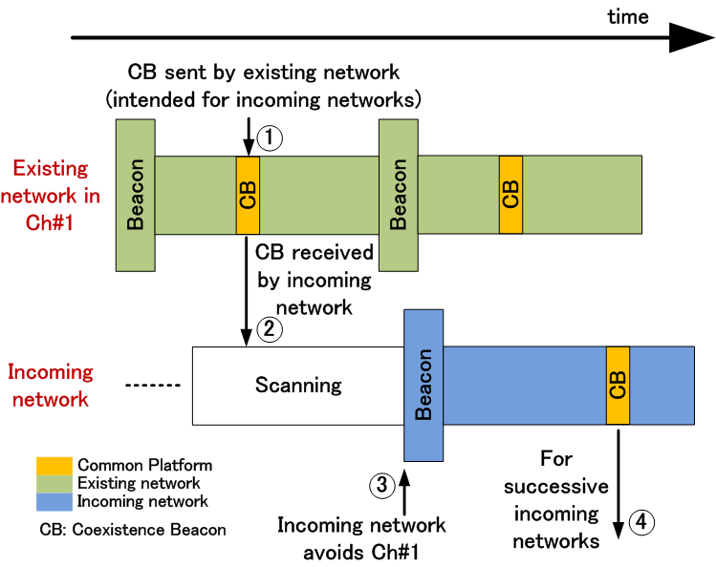
The Basics - How It Works

Slide 9
The Basics - Common Platform
Name for the predefined and pre-agreed PHY layer design
‘Common platform’
The candidates for the Common Platform:
2.4/5GHz WLAN – the most robust MCS
802.15.3c WPAN – the most robust MCS
Hybrid of both

Slide 10
The Basics - Operational Procedure
Existing DEV/STA coordinating a network in the current channel
CB transmitted using the Common Platform periodically
Prospective heterogeneous system DEV/STA enters the channel, performs scan
Receives CB in the Common Platform
Incoming heterogeneous system DEV/STA subjected to following options:
Decode and extract information in CB for synchronization
Try another channel
Stop communication
Incoming and existing DEV/STA can now coordinate respective networks in the same location
Once incoming DEV/STA starts new network, periodical CB transmission continues

Slide 11
Proposed Coexistence Mechanism
Two mechanism proposed: Plan A and Plan B
Unified operational procedure with different combinations of Common Platform
Candidates of Common Platform
Plan A
2.4/5 GHz WLAN MCS
OFDM, BPSK, CC rate ½, 5MHz channel spacing
Plan B
2.4/5 GHz WLAN MCS and 802.15.3c WPAN MCS
OFDM, BPSK, CC rate ½, 5MHz channel spacing
SC, π/2-BPSK, RS (255,239), 2160MHz channel spacing

Slide 12
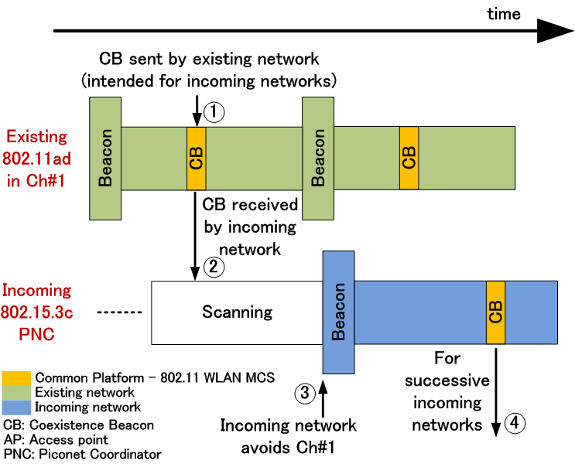
Plan A - Procedure

Slide 13
Plan A - Analysis
802.11ad radios will have dual-radio architecture
60GHz 802.11ad radio
2.4/5GHz 802.11 radio – Common Platform
The current situation in 802.11ad is leaning towards zero 802.15.3c/802.11ad coexistence
Instead of zero coexistence, this method gives a possibility for 802.11ad and 802.15.3c to discover each other
Future 60GHz radios may need to implement 802.11 2.4/5GHz radio anyway
Making 802.11 MCS the Common Platform is a reasonable approach
With Plan A as the base for heterogeneous coexistence, Plan B may be an enhancement to further increase the level of coexistence

Slide 14
What is Plan B
Plan B has similar operational procedure as Plan A, with an additional Common Platform candidate
The additional Common Platform is the 802.15.3c WPAN Common Signaling Mode (i.e. SC, π/2-BPSK, RS (255,239), 2160MHz channel spacing )

Slide 15
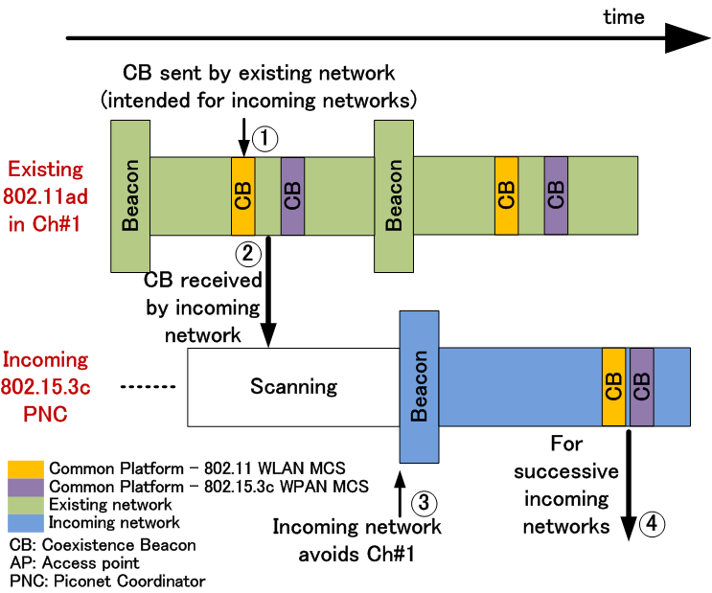
Plan B - Procedure

Slide 16
Plan B – Analysis
802.11ad radios may have dual-radio architecture
60GHz 802.11ad radio
2.4/5GHz 802.11 radio – Common Platform 1
60GHz 802.15.3c radio – Common Platform 2
In Plan A, a certain level of coexistence can be facilitated with 802.15.3c system that supports the Common Platform (i.e. 2.4/5GHz WLAN MCS)
In order to further boost the harmony in the 60GHz band environment, Plan B with an additional Common Platform is able to facilitate coexistence with 802.15.3c DEVs that are not supporting the 2.4/5GHz WLAN MCS

Slide 17
CB Frame Format
The CB frame for facilitating heterogeneous system coexistence can reuse most of the existing beacon frame
Some additional information need to be included in the CB:
Timing information for the CB
Operation mode of the existing network
Coexistence capability of the existing network

Slide 18
Operating Range
By employing the 2.4/5 GHz WLAN MCS, the operating range is substantially different from that of a 60GHz signal
Transmit power control has to be used to confine the 2.4/5 GHz CB within the intended radio sphere of influence

Slide 19
Additional Notes
The dual/tri-radio architecture, besides offering a higher capability of coexistence, provides other advantages such as user experience and system optimizations
One example is given in 10/259r2

Slide 20
Conclusion
This document proposes a method for cross-802 system coexistence – 802.11ad and 802.15.3c
Coexistence between the two systems is important to:
Mitigate the devastating CCI that causes performance degradation
Construct the coexistence assurance document

Slide 21
Straw Poll
Do you support inclusion of coexistence technique Plan A, as described in 10/0485r0 in the TGad draft amendment?
Yes: . No: . Abstain: .
Do you support inclusion of coexistence technique Plan B, as described in 10/0485r0 in the TGad draft amendment?
Yes: . No: . Abstain: .

