Slide 1
OFDM Proposal
Date: 2010-05-15
Author(s)/Supporter(s):
Name | Company | Address | Phone | email
Abu-Surra, Shadi | Samsung |  |  | sasurra@sta.samsung.com
Ban, Koichiro | Toshiba |  |  | koichiro.ban@toshiba.co.jp
Banerjea, Raja | Marvell |  |  | rajab@marvell.com
Basson, Gal | Wilocity |  |  | gal.basson@wilocity.com
Blanksby, Andrew | Broadcom |  |  | andrew.blanksby@broadcom.com
Borges, Daniel | Apple |  |  | drborges@apple.com
Borison, David | Ralink |  |  | david_borison@ralinktech.com
Cariou, Laurent | Orange |  |  | laurent.cariou@orange-ftgroup.com
Chamberlin, Philippe | Technicolor R&I |  |  | philippe.chambelin@technicolor.com
Chang, Kapseok | ETRI |  |  | kschang@etri.re.kr
Chin, Francois | I2R |  |  | chinfrancois@i2r.a-star.edu.sg
Choi, Changsoon | IHP GmbH |  |  | choi@ihp-microelectronics.com
Christin, Philippe | Orange |  |  | philippe.christin@orange-ftgroup.com
Chu, Liwen | STMicroelectronics |  |  | Liwen.chu@st.com
Chung, Hyun Kyu | ETRI |  |  | hkchung@etri.re.kr
Coffey, Sean | Realtek |  |  | coffey@realtek.com
Cordeiro, Carlos | Intel |  |  | Carlos.Cordeiro@intel.com
Derham, Thomas | Orange |  |  | thomas.derham@orange-ftgroup.com
Dorsey, John | Apple |  |  | jdorsey@apple.com

Slide 2
Author(s)/Supporter(s):
Name | Company | Address | Phone | email
Elboim, Yaron | Wilocity |  |  | yaron.elboim@wilocity.com
Fischer, Matthew | Broadcom |  |  | mfischer@broadcom.com
Giraud, Claude | NXP |  |  | claude.giraud@nxp.com
Glibbery, Ron | Peraso Technologies |  |  | ron@perasotech.com
Golan, Ziv | Wilocity |  |  | Ziv.golan@wilocity.com
Gong, Michelle | Intel |  |  | Michelle.x.gong@intel.com
Grandhi, Sudheer | InterDigital |  |  | sagrandhi802@gmail.com
Grass, Eckhard | IHP GmbH |  |  | grass@ihp-microelectronics.com
Grieve, David | Agilent |  |  | david_grieve@agilent.com
Grodzinsky, Mark | Wilocity |  |  | Mark.grodzinsky@wilocity.com
Hansen, Christopher | Broadcom |  |  | chansen@broadcom.com
Hart, Brian | Cisco |  |  | brianh@cisco.com
Hassan, Amer | Microsoft |  |  | amerh@microsoft.com
Hong, Seung Eun | ETRI |  |  | iptvguru@etri.re.kr
Hosoya, Kenichi | NEC |  |  | k-hosoya@ce.jp.nec.com
Hosur, Srinath | Texas Instruments |  |  | hosur@ti.com
Hsu, Alvin | MediaTek |  |  | alvin.hsu@mediatek.com
Hsu, Julan | Samsung |  |  | Julan.hsu@samsung.com
Hung, Kun-Chien | MediaTek |  |  | kc.hung@mediatek.com
Jain, Avinash | Qualcomm |  |  | avinashj@qualcomm.com
Jauh, Alan | MediaTek |  |  | alan.jauh@mediatek.com
Jayabal, Raymond Jararaj s/o | I2R |  |  | jraymond@i2r.a-star.edu.sg
Jeon, Paul | LGE |  |  | bjjeon@lge.com
Jin, Sunggeun | ETRI |  |  | sgjin@etri.re.kr
Jones, VK | Qualcomm |  |  | vkjones@qualcomm.com
Joseph, Stacy | Beam Networks |  |  | stacy@beamnetworks.com
Jun, Haeyoung | Samsung |  |  | Haeyoung.jun@samsung.com
Kaaja, Harald | Nokia |  |  | harald.kaaja@nokia.com
Kafle, Padam | Nokia |  |  | padam.kafle@nokia.com

Slide 3
Author(s)/Supporter(s):
Name | Company | Address | Phone | email
Kakani, Naveen | Nokia |  |  | naveen.kakani@nokia.com
Kasher, Assaf | Intel |  |  | Assaf.kasher@intel.com
Kasslin, Mika | Nokia |  |  | mika.kasslin@nokia.com
Kim, Hodong | Samsung |  |  | hodong0803.kim@samsung.com
Kim, Yongsun | ETRI |  |  | doori@etri.re.kr
Kraemer, Rolf | IHP GmbH |  |  | kraemer@ihp-microelectronics.com
Kreifeldt, Rick | Harman International |  |  | rick.kreifeldt@harman.com
Kwon, Edwin | Samsung |  |  | cy.kwon@samsung.com
Kwon, Hyoungjin | ETRI |  |  | kwonjin@etri.re.kr
Kwon, Hyukchoon | Samsung |  |  | hyukchoon.kwon@samsung.com
Laine, Tuomas | Nokia |  |  | tuomas.laine@nokia.com
Lakkis, Ismail | Tensorcom |  |  | ilakkis@tensorcom.com
Lee, Hoosung | ETRI |  |  | hslee@etri.re.kr
Lee, Keith | AMD |  |  | keith.lee@amd.com
Lee, Wooyong | ETRI |  |  | wylee@etri.re.kr
Liu, Yong | Marvell |  |  | yongliu@marvell.com
Lou, Hui-Ling | Marvell |  |  | hlou@marvell.com
Lynch, Brad | Peraso Technologies |  |  | brad@perasotech.com
Majkowski, Jakub | Nokia |  |  | jakub.majkowski@nokia.com
Marin, Janne | Nokia |  |  | janne.marin@nokia.com
Maruhashi, Kenichi | NEC |  |  | k-maruhashi@bl.jp.nec.com
Matsumoto, Taisuke | Panasonic |  |  | matsumoto.taisuke@jp.panasonic.com
Meerson, Yury | Wilocity |  |  | Yury.meerson@wilocity.com
Mese, Murat | Broadcom |  |  | mesem@broadcom.com
Montag, Bruce | Dell |  |  | bruce_montag@dell.com
Myles, Andrew | Cisco |  |  | amyles@cisco.com
Nandagopalan, Saishankar | Broadcom |  |  | nsai@broadcom.com
Ngo, Chiu | Samsung |  |  | Chiu.ngo@samsung.com
Nikula, Eero | Nokia |  |  | eero.nikula@nokia.com

Slide 4
Author(s)/Supporter(s):
Name | Company | Address | Phone | email
Park, DS | Samsung |  |  | dspark@samsung.com
Park, Minyoung | Intel |  |  | Minyoung.park@intel.com
Peng, Xiaoming | I2R |  |  | pengxm@i2r.a-star.edu.sg
Pi, Zhouyue | Samsung |  |  | zpi@sta.samsung.com
Ponnampalam, Vish | MediaTek |  |  | vish.ponnampalam@mediatek.com
Prasad, Narayan | NEC |  |  | prasad@nec-labs.com
Prat, Gideon | Intel |  |  | Gideon.prat@intel.com
Qu, Xuhong | I2R |  |  | quxh@i2r.a-star.edu.sg
Ramachandran, Kishore | NEC |  |  | kishore@nec-labs.com
Raymond, Yu Zhan | Panasonic |  |  | Raymond.Yuz@sg.panasonic.com
Roblot, Sandrine | Orange |  |  | sandrine.roblot@orange-ftgroup.com
Ronkin, Roee | Wilocity |  |  | Roee.ronkin@wilocity.com
Rozen, Ohad | Wilocity |  |  | Ohad.rozen@wilocity.com
Sachdev, Devang | NVIDIA |  |  | dsachdev@nvidia.com
Sadri, Ali | Intel |  |  | Ali.S.Sadri@intel.com
Sampath, Hemanth | Qualcomm |  |  | hsampath@qualcomm.com
Sanderovich, Amichai | Wilocity |  |  | Amichai.sanderovich@wilocity.com
Sankaran, Sundar | Atheros |  |  | Sundar.Sankaran@Atheros.com
Scarpa, Vincenzo | STMicroelectronics |  |  | vincenzo.scarpa@st.com
Seok, Yongho | LGE |  |  | yongho.seok@lge.com
Shao, Huai-Rong | Samsung |  |  | hr.shao@samsung.com
Shen, Ba-Zhong | Broadcom |  |  | bzshen@broadcom.com
Sim, Michael | Panasonic |  |  | Michael.Simhc@sg.panasonic.com
Singh, Harkirat | Samsung |  |  | har.singh@sisa.samsung.com
Soffer, Menashe | Intel |  |  | Menashe.soffer@intel.com
Song, Seungho | SK Telecom |  |  | shsong@sktelecom.com

Slide 5
Author(s)/Supporter(s):
Name | Company | Address | Phone | email
Sorin, Simha | Wilocity |  |  | Simha.sorin@wilocity.com
Smith, Matt | Atheros |  |  | matt.smith@atheros.com
Stacey, Robert | Intel |  |  | Robert.stacey@intel.com
Subramanian, Ananth | I2R |  |  | sananth@i2r.a-star.edu.sg
Sutskover, Ilan | Intel |  |  | Ilan.sutskover@intel.com
Taghavi, Hossain | Qualcomm |  |  | mtaghavi@qualcomm.com
Takahashi, Kazuaki | Panasonic |  |  | takahashi.kazu@jp.panasonic.com
Toyoda, Ichihiko | NTT |  |  | toyoda.ichihiko@lab.ntt.co.jp
Trachewsky, Jason | Self |  |  | jtrachewsky@gmail.com
Trainin, Solomon | Intel |  |  | Solomon.trainin@intel.com
Usuki, Naoshi | Panasonic |  |  | usuki.naoshi@jp.panasonic.com
Varshney, Prabodh | Nokia |  |  | prabodh.varshney@nokia.com
Vertenten, Bart | NXP |  |  | bart.vertenten@nxp.com
Vlantis, George | STMicroelectronics |  |  | george.vlantis@st.com
Wang, Chao-Chun | MediaTek |  |  | chaochun.wang@mediatek.com
Wang, Homber | TMC |  |  | homber@emcite.com
Wang, James | MediaTek |  |  | james.wang@mediatek.com
Wong, David Tung Chong | I2R |  |  | wongtc@i2r.a-star.edu.sg
Yee, James | MediaTek |  |  | james.yee@mediatek.com
Yucek, Tevfik | Atheros |  |  | Tevfik.Yucek@Atheros.com
Yong, Su Khiong | Marvell |  |  | skyong@marvell.com
Zhang, Hongyuan | Marvell |  |  | hongyuan@marvell.com

Slide 6
Proposal overview
This presentation is part and in support of the complete proposal described in 802.11-10/432r2 (slides) and 802.11-10/433r2 (text) that:
  Supports data transmission rates up to 7 Gbps
  Supplements and extends the 802.11 MAC and is backward compatible with the IEEE 802.11 standard
  Enables both the low power and the high performance devices, guaranteeing interoperability and communication at gigabit rates
  Supports beamforming, enabling robust communication at distances beyond 10 meters
  Supports GCMP security and advanced power management
  Supports coexistence with other 60GHz systems
  Supports fast session transfer among 2.4GHz, 5GHz and 60GHz

Slide 7
OFDM MCS Characteristics
Supports data rates up to ~7 Gbps
  Modulation formats: SQPSK, QPSK, 16-QAM and 64-QAM
  LDPC Coding: rates ½, 5/8, ¾ and 13/16
Designed to operate in NLOS environments
  Fixed Guard Interval (GI) of ~48 ns
  Coding tolerant to significant frequency selectivity
Significant commonality with associated SC MCS’s
  Common preamble
  Common LDPC coding scheme etc

Slide 8
OFDM MCS Table
coded bits per OFDM symbol
coded bits per subcarrrier
Info bits per OFDM symbol
MCS index | Modulation | Code Rate | NBPSC | NCBPS | NDBPS | Data Rate (Mbps)
13 | SQPSK | 1/2 | 1 | 336 | 168 | 693.00
14 | SQPSK | 5/8 | 1 | 336 | 210 | 866.25
15 | QPSK | 1/2 | 2 | 672 | 336 | 1386.00
16 | QPSK | 5/8 | 2 | 672 | 420 | 1732.50
17 | QPSK | 3/4 | 2 | 672 | 504 | 2079.00
18 | 16-QAM | 1/2 | 4 | 1344 | 672 | 2772.00
19 | 16-QAM | 5/8 | 4 | 1344 | 840 | 3465.00
20 | 16-QAM | 3/4 | 4 | 1344 | 1008 | 4158.00
21 | 16-QAM | 13/16 | 4 | 1344 | 1092 | 4504.50
22 | 64-QAM | 5/8 | 6 | 2016 | 1260 | 5197.50
23 | 64-QAM | 3/4 | 6 | 2016 | 1512 | 6237.00
24 | 64-QAM | 13/16 | 6 | 2016 | 1638 | 6756.75

Slide 9
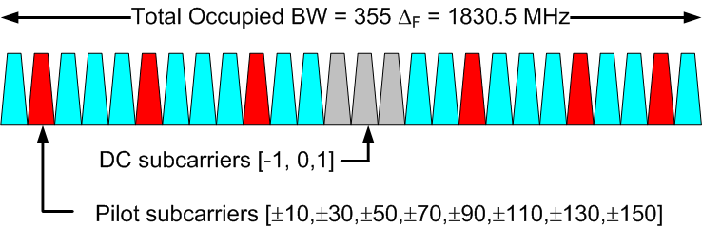
OFDM Parameters
Parameter | Notation | Value
FFT Size | N_{FFT} | 512
Number of data subcarriers | N_{SD} | 336
Number of pilot subcarriers | N_{SP} | 16
OFDM sampling frequency | F_{s} | 2640 MHz
Subcarrier frequency spacing | Δ_{F} | 5.16 MHz
Guard Interval/Cyclic Prefix | T_{GI} | 128/F_{s}= ~48ns

Slide 10
OFDM PPDU Format
Preamble
  Consists of STF and CEF
  Duration of ~1.75 us
Header
  carries 64 bits
    Includes 8-bit HCS and 8 reserved bits
  Fits into one OFDM symbol
    duration of ~ 242 ns
TRN-T/R Subfields (optional)
  Used for beamforming training/tracking

Slide 11
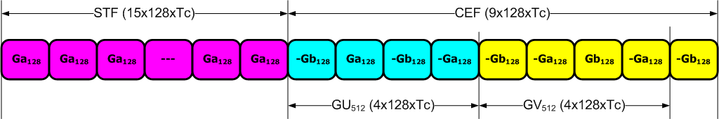
Preamble Format
Ga₁₂₈ and Gb₁₂₈ are 128-length Golay complimentary sequence pairs sampled at SC chip rate F_{s}=1760 MHz (T_{c} = 1/F_{s} ~ 0.57 ns)
  Allows common pre-amble processing for OFDM and SC PHYs
Short Training Field (STF)
  15x repetition of Ga₁₂₈ sequence
  Used for timing/frequency acquisition
Channel Estimation Field (CEF)
  Consists of two 512-length complementary sequence pairs (GU₅₁₂ and GV₅₁₂) and a cyclic post-fix (GV₁₂₈)
  Channel estimation in time or frequency domain
  Can auto-detect SC/OFDM PHY (different CEF formats employed)

Slide 12
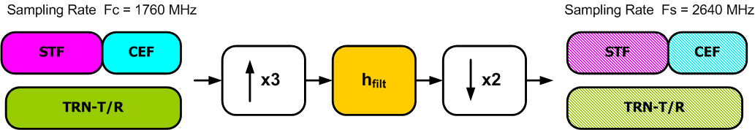
Preamble Re-sampling Filter
OFDM preamble sequences are defined at SC chip rate (F_{c}) to support common SC/OFDM preamble processing
3/2-rate re-sampling is required to convert from SC chip rate (Fc = 1760 MHz) to OFDM sampling rate (F_{s} = 2640 MHz)
Re-sampling filter (73 taps) is specified so that Rx can undo filter response from channel estimate

Slide 13
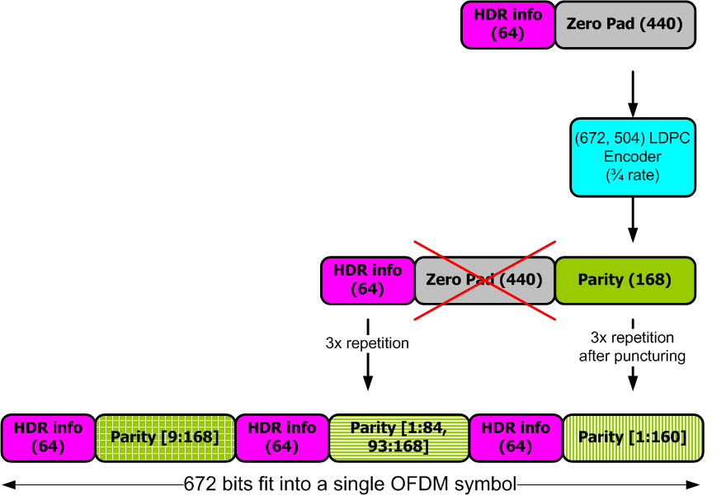
Header Coding & Modulation
Header contains 64 info bits
which are heavily protected
  168 parity bits generated by ¾ rate LDPC
  Info bits and parity repeated 3x
  Info bits not punctured
  Repetition of parity bits punctured differently
  Header mapped to OFDM symbol
  8-bit check sequence included

Slide 14
Payload Coding & Modulation
Scrambling
  Data scrambled using 7-th order m-sequence
  Scrambler initialization sequence is tx-ed in the PHY header
LDPC Encoding
  Zero padding to fit into OFDM symbols
  Parity bits generated
  Multiple code blocks are concatenated
Modulation
  SQPSK: each code block is mapped to two OFDM symbols
  QPSK: each code clock is mapped to a single OFDM symbol
  16-QAM: two code blocks are interleaved and mapped to a single OFDM symbol
  64-QAM: three code blocks are interleaved and mapped to a single OFDM symbol

Slide 15
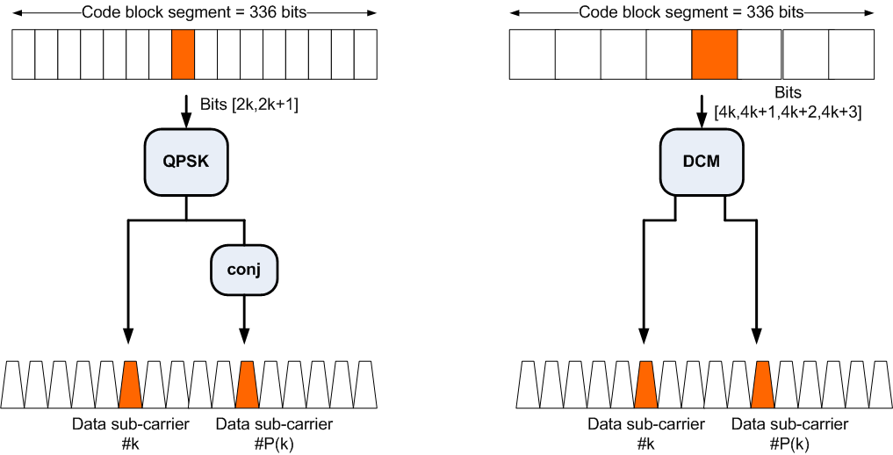
OFDM Tone Mapping (QPSK/SQPSK)
SQPSK
QPSK
Index P(k) is dependent on Dynamic/Static Tone Mapping
(a) when Static Tone Mapping (STP) is used P(k) = k+168
(b) when Dynamic Tone Mapping (DTP) is used P(k) is derived from feedback

Slide 16
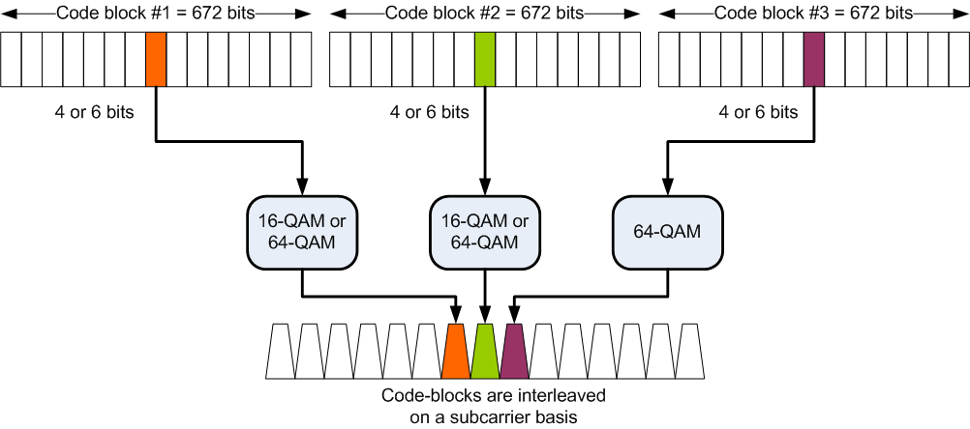
OFDM Tone Mapping (16-QAM/64-QAM)
Only for 64-QAM
For 16-QAM and 64-QAM, 2 and 3 code blocks are interleaved on a subcarrier basis, respectively.

Slide 17
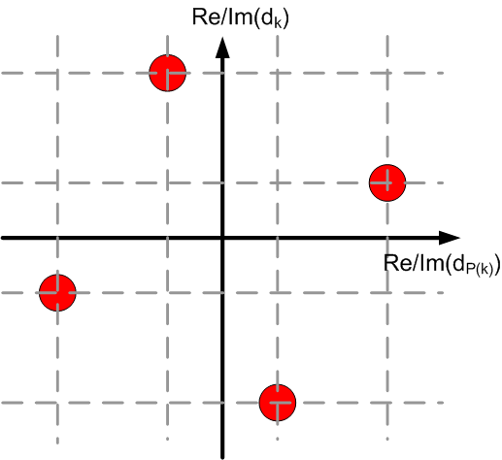
Diversity Techniques to
Combat Frequency Selectivity
SQPSK employs frequency domain spreading
QPSK employs DCM - a diversity code
  Pair of QPSK symbols [x_{2k}, x_{2k+1}] is converted to symbols [d_{k},d_{P(k)}]
  DCM constellation looks like rotated QPSK (see fig)
    instead of I vs. Q we have I/Q of subcarrier 1
    vs. I/Q subcarrier 2
  Properties
    Min Euc dist between constellation points is preserved
      Same performance in AWGN as conventional QPSK
    Signal has unique values on each axis/subcarrier
      Full order diversity
16-QAM and 64-QAM employ code-block interleaving

Slide 18
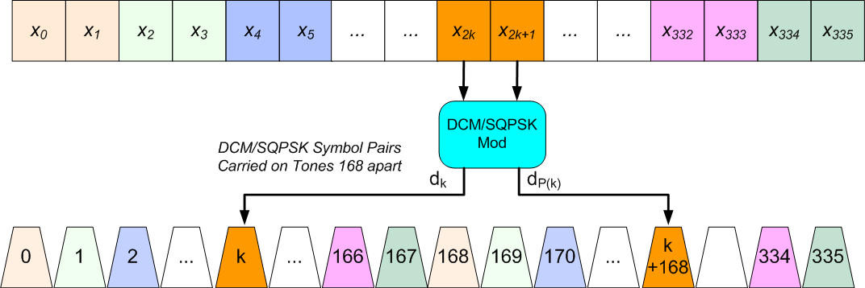
Tone Pairing for SQPSK/QPSK (MCS 13-17)
Static Tone Pairing
Static Tone Pairing (STP)
  Mandatory
  k-th DCM/SQPSK symbol pair is mapped to the k-th and (k+168)-th OFDM tones
Dynamic Tone Pairing (DTP)
  Optional
  Tone pairing dynamically adapted to the channel
  Offers significant performance improvement

Slide 19
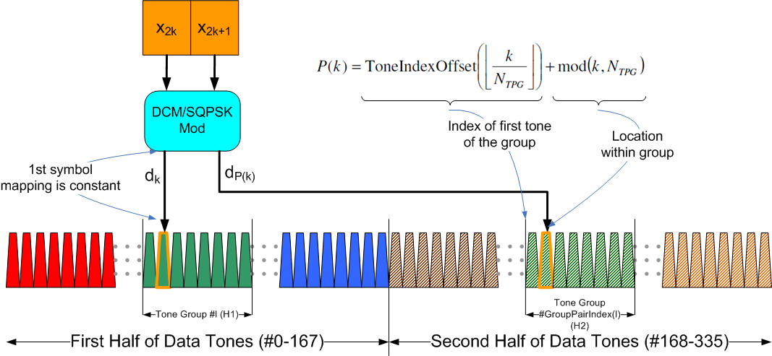
Dynamic Tone Pairing for SQPSK and QPSK (MCS 13-17)
First (N_{SD}/2=168) half of data tones are sliced to N_{G} (=42 ) groups
Second half of data tones are slices to N_{G} groups
Rx determines and feeds back pairings of groups
  l-th group of first half paired to GroupPairIndex(l)-th group of second half
Tx/Rx use fixed mapping of tone-pairs used within pairs of groups
MAC handles feedback signaling and synchronization issues

Slide 20
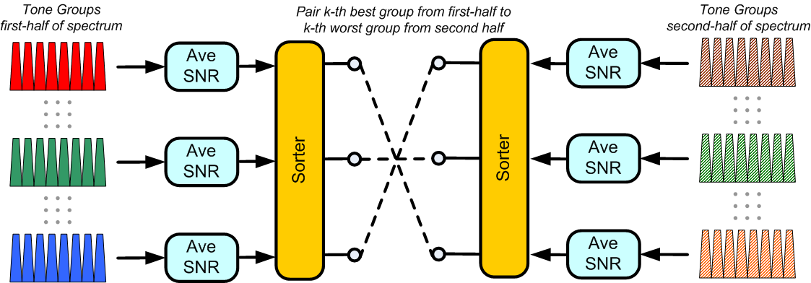
Example: A Simple DTP Algorithm
Computations required
(1) Ave SNR of 2xN_{G} tone groups (where N_{G}= 42)
(2) Sort N_{G} groups of the first half
(3) Sort N_{G} groups of the second half
May be implemented in software as latency requirement is relaxed

Slide 21
STP versus DTP with QPSK (MCS 15-17)
MCS 16
(5/8 Rate)
MCS 15
(1/2 Rate)
MCS 17
(3/4 Rate)
Sim Parameters: 2ns Exp PDP,
Ideal CE, DTP as per slide 20

Slide 22
Simulations as per EVM
Channel Model
  Conference/Living Room LOS/NLOS Environments
  Omni/Directional antenna configurations
RF Impairments
  Phase Noise
  Residual CFO
  Non-linear PA
Frame detection, channel estimation, and time/freq sync simulated
Static Tone Pairing (STP)
PA Back-off
  MCS 13-14 (OFDM/SQPSK) 10.0 dB
  MCS 15-17 (OFDM/QPSK) 10.0 dB
  MCS 18-21 (OFDM/16-QAM) 12.0 dB
  MCS 22-24 (OFDM/64-QAM) 14.0 dB

Slide 23
AWGN Channel

Slide 24
Conference Room (LoS/Omni-Omni)

Slide 25
Conference Room (NLOS/Omni-Dir)

Slide 26
Conference Room (NLOS/Dir-Dir)

Slide 27
Living Room (LOS Omni/Omni)

Slide 28
Living Room (NLOS Omni/Dir)

Slide 29
Living Room (NLOS Dir/Dir)

Slide 30
Conclusions
OFDM MCS’s have been proposed
  Part of complete proposal in 802.11-10/432r2 (slides) and 802.11-10/433r2 (spec)
Optimized for high performance
  Up to 7Gbps
  Optimized for NLOS – tolerant to high degree of multipath
  Significant commonality with counterpart SC MCS’s
    See IEEE 802.11-10-0429-01-00ad-NT-8
Performance evaluation as per EVM document
  Presented in IEEE 802.11-10-0431-03-00ad-CP-PHY

